Slide 1
How to add the KofC “Join” page to your Phone Home Screen (Apple & Android)
What is needed:
Apple iPhone or Android Phone with Google Chrome Web browser installed.
(Follow same procedure if using Apple or Android Tablet)
If Google Chrome Web Browser is already installed, please skip to page 4

Slide 2
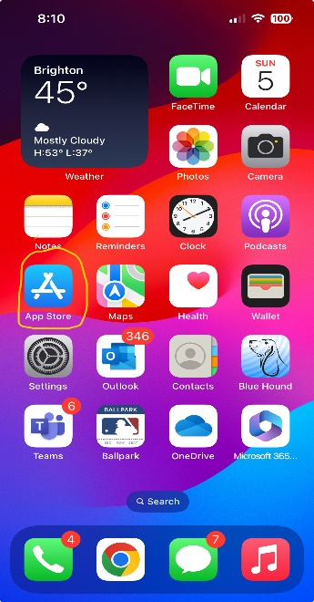
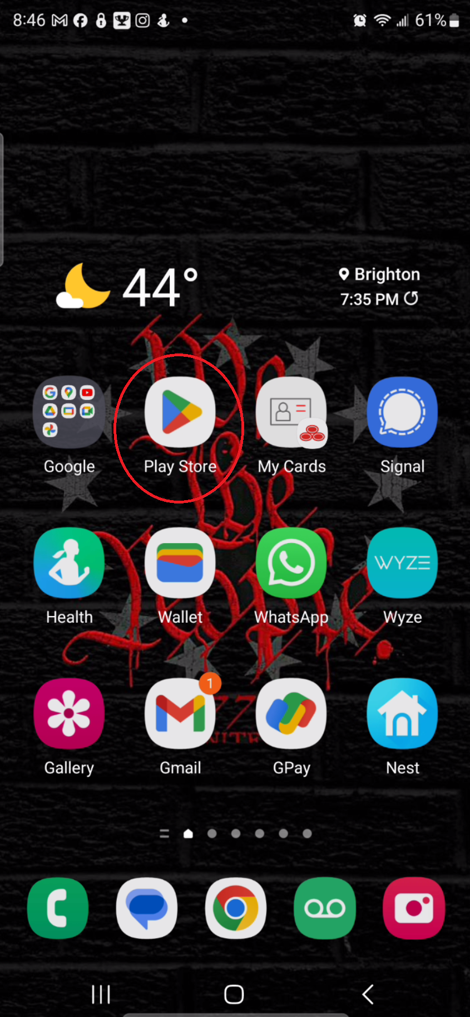
How to add the KofC “Join” page to your Phone Home Screen (Apple & Android)
Download “Google Chrome” from the Apple App Store or Google Play Store
Apple iPhone
Android Phone

Slide 3
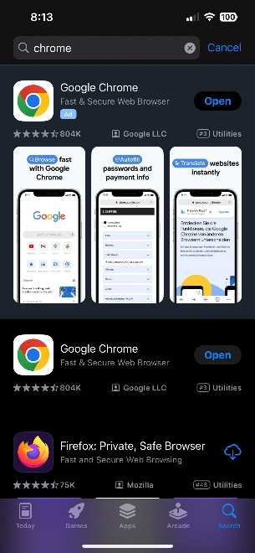
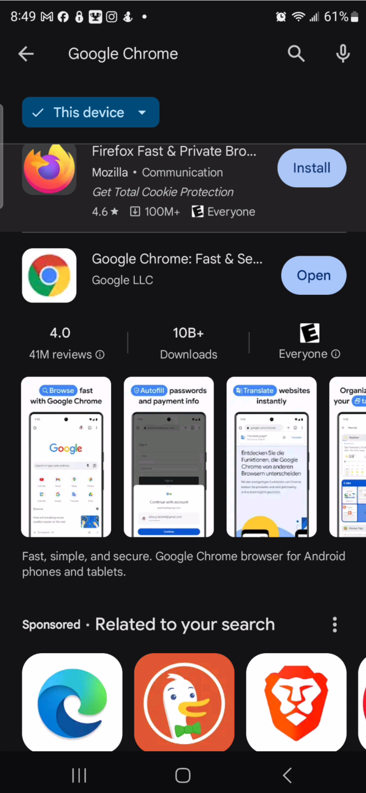
How to add the KofC “Join” page to your Phone Home Screen (Apple & Android)
Once Installed, open the app and follow any initial setup procedures.
Apple iPhone
Android Phone

Slide 4
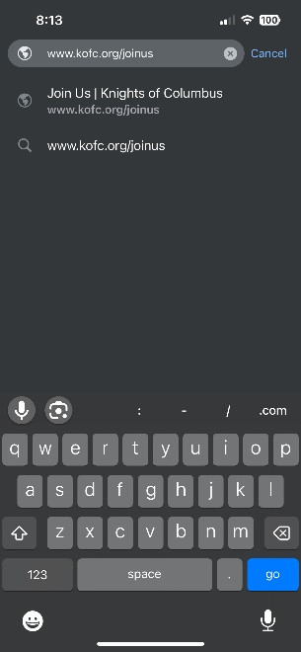
How to add the KofC “Join” Page to your Phone Home Screen (Apple & Android)
Inside the Google Chrome app, type into the address bar: kofc.org/joinus
Apple iPhone
Android Phone

Slide 5
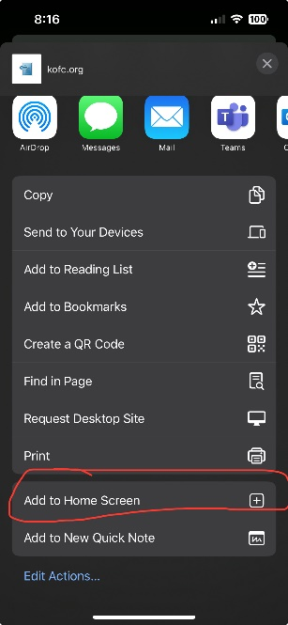
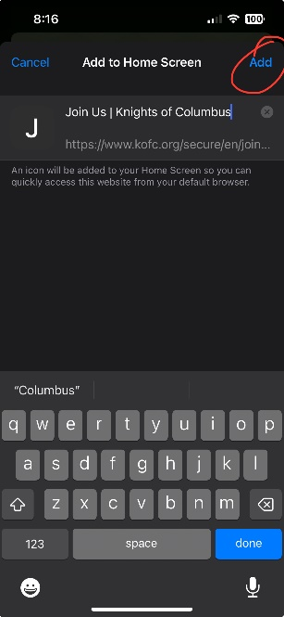
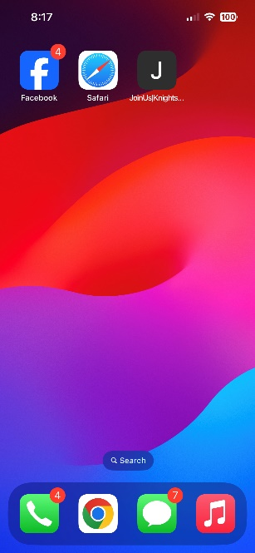
How to add the KofC “Join” page to your Phone Home Screen (Apple & Android)
On Apple iPhones, click the box with the arrow pointing up (icon located on upper right of app)
Scroll down and locate the “Add to Home Screen”. Select it, give it a name, then click “Add”. An icon will appear on your home screen, and look like an app.

Slide 6
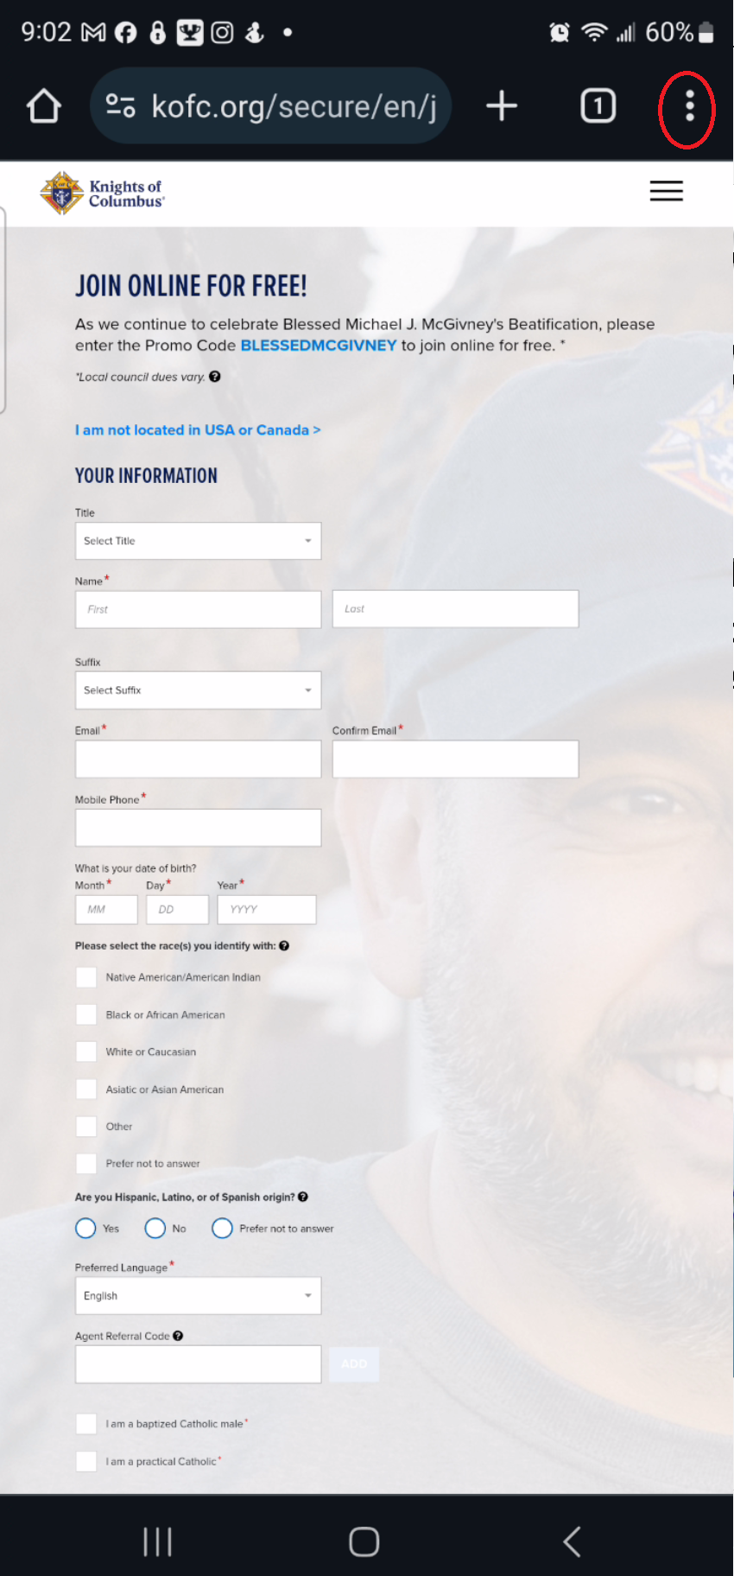
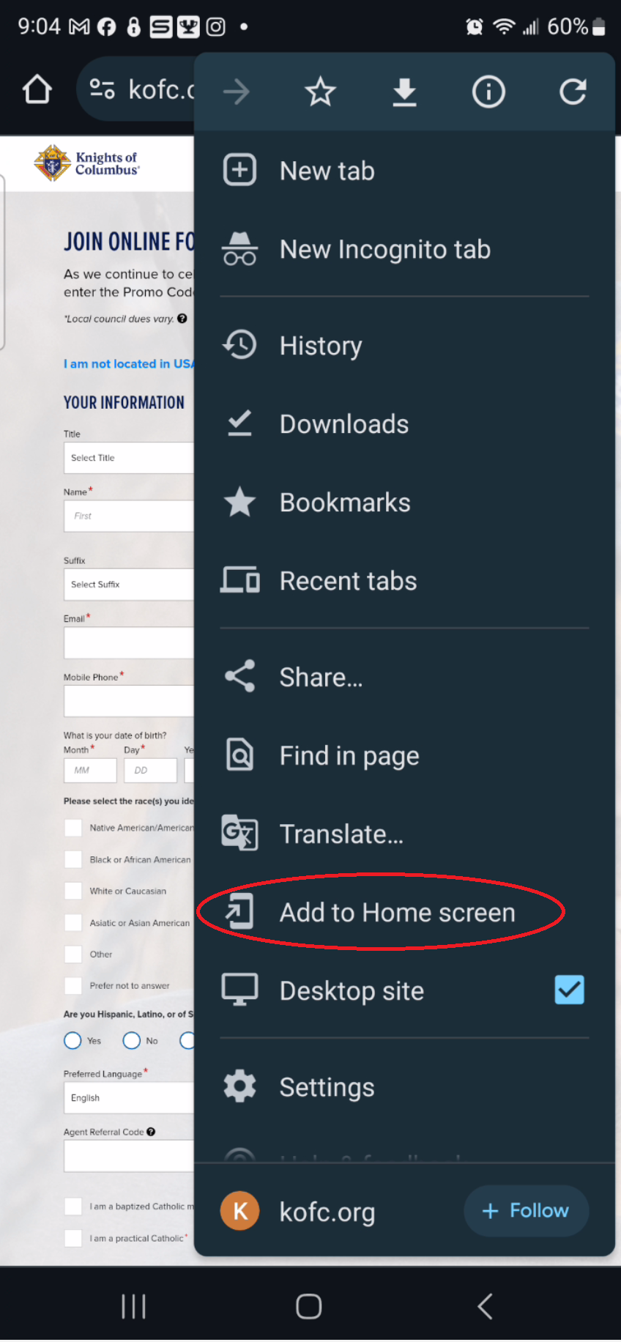
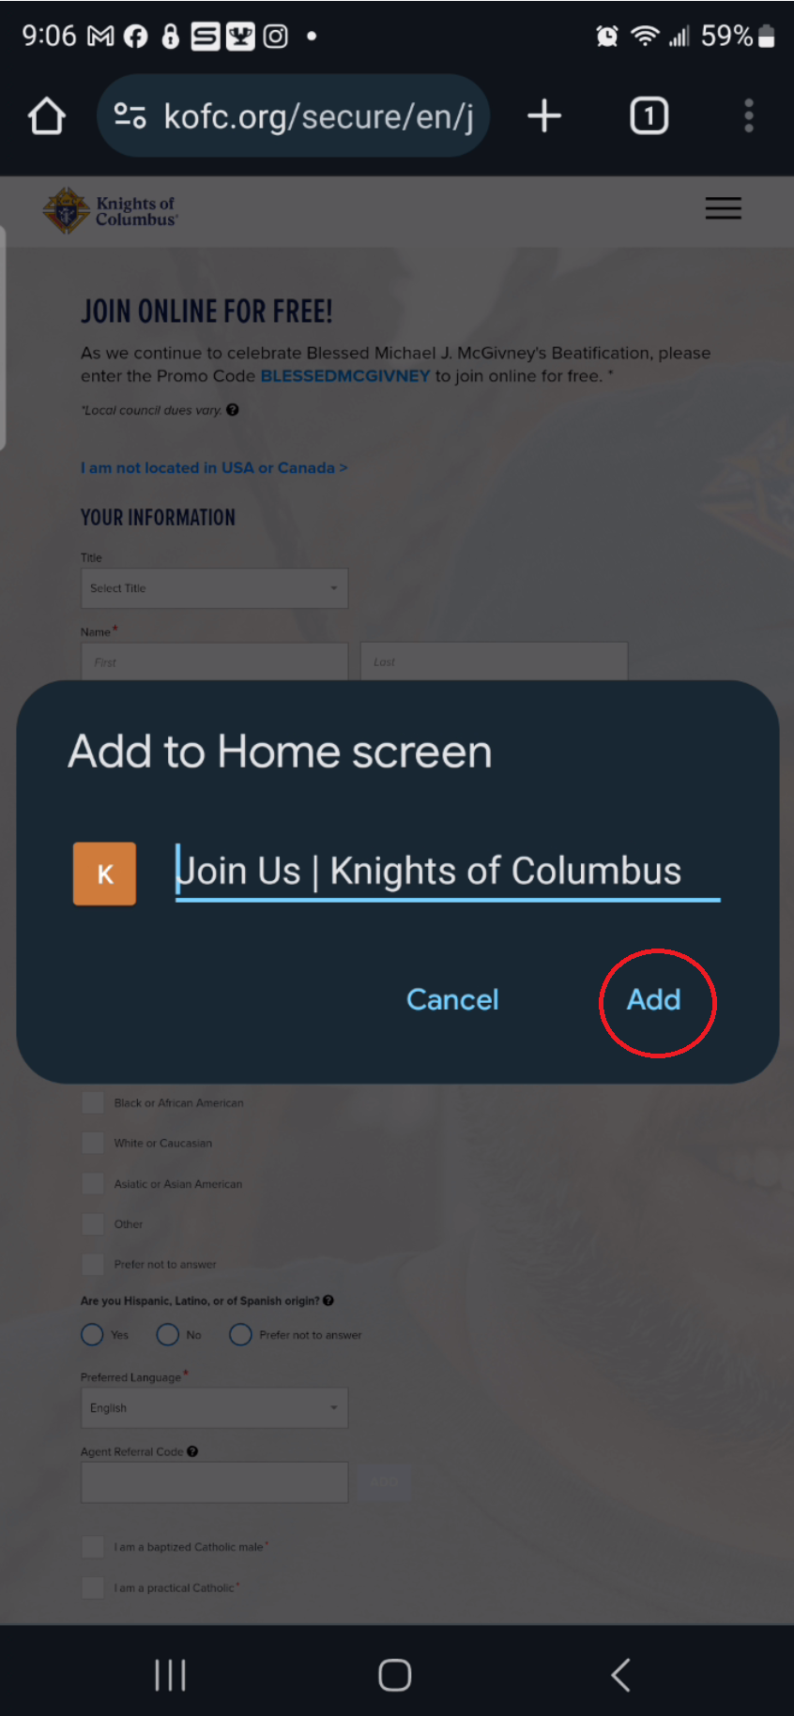
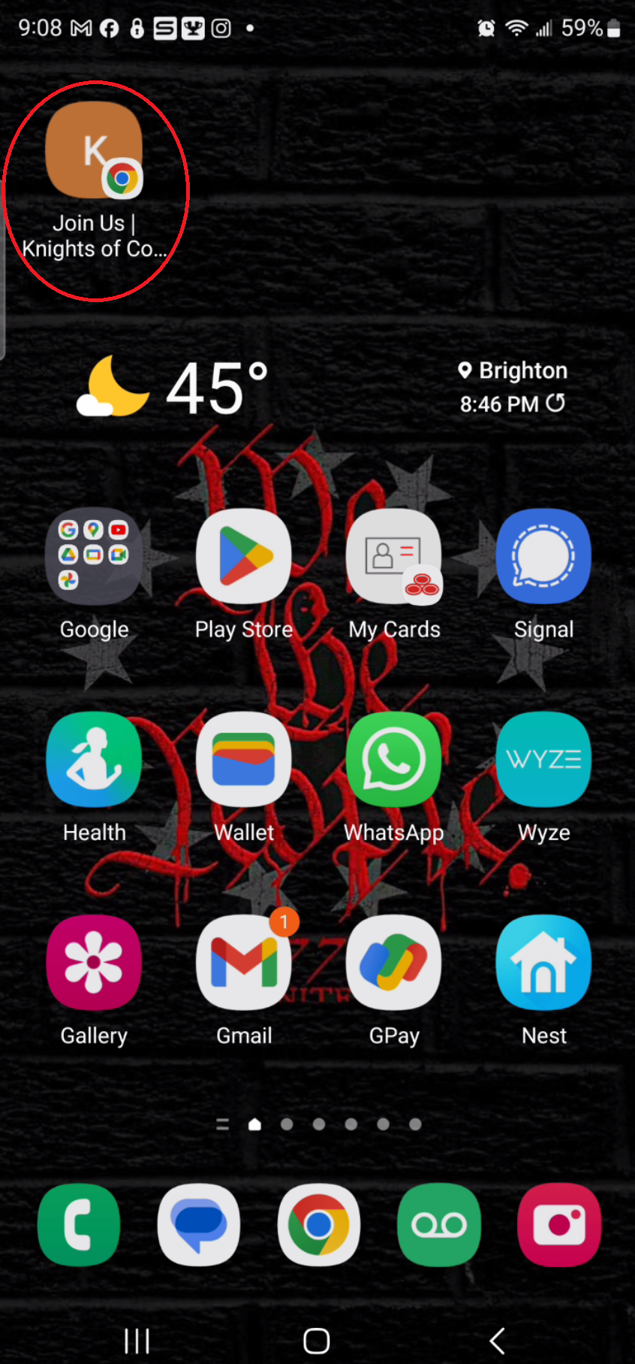
How to add the KofC “Join” page to your Phone Home Screen (Apple & Android)
On Android, click the 3 dots located on upper right of app.
Select the Add to Home Screen, give it a name, then click “Add”. An icon will appear on your phone and look like an app.

Slide 7
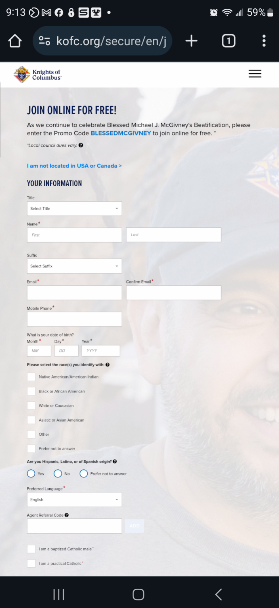
How to add the KofC “Join” page to your Phone Home Screen (Apple & Android)
That’s it! Now when you click on the icon, it will bring you to the Knights of Columbus join us page where you can easily signup interested prospects.

