Slide 1
Faith in Action

Slide 2
Agenda
This symbol will help provide tips and guidance..
Faith in Action – Life
Special Olympics Programs
Supreme website
#10626 - Guide Sheet
#10784 - Report Form
Form #10784 – Special Olympics
For MI Drive program
Other Special Olympics events
Go in document section
Go to WEB Link
Return to home page

Slide 3
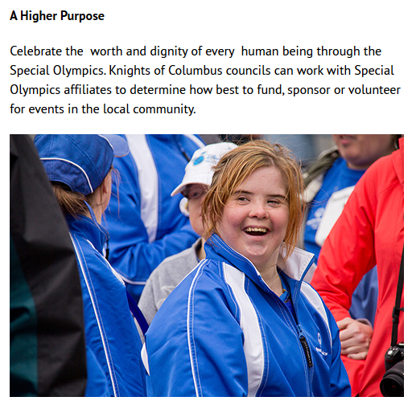
1. Faith in Action - Life
Novena for Life
March for Life (Featured)
Christian Refugee Relief
Ultrasound (Featured)
Special Olympics (Featured)
Mass for people with Special Needs
Pregnancy Center Support
Silver Rose

Slide 4
2a. Special Olympics Program Supreme website
Fill out this form even if you didn’t do anything for Special Olympics
Send in form with 0 hours, 0 events and 0 dollars.
Supreme Website – www.kofc.org
Click on and PROGRAMS
Click on RESOURCES
Click on LIFE
Scroll down to Special Olympics
#10626 - Guide Sheet – Instructions, steps, requirements, etc…
#10784 – Fraternal Programs Report Form (Used to be #4584)
#10702 - Vertical Poster - Advertisement
#10703 - Horizontal Poster - Advertisement

Slide 5
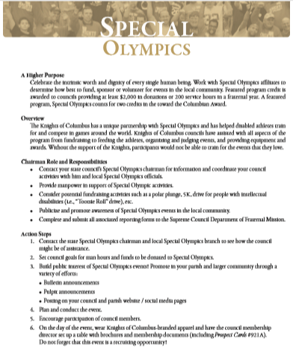
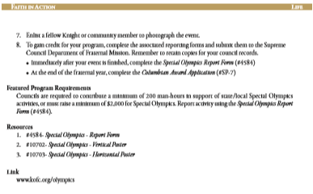
2b. Special Olympics Program #10626 – Guide Sheet
Chairman Role & Responsibilities – Things to do
Action Steps – Step-by-step procedures to have your event.
Regular Program – 10% of Council participates
Featured Program – Must meet these requirements

Slide 6
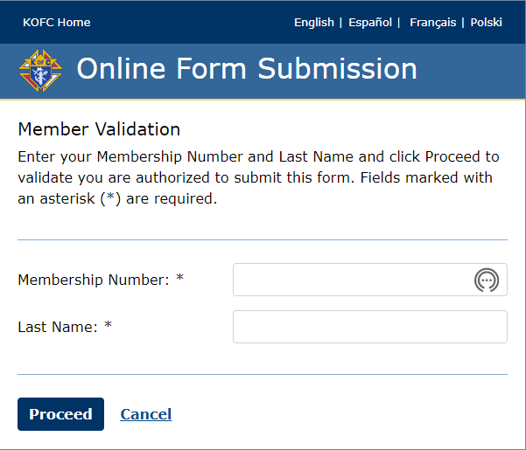
2c. Special Olympics Program Step 1 – Request the form
Supreme Website – www.kofc.org
Click on and PROGRAMS
Click on RESOURCES
Click on LIFE
Scroll down to Special Olympics
Click on
Enter your membership #
Enter your last name
Click on
Within 1-2 minutes, Supreme will send you an email (to the email address they have on file for you) with a link for you to submit your form.

Slide 7
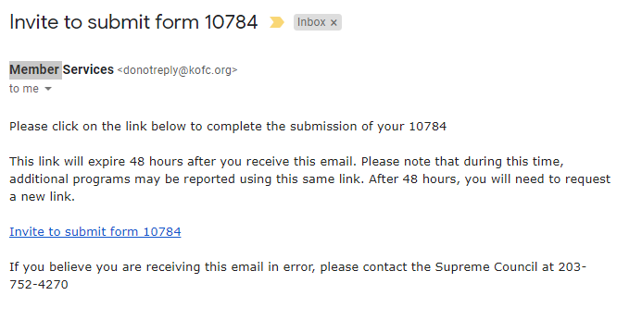
2c. Special Olympics Program Step 2 – Open the form via email
Open you e-mail
Open the email from Member Services
Click on the link for the form
If you don’t have an email address associated with your membership (or the email address on file is old), you won’t receive an email.
Give your correct email address to your Financial Secretary so he can update your membership records in Member Management.

Slide 8
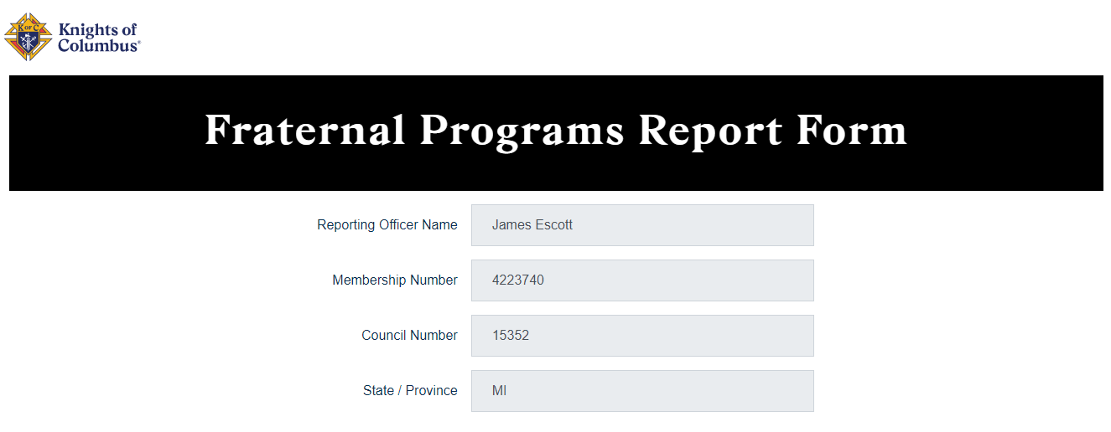
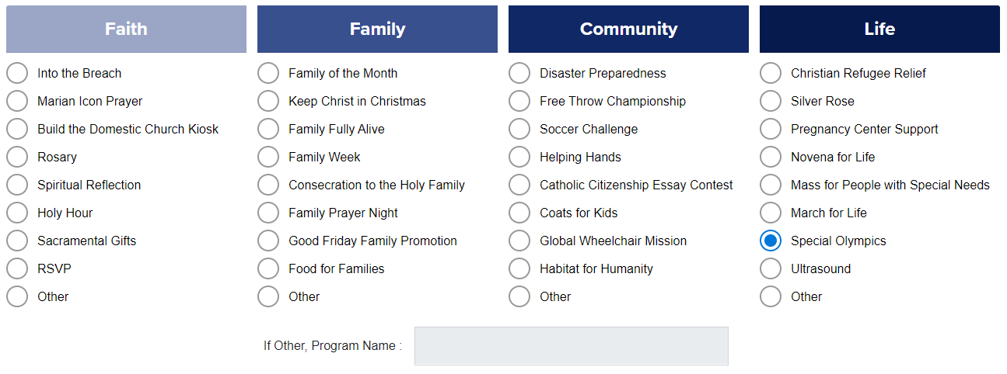
2c. Special Olympics Program Step 3 – Select Special Olympics
Click on
Form 10784 is being updated to allow for specific information by program.
Once you select Special Olympics, the rest of the form is displayed which is unique to this program.

Slide 9
2c. Special Olympics Program Step 4 – Dates
Enter the date(s) of the program
For “Event Specific” volunteers, enter the day the event began and the date in ended. NOTE: You may have spent time BEFORE & AFTER the event doing planning and follow-up but don’t include those dates here.
For “Year Round” volunteers, enter 1/1/20XX – 12/31/20XX.
You can also combine these onto one form. Enter 1/1/20XX – 12/31/20XX and just submit the one form in January (no later than 1/31)

Slide 10
2c. Special Olympics Program Step 5 – Volunteers
Members = Enter the total # of Council members that participated in any of the Special Olympics programs included within the dates specified.
Non-Members = Enter the total # of additional people that participated in any of the Special Olympics programs included within the dates specified. Include family members, parishioners, friends and neighbors.
Hours (Per Person) = This is a little complicated and you will most likely need to back into this number.
We all know not every volunteer spends the same amount of time.
I suggest you calculate the hours by volunteer, add them up & divide by the # of volunteers to get the average hours (per person).

Slide 11
2c. Special Olympics Program Step 6 – Other Volunteer Info
Participants = Enter the # of participants (Special Olympians) that attended these events.
Pastor Present = Enter yes if your Pastor attended “at least one” of these events.
Program Planning Costs = Enter the money your council spent for these events. Include any facility costs, food, awards, advertising, etc…
Program Planning Time = Enter the # hours spent by members and non-members to plan for these events. NOTE: These hours should also be included in the Total Hours listed in Step 5 (Volunteers).
Members Recruited = These Special Olympics programs are a great place to invite others (non-members) to join your council (or even just to be e-members).
Donations = Enter how much money was raised by these events. This should be total donations. Do not deduct costs (moneys spent).

Slide 12
2c. Special Olympics Program Step 7 – State Council Events
State Council Submission – Councils will ALWAYS answer no to this question. The Michigan State Council may also submit form 10784 for any activities they may sponsor.
# of Events = Enter the total # of events that you included on this form.

Slide 13
2c. Special Olympics Program Step 8 – Subjective Information
Parish & Council Engagement – This is very subjective and very little guidance has been provided by Supreme. Here are some recommendations:
If only 1-2 members of your council participated, I’d rate this a “1” = low participation.
If roughly 10% of your council participated, I’d rate this a “4” = high participation.
Comments – Supreme is always interested in hearing the details of programs. Success stories are then shared throughout the Knights to encourage other councils to learn from your success.

Slide 14
2c. Special Olympics Program Step 9 – Submit
Click Submit
Supreme will then send you a PDF copy of your submitted form. Once you receive this, please forward copies as follows:
Send a copy to your District Deputy (DDXXX@mikofc.org)
Send a copy to the Michigan State Council (forms@mikofc.org)
Send a copy to your Grand Knight, Program Director and Financial Secretary.

Slide 15
Michigan MI Drive Reporting as Special Olympics
ALWAYS submit form #10784 for Special Olympics.
If your council participates in the MI Drive…
Add the hours spent on the MI Drive (both of them can go on one form)
Add 20% of funds collected (which go to the State) as Special Olympics funds
Add any other MI drive funds which your council gives to Special Olympics
If your council does NOT participate in the MI Drive…
If you do something else for Special Olympics, submit the form for your activities.
If you do NOT do anything for Special Olympics, just enter 0 hours, $0 dollars & 0 events. (This way we know you didn’t just forget to submit the form).

