Slide 1




Financial Officer Workshop
Trustees
Treasurer
Financial Secretary

Slide 2
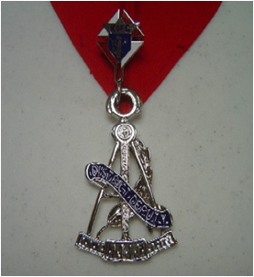





Overview
Funds Management
Semi-Annual Audit
Recent Changes
This symbol will help provide tips and guidance..
Go in document section
Go to WEB Link
Return to home page

Slide 3
1. Overview
Helpful Resources
For Financial Secretaries, Treasurers & Trustees
Navigating Supreme Website
Navigating Michigan State KofC Website
Where to go for help
How to Conduct a Council Audit
Form 1295 – Semiannual Council Audit Report
Treasurer Training Manual
Trustee Training Manual
Council Budget Template
Charter Constitution Laws – 2019
Leadership Resources
Primarily for Financial Secretaries
Member Management Training
Form 185 Video – https://youtu.be/7M-KYfKBDig
Form 365 Video – https://youtu.be/c0lswbh66tg
Prospect Tab – E-Member to Council Process
Candidate Tab – Candidate Tab Training Video
Financial Secretary's Guide
Summary of Financial Secretary's Responsibilities
Rolls and Responsibilities
Importance
Checks & Balances
Teamwork

Slide 4
1a. Roles & Responsibilities
Duties Responsibilities Council Officers Directors
Financial Secretary – Maintains all financial and membership records.
  Uses Member Management software
Treasurer – Manages council funds & bank accounts
  Handles the checkbooks and all bank transactions
Trustees – Oversees all financial business of the council
  Prepares form 1295 & conducts the semi-annual audit

Slide 5



1b – Why is Financial Management so important?
Manage council funds
  Like a small business
Tax accounting
  Like a small business
Proper control
  Avoid mis-appropriation of funds

Slide 6

1c – Checks & Balances
Honest Mistakes
Everyone makes mistakes
Losing $$$ is a big problem
Not-so-honest Mistakes
Remove temptation
Correct problems early

Slide 7
1d – Teamwork
Trustees
Oversees the process
Treasurer
Manages Bank Account(s)
Financial Secretary
Collects all Funds

Slide 8

2. Funds Management
Receipts – Incoming funds
Disbursements – Outgoing funds
Monthly Reconciliation – FS & Treasurer aligned?
Budgets – Prepare & approve a council budget
Bonding
  $5000 – Treasurer & FS by Supreme
  Additional amounts are available @ $7/$1000

Slide 9
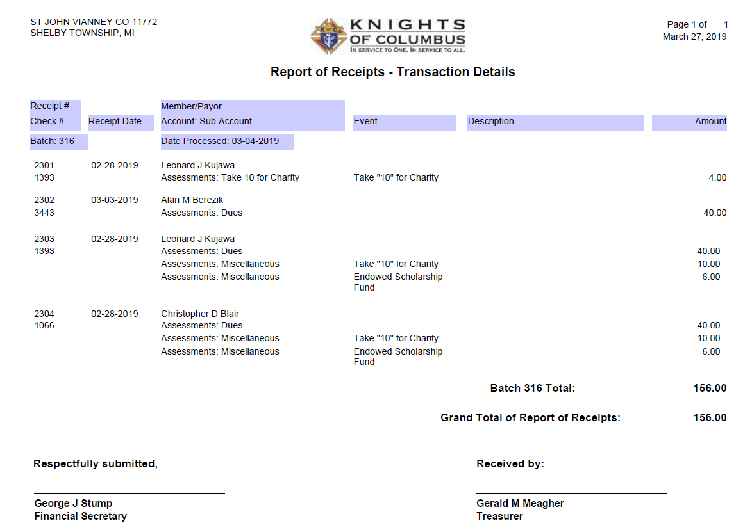
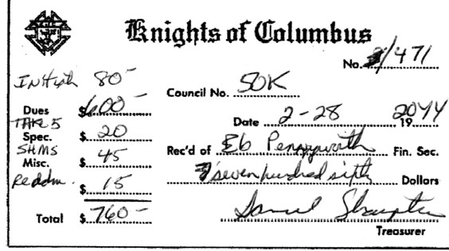
2a. Receipts
FS Receives
Cash
FS Turns
Cash Over
To Treasurer
FS Retains
Signed
Receipt
Treasurer
Verifies &
Signs Receipt
Treasurer
Retains
Receipt
Copy
Treasurer
Deposits
Cash

Slide 10
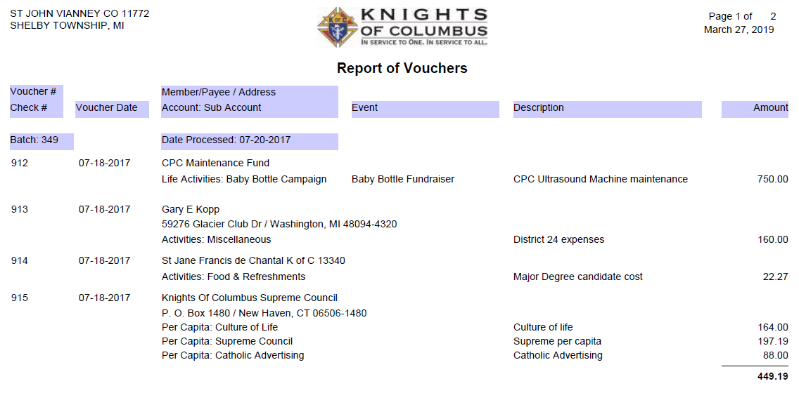
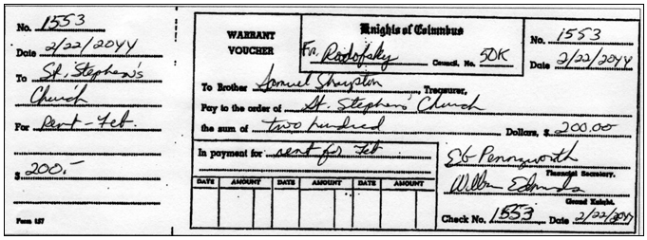
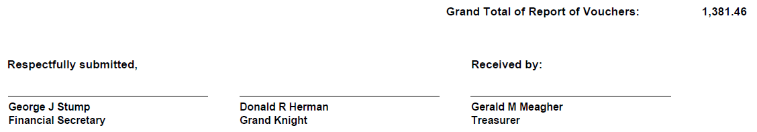
2b. Disbursements
FS Receives
Request & Bill
Approved by
Council if
Not budgeted
Trustees
Examine
Vouchers
FS Prepares
& Signs
Vouchers
Council
Approves
Paying bills
Voucher
Signed by
Grand Knight
Treasurer
Records
Disbursement
Treasurer
Writes
Check

Slide 11

2c. Monthly Reconciliation
Treasurer receives monthly bank statement
Treasurer adds any interest into checkbook and Cash Journal
Treasurer checks for any unusual charges or credits and deducts or adds to checkbook
Treasurer checks off all checks and deposits that have cleared
Treasurer writes in balance of statement in appropriate place on back of statement
Treasurer lists all open deposits and un-cashed checks in appropriate spots on statement
Balance derived on back should agree with checkbook – if not examine amounts and additions and subtractions until amounts are found
Treasurer reports all checks that have not been cashed that are beyond the legal period (usually six months) to Trustees at time of audit. Payees are to be written to see why checks have not been cashed.

Slide 12
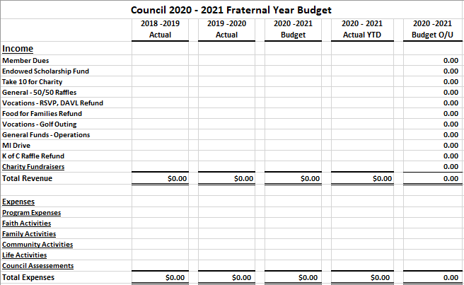
2d. Budgets
Purpose:
Forecast
Pre-approval of expenses
Approved @ 2 meetings
Detail:
Detailed enough to ensure the money is spent per the intent approved (Underlined lines should have an additional level of detail)
Generic enough to allow sufficient flexibility
Example:
  $500 for a Crisis Pregnancy Center donation (listed under “Life Activities”)

Slide 13

3. Semi-Annual Budget
Overview
Preparation
Audit – 3 main parts
  Membership – Done via Member Management
  Income & Expenses
  Assets & Liabilities
Post-audit tasks
How to Conduct a Council Audit (Word)
How to Conduct a Council Audit (PDF)
Semi-Annual Audit form
  PDF
  Online (Preferred Method)

Slide 14
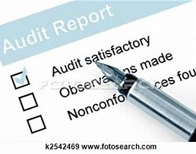
3a. Overview
When?
  Due by 8/15 – for January - June
  Due 2/15 – For July - December
Who
  Trustees should do the audit using the records and documents supplied by the Financial Secretary and the Treasurer.
  Financial Secretary provides documentation and answers questions.
  Treasurer provides documentation and answers questions
  Grand Knight attends the audit and signs the audit form
  Other potential people to invite to the audit include the DGK, DD & Recorder

Slide 15

3b. Preparation
FS – Don’t hold money on 6/30 & 12/31
FS – Provide documentation to the Trustees
  Report of receipts (From Member Management)
  Report of vouchers (From Member Management)
Treasurer – Provide documentation to the Trustees
  Checkbook (and register)
  Vouchers
  Bank statements
Trustees – Fill out form 1295 (PDF or Online (Preferred Method))
  Using documentation from FS & Treasurer as input
  FS & Treasurer should be available to answer questions as they arise
Trustees – Schedule the Audit meeting

Slide 16
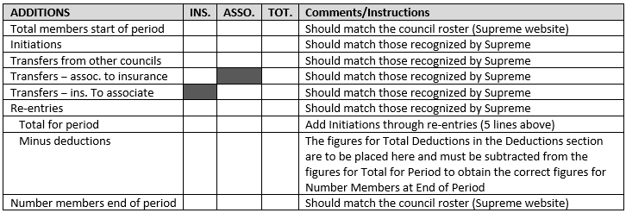
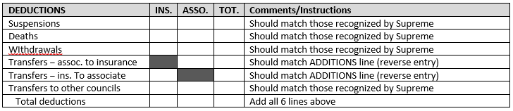
3c. Audit - Schedule A
Membership
Member Management
  Skip Schedule A
  Minimizes work
  Preferred method
Manually fill this out
  Follow instructions shown
  Much more documentation needed (Council rosters, form 100s, etc.)

Slide 17
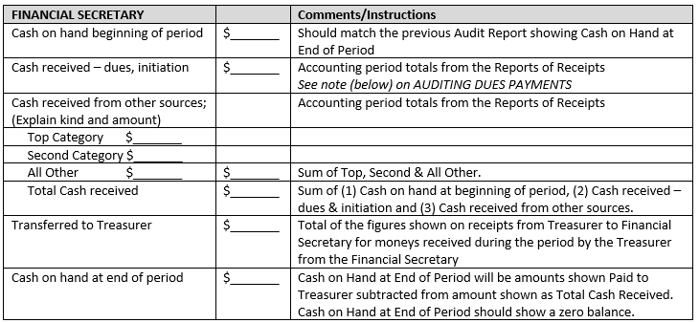
3c. Audit Schedule B - FS Cash Transactions

Slide 18
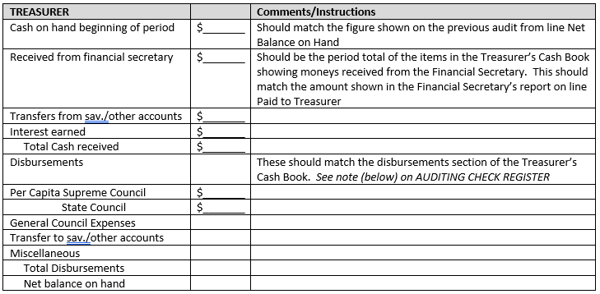
3c. Audit Schedule B – Treasurer Transactions

Slide 19

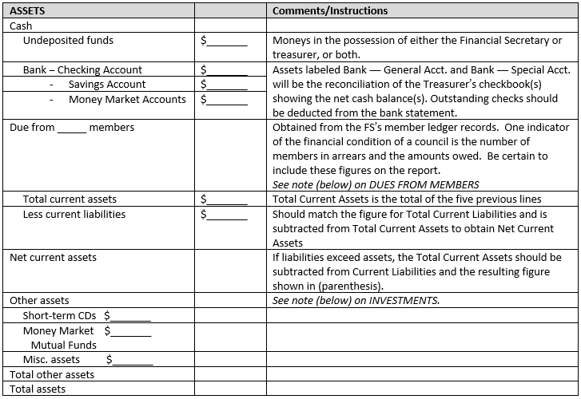
3c. Audit Schedule C – Assets

Slide 20

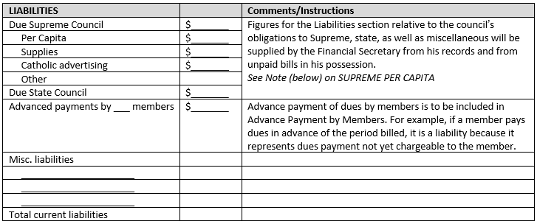
3c. Audit Schedule C - Liabilities

Slide 21

3d. Post Audit Tasks
Signatures – GK + Trustees (at least 2 of 3 Trustees)
  DGK can sign for either the GK or a Trustee (if required)
Council Copies – Everyone who attended (everyone invited)
  GK, DGK, Treasurer, Trustees & Recorder
Other Copies
  Supreme – council.accounts@kofc.org
  State – forms@mikofc.org (*)
  District Deputy – DDXXX@mikofc.org (where XXX is District #)
    (*) In 2020, roughly 5% of councils sent their audits to stateoffice@mikofc.org. The State Office doesn’t need (or want) copies of your audit.

Slide 22
4. Recent changes (for FSs to be aware of)
Title | Explanation
Prospect Tab (in Officers’ Online) | To be used when you are transferring online members into your council.
Candidate Tab (in Officers’ Online) | To be used to bring new members, transfers and reactivations into your council.

Slide 23
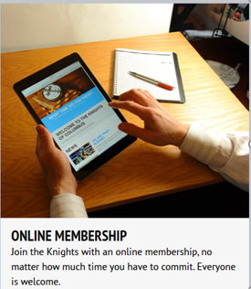
4a. Online Member Transfers – Prospect Tab
Step 0: Member joins online
Step 1: View Online Member Reports
Step 2: Contact the Online Members (*)
Step 3: Ask them to join (*)
Step 4: Exemplification (*)
Step 5: Update the Prospect Tab
Step 6: Update Member Management
Step 7: Welcome the new members (*)
(*) These steps should be performed by the Grand Knight and/or Membership Director.

Slide 24
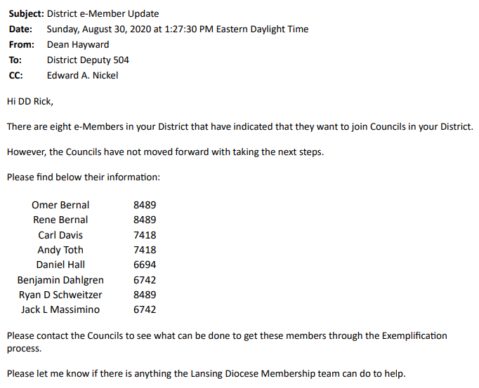
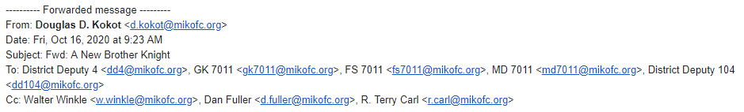
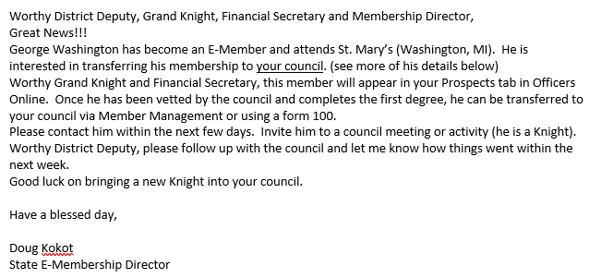
4a1 - View Online Member Reports
Reports are sent to Councils 3 ways:
  Prospect Tab – Officers Online (See next page) (District Deputies, Grand Knights & Financial Secretaries)
  Monthly Online Member Reports sent to DDs from SDRRs
  E-mail communication from State E-Member Director for each Online Member

Slide 25
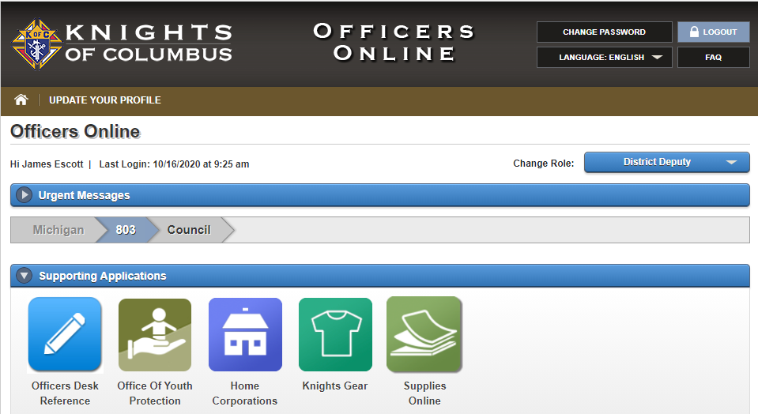
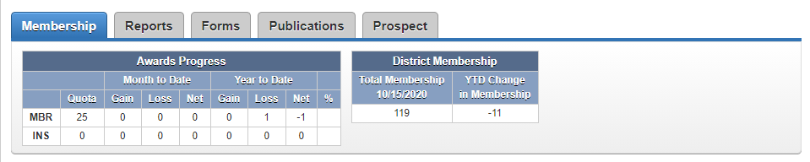
Officers Online Reports
Watch the first 2 minutes of this 7 minute YouTube video to see how to login to Officers Online
Go to Supreme Website (www.kofc.org)
Click on Sign In – Login to Officers Online
  Only District Deputies, Grand Knights and Financial Secretaries have access
Enter User Name & Password and Sign In
Click on the Prospect Tab
Online Membership Prospect Tab

Slide 26
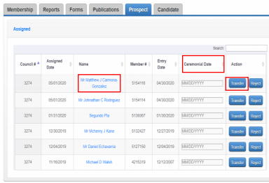
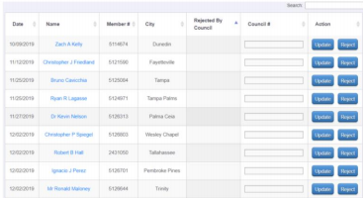
Step 1: View Online Member Report
(Prospect Tab)
Assigned List
  Includes members that have said they want to join your council.
  It may also include members assigned to your council by our State E-Member Director.
List of Prospects
  Click on the prospect name to see detailed information for a specific Prospect. (See next page)
Action
  FS should pass the Prospect information along to the Membership Director so the Prospect can be contacted.

Slide 27
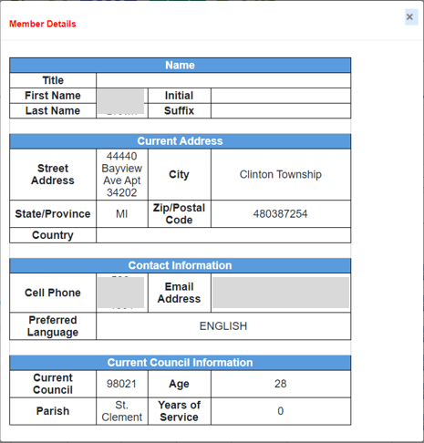

Member Detailed contact information
Click on Member Name
Member Details
  FS will need to pass this information on to the GK and/or MD for them to contact the prospect.
George
Washington
1234 Knights Dr.
(248)
123-4567
G.Washington@lovetheUS.com

Slide 28
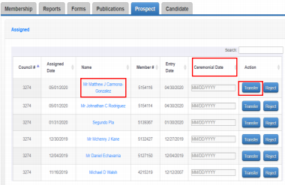
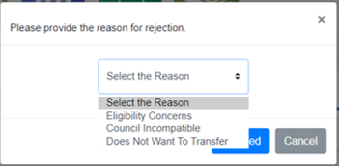
Step 5: Update the Prospect Tab
Action / Transfer – If you are transferring this member into your council…
  Ceremonial Date – Enter the date of his Exemplification.
  Transfer – Click transfer to complete the process.
Action / Reject – If you do NOT want this member transferred to your council…
  Reject – Clicking Reject will remove this member from your list. He will be unassigned.
  Select the Reason – From the drop down box, select the reason this member is being rejected.

Slide 29
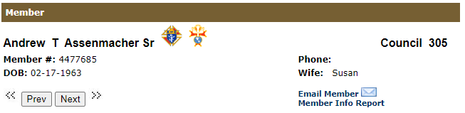
Step 6 - Update Member Management
Prospect Tab updates members as 1st Degree members
  The new Exemplification makes them 3rd Degree members
FS needs to update Member Management to make them 3rd Degree members.
  Login to Member Management & pull up the record for the new “1st Degree” member
  Click on “Fraternal Information” & copy the 1st Degree date into the fields for 2nd & 3rd Degrees
  Click
Send a notice to your Field Agent (Either fill out a Form 100 or print the Member Info Report)
  Click on Member Info Report
  Save the PDF
  Email it to your Field Agent
Roosevelt, Franklin D.
Council 12345
1234567

Slide 30
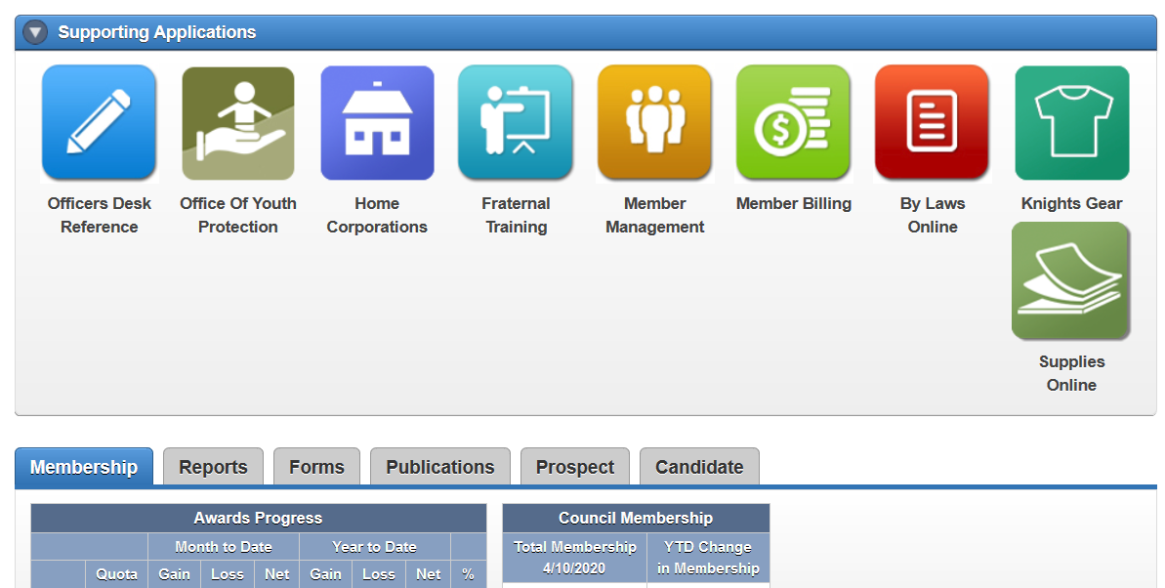
4b. Candidate Tab
New, Transfer or Reactive Members
Step 1: FS receives Form 100 (*)
Step 2: FS Adds candidate
Step 3: Council approves member (*)
Step 4: FS Updates the Candidate Tab
Step 5: Update Member Management
Step 6: Welcome the new members (*)
(*) These steps should be performed by the Grand Knight and/or Membership Director.

Slide 31
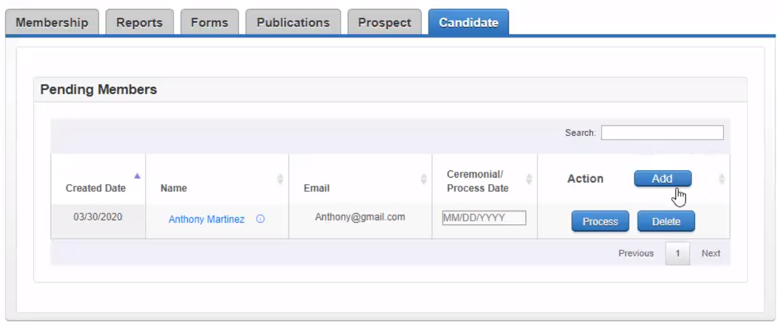
Financial Secretary Adds the Candidate
Get Form 100(s) from Council
  Make sure all information is filled out
  Email address is critical
Go to the Candidate Tab
  Login to Officers’ Online
  Click on the Candidate Tab
Click on

Slide 32
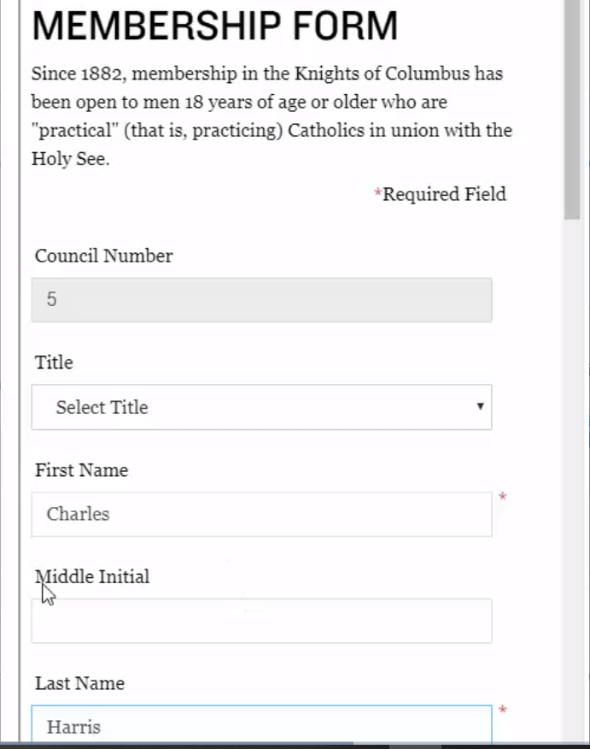
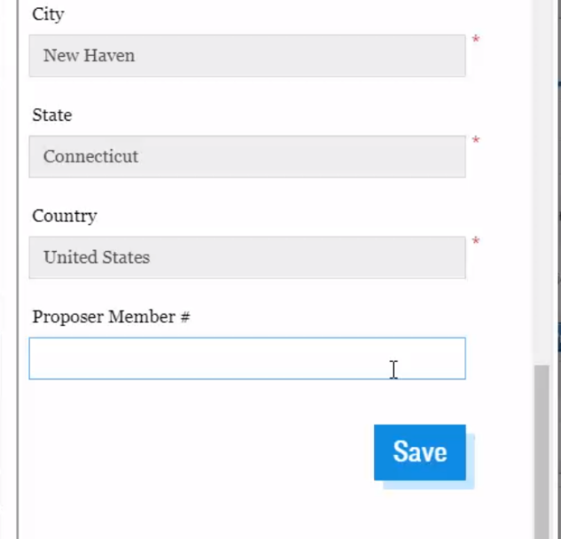
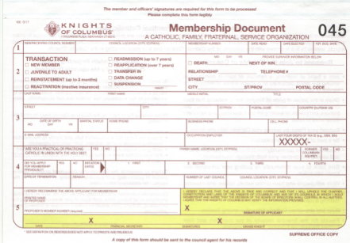

Key in all information from the Form 100
Name, Address, DOB, Marital Status
1-3 Phone #s – Cell Phone is key
Email is key
Occupation, last 4 of SSN, Parish
Transfer/Reactivate information
Click

Slide 33
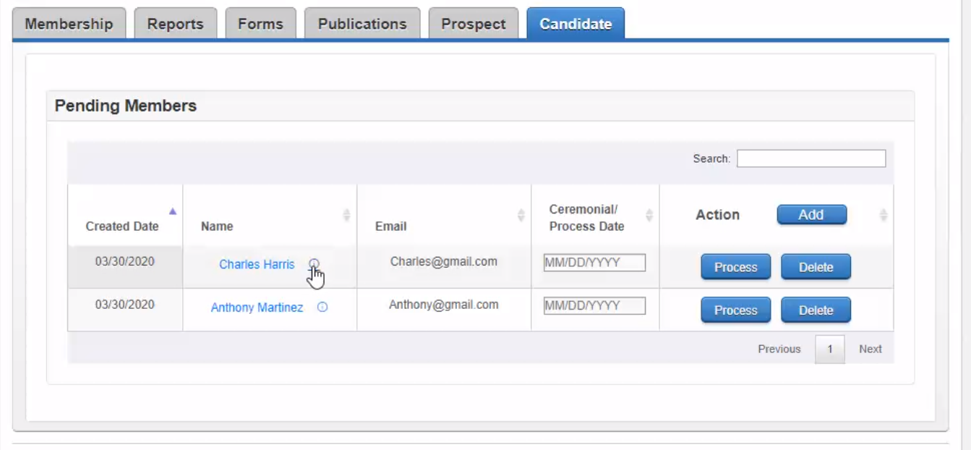
Process / Delete the Candidate
Council approves (or denies)
  Council Approves the candidate
  Council decides NOT to allow the candidate to join your council.
Process (if approved)
  Ceremonial Date:
    Add = Date of Exemplification
    Transfer or Reactivation = Date council approved the candidate
  Click
Delete (if NOT approved)
  Click This will remove the candidate from your list.

Slide 34
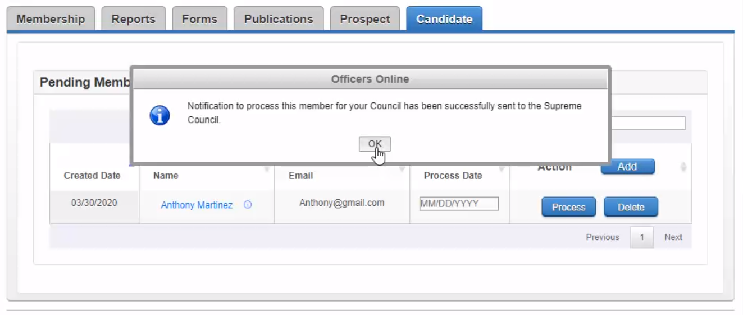
Officers’ Online Notification
Member is transferred
No need to send Form 100 to Supreme
Person is removed from the Candidate Tab
You’ll get a +1 toward your quota
Member will receive an automated email
Retain form 100 for Council Record
Forward a copy of the Form 100 to your Field Agent (or send the Member Info Report from MM)

Slide 35
Financial Secretaries
Treasurers
Trustees
Questions???

