Slide 1
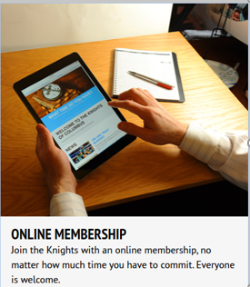
Bringing Online Members into your council
Step-by-Step How to Guide

Slide 2
Agenda
This symbol will help provide tips and guidance..
Overview
Step 0: Becoming an E-member
Step 1: View Online Member Reports
Step 2: Contact the Online Member
Step 3: Ask him to join
Step 4: Exemplification
Step 5: Update the Prospect Tab
Step 6: Update Member Management
Step 7: Welcome the new members
Jump to document section
Go to WEB Link
Return to home page

Slide 3
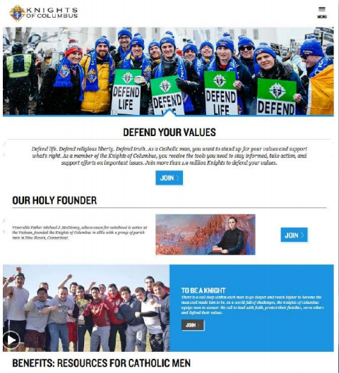
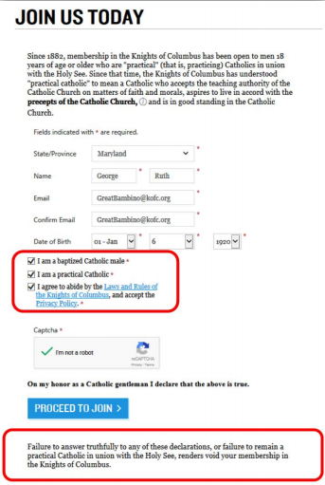
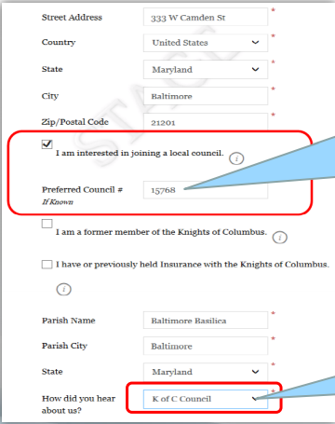
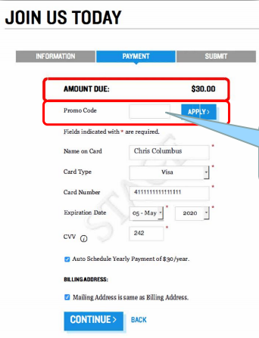
Step 0: Becoming an E-member
Click here to see Step 0 in detail: E-Membership Join Process
www.kofc.org/joinus
Name, Email, DOB, etc.
Address, Parish, prior member
Payment & Continue to join

Slide 4
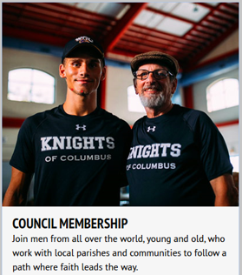
Overview
Why do we recruit?
Prospect Point of View
Roles and Responsibilities

Slide 5
Why do we recruit?
To strengthen our Parishes
To provide charity in our communities
To help men become better Catholics, husbands and Fathers
To strengthen Catholic families
To “Vivat Jesus” though our actions
Bring men and their families back to the Church
Evangelize – Tell your story why you are a knight and how being a Knight has helped you
Click on the link below to see why men want to join the Knights of Columbus. Keep these reasons in mind as you recruit.

Slide 6
Prospects point of view
Reach out to me
Engage me as a friend
Communicate with me early and often
Relate to my perspective
Understand my availability and offer choices
Include my family and yours
Thank me regularly and ask me to invite a friend

Slide 7
Roles & Responsibilities
Duties Responsibilities Council Officers Directors
Roles
Grand Knight – Oversee the process
Financial Secretary – Member Management
Membership Director (and Team) – Work with Prospects
District Deputies – Help councils and communicate
Rise up and Answer the call
Responsibilities – Get Online members to join your council
Educate and vet prospects
Get them involved with your council (meetings and activities)
Get them to (and through) the exemplification
Introduce them to the Council and help them become active

Slide 8
Step 1: View Online Member Reports
Reports are sent to Councils (and District Deputies) 3 ways
Officers Online (District Deputies, Grand Knights & Financial Secretaries)
Monthly Online Member Reports sent to DDs from SDRRs
E-mail communication from Doug Kokot for each Online Member
These men are already Knights – Bring them into your councils
Each one counts toward your membership quota
Recruiting is already done – All you need to do is Admit these men
Get them active in your council programs and meetings

Slide 9
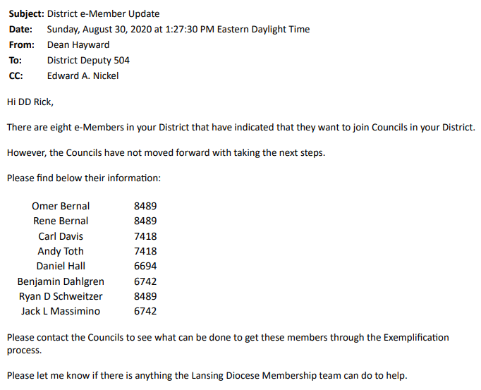
1st - Monthly Online Member Reports
Sent by SDRR
To each District Deputy

Slide 10
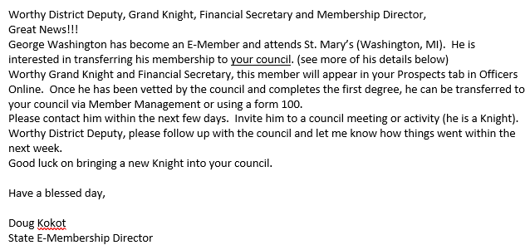
2nd - E-mail communication from Doug Kokot
To: GK, FS, MD, DD and others
Instructions: Doug gives you a pretty detailed list of action items on how to proceed.
Call the Prospect
Vet the Prospect
Exemplification
FS – Update MM

Slide 11
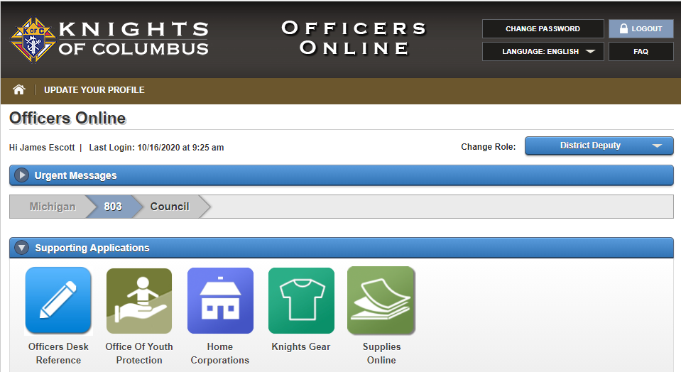
3rd - Officers Online Reports
Watch the first 2 minutes of this 7 minute YouTube video to see how to login to Officers Online
Go to Supreme Website (www.kofc.org)
Click on Sign In – Login to Officers Online
Only District Deputies, Grand Knights and Financial Secretaries have access
Enter User Name & Password and Sign In
Click on the Prospect Tab
Online Membership Prospect Tab

Slide 12
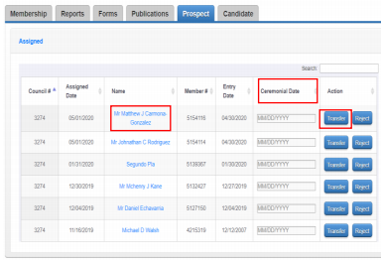
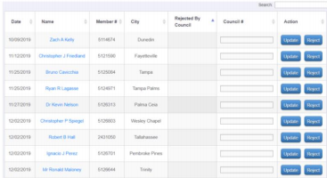
Prospect Tab
Assigned List
Includes members that have said they want to join your council.
It may also include members assigned to your council by our State E-Member Director.
List of Prospects
Click on the prospect name to see detailed information for a specific Prospect. (See next page)
Action
FS should pass the Prospect information along to the Membership Director so the Prospect can be contacted.

Slide 13
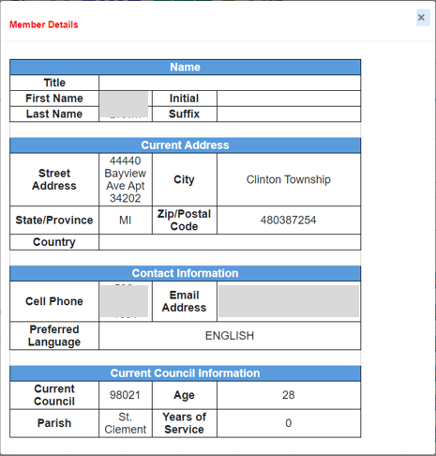
Prospect Report (Member Name)
Click on Member Name
Member Details
Use this information to either call (or e-mail) the Prospect
George
Washington
1234 Knights Dr.
(248)
123-4567
G.Washington@lovetheUS.com

Slide 14
Step 2: Contact the Online Members
Each council has their own process to contact prospects so please follow whatever processes are appropriate for your council. But, ensure the following things are accomplished:
Contact them
Vet them
Invite them to participate
Invite them to join
Contact each Prospect
Introduce yourself
Get to know the prospect (Vet him)
Answer any questions the Prospect has
Invite him to come to a Council meeting (and/or event)
Invite him to join

Slide 15
Step 3: Ask him to Join
Don’t over think this step or try to make it complicated
The prospect has already said he is interested in joining your council
Just tell him how to join (provide options for exemplification)
Follow your council’s normal vetting process
Meets requirements (age, practical Catholic, etc…)
Don’t be too harsh (or too easy) – Just follow your normal process
Answer any questions the prospect may have
This ensures the Prospect has all the information he needs to join
Get your councils approval for him to join
Follow your councils standard process to approve him to join

Slide 16
Step 4: Exemplification
Council Exemplification
After Mass or at a Council meeting
District Exemplification
If your council doesn’t have an exemplification team
State Exemplification
Zoom exemplifications
Supreme Exemplification
On Demand exemplifications
All of these are acceptable exemplifications and available for you and your prospects. These are listed in priority sequence:
Council exemplifications are always preferred. They are the most personal and intimate.
Supreme exemplifications provide additional flexibility but are much less personal.

Slide 17
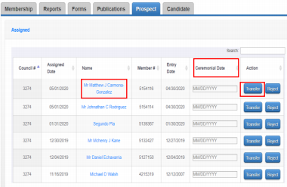
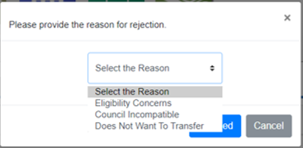
Step 5: Update the Prospect Tab
Action / Transfer – If you are transferring this member into your council…
Ceremonial Date – Enter the date of his Exemplification.
Transfer – Click transfer to complete the process.
Action / Reject – If you do NOT want this member transferred to your council…
Reject – Clicking Reject will remove this member from your list. He will be unassigned.
Select the Reason – From the drop down box, select the reason this member is being rejected.

Slide 18
Step 6 - Update Member Management
Prospect Tab updates members as 1st Degree members
The new Exemplification makes them 3rd Degree members
FS needs to update Member Management to make them 3rd Degree members.
Login to Member Management & pull up the record for the new “1st Degree” member
Click on “Fraternal Information” & copy the 1st Degree date into the fields for 2nd & 3rd Degrees
Click
Send a notice to your Field Agent (Either fill out a Form 100 or print the Member Info Report)
Click on Member Info Report
Save the PDF
Email it to your Field Agent
Roosevelt, Franklin D.
Council 12345
1234567

Slide 19
Step 7: Welcome (Man & family)
Proposer Roles & Responsibilities
Introductions – Individually & to the entire council
Sit with him – Explain anything needing explanation
Sign him up – Get him (and his family) engaged in an activity
Council Roles & Responsibilities
Program Director – Get him engaged in an activity
Grand Knight – Welcome
Everyone – Make him feel accepted

Slide 20
Summary
Be proactive to reach these prospects
They want to join your council
Prospects see delays as “You aren’t interested in them”
Call them within 1-2 weeks
Don’t make this too complicated
Just follow your normal council process to “Admit” new members
The hardest part of Membership work is already done
These men already want to join your council
Just vet them, get them through an exemplification, process the paperwork & get them actively engaged.
Remember why you’re doing all this
Strengthen your church
Grow the Order
Help these men become better Catholics, husbands, fathers and men

