Slide 1
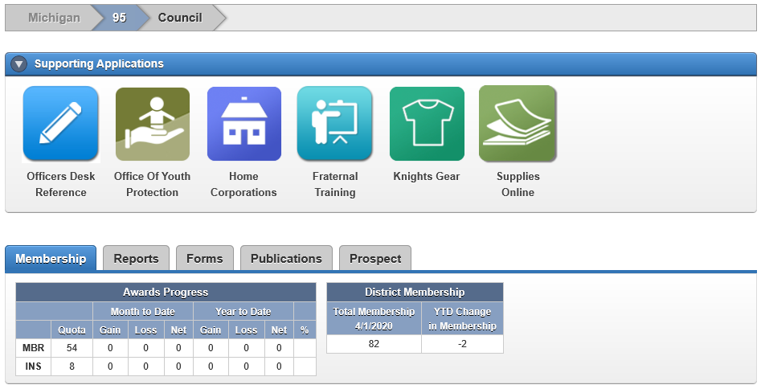
DD Training 2020 – Officers Online
Notes:
What to say…
Thank them all for volunteering to Shepard their councils!
If they put in the time, it will be very rewarding.
What NOT to say…
You guys are suckers for volunteering
This will be the worst year of your life
Overall message to get across…
You want them leaving this workshop
Excited, motivated and anxious to do a great job
Knowing the basic information to get started
Knowing where to turn for help – They are not alone

Slide 2
Agenda
How to Login
District / Council Details
Supporting Applications Overview
Tabs Overview
Most Important for District Deputies
DD Training 2020 - Officers Online
Notes:
What to say…
This workshop is a combination of best practices & lessons learned from many Past Grand Knights.
If you follow these things, you should
Be seen as a successful GK by your council and your parish
Make the most of the time you put in (minimize spinning your wheels)
What NOT to say…
Anything negative
Overall message to get across…
You want them to
Consider this material as great advice
Keep is handy to reference throughout their term as GK

Slide 3
How to Log in
Go to www.kofc.org
Click “SIGN IN”
Enter user ID, password and click “SIGN IN”
DD Training 2020 - Officers Online
Notes:
What to say…
This workshop is a combination of best practices & lessons learned from many Past Grand Knights.
If you follow these things, you should
Be seen as a successful GK by your council and your parish
Make the most of the time you put in (minimize spinning your wheels)
What NOT to say…
Anything negative
Overall message to get across…
You want them to
Consider this material as great advice
Keep is handy to reference throughout their term as GK

Slide 4
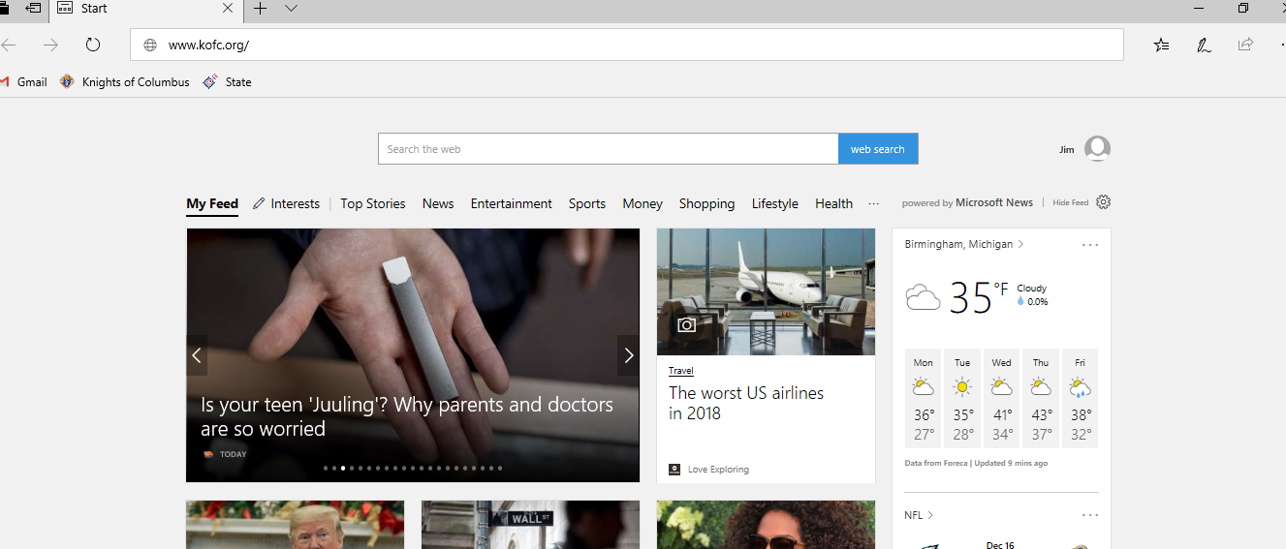
Step 1: www.kofc.org
Everyone uses different browsers – The above example is mine
Type “www.kofc.org” in the top area and hit enter
DD Training 2020 - Officers Online

Slide 5
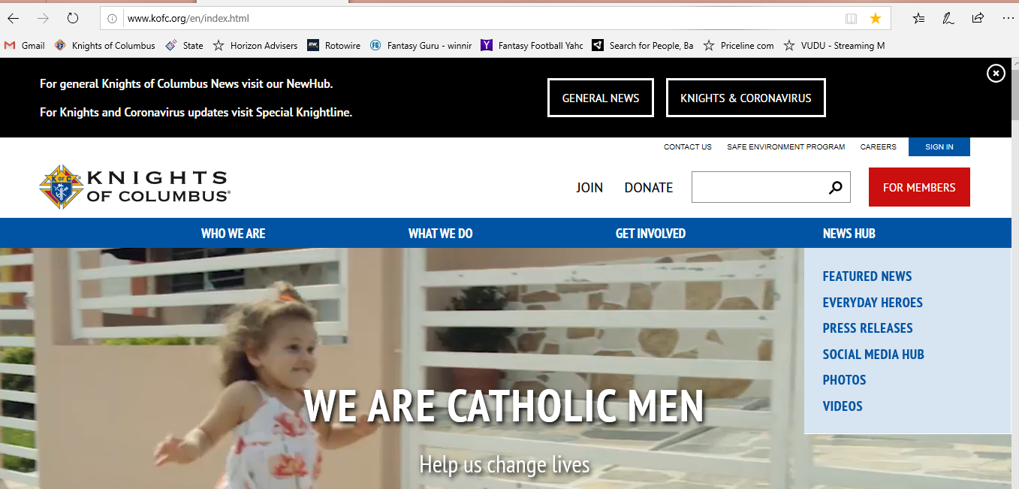
Step 2: Click “SIGN IN”
This is the main website for the Knights of Columbus
In the upper right hand corner, click on “SIGN IN”
DD Training 2020 - Officers Online

Slide 6
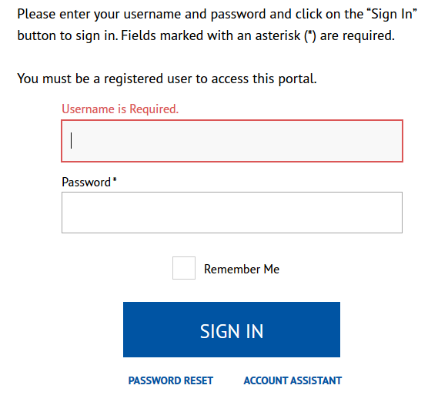
Step 3: Enter Login Credentials
Login ID (provided by Supreme)
Password
If you check the box for “Remember Me”, your user ID and password will be saved for all future times you login.
After you enter your user ID and password, click on “SIGN IN” to continue.
Click on “PASSWORD RESET” if/when you forgot your password.
Click on “ACCOUNT ASSISTANCE” if you forgot your user ID. You will receive an email helping you to login.
DD Training 2020 - Officers Online

Slide 7
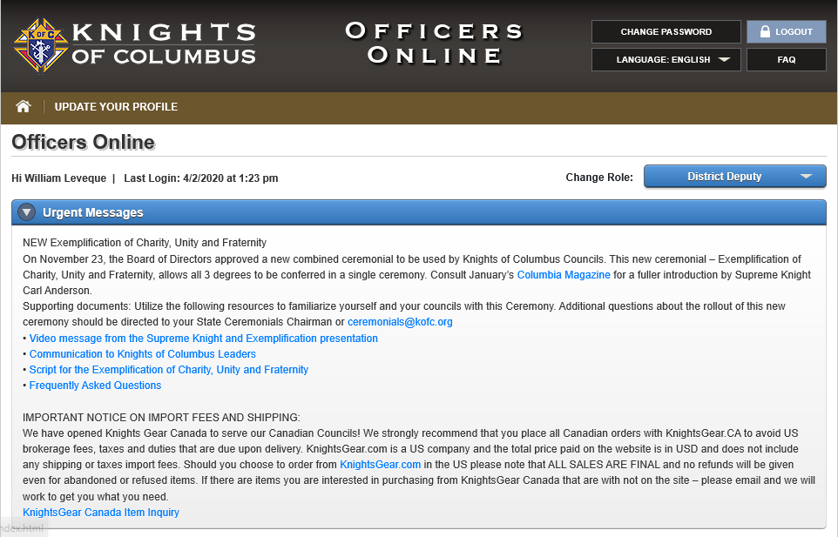
Main Screen
This tells you your name & the last time you logged in.
Urgent message changes so please read at least once/month.
Council Details
Supporting Applications
Tabs
Membership
Reports
Forms
Publications
Prospects
DD Training 2020 - Officers Online

Slide 8
District / Council Details
You can view information at a District Level. Reports & data reflect information for your entire District.
You can view information at a Council Level. Reports & data reflect information for a specific Council.
DD Training 2020 - Officers Online

Slide 9
Council Details
You can view information at a District Level
All reports & data reflect summary information for your entire District
You can view information at a Council Level
All reports & data reflect information for a specific council
DD Training 2020 - Officers Online

Slide 10
Officers’ Desk Reference – This provides answers to frequently asked questions about our name and emblem, home corporations, membership issues, tax issues, fraternal issues, council and assembly issues, the Fourth Degree and social communications.
Office of Youth Protection is a one-stop shop to tell District Deputies just about everything they need to know about youth protection for the Knights of Columbus and their Diocese.
DD Training 2020 - Officers Online

Slide 11
Home Corporations: The Knights of Columbus conducts its charitable and fraternal mission through an extensive network of subordinate councils, which are prohibited from owning real property. Subordinate councils have the discretion to choose a suitable location to conduct their activities in light of the mission and identity of the Knights of Columbus. The Supreme Council has strongly encouraged councils to meet at a local parish, in accord with the original vision of Father McGivney. The Handbook for Councils using Home corporations contains important information.
Fraternal Training Portal provides an entire library of courses to assist councils, districts and assemblies in their daily activities.
DD Training 2020 - Officers Online

Slide 12
Order council supplies which can be charged to your council’s account.
Click on Supplies Online to view the materials available and place your order.
Gift items are also available by clicking on the Knights Gear logo, which brings you to knightsgear.com. Through this website, your council can also order customized apparel (e.g. your council’s name and number).
DD Training 2020 - Officers Online

Slide 13
Tabs – Membership
DD Training 2020 - Officers Online

Slide 14
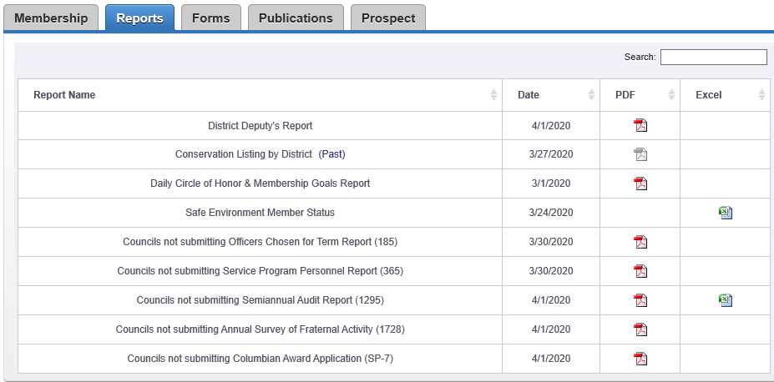
Tabs – Reports
DD Training 2020 - Officers Online

Slide 15
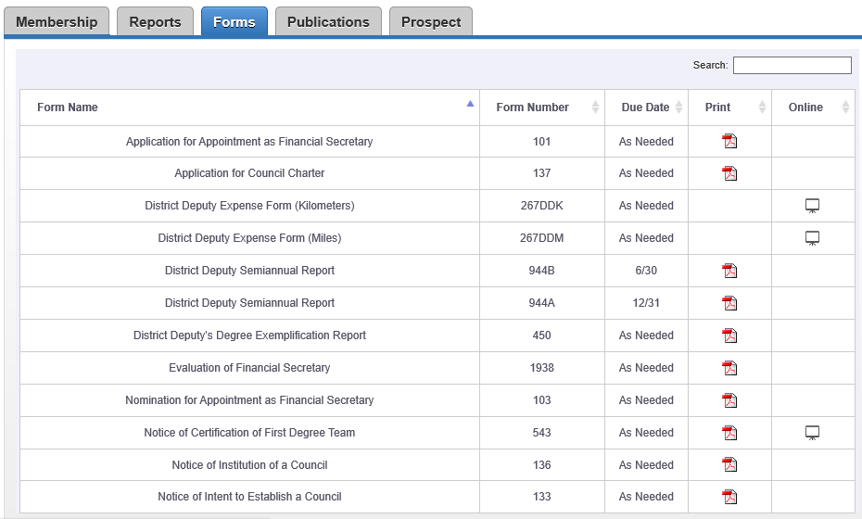
Tabs – Forms
DD Training 2020 - Officers Online

Slide 16
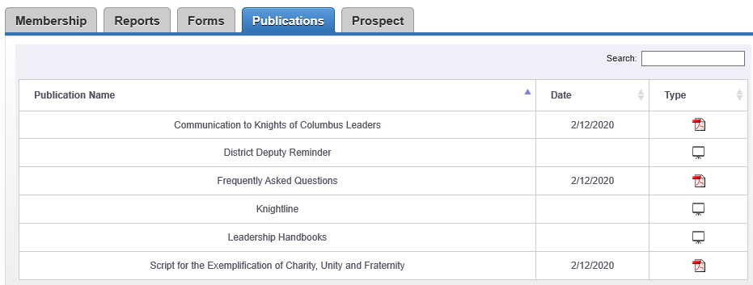
Tabs – Publications
DD Training 2020 - Officers Online

Slide 17
Tabs – Prospect
DD Training 2020 - Officers Online

Slide 18
Most Important for DDs
View Council Details (before each meeting)
View Reports Tab – Ensure ALL council forms are at Supreme AND you have a copy
Log in at least monthly
Ensure your Grand Knights are also using this
Member Management is also listed as an Application for Grand Knights.
DD Training 2020 - Officers Online
Notes:
What to say…
This workshop is a combination of best practices & lessons learned from many Past Grand Knights.
If you follow these things, you should
Be seen as a successful GK by your council and your parish
Make the most of the time you put in (minimize spinning your wheels)
What NOT to say…
Anything negative
Overall message to get across…
You want them to
Consider this material as great advice
Keep is handy to reference throughout their term as GK

Slide 19
DD Training 2020 – Officers Online
Notes:
What to say…
Thank them all for volunteering to Shepard their councils!
If they put in the time, it will be very rewarding.
What NOT to say…
You guys are suckers for volunteering
This will be the worst year of your life
Overall message to get across…
You want them leaving this workshop
Excited, motivated and anxious to do a great job
Knowing the basic information to get started
Knowing where to turn for help – They are not alone

