Slide 1
District Deputy
Roles, Responsibilities & Resources

Slide 2
New District Deputy Training June 13^{th, 2020}
Each presentation will be made available to all District deputies.
The PowerPoint version has audio attached, links to jump around & links to resources (forms, videos, other websites)
The PDF version is for those who do not have PowerPoint and all links should still work.
A video will also be made available to watch from beginning to end
Websites are going through major changes
Supreme is working on a lot of additional information
Michigan website is being completely redone
I will update all presentations in July (or August) as the changes are made public.

Slide 3
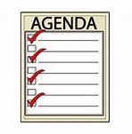
Agenda
This symbol will help provide tips and guidance..
District Meetings
Roles & Responsibilities
How to get started
Crawl, walk, run
Where to go for help
Here audio for current page
Go in document section
Go to WEB Link
Return to home page

Slide 4
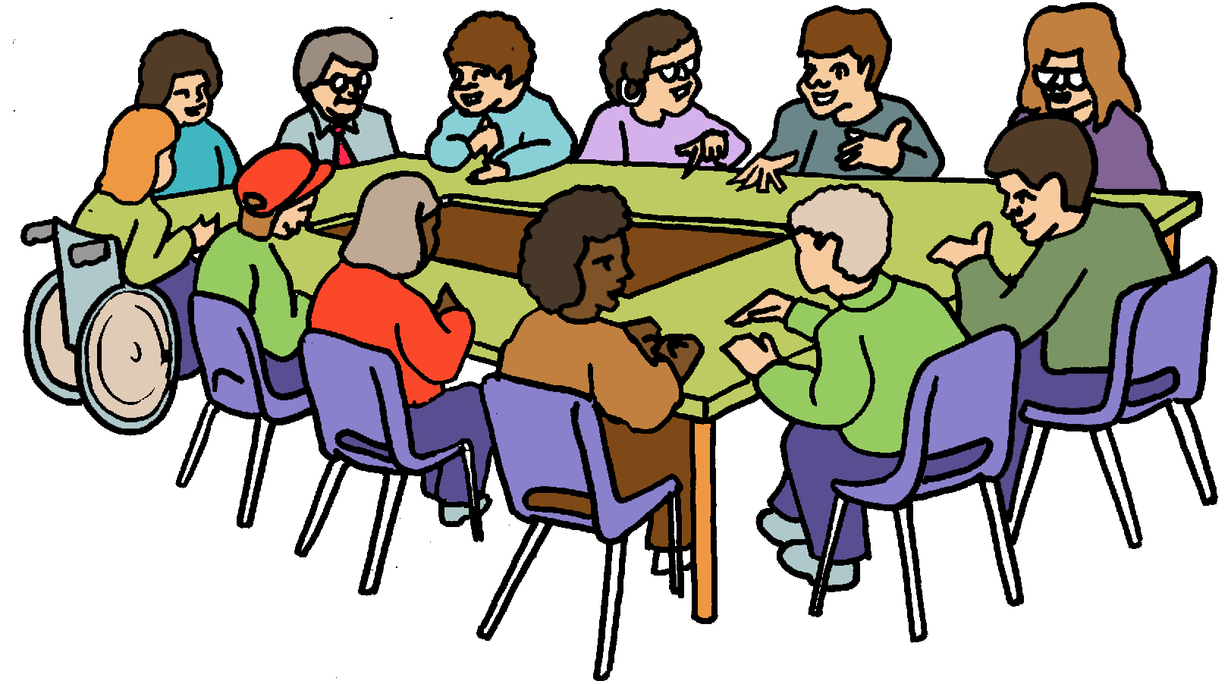
1. District Meetings
Purpose of a District Meeting
Tri-District Meeting
Invitations – Getting the right people to attend
Meeting logistics
Lot’s to cover in a short amount of time
Agenda Strategies – Categorize Agenda Items
District Deputies represent the State Deputy
Others to invite to your District Meeting

Slide 5
Purpose of a District Meeting
There are three main purposes of a District meeting:
Push – Pass along important information from the State
Pull – Pass along important information your Councils want
Lead – What do “You” think they need to be successful?
How to measure the success of a District Meeting:
State – Did you cover all topics the State requested you cover?
Councils
Did your Councils find the meeting as a valuable use of their time?
Did they leave motivated, excited, fired up, gung ho, prepared?
Results
Did your councils put into practice what they learned?
Did it make them more successful?

Slide 6
Tri-District Meetings
Advantages to Tri-District Meetings:
Each District Deputy can prepare (and present) part of the agenda
DDs can “learn” from each other
“Most” of the material is common anyway
State/Diocesan guests can attend (Please coordinate the date of your meeting with your SDRR to ensure he can attend)
Guidance:
Size: Target 3 Districts per meeting
Fewer (1 or 2) is OK but minimizes the advantages listed above
More (4 or 5) is OK but can become too large (difficult to manage)
Planning – Meet ahead of time (in person, phone or Zoom)
Have ALL DDs involved in a planning meeting.
Have each DD prepare a portion of the material/agenda.
Get your SDRR approval for District meetings with < 3 Districts

Slide 7
Council Invitations
Ask for date preferences – What dates work for your Councils?
E-mail – Send e-mails (Scheduled, 1 month prior & 1 week prior)
Cell Phone meeting reminders – Use technology
Remind at Council Meetings – Take 30 seconds at each meeting
GK RSVP – Ask each GK to provide a count for his Council
Text the day of – A morning text ensures they don’t forget
Agenda/pre-work – Send out agenda & pre-work in the email
Council Calendars – Make sure it is on the Council Calendar
When/where you expect no-shows
Host – Ask problem Councils to Host the District Meeting
Anticipate excuses – Eliminate excuses BEFORE they are used
Accountability – Hold the GK accountable to “know” the information
Remote participation – For those who live “far” from the meeting
Sending a Gmail invitation will provide automatic reminders

Slide 8
Other Invitations
Diocesan Program Director
Diocesan Membership Director
Field Agent (or General Agent)
State Officer
State Deputy Regional Representative
Others you deem necessary
Ensure SDRR schedule allows him to attend

Slide 9
Meeting Logistics Covid-19 Recommendations
Option 1 – Teleconference (Zoom or other)
Have people join in from the safety of their homes
Technology challenged people can join with a friend
Option 2 – In-person AND teleconference
Follow Michigan Covid-19 guidelines (And Parish guidelines as well)
In-person participation for those who can
Teleconference participation for those more vulnerable
Social distance, wear masks, hand-sanitizer rules apply
Overall logistics
Have 3 Districts in one meeting (if possible)
Target 90 minutes of actual meeting time
Record the meeting for those who are unable to participate
Record the meeting for any people who missed it

Slide 10
Agenda Challenges Balance these constraints
You have a list of topics to cover provided by the State Deputy
You have limited time – you will lose them in less than 2 hours
State Agenda
Time Constraints
You have a list of topics your Councils want you to cover
Council needs
Your material all needs to be cohesive and complementary
Council wants
Cohesive Content
You have a list of topics You believe are important
Overview State, Diocesan, SDRR and District roles and how they interaction

Slide 11
Agenda Strategies
Booklet (Hand-outs) – Minimize the need for note taking
Increases their attention & gives them information to take home
Pre-meeting – Gather any homework assignments
Meeting
Follow the agenda
Cover important items
Reference (Don’t read) the booklet (hand-out)
Post-meeting – Reinforce material over next few months
Make meeting recording available to councils for anyone who missed AND for council reference material.

Slide 12
Inter-District cooperation
Membership
Share good recruiters to participate in membership drives
Create District-wide Exemplification Teams
Programs
Consider holding District-wide programs
District Picnics, Fraternal Benefit Nights, Clergy Appreciation Dinners
Other
Financial – Get all FS’s to share Member Management best practices
Home Corporations – Encourage all councils support them

Slide 13
2. Roles & Responsibilities
Represent the State Deputy
Financial – Oversee council’s assets
Order – Ensure compliance to Laws & Rules
Membership – Promotes/Directs Membership efforts
Programs – Encourage effective Council programming
Leadership – General care & well being of all councils

Slide 14
Represent the State Deputy
State Officers
District Deputy
Council Officers
Pass along vision, plans, direction & goals
Pass along results, successes, failures & issues

Slide 15
Financial – Oversees Councils Assets
Inspect all council books
Ensures proper handling of council funds
Ensures payment of Supreme & State per capita
Ensure council books are kept as prescribed by law
Directs council Trustees on their duties
In case of dissolution – Take possession of Council books
Watch the Financial Officer Training Video

Slide 16
Compliance to Laws & Rules of the Order
Ensures that councils follow procedures, laws and rules of the order
Charter Constitution Laws - 2019

Slide 17
Promotes / Directs Membership Efforts
Promote & provide assistance with recruitment & retention
Have a District-wide recruiting team
Advise councils on need to keep members active
Encourage councils to conduct frequent exemplifications
Get all 1st degree members to go through an exemplification
Short-term – Hold Online Exemplifications (District and Council)
Identify locations for new councils and assist in their development
Watch the Membership Director Training Video

Slide 18
Encourage effective Council Programs
Ensure Grand Knights develop & foster a healthy relationship with their Pastor(s)
Encourage programs that support Faith in Action
Steer councils away from programs that compete with their parish(es)
Encourage membership recruiting at all council programs
Watch the Program Director Training Video

Slide 19
General care and well-being
Install council officers as soon as possible
Attend all state council organizational & mid-year membership meetings
Hold district meetings (Minimum 2/year Maximum = as many as you need)
Encourage each council to conduct annual strategic planning meetings
Attend council meetings each month (Worst-case quarterly)
Monitor completion of council reports/forms
Council Forms Video
Council Forms Spreadsheet
File reports with Supreme & State
Supreme District Deputy Forms
Michigan District Deputy Forms

Slide 20
3. How to get started First 3 months (July – September)
Get Educated
Assess your councils
Win over your councils
Set a good example (Rise up and answer the call)
Avoid being the bad guy (if possible)
Get 1-2 District Wardens & get them involved

Slide 21
Get Educated
DD Training – Officers Online – Fraternal Training Portal
How to be a District Deputy (see next page)
Supreme District Deputy Reports/Forms
State District Deputy Reports/Forms
Fraternal Operations during Covid-19 Fraternal Webinars

Slide 22
TIPS FOR SUCCESS
How to Run an Open House Council Health Assessment Sample District Meeting Agenda
ADMINISTRATIVE
944 Form Tips Admission Degree Exemplification Schedule #30 - Charter, Constitution and Laws #1831 - Disability Exemption Application #5087 - District Deputy's Guide #5093 - Leadership Resources #10318 - Method of Conducting Council Meetings #1612 - Protocol Handbook #2235 - Public Relations and Publicity Guide Request for Membership Suspension and Procedures #1845A - Retention Billing Procedures Sample Suggested District Meeting Agenda #10238 - Summary of Financial Secretary's Responsibilities
TRAINING
Please find below a link to the PowerPoint presentation for your jurisdiction's Organizational Meeting presentation on the new required DD Training as well as an attendance sign-in form.
District Deputy Training Course District Deputy Training Attendance Sign-In Form
LEADERSHIP RESOURCES
#5093 - Leadership Resources

Slide 23
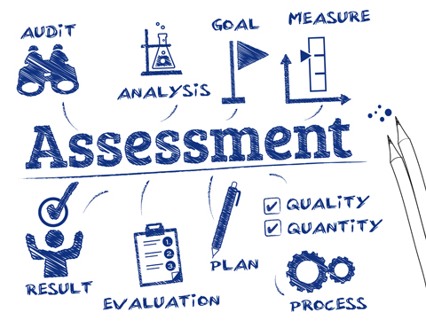
Council Assessment
Previous DD Assessment
Grand Knight Assessment
Council previous year forms
Observe them for 3 months
#944A - District Deputy Semiannual Report – due 12/31 #944B - District Deputy Semiannual Report – due 6/30

Slide 24
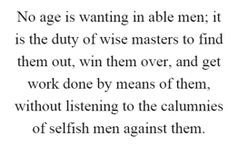
Win over your councils
Offer to help them and follow through
When they ask a question, give a good answer. If you don’t know…
Say so & go find the answer (Don’t tell them to call someone else)
Don’t guess, make up an answer or B.S.
Look for opportunities to help
Listen to them and fill the needs they see
If you can’t answer a question, go find the answer.
Don’t tell them to call someone else.
Be an expert
Become an expert

Slide 25
Set a good example Rise up and answer the call
Educate yourself on everything
Work hard for them & they will work hard for you
Be a great recruiter – actively participate in council recruiting
Be positive and enthusiastic – Smile are contagious
Set high standards, live them and expect them from others

Slide 26
Avoid being the bad guy Don’t expect their respect - Earn it
If you tell them they are wrong…
You don’t fully understand the situation
You haven’t earned their respect
How will you ever win them over
If you see things you don’t like…
Weigh it’s importance
Observe and understand the situation first
Respond is a positive / helpful way

Slide 27
District Wardens Assign 1-2 and put them to work
They are your backup
If you can’t make a meeting, council event or exemplification
Find people who compensate for your weaknesses
Assign them responsibilities for your District
Forms tracking
Membership
Programs
Train them so one day they can replace you
Educate them
Teach them so they can one day be a great District Deputy

Slide 28
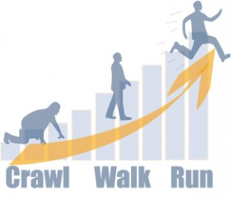
4. Crawl, Walk, Run
Set achievable expectations
Don’t set your councils up to fail
Struggling Councils – Teach them to crawl
Get them moving in the right direction
OK Councils – Teach them to walk
Pick up the pace, Get some positive momentum
Good Councils – Teach them to run
They can become great, outstanding and awesome

Slide 29
Membership – 1 step at a time
Factor | Crawl | Walk | Run
Membership & Retention Directors | Right person Basic Training Show him how-to | Energize him Advanced Training Observe & mentor | Empower him Support him Clone him
Quota | Ignore Quota Focus on “any” growth | Use as a carrot “if / when achievable” | Double Star
Recruiting | Quarterly | Monthly | All the time
Delta Drives | Share the process & demonstrate | Help them through their 1st delta drive | Quarterly Delta Drives
Active Members | Follow the retention process | Address “at risk” members | Oversee “all” members
Exemplifications | Provide exemplifications for these councils | Get council members on an exemplification teams | Get council to have their own team
Council Assistance | GK, PGKs, FA, DD, DMD, Pastor & District Team | 2-4 regular helpers | 5-8 regular helpers Whole council
Recognition | Recognize effort – regardless of results Recognize improvement in results

Slide 30
Programs – 1 step at a time
Factor | Crawl | Walk | Run
Program Director(s) | Right person Basic Training Show him how-to | Energize him Advanced Training Observe & mentor | Empower him Support him Clone him
Program Director(s) | Establish a good Program Director | Faith, Family, Life and Community Directors | Back-ups and many directors
Faith In Action | Educate FIA & BDC Pastor Relationship | Encourage Columbian Award | Encourage submitting a Program book
Recruiting | Recruit at 1 program per quarter | Recruit at 1 program / month | Recruit at all programs
Youth Protection | Get form 365 done Get Directors on board Get council certified | Get council leadership team trained | Get everyone who helps with youth programs trained

Slide 31
Insurance – 1 step at a time
Factor | Crawl | Walk | Run
Field Agent | Invite FA/GA to council meetings | Monthly Insurance | FA on Membership & Retention Teams
Fraternal Benefit Seminars (FBSs) | Invite Council to a District Seminar (to participate) | Council conducts their own FBS | Council hosts a District FBS
Grand Knight | FA / GK Relationship Support Insurance | FA/GK Teamwork | Speaks in lieu of FA Recruits new FAs
Exemplifications | Invite FA to exemplifications | Ask your FA to speak at exemplification (5-min) | FA on your exemplification team

Slide 32
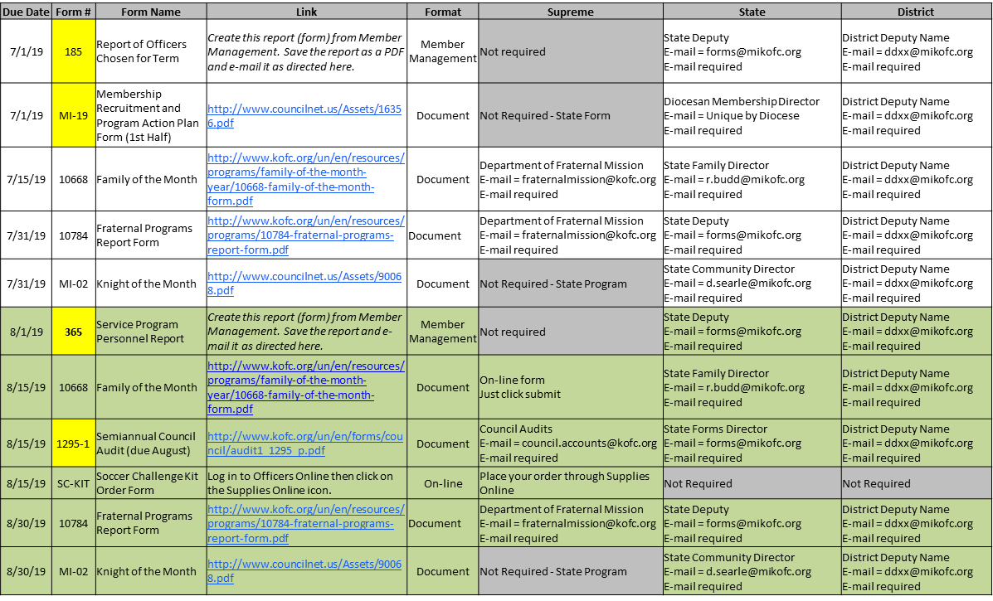
Forms – 1 step at a time
Use the tracking spread sheet to help keep you on track!
Watch this video to see
where to find all forms
Factor | Crawl | Walk | Run
Knowledge | Aware of what forms are due & when | Understands each form that applies | Expertise in filling out each form
Ownership | GK & FS own all forms Worst case – DD does form | Assigns owners to fill out each form
Due Dates | Need frequent DD reminders | Needs “a few” DD reminders Has a calendar | Covers forms at officers meeting.

Slide 33
5. Where to go for help
Look up the answers yourself
We provided many websites, documents, videos, etc…
State Deputy Regional Representative (SDRR)
New position this year specifically named to help District Deputies
State personnel
Lots of people here to help you
Look them up in the State Directory & call them up
Be nice
Try again
Forgive
Escalate

Slide 34
District Deputy
Questions???

