Slide 1
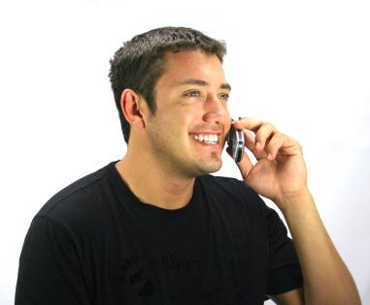
Creating a Winning Team?
Communication
FA
By Phone,
Email
or Text
District Deputy

Slide 2
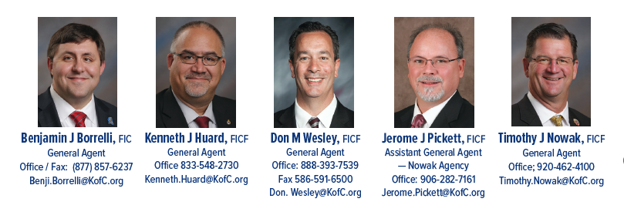
Creating a Winning Team?
ALL Councils have an Agent
4 General Agents
1 Assistant General Agent
30 Field Agents

Slide 3
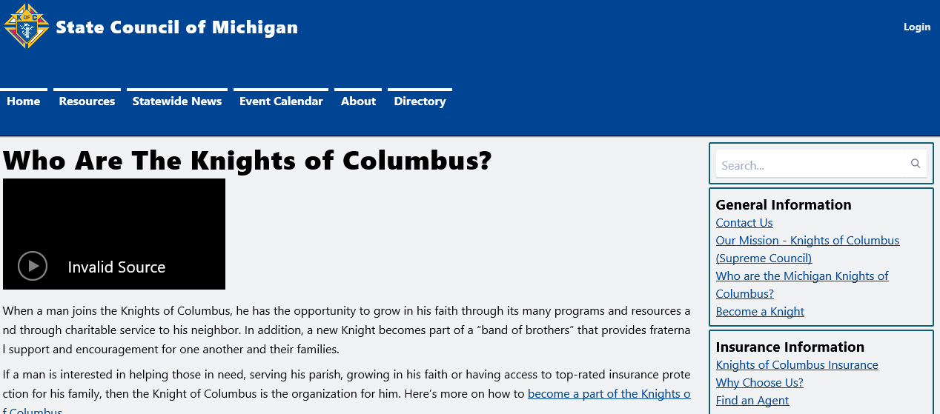
Find an Agent !!!
About
Find an Agent

Slide 4
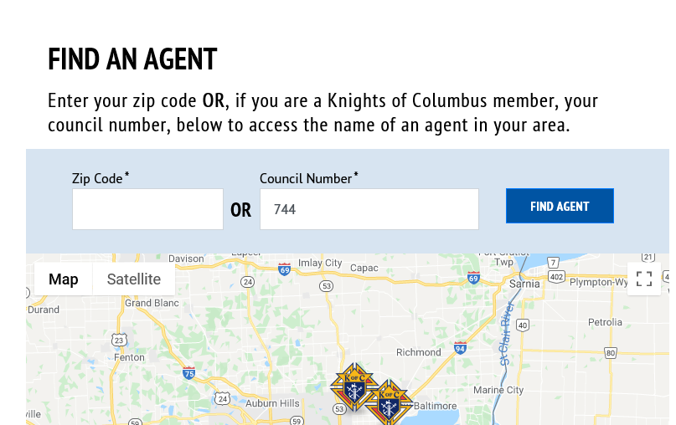
Find an Agent !!!
Zip
Council

Slide 5
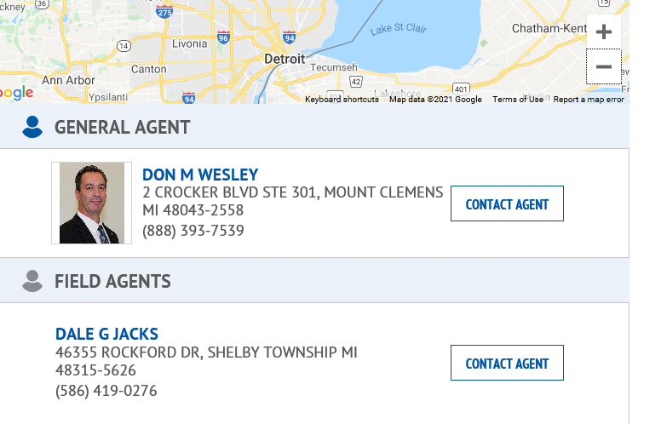
Find an Agent !!!

Slide 6
Supreme Council Insurance Agents Contractual Obligations to the Order?
Service existing Knights of Columbus policyholders to
make sure what they own is up to date
Visits Associate/Insurance/Inactive members to find any areas that the Knights are able to assist with and fill the voids in their member benefits
Maintain good fraternal relationships with our councils, officers and members (Insurance and Associate)

Slide 7
Supreme Office Directive for Agents
Make 100% of his production quota for that calendar year
Creating “Owners of Order” with at least
24 associate to insured – including new and existing members. 12/YR RECRUITED BY FIELD AGENT
Provide personal service to our existing and future policyholders
Do all this in an extremely ethical, moral and Christian like manner

Slide 8
Supreme and Agency Directive
Attend the State, Diocesan and Local Meetings
Attend all First Degrees, when possible
Attend all Major Degrees, when possible
Put on a Fraternal Benefits Night(s) in each State, District or Council- when possible
Make the Insurance Quota for our councils
CURRENTLY 2 FRATERNAL BENEFIT EVENTS

Slide 9
The Process of Making an “Owner”
Typically it takes anywhere from 3-8 phone calls or email contacts to obtain one appointment.
The initial visit is usually getting to know the member and his family where the new member gets to learn the history of the Order.
Meet the Agent - we learn about any voids in current plan and see how we can assist.
The 2nd appointment is where we would show Knights of Columbus solutions and fill their voids
This Process could take up to 6 weeks or longer

Slide 10
What counts as an Insurance Member “Owner”
Any Knights of Columbus product on the Member – who did not previously own one
Life insurance, Long Term Care, Annuities, Disability Income Insurance
Repeat or different products on the same member, wife and children, Do Not Count

Slide 11
Creating the Right Environment
Support starts at the beginning of your term as District Deputy as well as your Grand Knights and Officers
Supreme Council Insurance Agent wants to have a good working relationship with you and the council – We all have a huge time crunch
Call/email us when you need something or hear something we need to know, or you have questions
Death’s (Members and their Spouses/Widows)
Degree’s
District Events
Council Events

Slide 12
Supreme Council Insurance Agent’s Time Crunch
The average agent has 5 - 8 councils
A council has 2 meeting a month
With 20 working days in a month – this only leaves 10 days to do the work of the Order
Even 5 meetings a month would impair his ability to meet Supreme Council’s expectations

Slide 13
Creating the Support System
Support starts from the podium
“Supreme Council Insurance Agent” is our title
Realizing how busy the Field Agents are and communicate that to the Councils
It’s not that the Field Agents doesn’t want to go to your meetings – it’s just that the system and structure doesn’t allow for that with today’s number of councils

Slide 14
What to do if there is a Concern?
First, call the Supreme Council Insurance Field Agent
If you can’t get a resolution – call the
Supreme Council Insurance General Agent
We realize you don’t want to “go over the agent’s head”…but realize that we will handle the situation as a Brother Knight – we’re in this together!

Slide 15
That being said…
The Benefits of the Order are for Members, Spouse and dependent children under the age of 18
To exercise the Benefits is voluntary
To learn about the Benefits is a “Responsibility”
Our goal is to help our Councils make Star Council
Make sure the membership/admissions team is giving a good recommendation about the insurance program… Many join for this sole reason…..
Invite your agent to membership drives… he’s a member of your recruiting team

Slide 16
Thank You!!
Thank you for taking a leadership position
Thank you for the personal sacrifice you are making
Thank you for helping to expand the mission of Fr. McGivney
Thank you for helping to make the world a better place through KofC charitable efforts in the community

