Slide 1
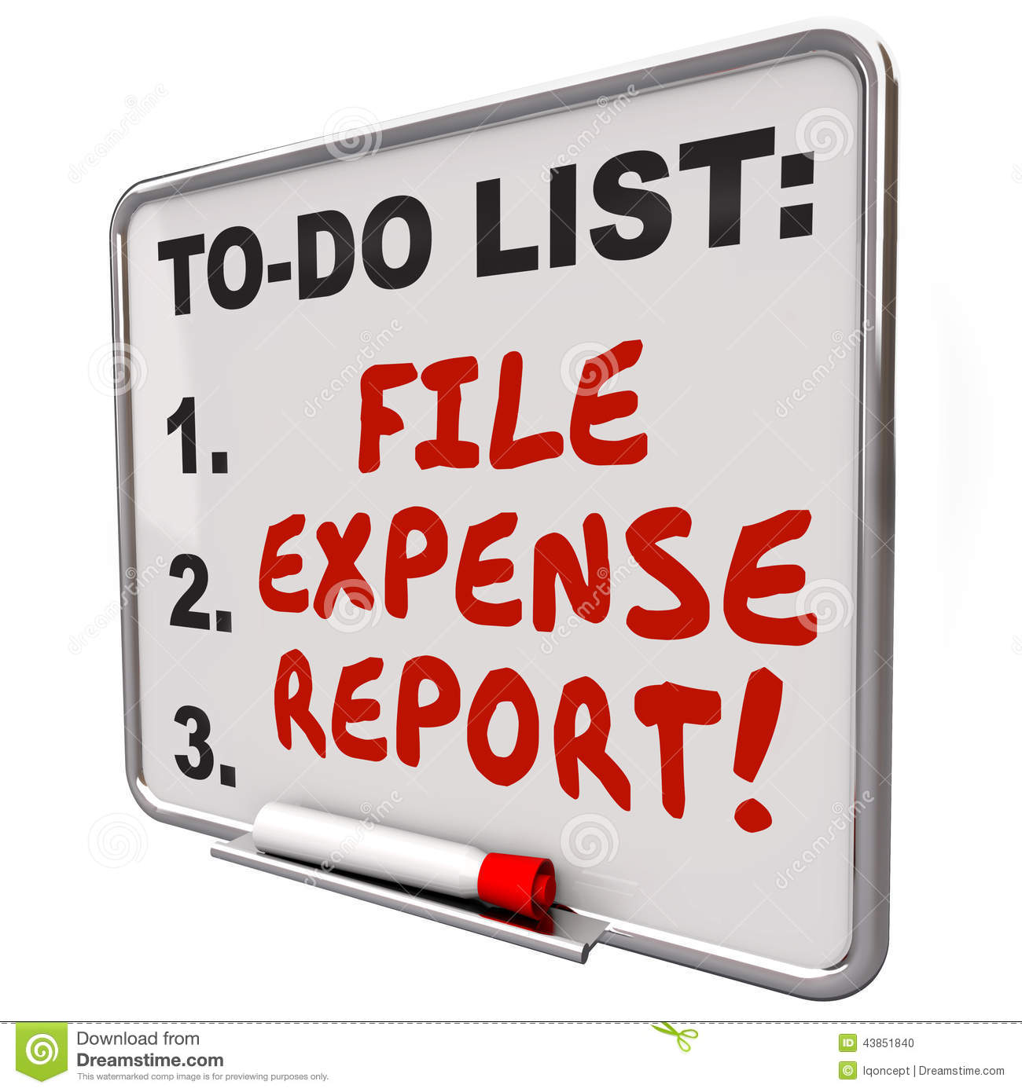
District Deputy Expense Report Overview
General Overview
Supreme Expense Reports
Michigan State Expense Reports

Slide 2
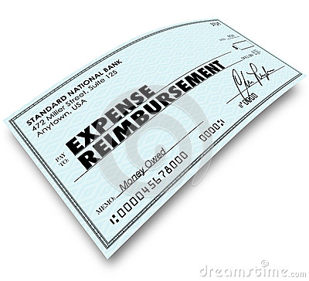
1. General Overview
Purpose
Supreme vs. State
What is NOT reimbursable?

Slide 3
1a. Expense Report Purpose
As District Deputy, you should be (and will be) compensated for reasonable out-of-pocket expenses as you fulfill your duties.
Filling out and submitting expense reports regularly will ensure your expenses are appropriately.
“The position of district deputy doesn’t pay much, but the personal rewards can be many & are often and truly immeasurable”.

Slide 4
1b. Supreme versus State
Supreme Expenses
Visiting your councils
Council Meetings
Council Events
Exemplifications
New Council Development activities
Summer & Winter Meetings
Even though these are outside your District.
Michigan State Expenses
Travel outside your District
State Convention (No report required)
State & Diocesan Meetings
Training
95% of the time, use a Supreme Expense Report

Slide 5
1c. What is NOT reimbursable?
Supreme Expenses
Expenses incurred for Chapter meetings and Fourth Degree events.
Postage, guest meals, stenographic and clerical assistance, printing, stationery and duplicating.
Annual State Convention (You will receive a check without submitting an expense report)
Travel Outside of District
Michigan State Expenses
Expenses incurred for Chapter meetings and Fourth Degree events.
Guest meals, stenographic and clerical assistance.
Items that should be expensed on a Supreme expense report
Travel Outside of District (If not pre-approved by your SDRR).
District Warden expenses, State Officer Installation expenses.

Slide 6
2. Supreme Expense Reports
Step-by-step process
Form & Instructions
Detailed Instructions

Slide 7
2a. Step-by-step instructions
Go to Michigan State website (www.mikofc.org)
Click on RESOURCES and scroll down and click on District Forms
Click on Supreme Council Expense Form
Save it to your computer
For each expense report
Fill it out, print it & sign it.
Scan it & email it (with receipts)
to the State Deputy
This version is slightly different from the official form on the Supreme website. This form automatically does all the math for you.

Slide 8
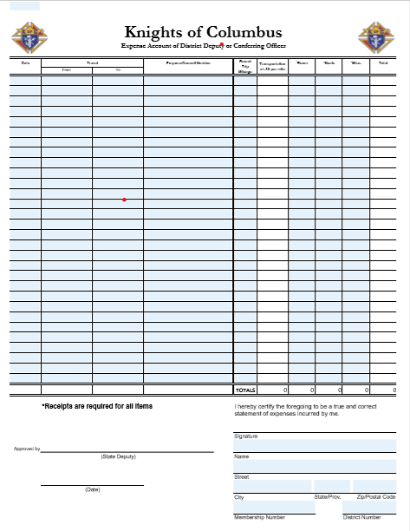
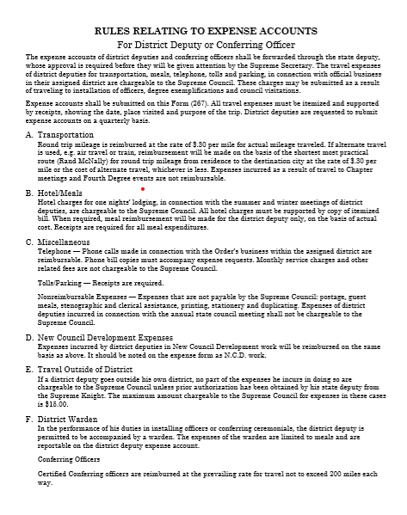
2b. Supreme Expense Report form & Instructions
Follow the instructions and fill out the form

Slide 9
2c. Supreme Instructions
Form Instructions – The expense accounts of district deputies and conferring officers shall be forwarded through the state deputy, whose approval is required before they will be given attention by the Supreme Secretary. The travel expenses of district deputies for transportation, meals, telephone, tolls and parking, in connection with official business in their assigned district are chargeable to the Supreme Council. These charges may be submitted as a result of traveling to installation of officers, degree exemplifications and council visitations. Expense accounts shall be submitted on this Form (267). All travel expenses must be itemized and supported by receipts, showing the date, place visited and purpose of the trip. District deputies are requested to submit expense accounts on a quarterly basis.
Send to the State Deputy w.winkle@mikofc.org
Note what expenses are allowed
Note what purposes are allowed
Receipts are required
Submit “at least” quarterly

Slide 10
2c. Supreme Instructions Continued
Use your cell phone App to determine mileage.
Hotels are reimbursable for Summer/Winter meetings.
Meals – Use common sense
If possible, eat at home
If you need to eat out prior to a meeting, by all means expense it.
Telephone expenses should be rare.
Form Instructions –
Transportation Round trip mileage is reimbursed at the rate of $.30 per mile for actual mileage traveled.
Hotel/Meals Hotel charges for one nights’ lodging, in connection with the summer and winter meetings of district deputies, are chargeable to the Supreme Council. All hotel charges must be supported by copy of itemized bill. When required, meal reimbursement will be made for the district deputy only, on the basis of actual cost. Receipts are required for all meal expenditures.
Miscellaneous
Telephone — Phone calls made in connection with the Order’s business within the assigned district are reimbursable.
Tolls/Parking — Receipts are required.

Slide 11
2c. Supreme Instructions Continued
Form Instructions
New Council Development Expenses incurred by district deputies in New Council Development work will be reimbursed on the same basis as above. It should be noted on the expense form as N.C.D. work.
District Warden In the performance of his duties in installing officers or conferring ceremonials, the district deputy is permitted to be accompanied by a warden. The expenses of the warden are limited to meals and are reportable on the district deputy expense account.
NCD expenses are reimbursable
District Warden meals can be covered on a DD expense report for…
Installation of Officers
Exemplifications
District Wardens cannot submit an expense report. Please add his meals to your expense report.

Slide 12
3. Michigan State Expense Reports
Step-by-step process
Form & Instructions

Slide 13
3a. Step-by-step instructions
Go to Michigan State website (www.mikofc.org)
Click on RESOURCES and scroll down and click on District Forms
Click on State Council Expense Form
Save it to your computer
For each expense report
Fill it out, print it & sign it.
Scan it & email it (with receipts
to the State Deputy
Save it to your computer. Then, key in the information that doesn’t change & save it again.
Name & Position
Name, Street Address
City, State & Zip code

Slide 14
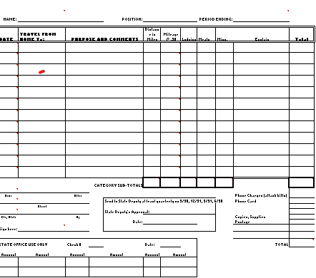
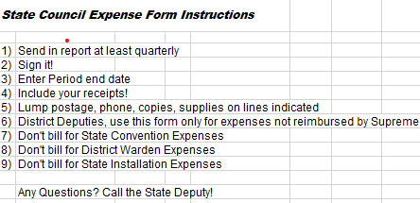
3b. State Expense Report form & Instructions
(Note 1)
Note 1: Get your SDRR approval BEFORE submitting postage, phone, copies and supplies
Postage – Try to use email as much as possible
Phone – typically not expensed without line item charges for a specific phone call.
Copies – Preferably paper & ink for home printer
Supplies – Check with SDRR for reasonableness

