Slide 1
DISTRICT DEPUTY
TRAINING

Slide 2
Training Overview
District Deputy Roles
Responsibilities
Resources

Slide 3
LEADERSHIP ROLE AS DD
You are an important leader in the KofC and the Church.
Lead by example.
Lead in faith and prayer.
Help every council grow
“Laypeople are on the front line of the life of the Church”
- Pope Francis

Slide 4
The District Deputy is the most critical officer role in the Knights of Columbus
THE WORLD NEEDS…
Be present
Be a resource
Be a mentor
Drive activity

Slide 5
A District Deputy must be present.
Not a District Phone Number
nor a District Email Address
Be at meetings
Attend programs
Have District meetings
Build relationships

Slide 6
A District Deputy must be a resource.
You’re the expert!
Answer questions.
Share best practices.
Communicate early and often.

Slide 7
A District Deputy must be a mentor.
Help councils achieve their potential.
Don’t just commiserate.
There’s no excuse for no growth or no activity…
…but not just for it’s own sake!

Slide 8
A District Deputy must drive activity.
Ceremonials. Programs. Drives.
Activity drives results.
It’s not easy, but it’s not complicated.

Slide 9
RESOURCES
Your best resources are other fraternal leaders.
Read regular Supreme Council and State Communications.
Printed Resources

Slide 10
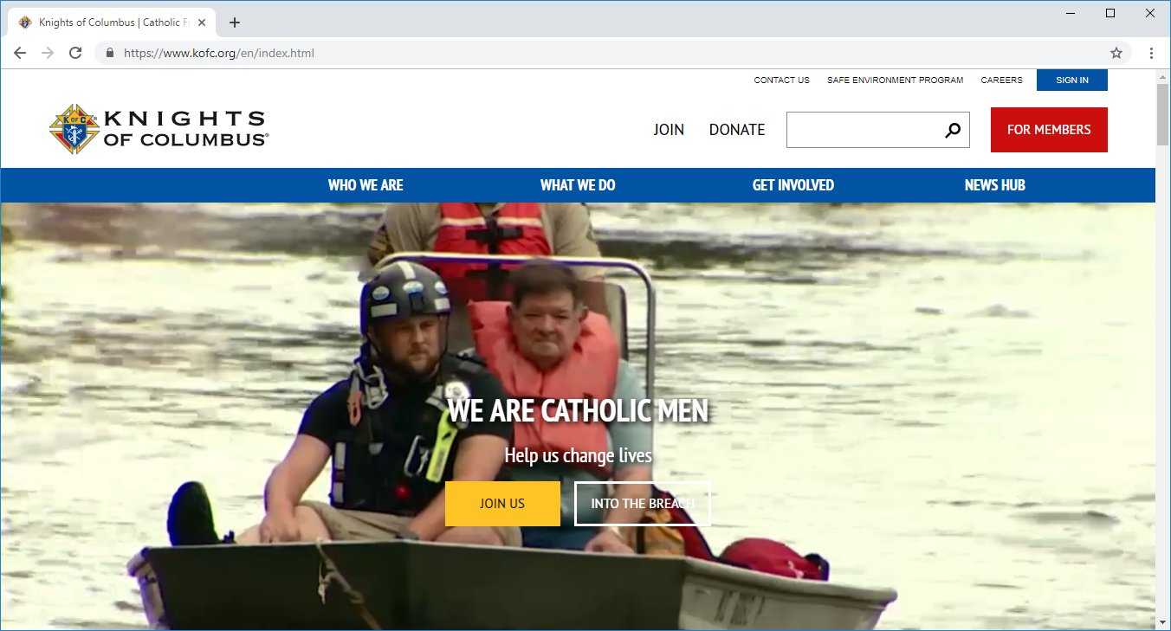
WEB RESOURCES
Kofc.org/training
Kofc.org/formembers
Kofc.org/FIAresources
Kofc.org/star
Kofc.org/crp

Slide 11
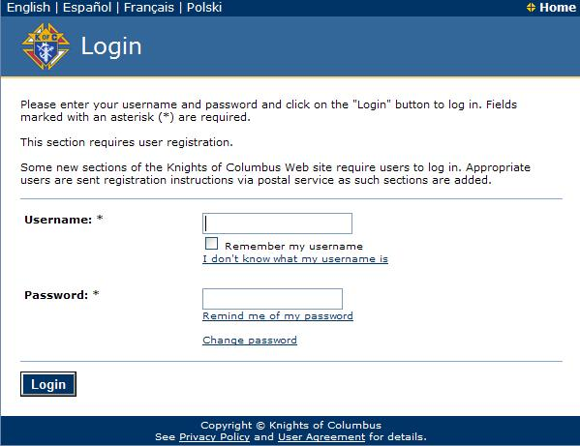
Officers Online
Secure Access for Fraternal Leaders
Permissions based on role code
Access code sent once election or appointment is processed

Slide 12
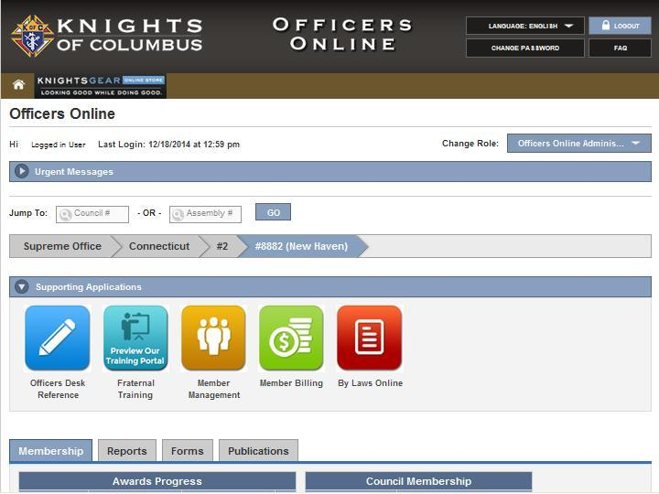
Officers Online (cont.)
Officer Desk Reference
Member Management
Member Billing
Supplies Online
Knights Gear
Ceremonials

Slide 13
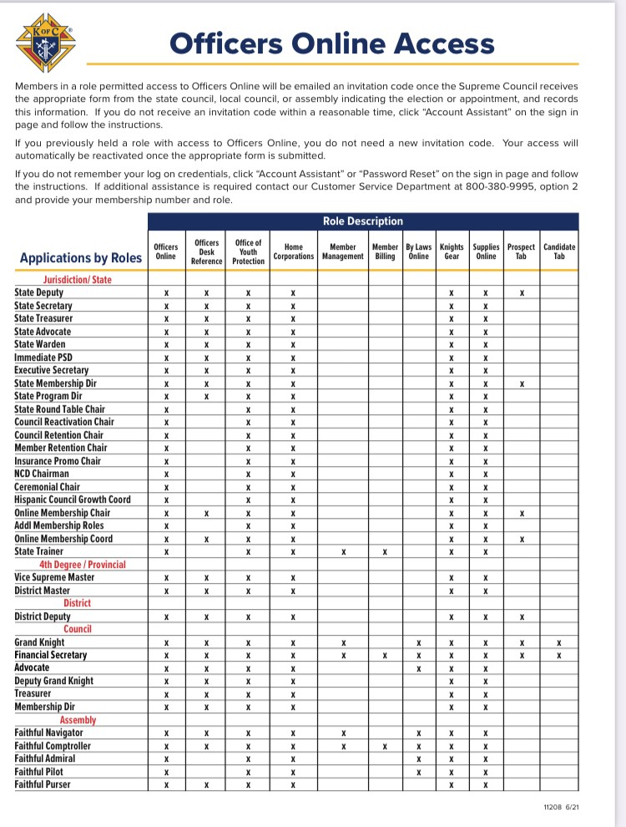
Officers Online (cont.)
Found in FLA
Updated 6/17/2021

Slide 14
Publications From Supreme
Fraternal Leader Advisory
Knightline
Columbia
Emails
Note who it was sent to:

Slide 15
Awards from Supreme
Promote Star Council
Achieve Star District
All Star District

Slide 16
Star Council
365 Service Program Personnel Report
1728 Annual Survey of Fraternal Activity
Father McGivney Award ( Membership goal)
Founders Award (FBN goal)
Columbian Award ( Programs in all 4 FIA)
Safe Environment Compliant
Good Standing with Supreme
Outstanding Achievement Growth of Council

Slide 17
Star District
Membership Growth (70% of Combined Quotas)
Insurance Growth (Founders Awards for all councils in District)
Both 944 forms for every Council ( 1/1/22 and 6/30/22)
1 Star Council in District
Outstanding Achievement Growth of a District Deputy

Slide 18
All Star District
Outstanding Achievement Growth of a District Deputy
All Star Councils in District

Slide 19
Shameless Plug for my Webinars and Trainings
Delta Church Drive
Council Growth
Council Experience
You R your Programs
CRP
Council Meetings
Specific
In-person and by Webinar

Slide 20
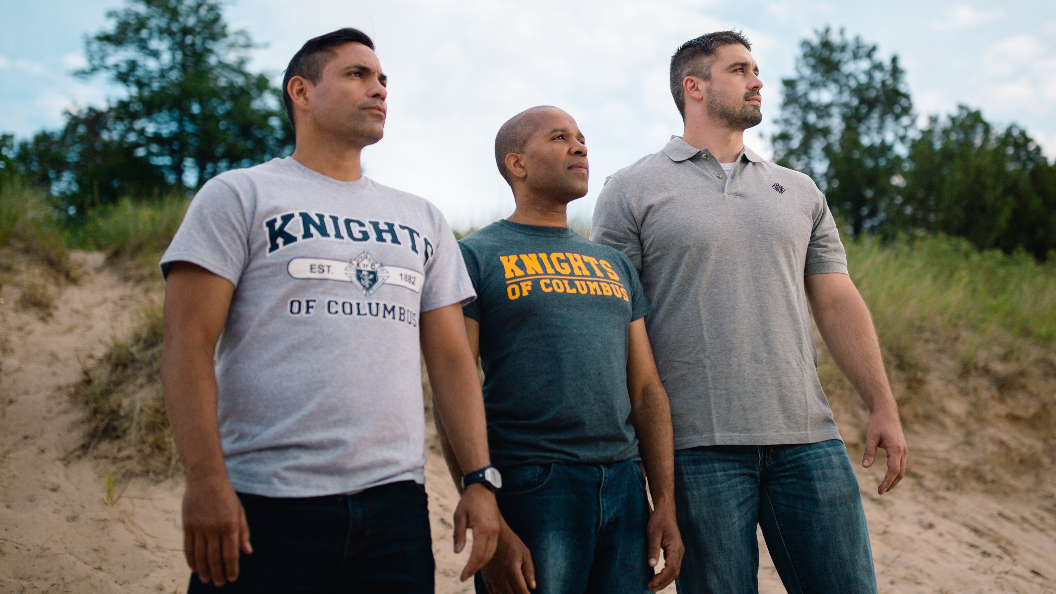
NOW YOU ARE READY FOR SUCCESS

Slide 21
THANK YOU

Slide 22
QUESTIONS?
jon.olson@kofc.org

