Slide 1
Online Membership (How to electronically signup an e-member)
Doug Kokot
State E-Membership, Retention & Email Director

Slide 2
How to Join WWW.kofc.org/Joinus

Slide 3
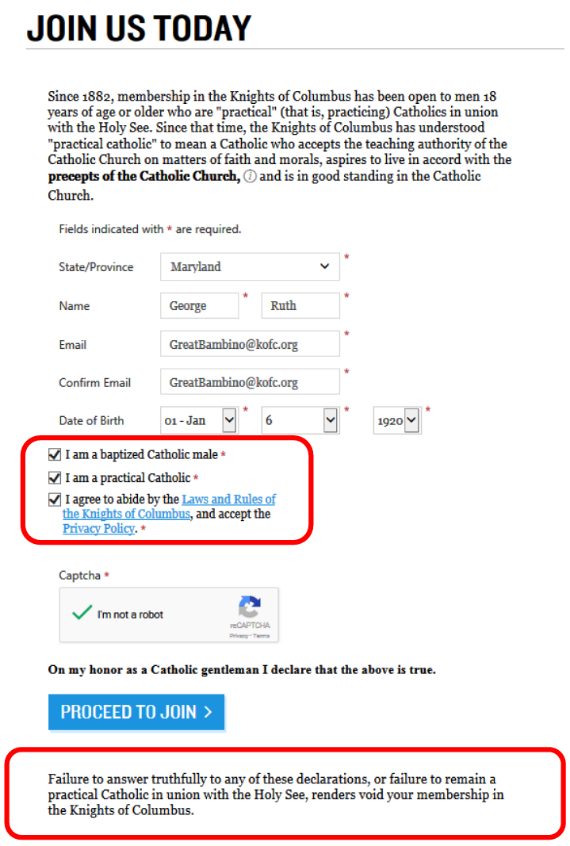

Slide 4
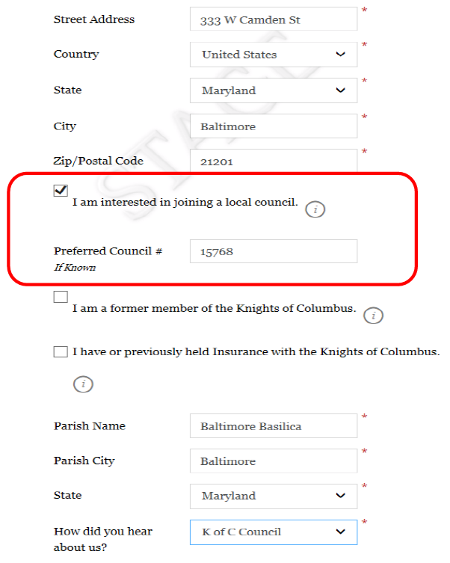
An email will be sent to the State Membership Team, Grand Knights & Financial Secretaries, when “Preferred Council” is checked by member.
Use the pulldown to select Council Member.
A field will appear for Proposer's Membership Number.

Slide 5
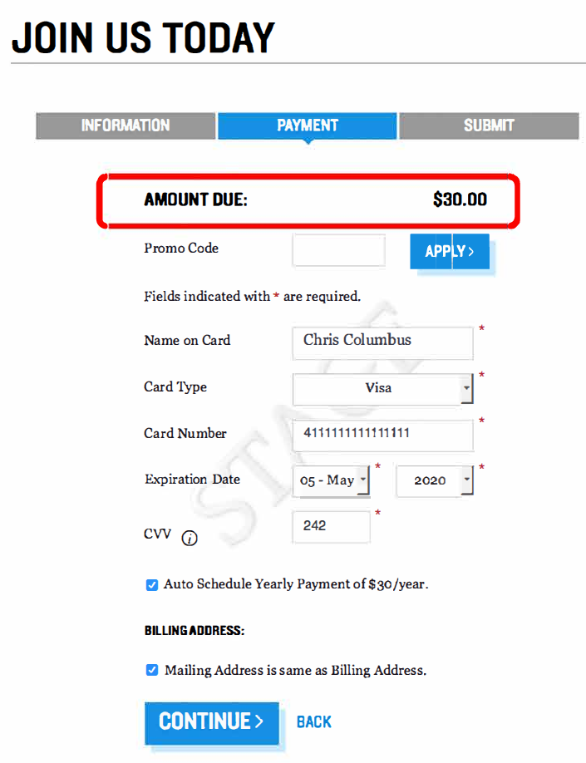
Current Promotion:
MCGIVNEY2020
(1yr. Free Membership)

Slide 6
Online Member Welcome Packet

