Slide 1
Key Issues
No Man is too busy to give up one day (24 hours) a year
By spending just 24 hours with the KofC you will be able to serve your parish, help those in need in your community, grow in faith, and protect your family
Nearly 2 million men around the world have found the KofC adds something to their lives

Slide 2
Just 24 hours can change your life
8 Hours a year working with you council on charitable projects
4 Hours a year enjoying a
council social function
4 Hours a year attending
council meetings
6 Hours a year reading the Columbia, visiting www.kofc.org and www.mikofc.org
1 Hour a year meeting your Supreme Council Field Agent
1 Hour attending a Corporate Communion
24 Hours

Slide 3
Bonus Question Round!!
What Percent of E-Members transfer to councils?
Order Wide Average = 60%
Michigan = 70%

Slide 4
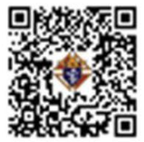

E-Membership Presentation
Summer Meeting 2025
Jim Escott
Overall E-membership Process
Prospect Tab
Candidate Tab
https://site-842560.bcvp0rtal.com/detail/videos/membership/video/6314055973112/online-join-video?autoStart=true

Slide 5
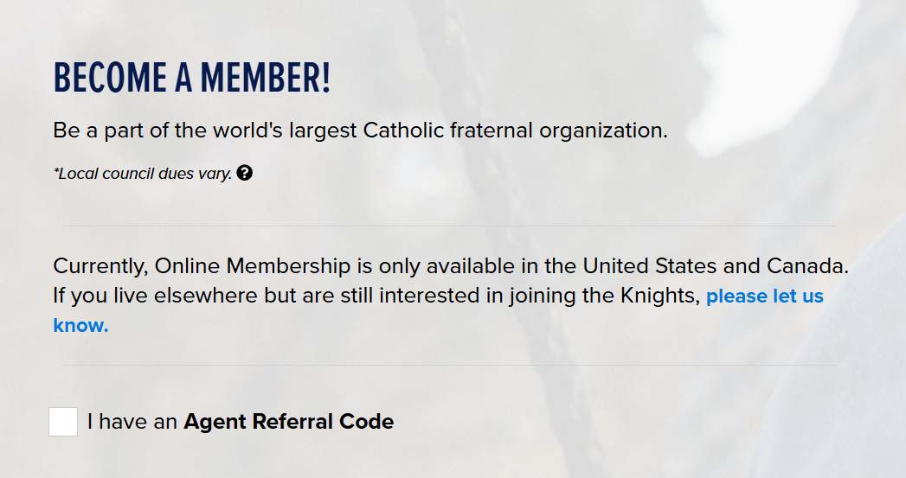
If you click here and enter an Agent Referral code, the BLESSEDMCGIVNEY field will disappear.
Online Membership is only available to residents of the United States or Canada. Residents outside of these countries must click the circled link.

Slide 6
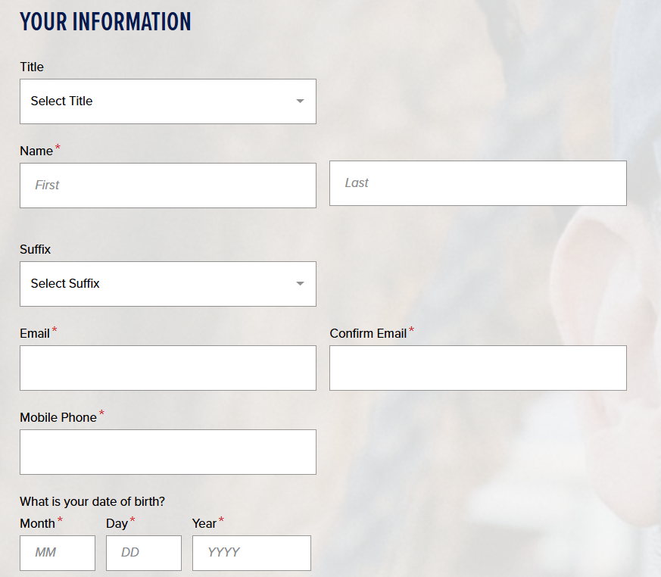
Just fill in the blanks.
Name, Email, Phone & DOB are all required fields.

Slide 7
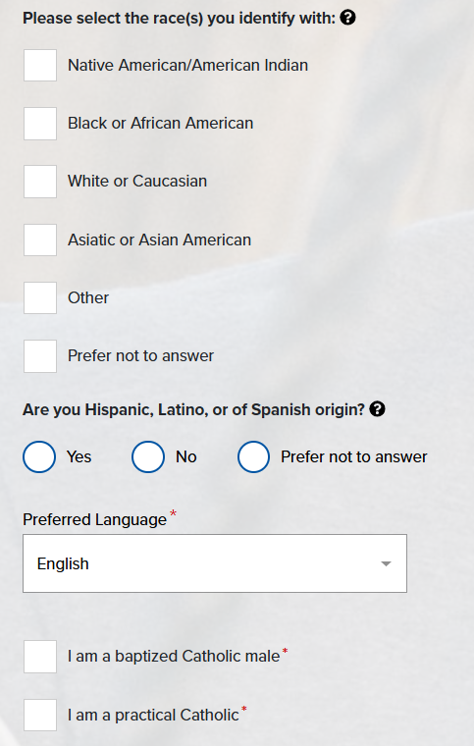
Race: Check a box (Note: you can say prefer not to answer)
Hispanic: Check a circle (Note: you can prefer not to answer)
Language: Defaults to English
Religion
  Must be baptized
  Must be baptized Catholic
  Must be a Male
Practical Catholic
  This is NOT for you (us) to judge – Stay out of it.
  If asked what this means – say... If you see yourself as a Catholic and believe in most of the church teachings, check the box and continue.

Slide 8
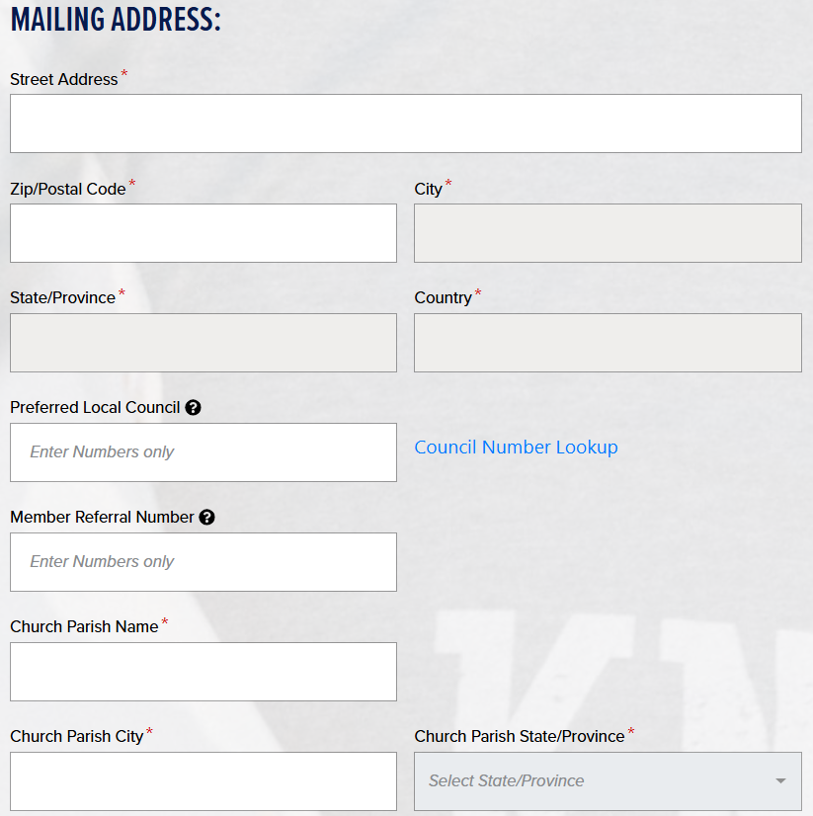
Street Address – 12345 McGivney Blvd
Zip Code – Must answer
  It automatically fills in the city/state. If the zip is valid for multiple cities, it will provide a list of the cities for you to choose from.
Preferred Local Council
  Try and get the prospect to enter a council #.
  If he does NOT want to join a council, enter 98021.
Member referral #
  Give him your member # so you can get the credit.
  If it’s NOT entered here, your FS can enter it when he transfers the member to your council.
Church Parish Name & City (Required)
  Help the prospect if he struggles here.

Slide 9
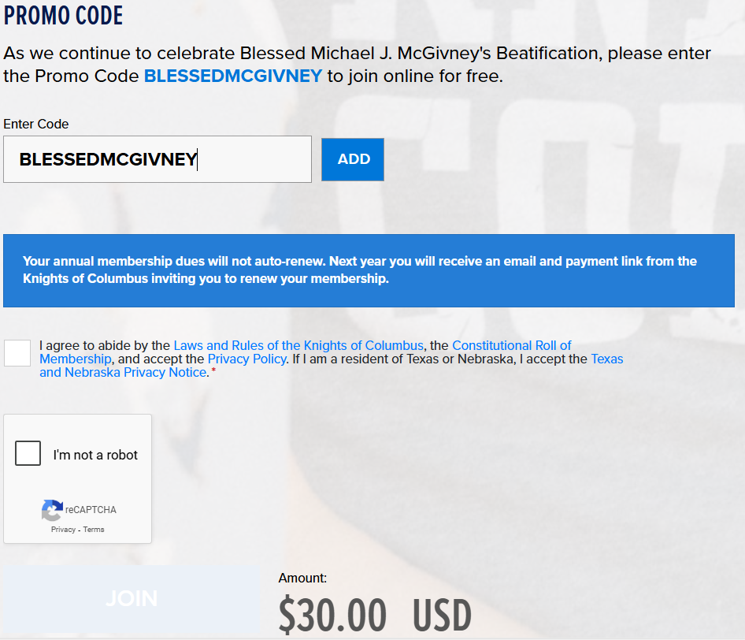
Promo Code:
This field will disappear if/when an Agent Referral Code is used.
The $30.00 amount will change to $0.00 only is you click on ADD.
Check the boxes
  Agree to abide by rules
  You’re not a robot

Slide 10
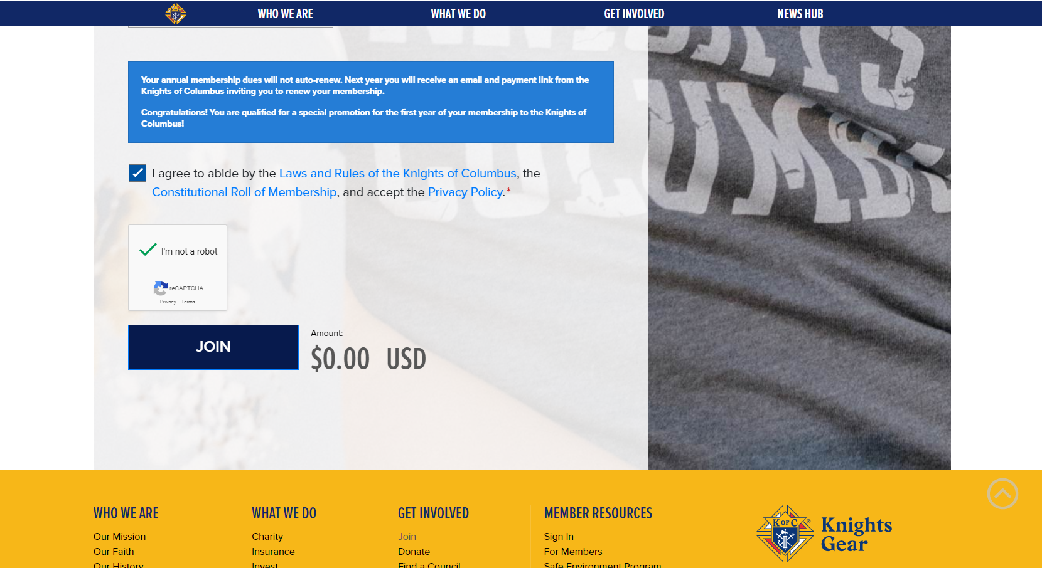

Slide 11
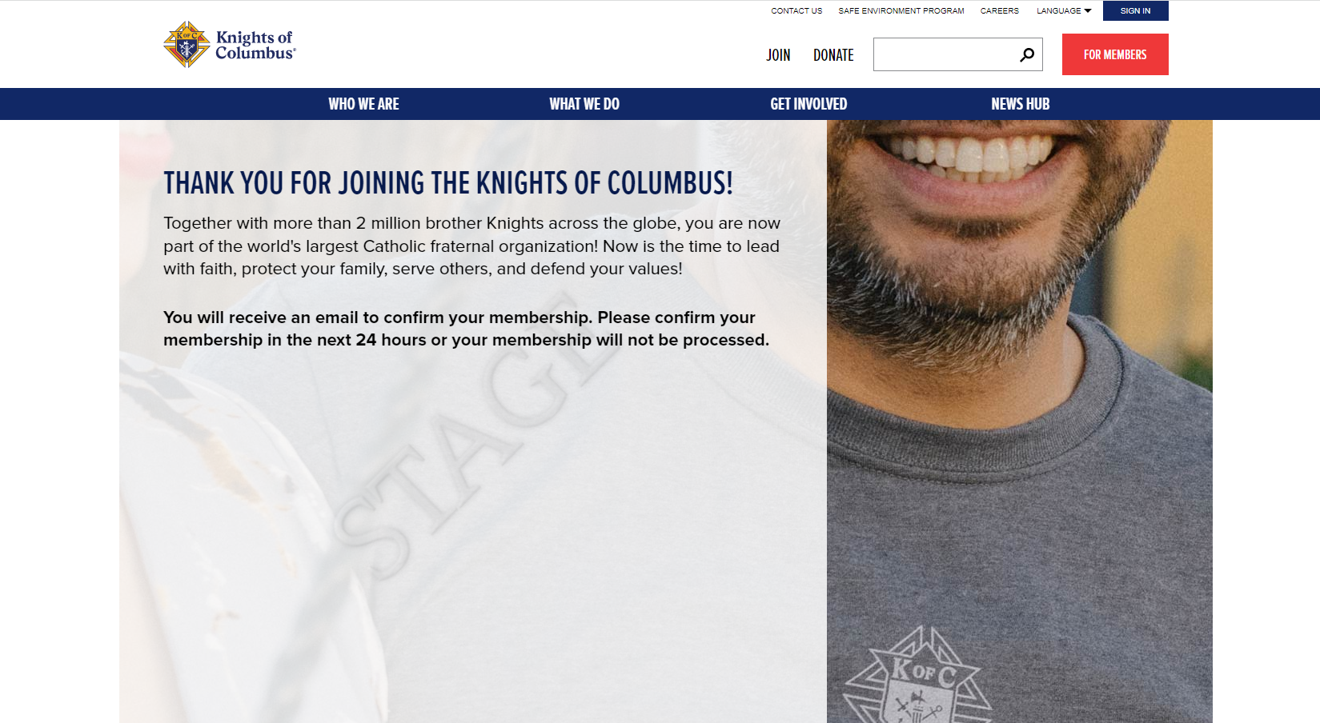

Slide 12
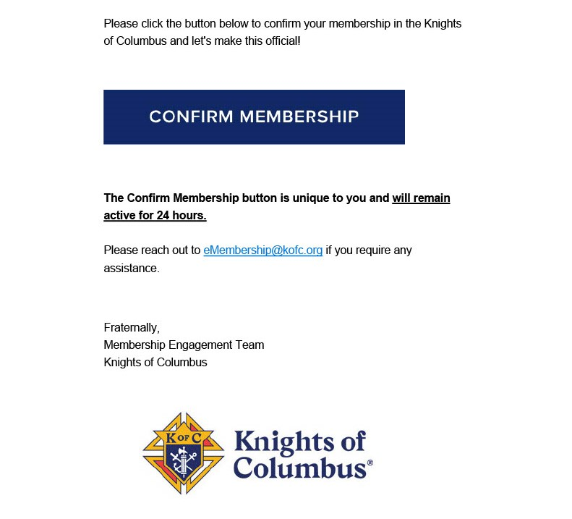
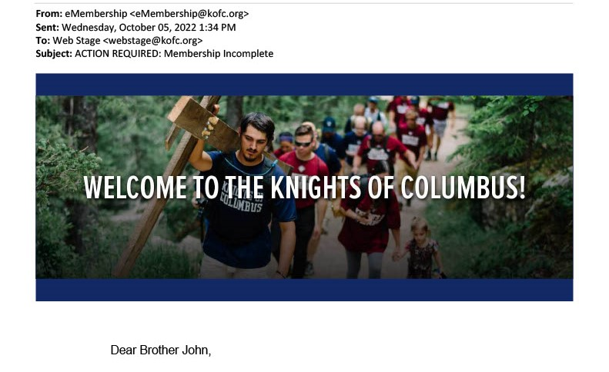

Slide 13
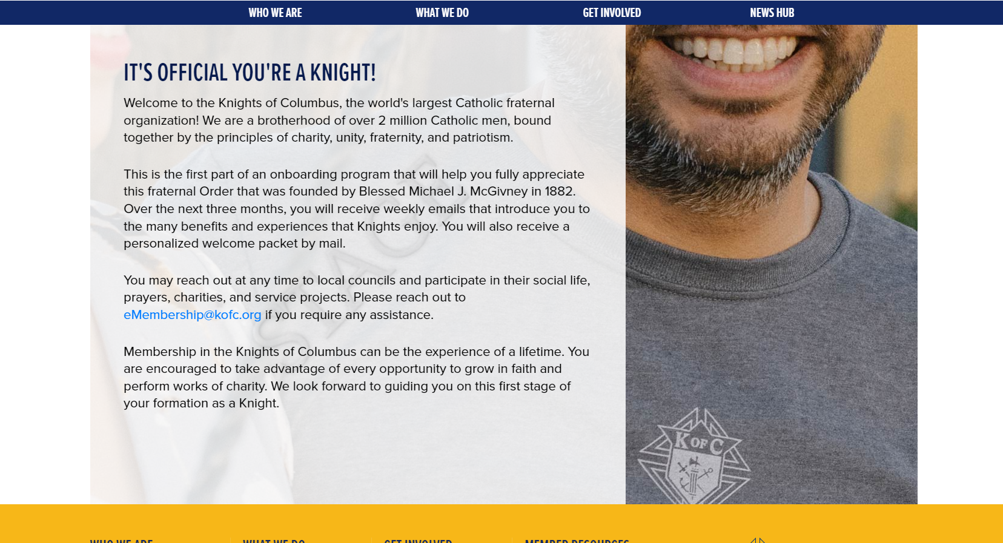

Slide 14
Prospect Tab
If Candidate selects a council.
Candidate fills out “join us” form
Supreme sends candidate an e-mail.
Candidate clicks on “Confirm”
No
Yes
Jim Escott assigns a council within 2 days
E-member is assigned to council tab

Slide 15
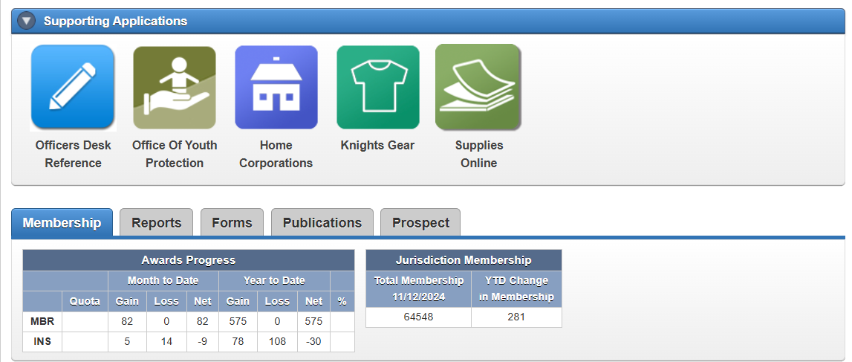

Prospect Tab
https://site-842560.bcvp0rtal.com/detail/videos/membership/video/6250025226001/prospect-tab-training-video?autoStart=true
Candidate

Slide 16
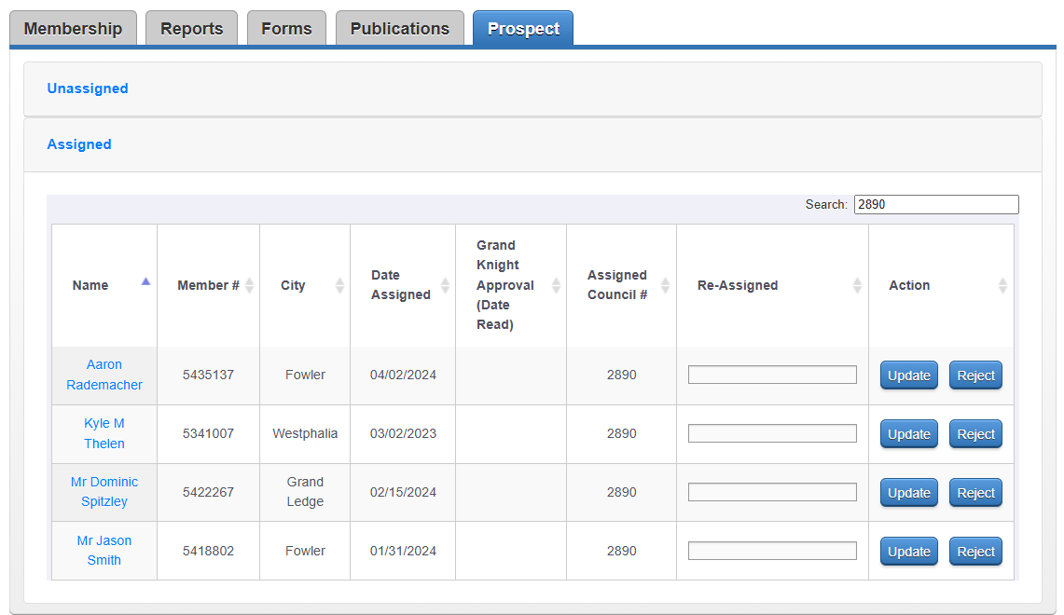
Prospect Tab
Assigned list
  Includes e-members that said they wish to join your council.
  May include other e-members assigned by Jim Escott
List of Prospects - Click on the prospect name to see detailed information. (next page)
Action – FS (or GK) should pass this information along to the Council Membership Director.

Slide 17
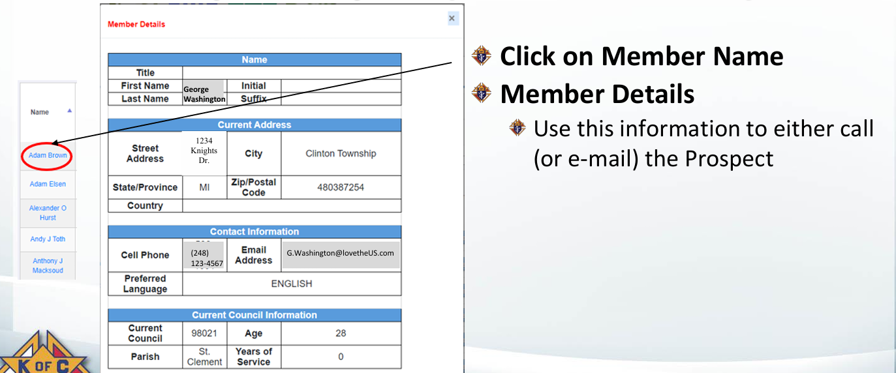
Prospect Tab

Slide 18
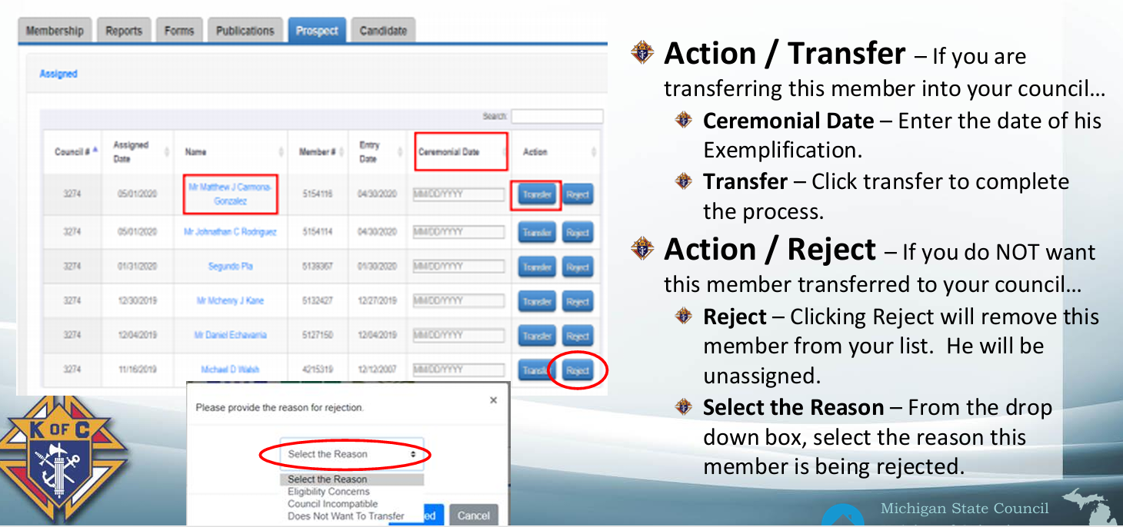
Prospect Tab

Slide 19
Candidate Tab
https://site-842560.bcvp0rtal.com/detail/videos/membership/video/6145850993001/candidate-tab-training?autoStart=true
What do you do if an e-member is missing from your Prospect Tab?
What do you do if you accidentally reject an e-member?
What do you do if you have a candidate that wants to join your council but is NOT an e-member?
What do you do if you want to transfer an existing member from a different council to your council?

Slide 20
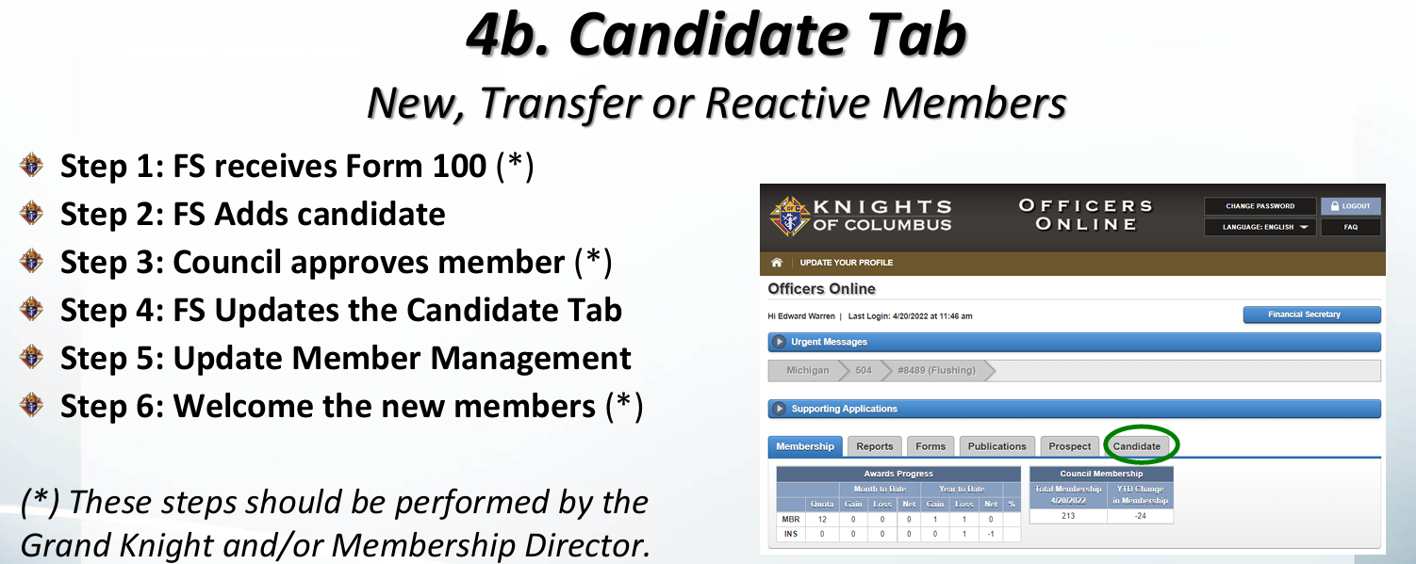
Information Provided

Slide 21
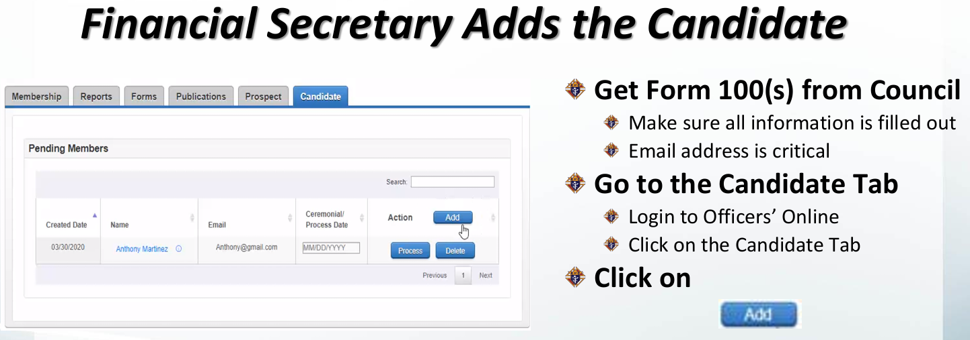
What do you need to do?

Slide 22
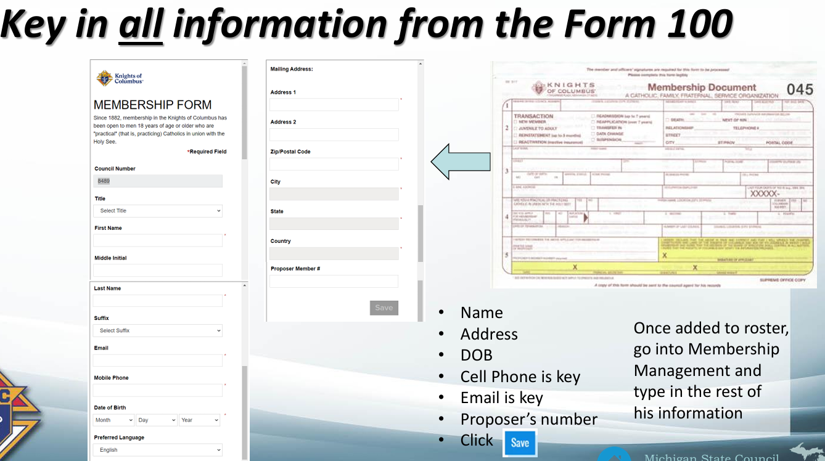
Information Provided

Slide 23
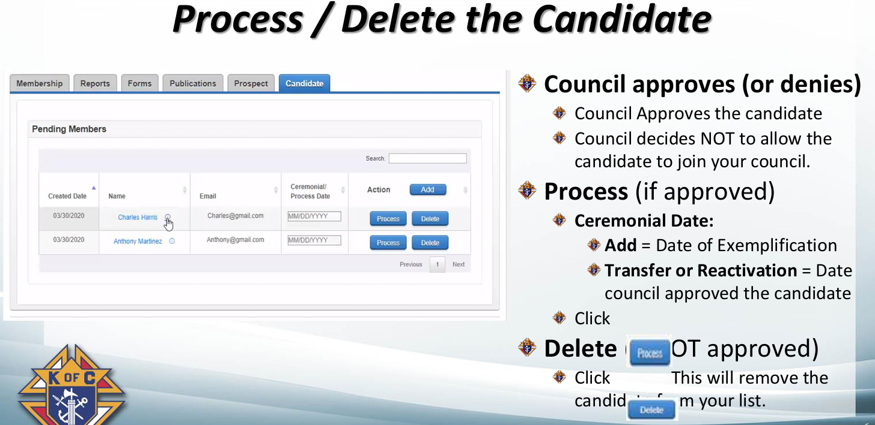
What do you need to do?

Slide 24
What do you need to do?
Frequently Asked Questions
Do you need a membership # to bring a former member (or transfer a member) into your council?
What is the main reason a new e-member does NOT come through to your Prospect tab?

Slide 25

Tom Kendziorski
State New Council Development Director
Service
Optimism
Aspire
Responsibility
Let’s SOAR to New Heights

Slide 26

Michigan Knights of Columbus Email
Jeff Thomas
State Email Director
Notes:
1

Slide 27
Email Naming Convection
District Deputies
(July 1st - ask to share)
ddXXX@mikofc.org
SDRR’s/Diocesan/Regional/State Directors
& State Officers
First Initial dot Last Name @ mikofc.org
j.thomas@mikofc.org
Notes:
Email Naming Convection
District Deputies
1 (July 1st - ask to share) – Contact your predecessor
2 ddXXX@mikofc.org and start looking regularly – should be daily after July 1 – change password after 7/1
3 SDRR’s/Diocesan/Regional/State Directors & State Officers
4 First Initial dot Last Name @ mikofc.org
5 d.kokot@mikofc.org
3

Slide 28

MI KofC Email
Council
GKXXXX Grand Knights
FSXXXX Financial Secretaries
MDXXXX Membership Directors
PDXXXX Program Directors
Share until July 1st – Then... Hand it Off!!!
Notes:
1 GKXXXX Grand Knights
2 FSXXXX Financial Secretaries
3 MDXXXX Membership Directors
4 PDXXXX Program Directors
5 Share until July 1st – Then... Hand it Off!!!
4

Slide 29
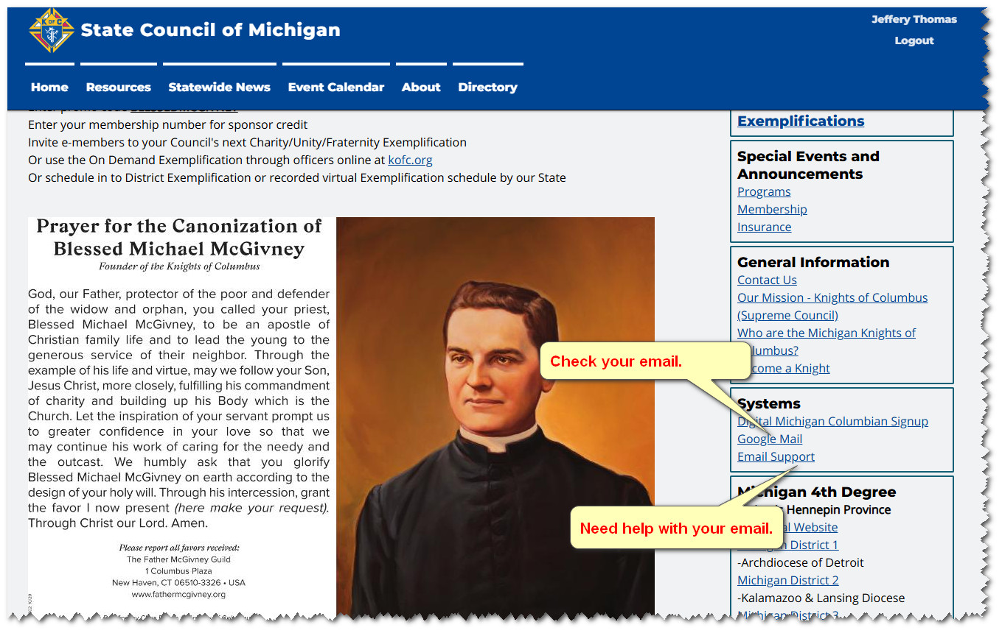
Email access & Email Support
Notes:
How to Logon
Go to WWW.mikofc.org
On Home Page – Right Boxes scroll down to:
1 Box called Systems click on Google mail
5

Slide 30
Automatic Email Forwarding
In the near future Automatic Email Forwarding will be turned off.
The ability to automatically forward your MIKofC.org email to another email account will be discontinued.
Notes:
Maybe
13

Slide 31
www.mikofc.org
The State Website
A Whirl Wind Tour
Notes:
1

Slide 32
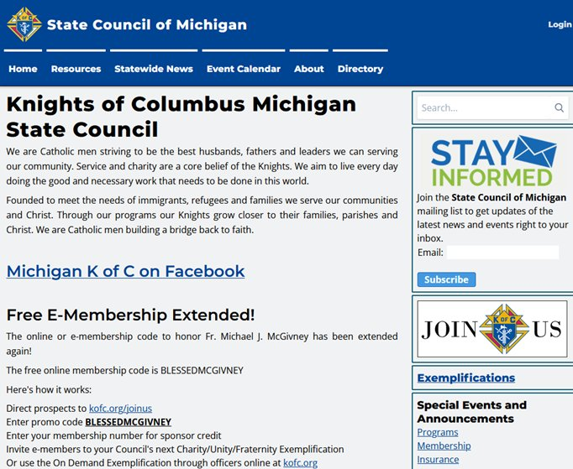
Notes:
1 Unlike Supreme – custom search that stays in the website - custom not just a google
2 Everyone – anyone – your wives should join – new articles posted by Matthew Hoxsie – The Michigan Columbian
3 Links to the Supreme sign up & the promo code is on the left
2

Slide 33
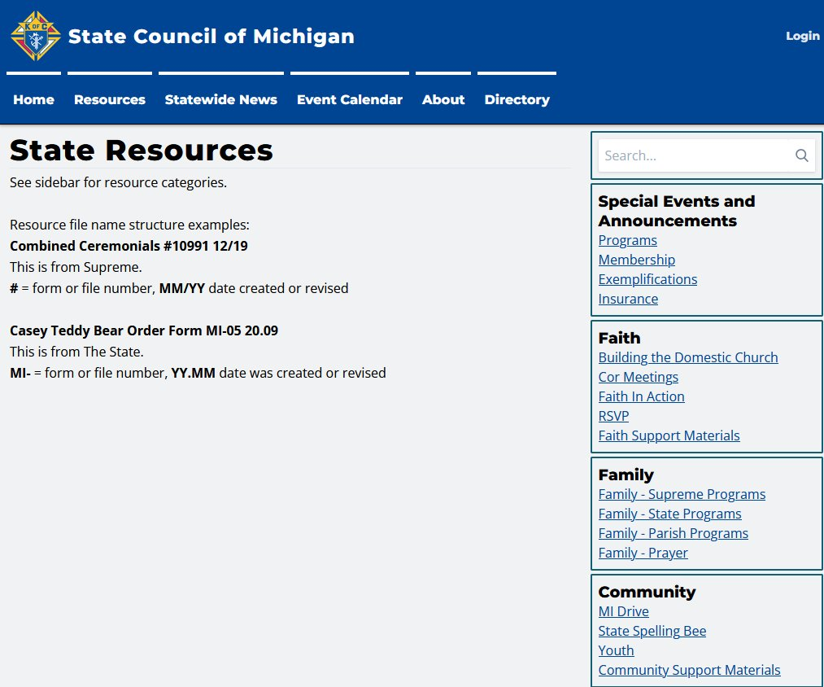

Notes:
A Cornucopia of useful information
State & links to Supreme
4

Slide 34
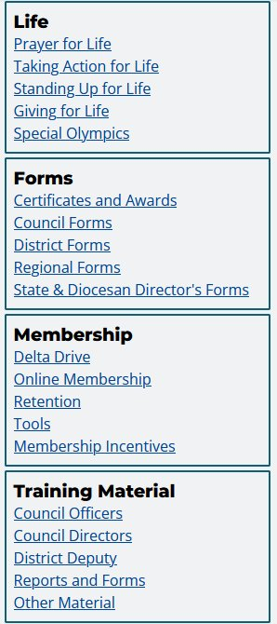
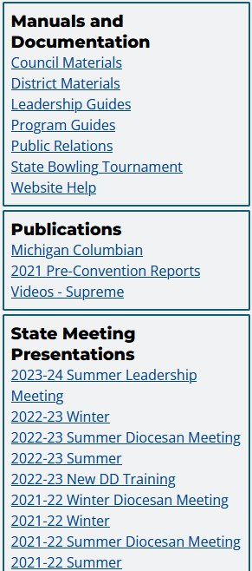
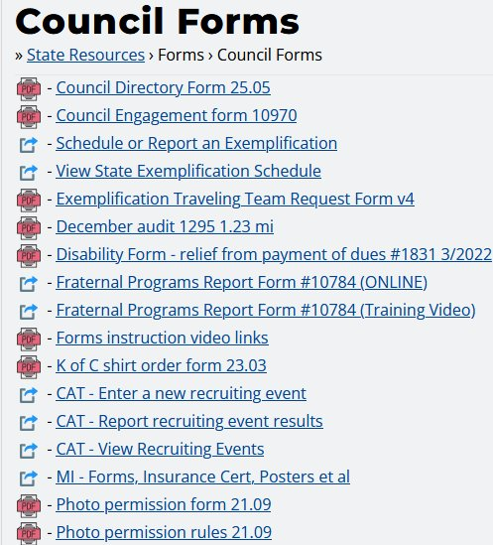
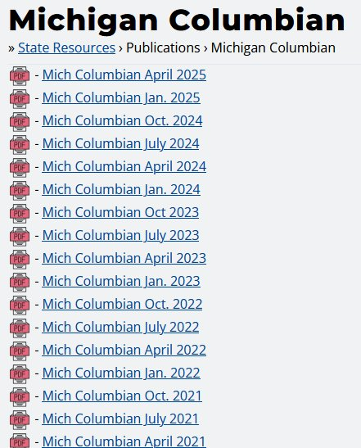
Notes:
Again, Remembering to scroll down…
1 Clicking on Council forms
2 Brings up a library - again State & Supreme
3 In the Publications Box clicking on Michigan Columbian – brings up an archive
5

Slide 35
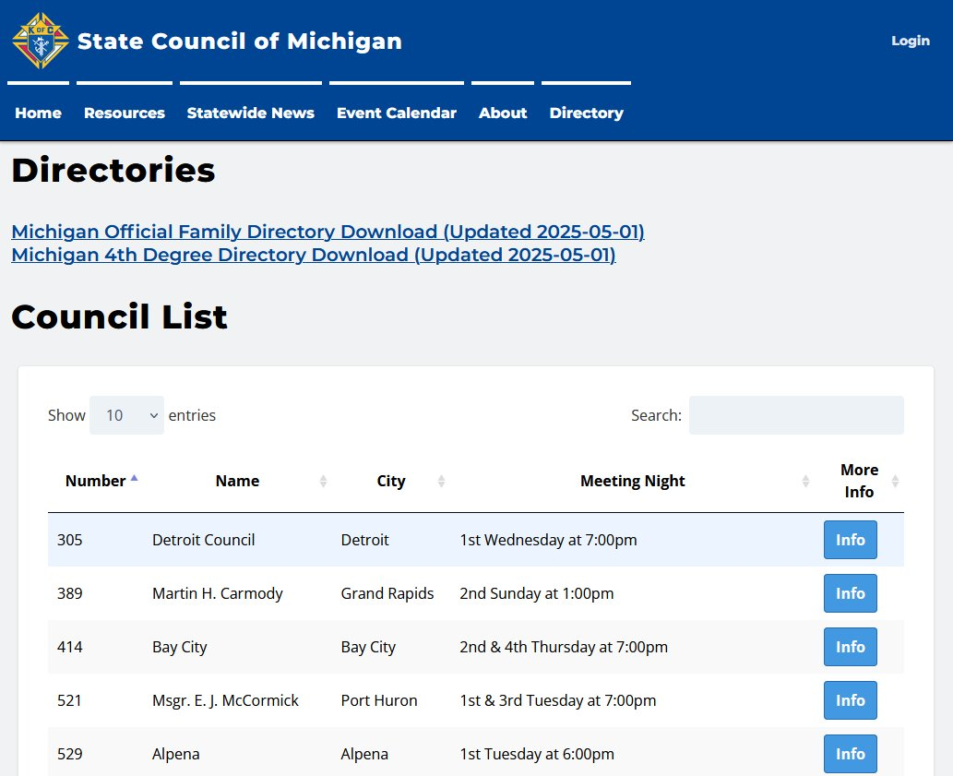

Notes:
Anybody can see
1 But if they want to access
6

Slide 36

Questions?
Notes:
9

Slide 37
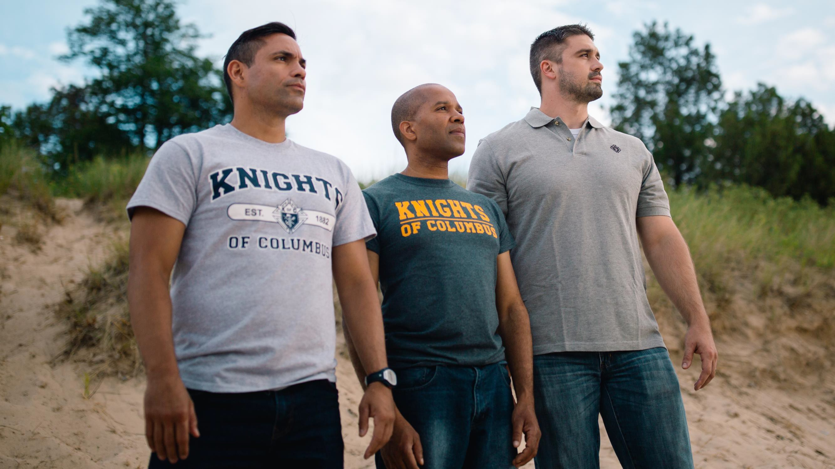


NOW YOU ARE READY TO SOAR WITH US

Slide 38


