Slide 1
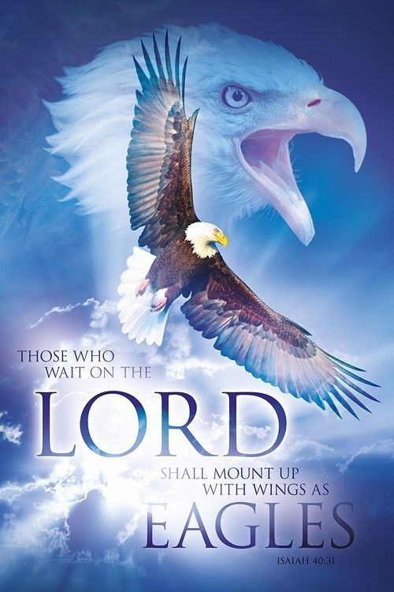
Membership
All District Deputies
An Invitation to Come SOAR with Us
Service – What Life is About
Optimism – The Faith that Leads to Achievement
Aspire – to Accomplish Great Deeds
Responsibility – to do Your Duty
Let’s SOAR to New Heights

Slide 2
State
Membership
Leadership
Team

Slide 3
LEADERSHIP ROLE AS DD
You are an important leader in the KofC and the Church
Lead by example
    Recruit one new Member by the end of September!!
Lead in faith and prayer
Help every council grow
“We must pray for perseverance because none of us is exempt from difficult moments.”
Pope Leo XIV

Slide 4
Bonus Question Round!!
Of 420 Councils, how many grew their Membership last Year?
320 (70%)
That means the District Deputies need to help the remaining Councils to Secure their health.
100 (30%)

Slide 5
Importance of Membership:
Not because of quotas or awards…
We should grow our membership because we want to give other Catholic men the same opportunity for faith growth and fraternal friendships that we all enjoy. The more Knights that join our ranks increases the overall impact that we can have in our Church, community, and the world.

Slide 6
Supreme Quota
2634
1st Qtr 20% 2 ½ Precent Reduction
2nd Qtr 50% 2 ½ Precent Reduction
TBD Star Council for Circle of Honor
Conversion – Reduction of 1 for 10

Slide 7
Expectations
Inspire Your Councils
(Use Dan Remeika’s Talking Points)
Grow the order
Identify problems/resolve them
  Ask for help
One District Exemplification Per Month Minimum

Slide 8
Expectations
Report your membership growth opportunities for your Councils’/District’s on CATs (Council Activity Tacker)
Keep the Exemplification Schedule up-to-date on the State Website
Promote Programs

Slide 9
Goals
Every Council Active by Sept 1st
Supreme Quota
50% by December 31st
No ZERO Growth District By Aug. 31st
No ZERO Growth Councils By Oct. 31st
Minimum of One Exemplification per Month per District

Slide 10
Goals (Continued)
Improve your councils each year
Leave your councils better than you found them

Slide 11


Slide 12
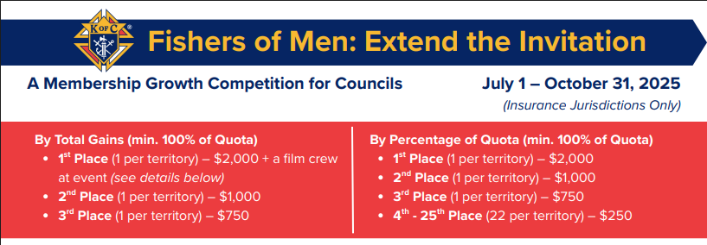

Slide 13
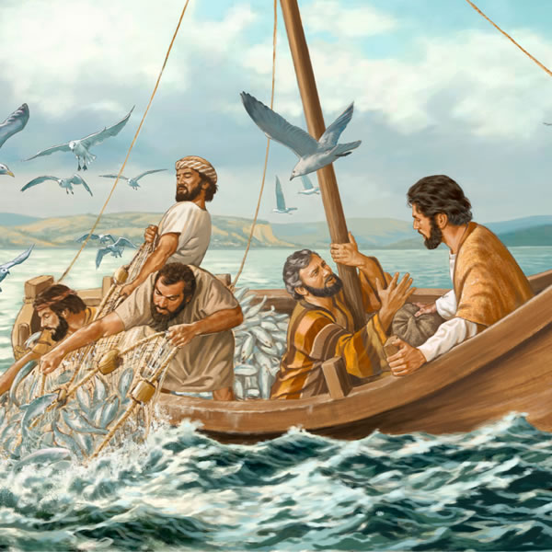
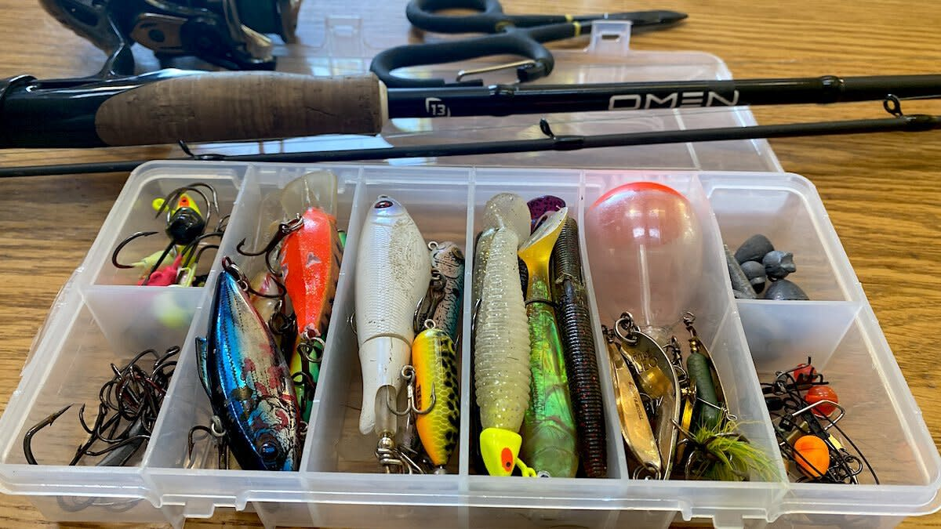
Let’s be Fishers of Men
What is in your tackle box?
Pick the right lure

Slide 14
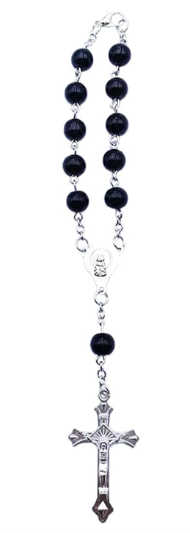
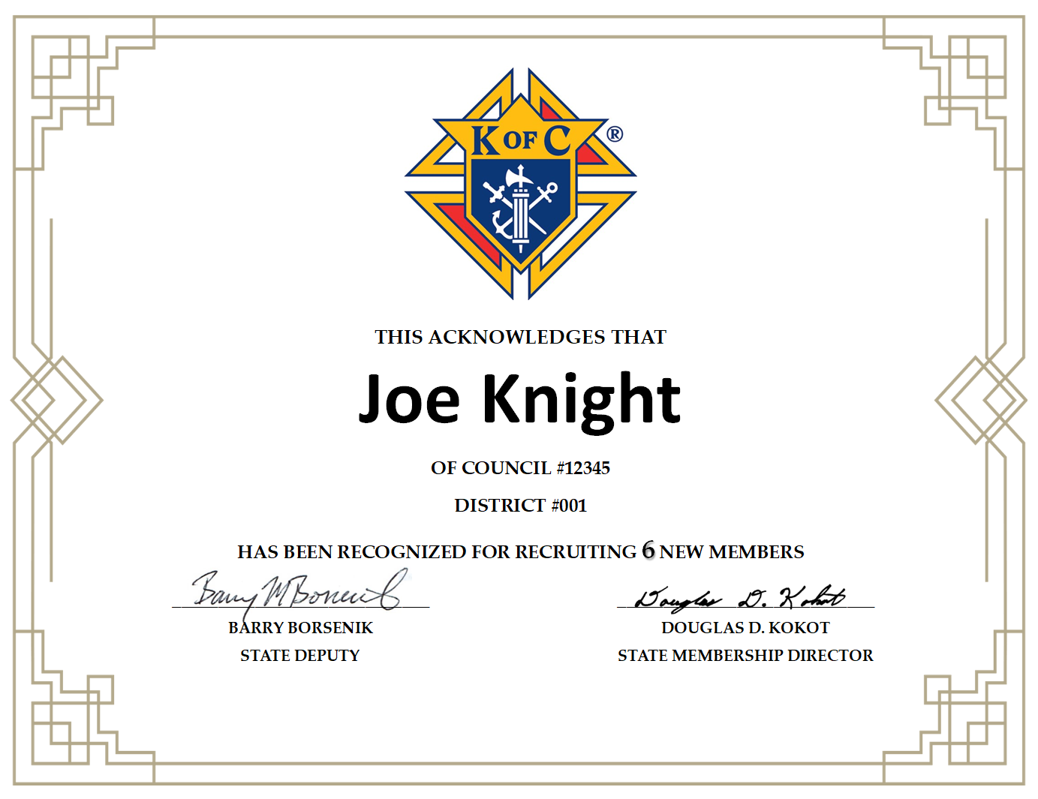
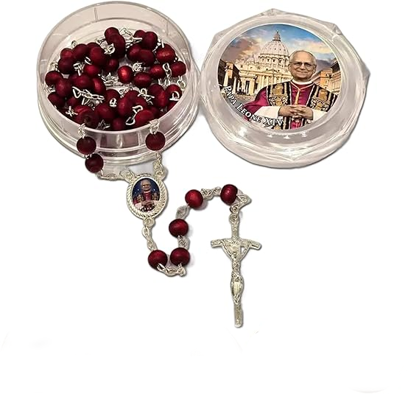

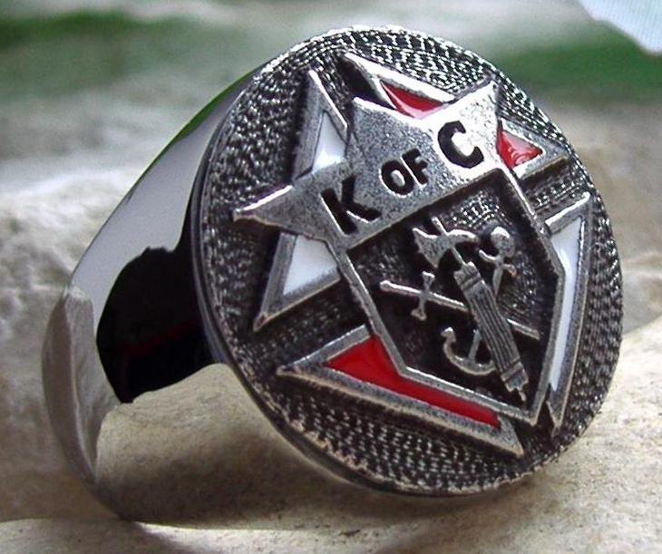
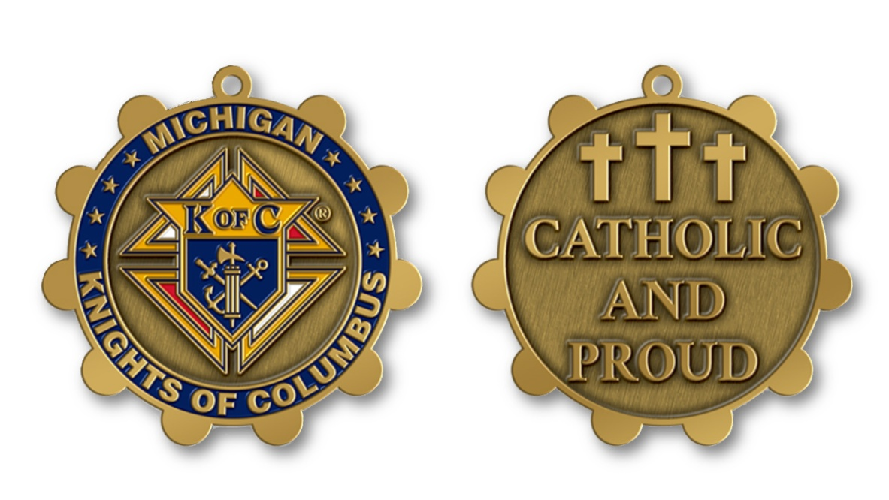
Proposers Recognition
Certificates
Car Rosary – 2 Members
Keychain – 4 Members
Pope Leo XIV Rosary – 6 Members
Ring – 20 Members

Slide 15

Council Recognition
50% by September 30th
8ft Knights of Columbus Table Covering

Slide 16
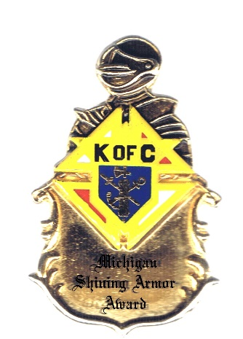
Michigan
Shining Armor Award
Any Michigan Knight can qualify for the “Michigan Shining Armor Award”.
Be involved in at least 3 council meetings, and/or parish/council activities as a Knight.
Meet with their council’s insurance representative or attend a fraternal benefits event.
Recruit at least one new member.

Slide 17
Diocese Chaplain/Bishop Awards
The Diocese with the highest percentage of growth, based on the published quotas will win the first six-month incentive. The Diocesan Chaplain will receive $250 and Bishop will receive $500.

Slide 18
            “Quick Start” Council and District Awards
Councils and District Deputies that obtain 50% or more of their membership quotas for the Father McGivney Award by the mid-point of the fraternal year at the end of December will be recognized with a “Quick Start” Award at the annual State Membership Tribute Banquet in February.

Slide 19
            State Chaplain/State Deputy Awards
Councils and District Deputies who obtain 100% or more of their membership quotas for the Father McGivney Award by the mid-point of the fraternal year at the end of December will be recognized with a State Chaplain/State Deputy’s Award at the annual State Tribute Banquet in February.

Slide 20
            Council Membership Director Awards
Council Membership Directors who achieve 100% or more of their membership quotas for the Father McGivney Award by the mid-point of the fraternal year at the end of December will be recognized at the annual State Membership Tribute Banquet with the Council Membership Director Award.

Slide 21
            “Finish Strong” Council & District Awards
Councils and districts that achieve 100% or more of their membership quotas for the Father McGivney Award by May 1st of the fraternal year will be recognized at the State Convention with a “Finish Strong” Award during the convention weekend on Mackinac Island.

Slide 22
18+ Catholic Men 779,156 | Total Members 64,772
Eligible Knights 714,384 | Market Penetration 8%

Slide 23

Number One Reason Men Have Not Joined The Knights of Columbus...
They Have Not Been Asked!!!

Slide 24
Marty Brown
State Deputy Regional Representative (SDRR)

Slide 25


& The Knights of Columbus
Invite them to Soar with us!!!

Slide 26
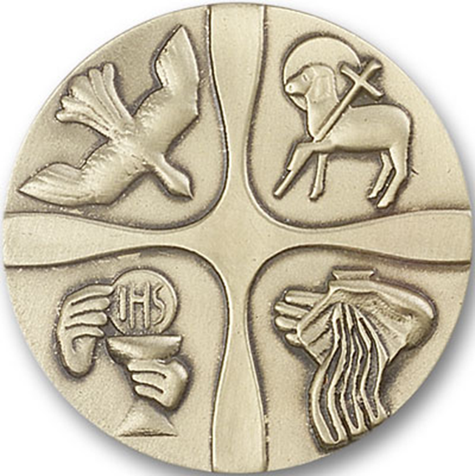

The New Catholic
Man Wins
Work with men with the same faith and ideals
A way to practice his faith of charity
A place to develop family friendships
Grow in faith through action

Slide 27
The Knights Win
A man that has shown his conviction to our faith
A man that is looking for a way to put his faith into action
A man looking to connect his family with his faith

Slide 28
How
Knights as Sponsors 1#
Request to speak at a class
Provide gifts to OCIA candidates – rosaries, etc.
Request a list of OCIA candidates
Notes:
Grand knights should ask the pastors of all the parishes the council serves if they can regularly give them a list of RCIA graduates. (The grand knight should assure the pastor that RCIA members will not be coerced into joining.) The grand knight should give the list to the membership director who can contact the men personally. Along with other recruitment materials, give these prospects copies of the Faith-Based Recruitment flyer (#4497) that details how K of C membership can help men and their families grow the Faith. Men recently admitted to the Church are promising prospects. Approach them and you are sure to increase your membership!

Slide 29
How
Request a list of OCIA graduates
Contact the men personally
Provide the man with a copy of the Faith-Based Recruitment flyer (#4497)
Notes:
The Rite of Christian Initiation for
Adults (RCIA) is the Catholic
Grand knights should ask the pastors of all the parishes the council serves if they can regularly give them a list of RCIA graduates. (The grand knight should assure the pastor that RCIA members will not be coerced into joining.) The grand knight should give the list to the membership director who can contact the men personally.
Along with other recruitment materials, give these prospects copies of the Faith-Based Recruitment flyer (#4497) that details how K of C membership can help men and their families grow the Faith. Men recently admitted to the Church are promising prospects.
Approach them and you are sure to increase your membership!

Slide 30
Family men, Doctors, Attorneys, Engineers
& Other Professionals
Have you ever heard
“I’m just too busy”?
“I’m Just too busy to be a Knight of Columbus

Slide 31
Ask the Questions
Do you belong to a professional organization or society?
Why did you join?
How much time do you put into it?
What do you get out of it?

Slide 32
What do professional organizations / societies have in common with the Knights of Columbus?
They both send periodicals to keep you up to date
They lobby for your best interest
You can make connections
You choose how much time you commit

Slide 33
Consider joining the Knight of Columbus as your professional organization for your faith.

Slide 34

One thing about joining the Knights...
Your rewards are not only earthly…
They are Eternal

Slide 35
24 Hour Knight

