Slide 1

Membership
New District Deputies
An Invitation to Come SOAR with Us
Service – What Life is About
Optimism – The Faith that Leads to Achievement
Aspire – to Accomplish Great Deeds
Responsibility – to do Your Duty
Let’s SOAR to New Heights

Slide 2
 | DMD |  | SDRR
Detroit
Detroit E1 | Wally Papciak | 586.481.6833 | Paul Thorn | 248.709.9761
Detroit E2 | Rick Fisher | 586.215.9182
Detroit W1 | Hans Hansen | 734.765.6767 | Ray Bilyk | 313.247.2110
Detroit W2 | Lou Brotchner | 734.837.6371
Gaylord
Gaylord - West | Joseph Zayaz | 248.238.1515 | Mike Szukhent | 810.625.3708
Gaylord - East | James L. Szafran | 989.257.5313
Grand Rapids
Grand Rapids - North | Robert Wassick | 618.973.2112 | Marty Brown | 616.560.0479
Grand Rapids - South | Larry Adams | 517.526.4920
Kalamazoo
 | Joseph Harnish | 269.290.4840 | Nick Zafer | 269.254.5403
Lansing
Lansing - South | Paul Funk | 248.765.4655 | John Yanok | 810.599.0099
Lansing - North | Kevin Duffy | 517.974.0829
Marquette
 | Dave Guenther | 906.204.9033 | Mike Prokopowicz | 906.361.4625
State Membership Director | Doug Kokot | 616.634.2400
State E-Memb Dir. | Jim Escott | 248.345.8523
New Council Dev Dir. | Tom Kendzorski | 248.953.5147
Hispanic Outreach Dir. | Julio Salinas | 956.638.4073
Eastern Rite Dir. | Ben Jilika | 586.604.3031
College Council | Larry Stopczynski | 248.514.0323
Council Retention | Richard Shelt | 734.812.0645
State Affillite/Retention Dir. | Jim Escott | 248.345.8523
State
Membership
Leadership
Team

Slide 3


Slide 4
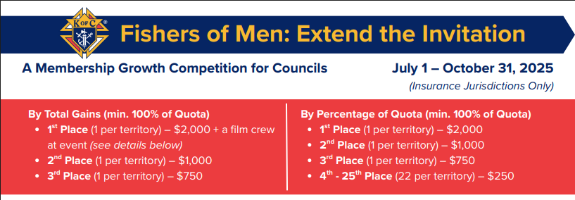

Slide 5
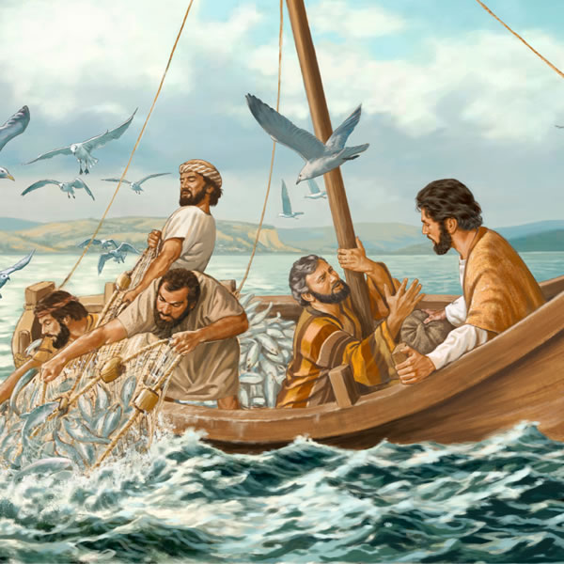
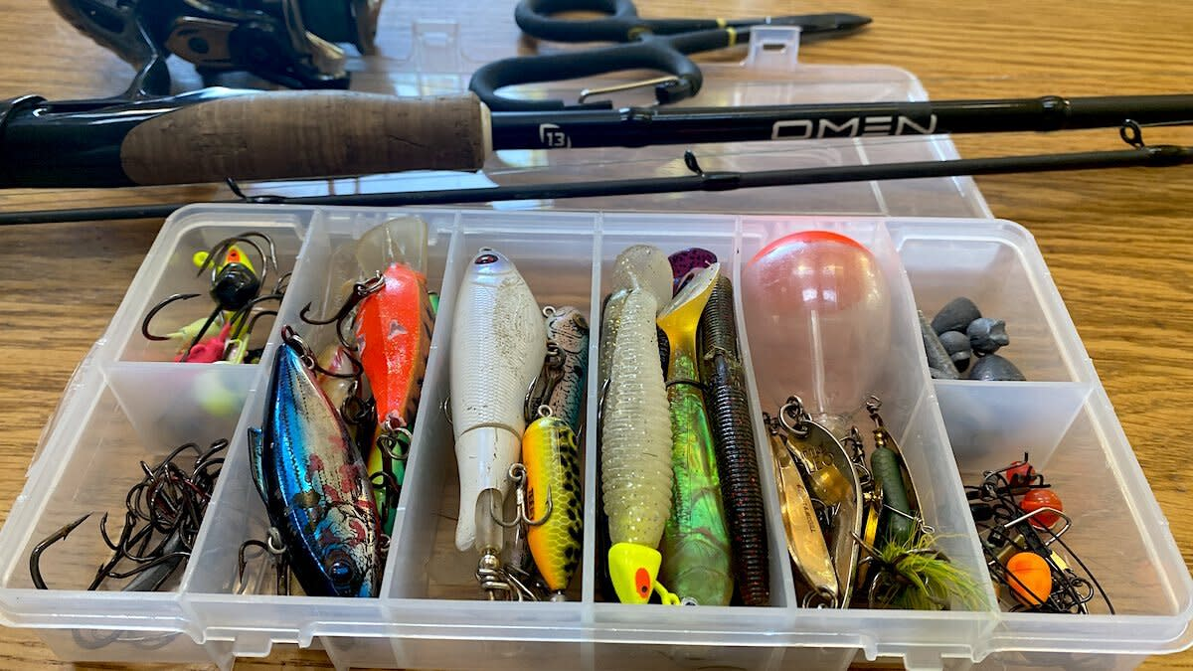
Let’s be Fishers of Men
What is in your tackle box?
Pick the right lure

Slide 6
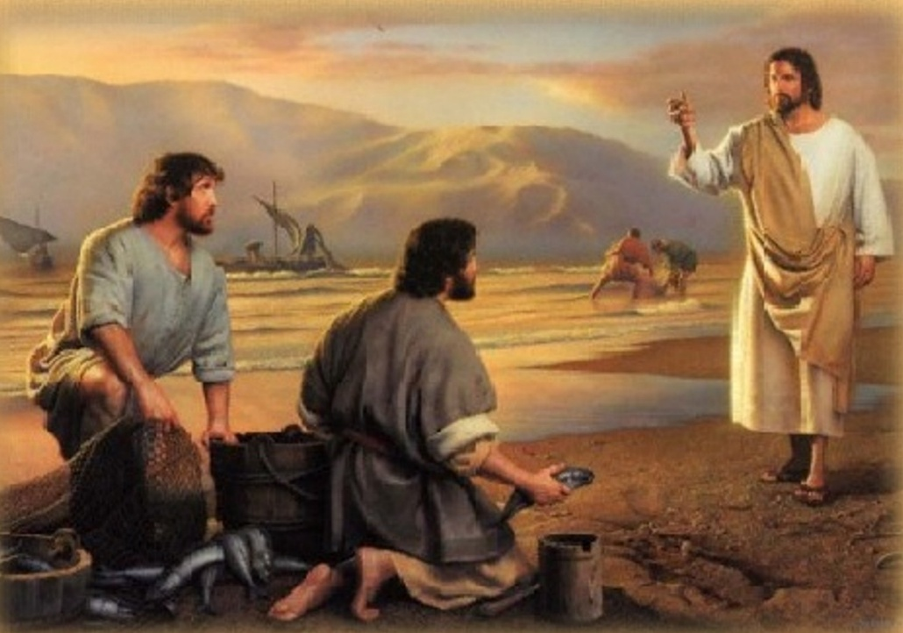

What is in Fishers of Men
HOW TO INVITE SOMEONE
          CONVERSATION STARTERS
      OVERCOMING OBJECTIONS
      TIPS TO REMEMBER
FRATERNAL BENEFITS: WHY JOIN
RESOURCES

Slide 7

Tips to Remember
Rally the support of your spiritual leaders (chaplains, pastors, deacons, etc.).
Work with your leadership and local K of C ﬁeld agents – you are not alone.
Demonstrate good listening skills so you can eﬀectively see what the man’s needs and wants are. (Pick the right lure.)

Slide 8
Tips to Remember (Continued)
Prepare and practice – identify a few questions that will help the other person to open up and your favorite conversation starters. (Ask Yourself First)
Involve your families as well as theirs.
If willing, ask your wife to share her perspective with them.
Pray throughout.

Slide 9
Let’s be Fishers of Men
Every Knight is called to bring others to Christ and help realize Blessed Michael McGivney’s mission.
“Come after me, and I will make you ﬁshers of men.”
MT 4:19

Slide 10
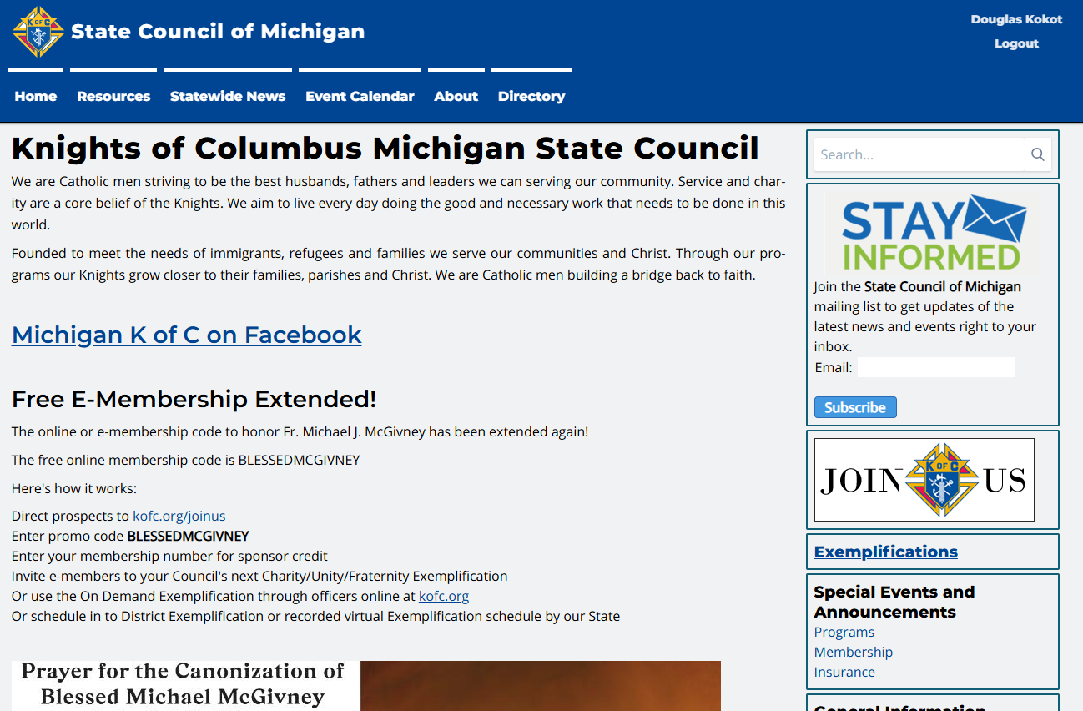

Slide 11
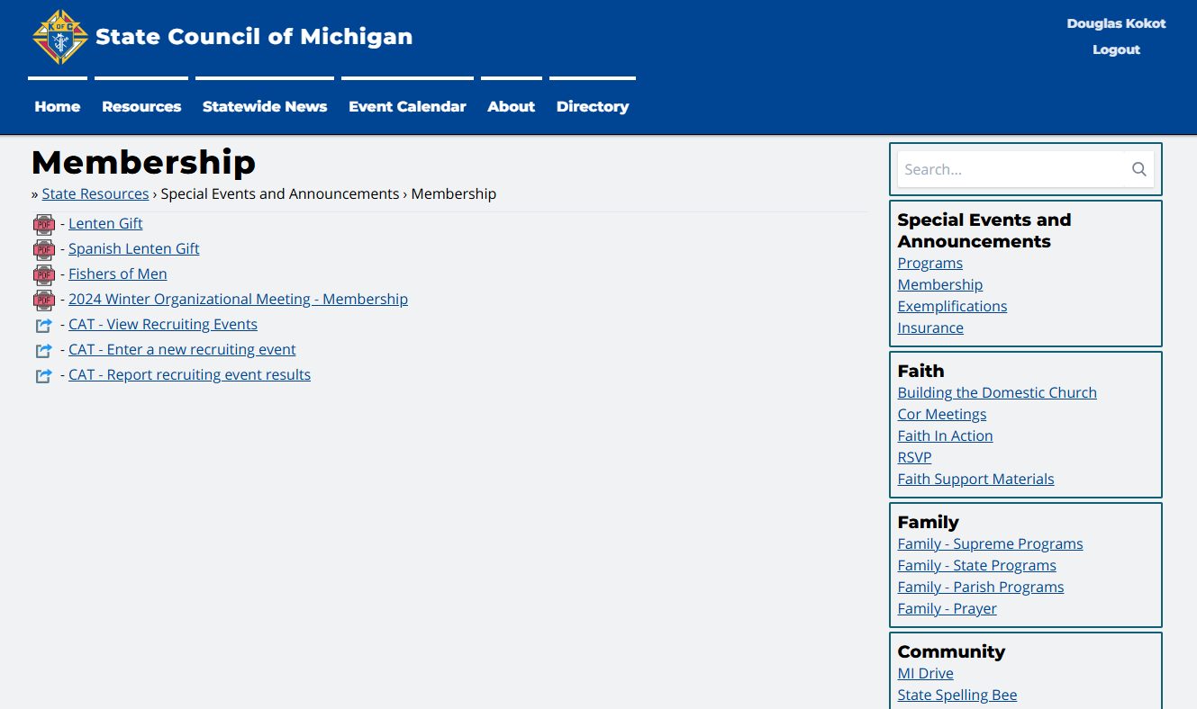
WWW.MIKOFC.ORG

Slide 12
Catholic men are waiting to be invited
21 million Catholic men are not members of a Catholic men’s organization
7 million say they are willing to join the Knights of Columbus
Nearly half of all Catholic men say they’ve not joined the Knights – at least in part – because nobody has asked them to.

Slide 13
Let’s be Fishers of Men
Filled with the Holy Spirit, the ﬁrst Apostles went out, two by two.
Like them, we are not alone – we are supported by our brother Knights.
Let us be the ﬁshers of men God is calling us to be.

Slide 14

Installation of Officers
Why?
Logistics
Script
Notes:
This is just an introductory slide
You should introduce yourself here
Make sure you spend only 10 minutes on this.

Slide 15
1 – Why do Installation of Council Officers?
The DD has the privilege of installing the officers of the councils in his District.
When Council Officers are “ceremoniously” installed:
  The importance of their role is understood by all
  They feel more empowered
  They are “blessed”
Notes:
Ask who has been to an installation & who has not
Ask those who attended their thoughts
It’s very meaningful to…
Have a Priest bless the jewels
Have your superior put that jewel around your neck.

Slide 16
2. Logistics
Hold the ceremony as early in the Fraternal year as possible
  July or August is best
Formality – This is a formal event
  Wear a coat & tie – Ask the council officers to also dress appropriately
Include a Chaplain and District Warden (if possible)
  Don’t try to do it all yourself
If you’re having trouble finding dates…
  You can combine and do multiple councils at the same ceremony
  Consider “just prior” to your District Meeting
  Consider “just prior” to your Council Meetings
Notes:
Discuss the 4 main bullets:
Hold the installations ASAP
Dress nice (nicer than a typical council meeting)
Fill each role in the script
There’s always trouble picking a date – discuss options.

Slide 17
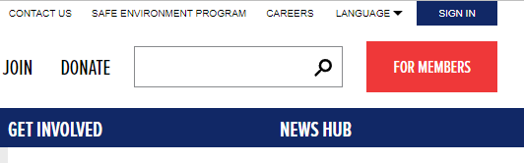
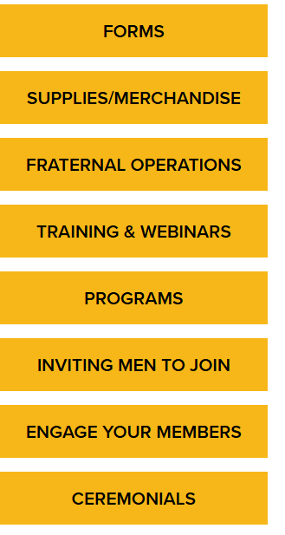
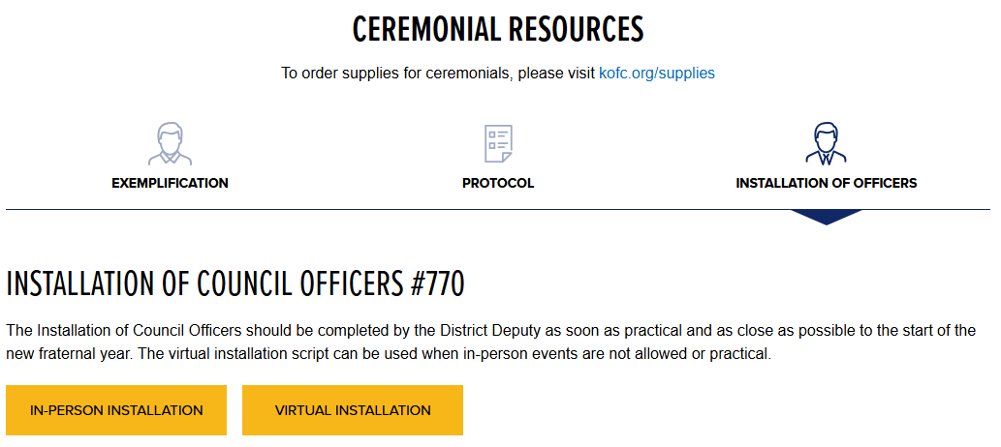
3. Script – Where to find it
Supreme website (www.kofc.org)
FOR MEMBERS / CEREMONIALS
INSTALLATION OF OFFICERS
IN-PERSON INSTALLATION
Notes:
Walk them through this slide (quickly)
Then, actually demonstrate (Live)
Bring up the document
Show them what it looks like & the roles
Tell them to print several copies & fill in the blanks
They should print one for the Chaplain as well

Slide 18
Marty Brown
State Deputy Regional Representative (SDRR)

Slide 19
District Deputy
Promoter for Membership
Why?
What?
How?
Notes:
Another Introduction slide – nothing to say
But – This should last 40 minutes
Why = 5 minute Max
What = 20 minutes Min
How = 5-10 minutes
Q&A – for the remainder of the time

Slide 20
1. Why?
Many councils undervalue the importance of membership
  I’m happy with the guys we have (Short-term focus)
  I don’t like to recruit (not fun or rewarding)
  Excuses are easy – Solutions take creativity
    Our church is declining, we don’t have a school, the Pastor doesn’t like us.
District Deputies need to encourage councils to grow
  At every meeting, talk about membership growth
  Encourage recruiting, inviting and growing
Notes:
5 minutes max
Without the encouragement and support from the District Deputy, many councils would die.
Many councils have a “short-term” focus
As DD, keep reminding them of the “long-term” benefits
Council sustainability
The good we do (Faith, Family, Community & Life)
Helping men be better fathers, husbands, Catholics

Slide 21
2. What? Promote/direct Membership Efforts
Schedule an Exemplification
Help Establish Retention Plan
Establish Round Tables
Help Establish Membership Plan t
Develop New Councils
Notes:
Schedule frequent Exemplifications:
1/month/district – Demonstrate how to add an exemplification
Ensure your councils are using it.
Establish Round Tables:
Make sure they know what a RT is.
Parishes and schools
Develop New Councils (3 criteria):
When a Pastor wants his own council
When you have 20+ men
When you have potential officers
Help Establish Membership Plans within your councils:
Encourage the use of CAT & MI-19 forms - Demonstrate
Help Establish Retention Plans:
Make sure new members have a mentor
Ensure they are contacting members throughout the year

Slide 22
3. How to encourage membership?
Establish a relationship with each Council Membership Director
  Review his plan – Help him create one if he needs your help
  Encourage (and support) his ideas
  Get him what he needs
At Council Meetings
  As great programs are discussed, encourage recruiting at the event
  Praise councils when they bring in new members
Outside of council meetings
  Attend recruiting drives (if possible and when needed)
  Attend Exemplifications (if possible)
Notes:
Council Membership Directors – It’s a tough job
Make sure they understand their role
He needs to see you as his strongest supporter
He needs to see you expect him to do his job
At council meetings – ALWAYS talk about membership (but keep it positive and brief)
Outside of council meetings – Get involved, be present and show your councils you support their membership activities.

Slide 23
Next Up
District Deputy Roles
Responsibilities
Resources

Slide 24
LEADERSHIP ROLE AS DD
You are an important leader in the KofC and the Church
Lead by example
    (Recruit one new Member by in the 1st Qtr)
Lead in faith and prayer
Help every council grow
“Laypeople are on the front line of the life of the Church”
- Pope Francis

Slide 25
The District Deputy has a critical role in the Knights of Columbus
Be Present
Be a Resource
Be a Mentor
Drive Activity

Slide 26
A District Deputy must be present.
Not a District Phone Number
nor a District Email Address
Be at meetings
Attend programs
Have District meetings
Build relationships

Slide 27
A District Deputy must be a resource
You’re the expert!
Answer questions
Share best practices
Communicate early and often

Slide 28
A District Deputy must be a mentor
Help councils achieve their potential
Don’t just commiserate
There’s no excuse for no growth or no activity…
…but not just for it’s own sake!

Slide 29
A District Deputy must drive activity
Ceremonials. Programs. Drives.
Activity drives results.
It’s not easy, but it’s not complicated.

Slide 30

RESOURCES
Your best resources are other fraternal leaders
Read regular Supreme Council and State Communications
Familiarize yourself with the Supreme and State Websites

Slide 31
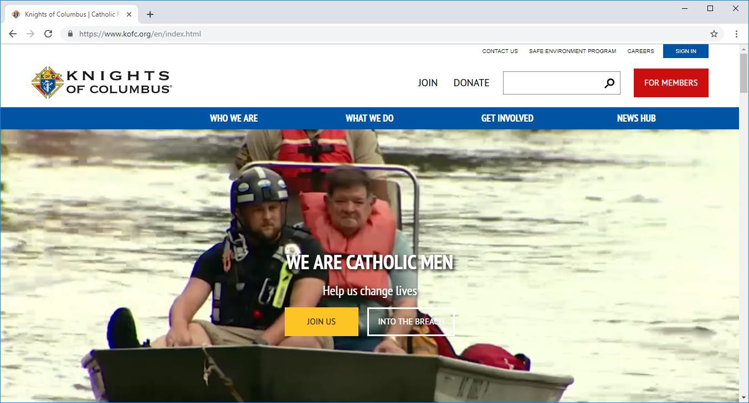
DIGITAL WEB
RESOURCES
Kofc.org/training
Kofc.org/formembers
Kofc.org/FIAresources
Kofc.org/star
Kofc.org/forms

Slide 32

Publications From Supreme
Fraternal Leader Advisory
  Sign-Up at kofc.org
Fraternal Leadership Planner
Knightline
Columbia
Emails

Slide 33
Publications From Michigan State Council
Michigan Columbian
Constant Contact
Talking Points (Dan Remika)
State Emails

Slide 34
Awards from Supreme
Promote Star Council
Achieve Star District
All Star District

Slide 35


Star Council
185 Election of Council Officers
365 Service Program Personnel Report
1728 Annual Survey of Fraternal Activity
Father McGivney Award (Membership goal)
Founders Award (FBN goal)
Columbian Award (Programs in all 4 FIA)
Safe Environment Compliant
Good Standing with Supreme

Slide 36

Star District
Membership Growth (70% of Combined Quotas)
Founders Award – 50% of Councils
944 form every Council Due 9/15/24 Now online form.
  75% of Council - Youth Compliant
1 Star Council in District

Slide 37
All Star District
All Star Councils in District

Slide 38
Doug Kokot
State Membership Director (SMD)

Slide 39
Leadership Traits
Justice
Judgment
Dependability
Initiative
Decisiveness
Tact
Integrity
Enthusiasm
Bearing
Selflessness
Courage
Knowledge
Loyalty
Endurance

Slide 40
Leadership Principles
Know yourself and seek self-improvement.
Be technically proficient.
Know your people and look out for their welfare.
Keep your personnel informed.
Set the example.
Ensure the task is understood, supervised and accomplished.

Slide 41
Leadership Principles (cont.)
Train your members as a team.
Make sound and timely decisions.
Develop a sense of responsibility.
Employ your members within their capabilities.
Seek responsibilities and take responsibility.

Slide 42
State Membership Initiative
“Ask Yourself First”
Notes:
What we do pretty well:
Supreme Literature, Training DDs, Training GKs
What about the guy on the ground?
We usually give him some handouts as say good luck.
Do you remember the first time you were asked to help out a Membership drive?
This is a tool for the guy on the ground.
It also gets at the prospective members question “What’s in it for me”.

Slide 43
First Some Questions…
Do you remember the first time you were asked to help at a membership drive?
Do you believe that our members want to do a good job?
For some, they really don’t have a clue as to how to approach someone… so they won't.

Slide 44
“Ask Yourself First” is not training for YOU.
It is for our members and making them more confident and effective when they recruit.

Slide 45
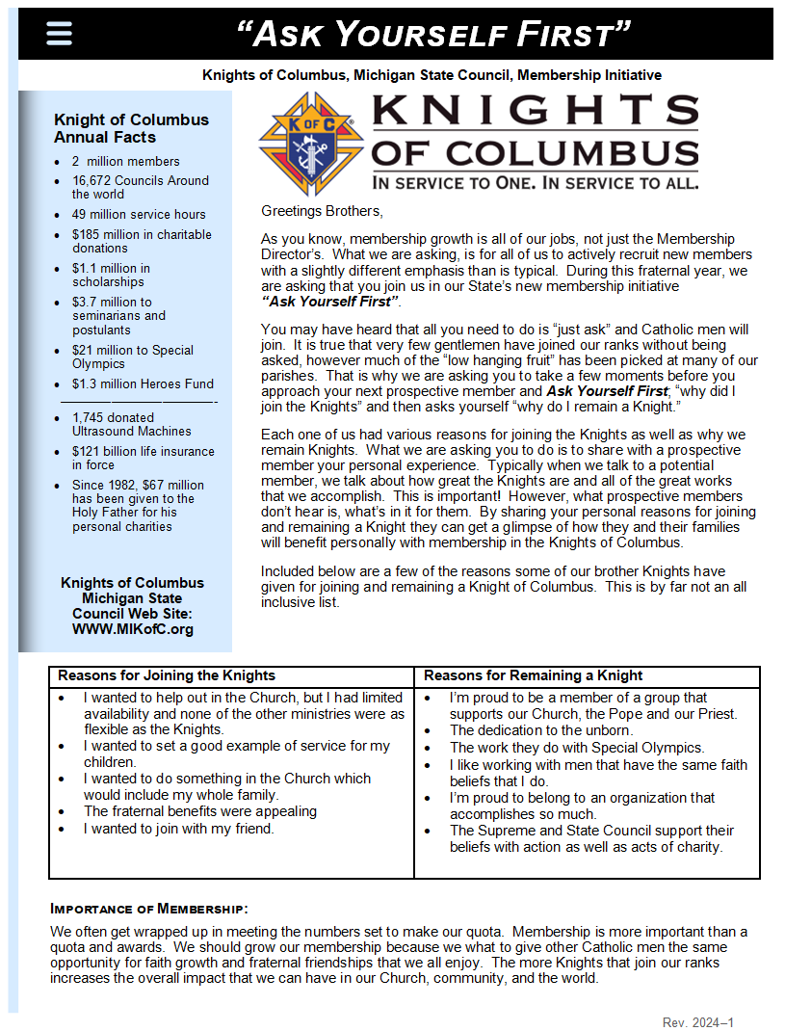
Quick Reference General KofC Info
Reasons for
Joining
Reasons for
Remaining
Notes:
What we do pretty well:
Supreme Literature, Training DDs, Training GKs
What about the guy on the ground?
We usually give him some handouts as say good luck.
Do you remember the first time you were asked to help out a Membership drive?
This is a tool for the guy on the ground.
It also gets at the prospective members question “What’s in it for me”.

Slide 46
Reasons for
Joining
Reasons for
Remaining
Notes:
What we do pretty well:
Supreme Literature, Training DDs, Training GKs
What about the guy on the ground?
We usually give him some handouts as say good luck.
Do you remember the first time you were asked to help out a Membership drive?
This is a tool for the guy on the ground.
It also gets at the prospective members question “What’s in it for me”.

Slide 47
Quick Reference General KofC Info
Notes:
What we do pretty well:
Supreme Literature, Training DDs, Training GKs
What about the guy on the ground?
We usually give him some handouts as say good luck.
Do you remember the first time you were asked to help out a Membership drive?
This is a tool for the guy on the ground.
It also gets at the prospective members question “What’s in it for me”.

Slide 48
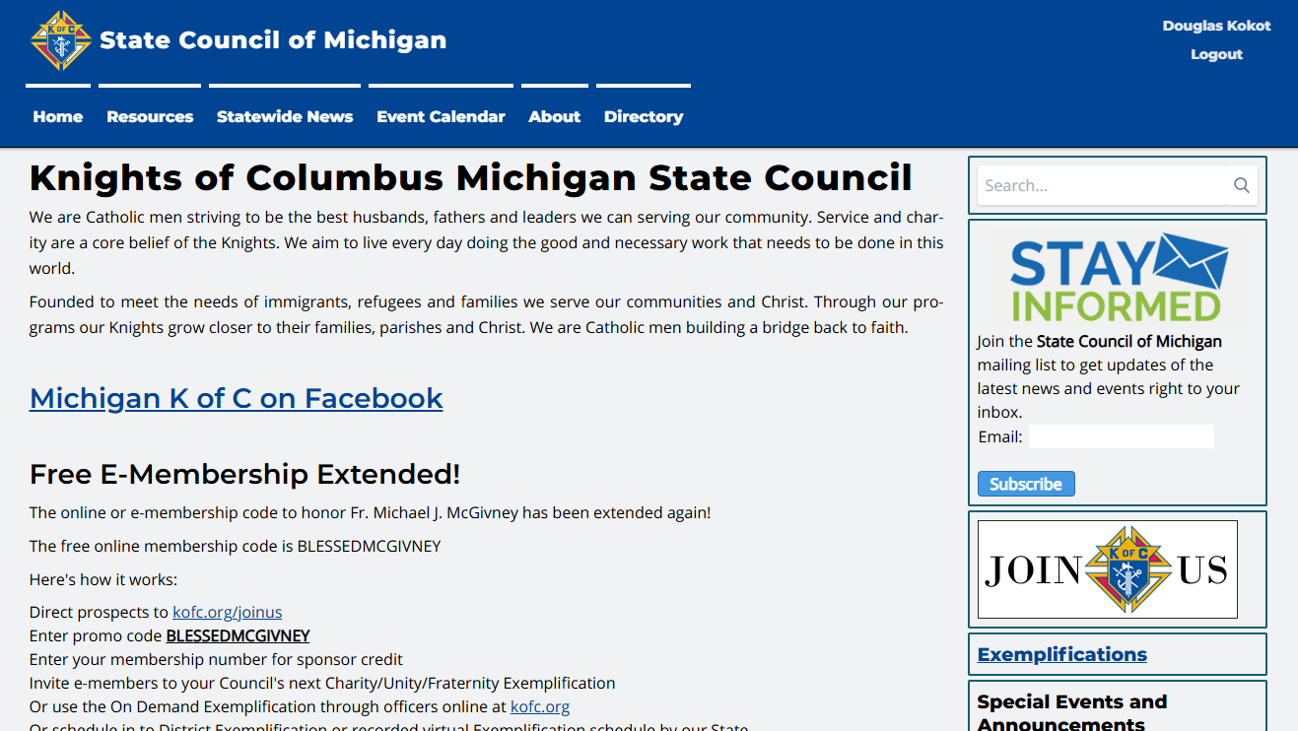
WWW.MIKOFC.ORG

Slide 49
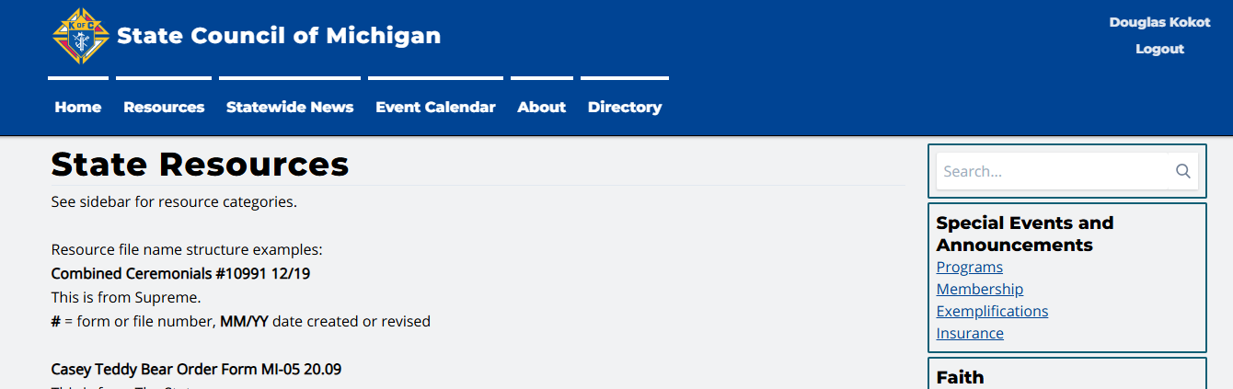
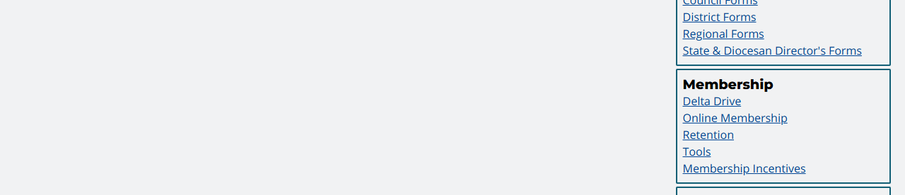
WWW.MIKOFC.ORG

Slide 50
Help Make Every Knight a more Effective Recruiter
Have all of your councils use:
“Ask Yourself First”

Slide 51
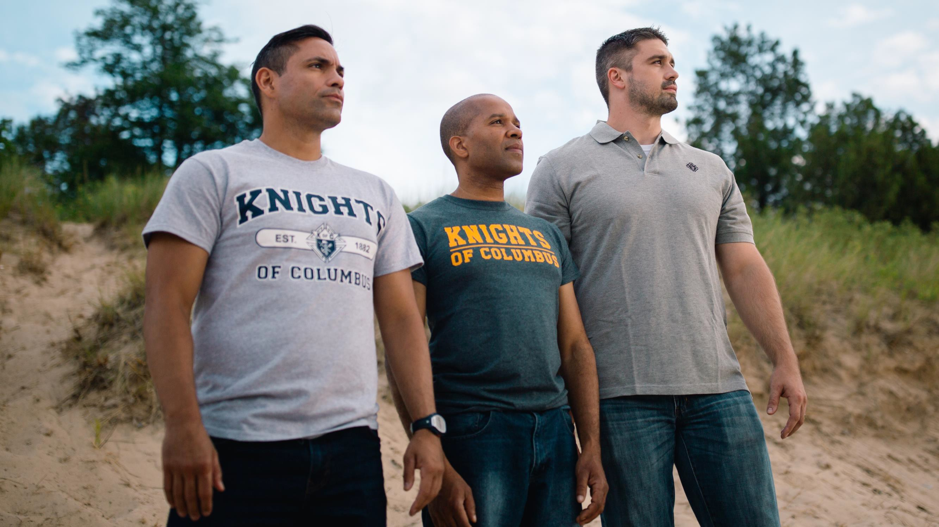


NOW YOU ARE READY TO SOAR WITH US

Slide 52


