Slide 1

MIKofC Email
Jeff Thomas
State Email Director
Notes:
1

Slide 2

MIKofC Email
Agenda
MIKofC.org Email
  Email naming
  How to logon
  Add Another User
  Passwords
  Support
Notes:
What we are going to talk about
1 MIKofC Email
2 Email naming
How to logon
Add Another User
Passwords
Support
2

Slide 3
Email Naming Convection
District Deputies
(July 1st - ask to share)
ddXXX@mikofc.org
SDRR’s/Diocesan/Regional/State Directors
& State Officers
First Initial dot Last Name @ mikofc.org
d.kokot@mikofc.org
Notes:
Email Naming Convection
District Deputies
1 (July 1st - ask to share) – Contact your predecessor
2 ddXXX@mikofc.org and start looking regularly – should be daily after July 1 – change password after 7/1
3 SDRR’s/Diocesan/Regional/State Directors & State Officers
4 First Initial dot Last Name @ mikofc.org
5 d.kokot@mikofc.org
3

Slide 4

MI KofC Email
Council
GKXXXX Grand Knights
FSXXXX Financial Secretaries
MDXXXX Membership Directors
PDXXXX Program Directors
Share until July 1st – Then... Hand it Off!!!
Notes:
1 GKXXXX Grand Knights
2 FSXXXX Financial Secretaries
3 MDXXXX Membership Directors
4 PDXXXX Program Directors
5 Share until July 1st – Then... Hand it Off!!!
4

Slide 5
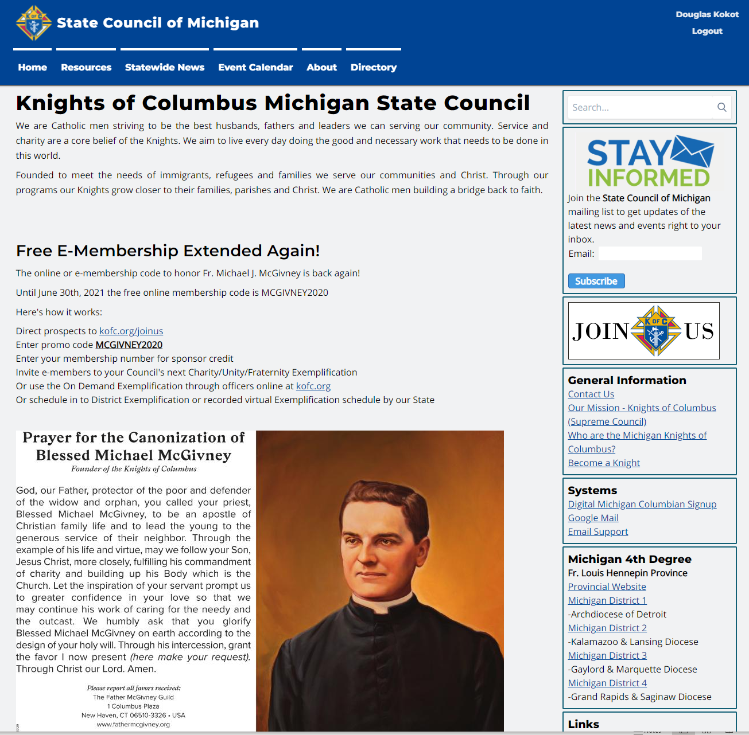
How to Logon
Notes:
How to Logon
Go to WWW.mikofc.org
On Home Page – Right Boxes scroll down to:
1 Box called Systems click on Google mail
5

Slide 6
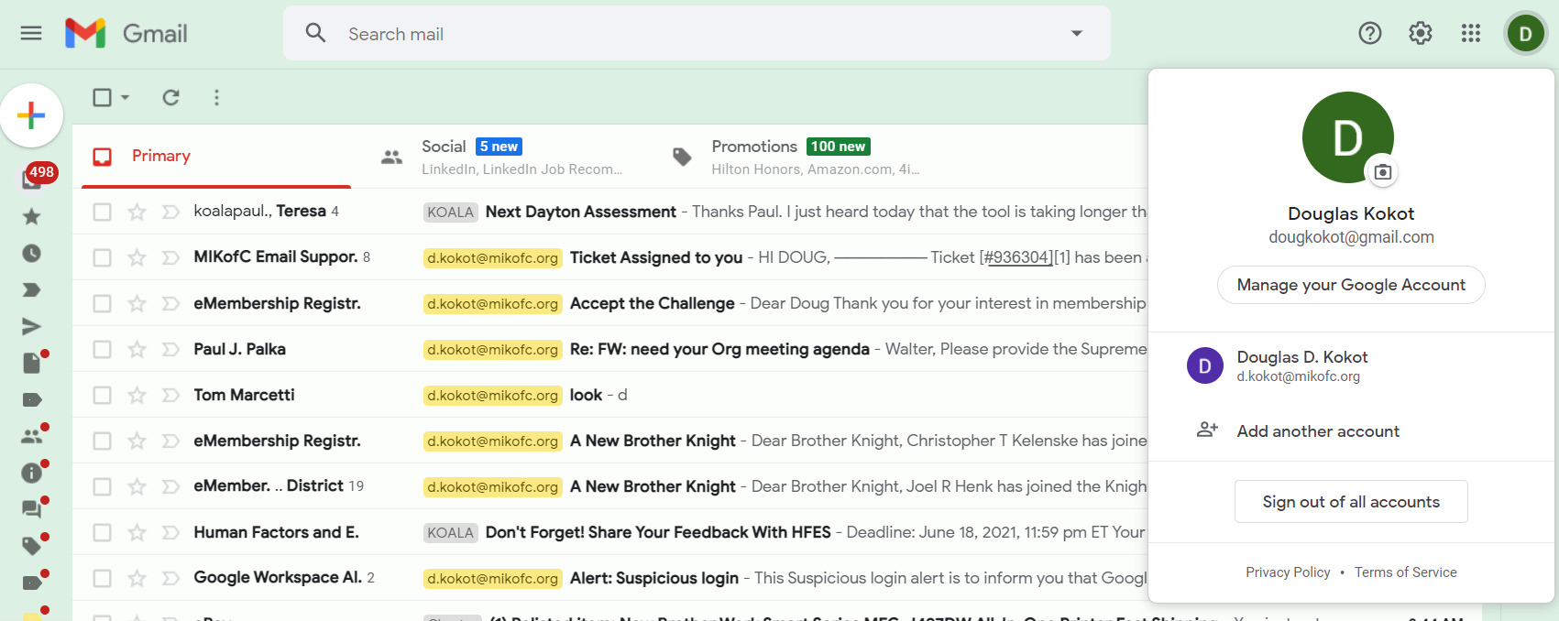
Add another account
(If you already have a Google Email Account)
Swap
This is also how you swap between accounts
Notes:
If you already use Google you can add another account
Open your Google mail, click on the top right (The Green letter) and the drop down will appear
1 Click on Add another account & enter your Mikofc.org account and password
2 For future session, you will be able to open one app & swap between emails – all your accounts together
6

Slide 7
Email Password
How do councils get their email password?
July 1st... Hand it off!!! (Can share until July 1st)
Get it from their predecessor
Email Support
If you can’t get it from predecessor or just plain lost it.
Notes:
How do councils get their email password?
1 July 1st... Hand it off!!! (Can share until July 1st) - Get it form their predecessor
2 If you can’t get it from predecessor or just plain lost it. We will use Email Support
7

Slide 8
Email Support
Go to www.mikofc.org
Notes:
8

Slide 9
Email Support
Notes:
On Home Page – Right Boxes scroll down to:
1 Box called Systems click on Email Support
9

Slide 10
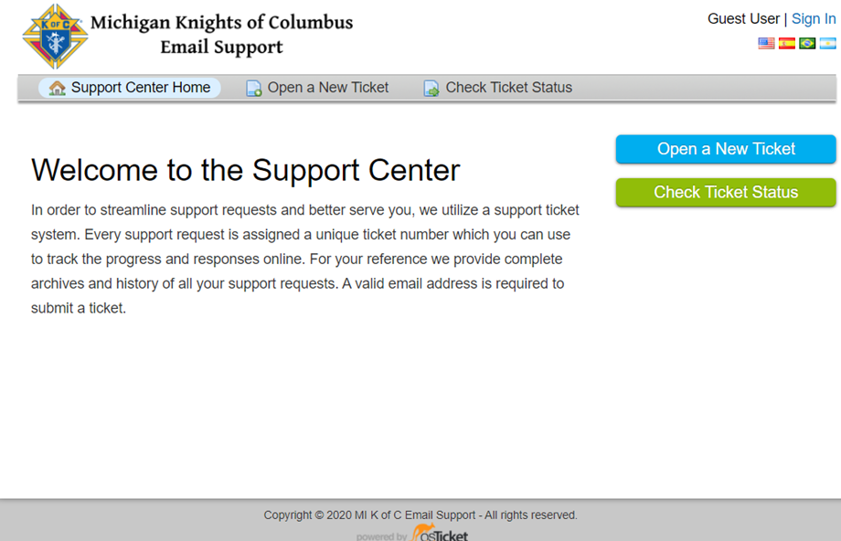
Notes:
Select Open a New Ticket
10

Slide 11
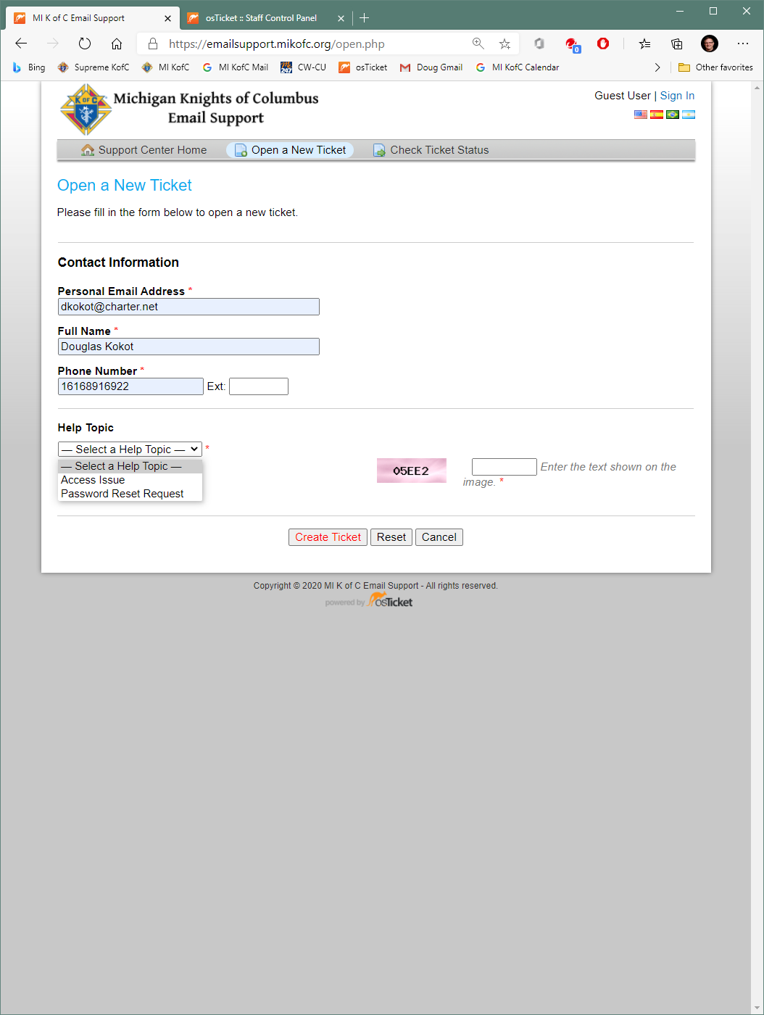
Notes:
Fill in Contact Information
Select Password Reset Request from the dropdown box
Prove that you are not a computer by entering the text you see in the box to the left – security of your data & ours 3rd party
Click Create Ticket (at the end of the blue arrow)
11

Slide 12
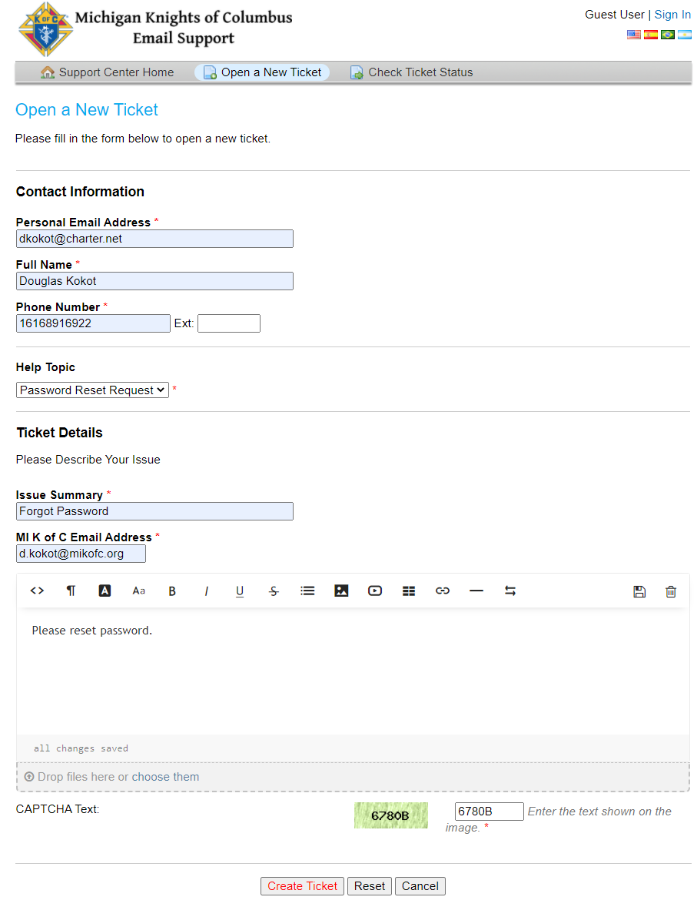
Notes:
More fill ins
12

Slide 13
Automatic Email Forwarding
Beginning July 1, 2025 Automatic Email Forwarding will be turned off.
The ability to automatically forward your MIKofC.org email to another email account will be discontinued.
Notes:
Maybe
13

Slide 14

Questions?
Notes:
14

Slide 15
WWW.MiKofC.org
The State Website
A Whirl Wind Tour
Notes:
1

Slide 16
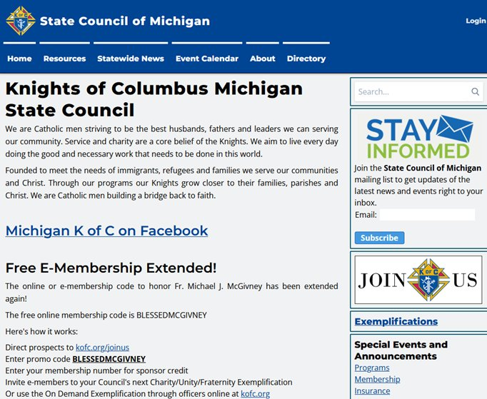
Notes:
1 Unlike Supreme – custom search that stays in the website - custom not just a google
2 Everyone – anyone – your wives should join – new articles posted by Matthew Hoxsie – The Michigan Columbian
3 Links to the Supreme sign up & the promo code is on the left
2

Slide 17
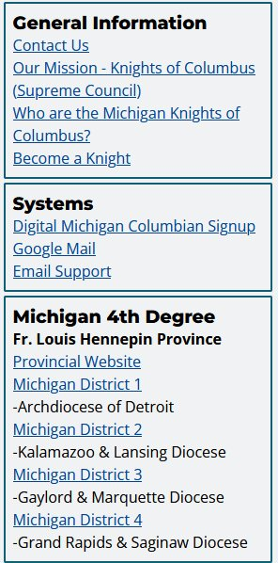
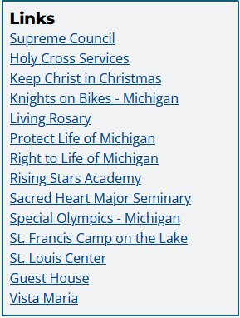
Always Scroll Down
Notes:
3

Slide 18
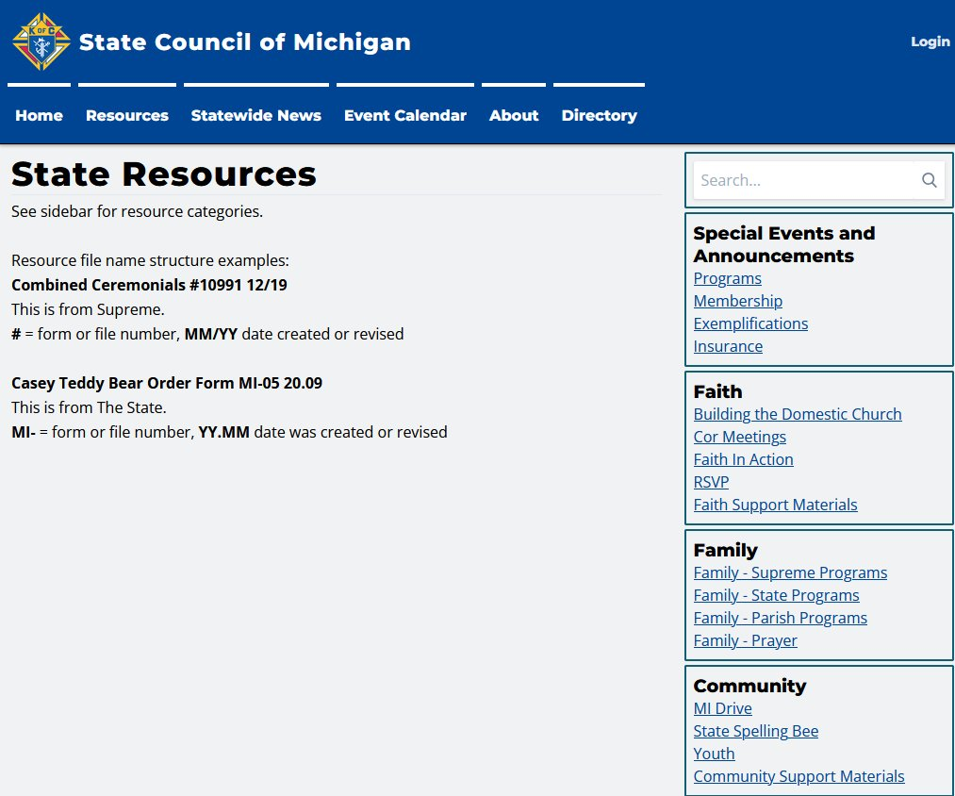

Notes:
A Cornucopia of useful information
State & links to Supreme
4

Slide 19
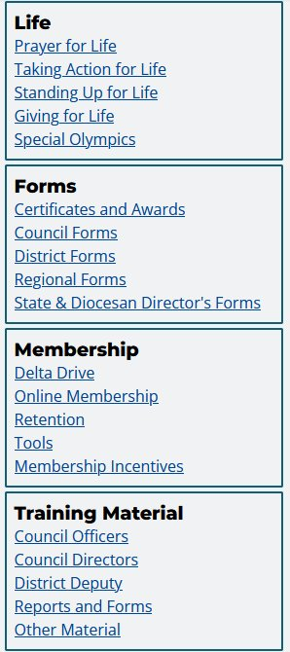
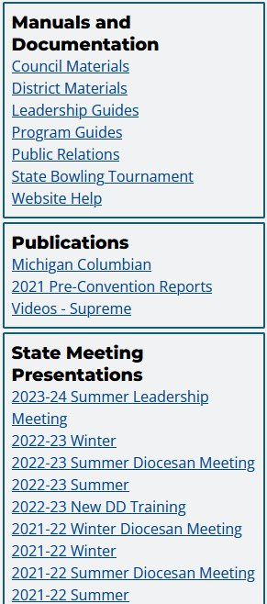
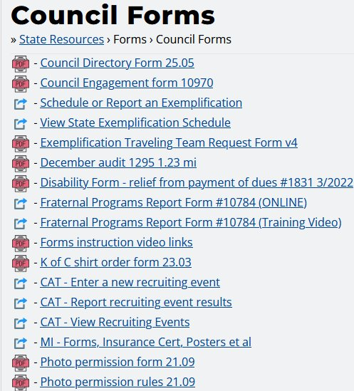
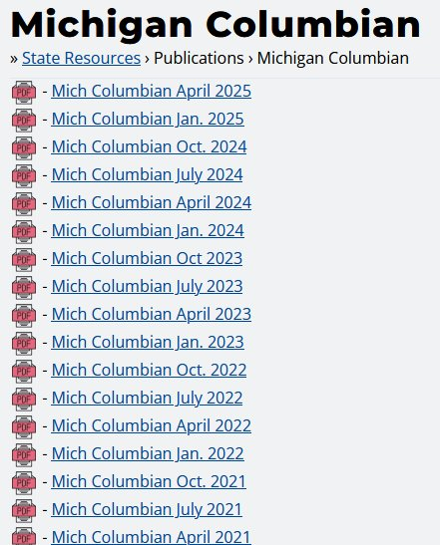
Notes:
Again, Remembering to scroll down…
1 Clicking on Council forms
2 Brings up a library - again State & Supreme
3 In the Publications Box clicking on Michigan Columbian – brings up an archive
5

Slide 20
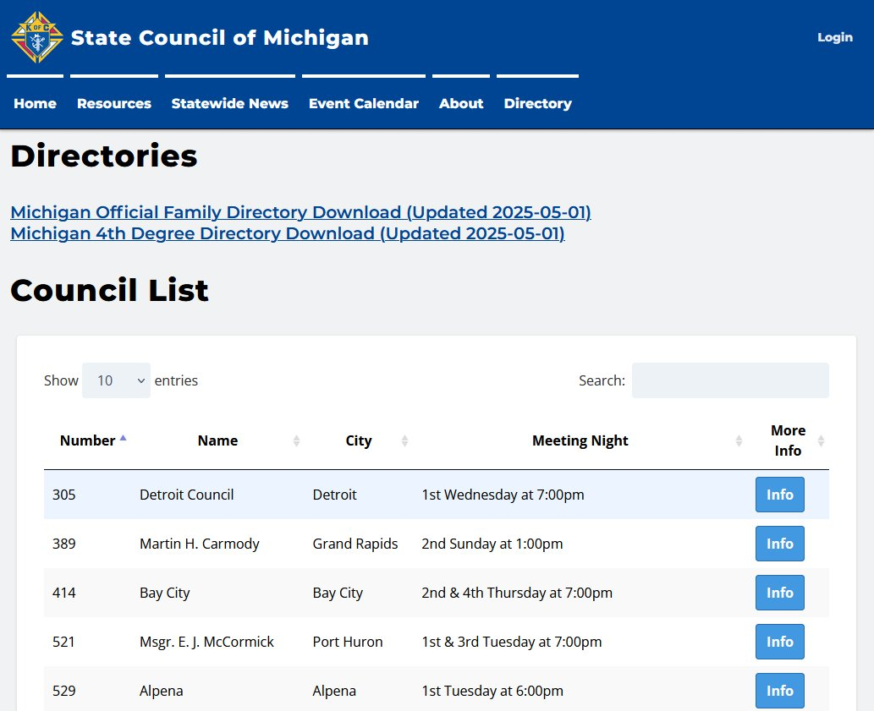

Notes:
Anybody can see
1 But if they want to access
6

Slide 21
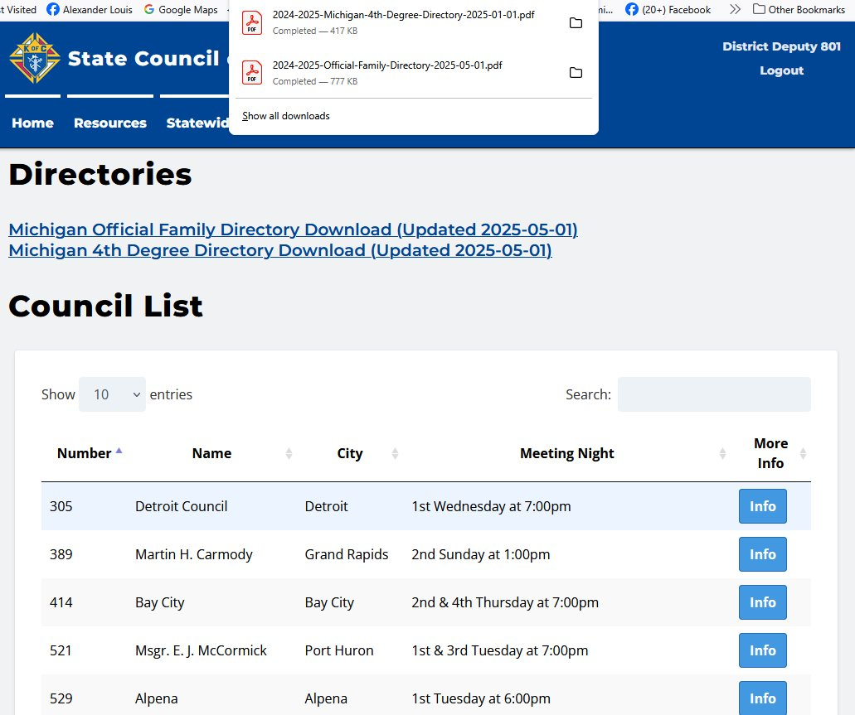
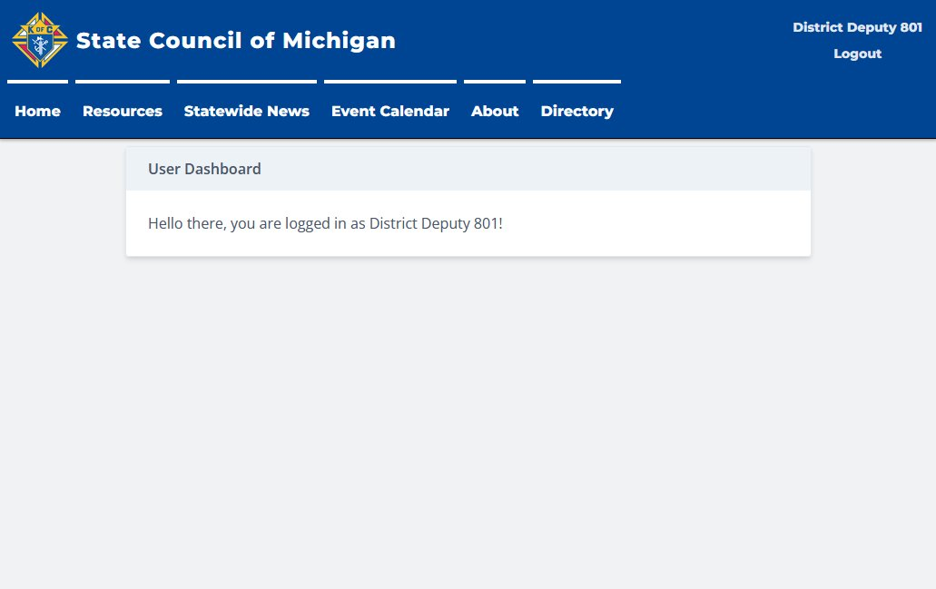
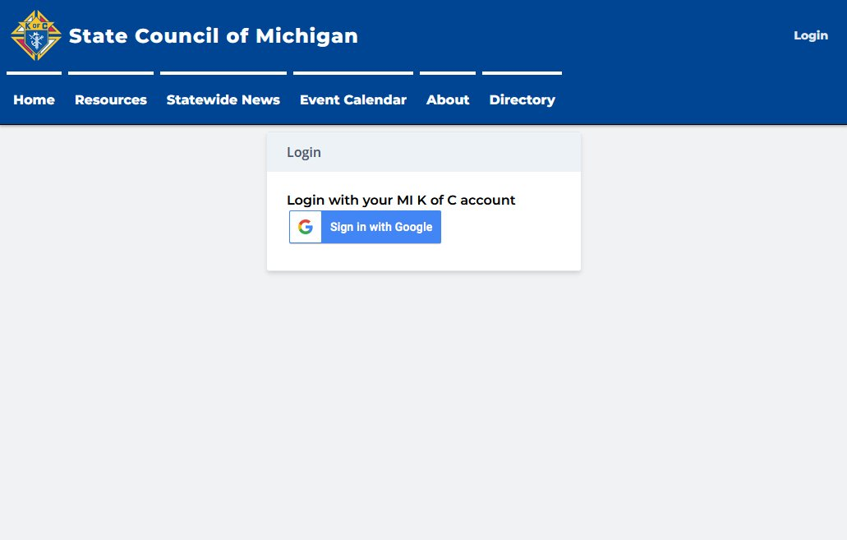
Notes:
Login request
1 login welcome
2 what you can do
7

Slide 22
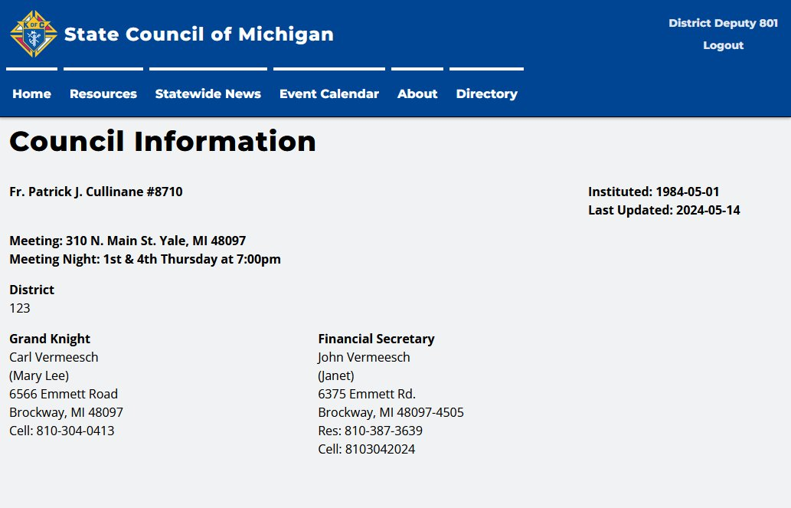
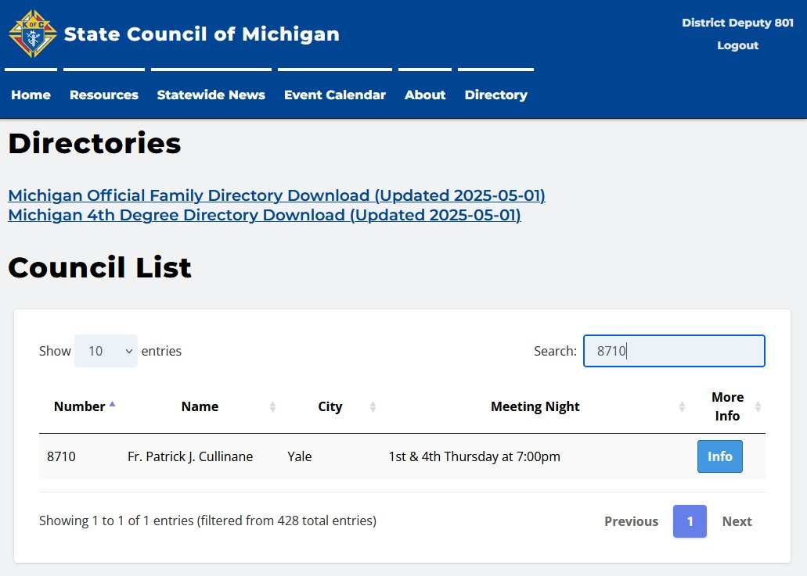
Notes:
Looking up councils
1 to protect local officers contact information – MiKofC.org required
2 Council information – Last update just before this year’s elections
8

Slide 23
Questions?
Notes:
9

Slide 24
Filling Out A Fillable PDF
Easy As 1 - 2 - 3
1. Open & Down Load
2. Fill out & Save to Your Computer
3. Attach & Send
Notes:
All slides except 4 & 5 use fly in Best to fill forms on a desk or Lap top – Both Apple iPhone & androids have little quirks that can cause problems
Slide 1 4x
Slide 2 2x
Slide 3 2x

Slide 25
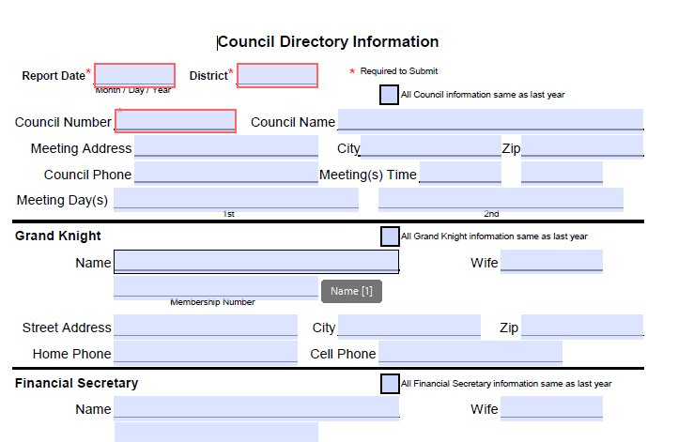
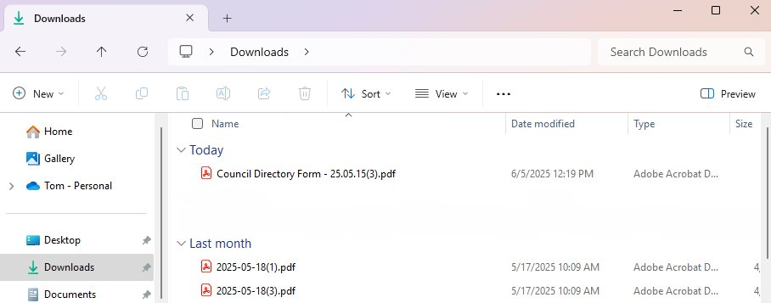
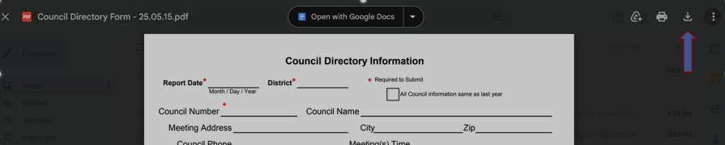
1. Open & Down Load
Notes:
If Received in an Email all you may have to do is open
If You use the State Website, you may need to Download
Either it will be in your Download Folder (Windows 11)
Or You may need to manually down load

Slide 26
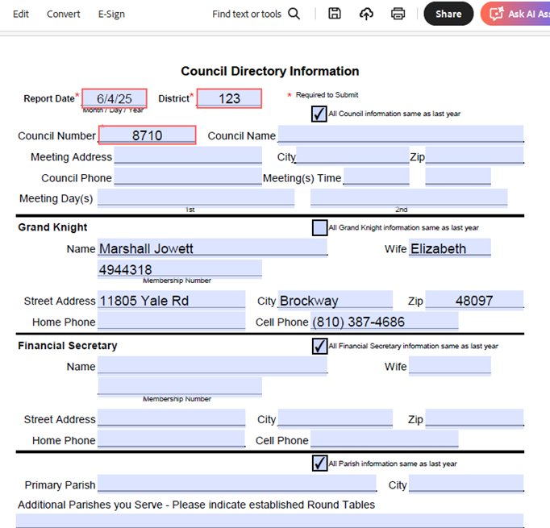


2. Fill out & Save to Your Computer
Notes:
Make sure Required information is correct
Use check boxes when available
When Saving to your computer
Use Save as and make the name unique
Make Sure you make note where you saved it

Slide 27
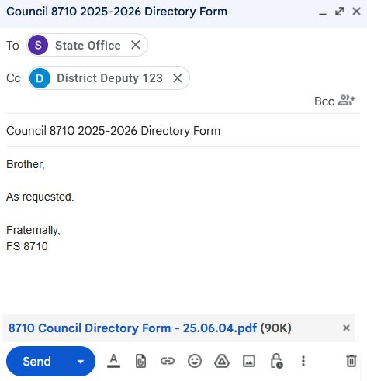
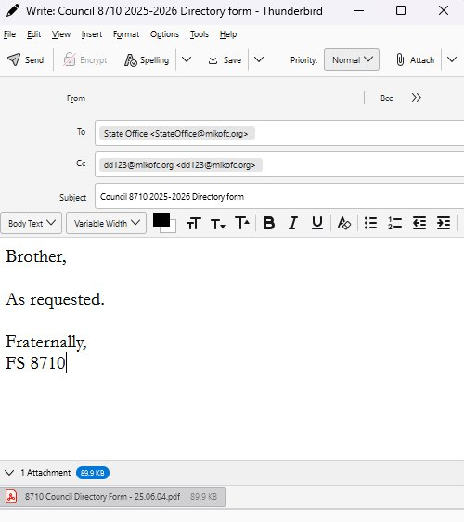
3. Attach & Send
Notes:
Whatever app you use to Email make sure:
To send it to everyone that should receive a copy
That the PDF is attached
Now as a bonus, you have a copy on your computer that you can Print and if you need to update contact information you can just edit & resend

Slide 28
Questions?

