Slide 1

Programs
Service
Optimism
Aspire
Responsibility
Let’s SOAR in 25!
“Those who wait on the Lord shall mount up with wings as eagles.” - Isiah 40:31

Slide 2

We SOAR by putting our Faith in Action

Slide 3
Why We Do Programs
  Our goal is to help men; their families and their parishes grow closer to Christ. Through our programs and resources, we provide opportunities to live and spread the Catholic faith.
  Together, we’re empowering Catholic men to live our faith at home, in our parish, at work and in our community

Slide 4
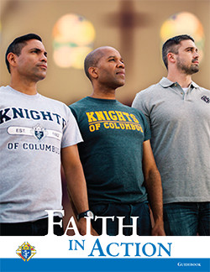
These Are Your State Faith in Action Team
Matt Wierzgac (State Program Director)
  m.wierzgac@mikofc.org
  734.323.5888
Robert Bagley (State Faith Director)
  r.bagley@mikofc.org
  269.806.3883
James Kelley (State Family Director)
  j.kelley@mikofc.org
  586.909.8359
Larry Herman (State Community Director)
  l.herman@mikofc.org
  231.357.5621
Ed & Lynn Strach (State Life Director/Couple)
  e.strach@mikofc.org
  734.476.6296

Slide 5








YOUR
State
Program
Leadership
Team

Slide 6
The Faith in Action Categories
FAITH
FAMILY
COMMUNITY
LIFE

Slide 7





A Review of the Faith in Action Programs
Supreme-Recommended Program Category Matrix

Slide 8
NEW! Faith in Action Programs
Supreme-Recommended Program Category Matrix
Viva Christo Rey
Imitating Juan Diego
Bright Futures
Celebrating our Catholic Heritage
Remembering our Faithful Departed
Quinceanera Support
Holy Hour for Life with Our Lady of Guadalupe
The Gospel of Life

Slide 9
A Review of the Faith in Action Programs
Supreme-Recommended Program Category Matrix

Slide 10
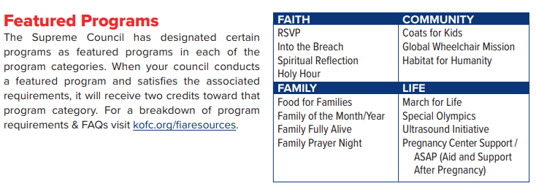
A Review of the Faith in Action Programs

Slide 11
Faith in Action Programs
To qualify for the Columbian Award (SP-7), you need to fulfill a total of 4 points in each of the 4 categories.
Total of 16 Points total at a minimum

Slide 12
A Review of the Faith in Action Programs
Supreme-Recommended Program Category Matrix
4
4
16
4
4
Featured Programs (Highlighted in Red) count for 2 points each.

Slide 13

Download the Faith in Action Guidebook
Available to download on Supreme’s website. In search bar on kofc.org, enter “10907”
Keep a copy local on your laptop/tablet.
Print a copy if you like.
Printed copies can be ordered through Supplies Online on Supreme’s Website.
Send a copy to council program directors.

Slide 14
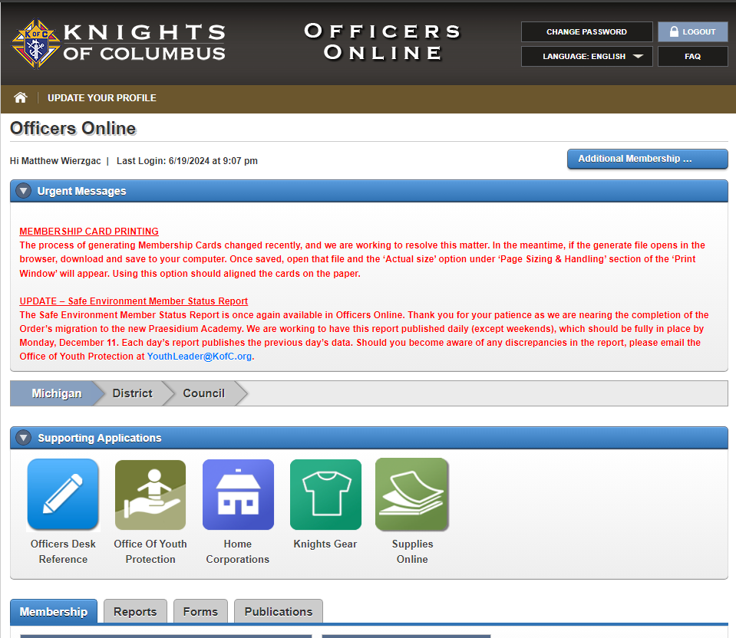
How to Order the Faith in Action Guidebook
Once logged into Officers Online, locate and click “Supplies Online”

Slide 15
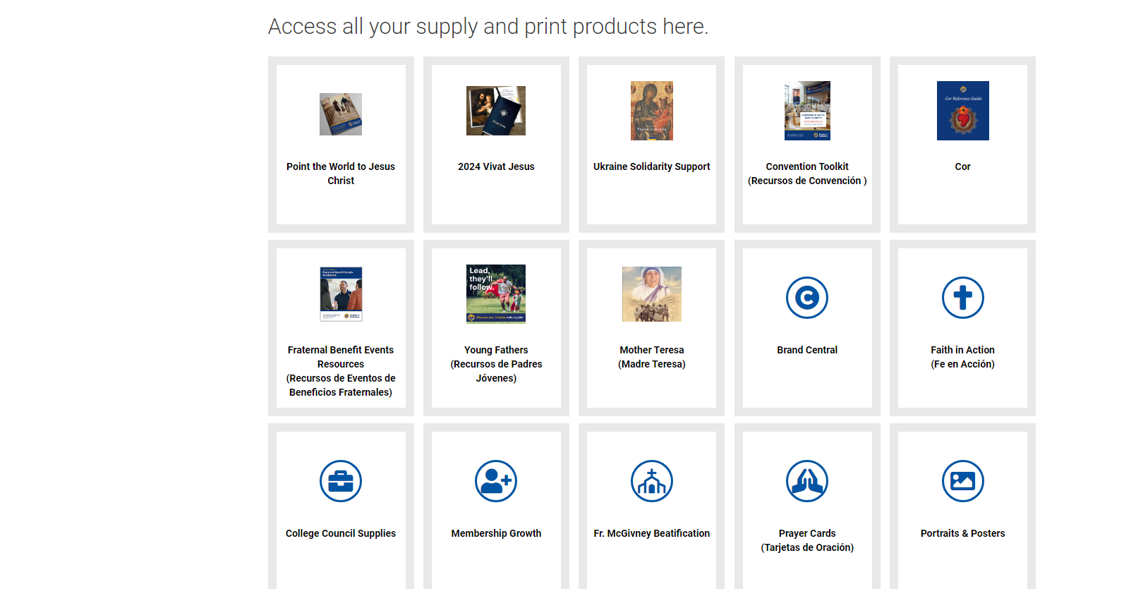
How to Order the Faith in Action Guidebook
Scroll down and locate “Faith in Action”

Slide 16
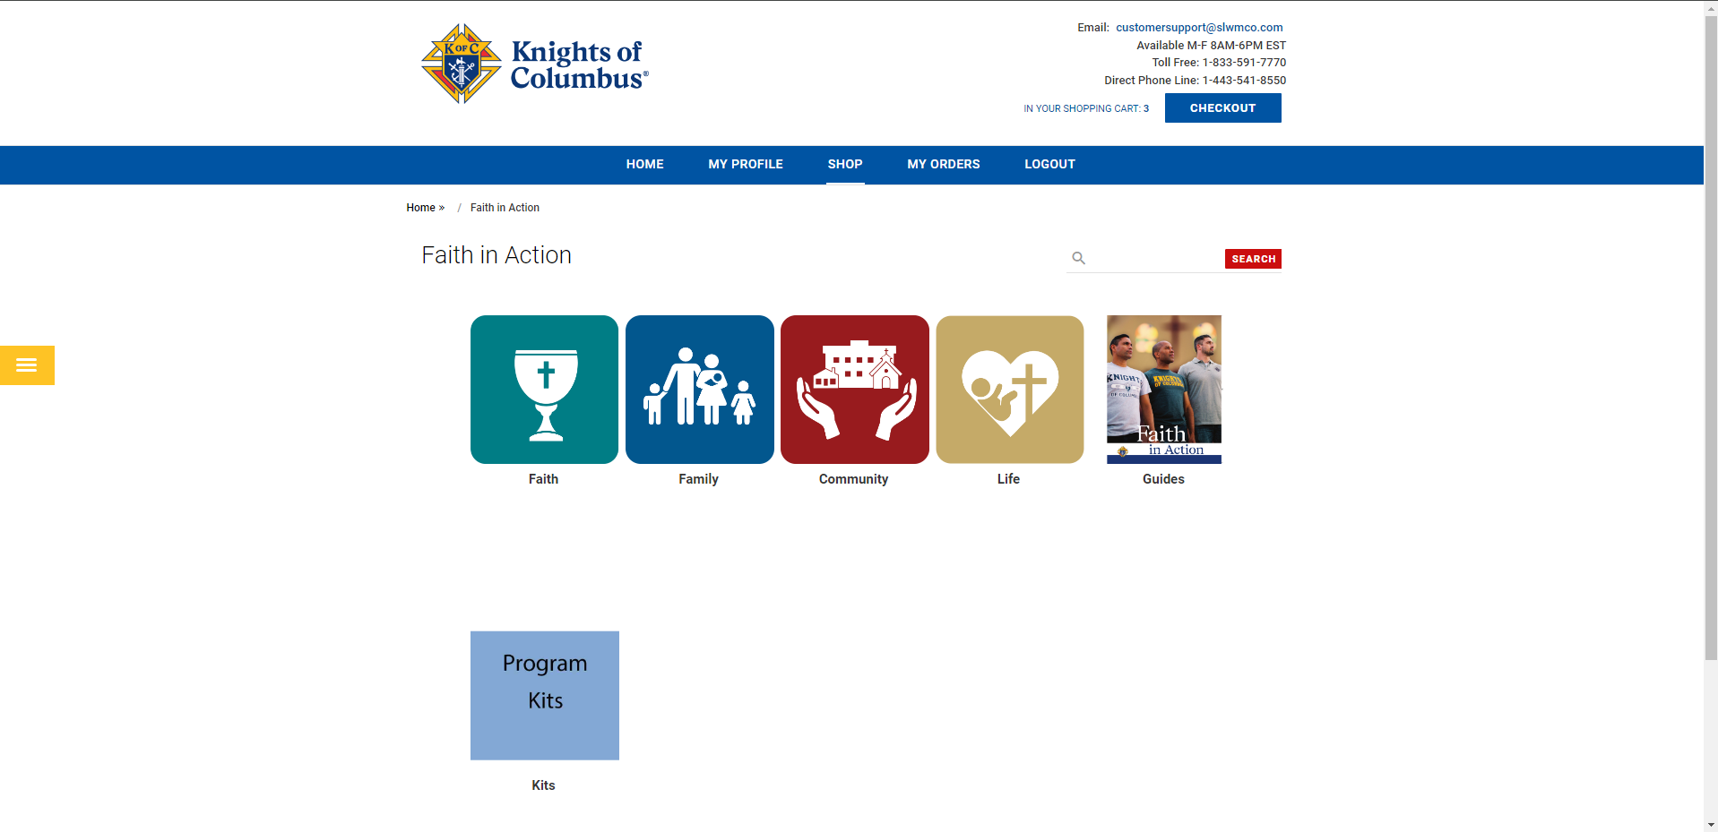
How to Order the Faith in Action Guidebook
Click on “Guides”

Slide 17
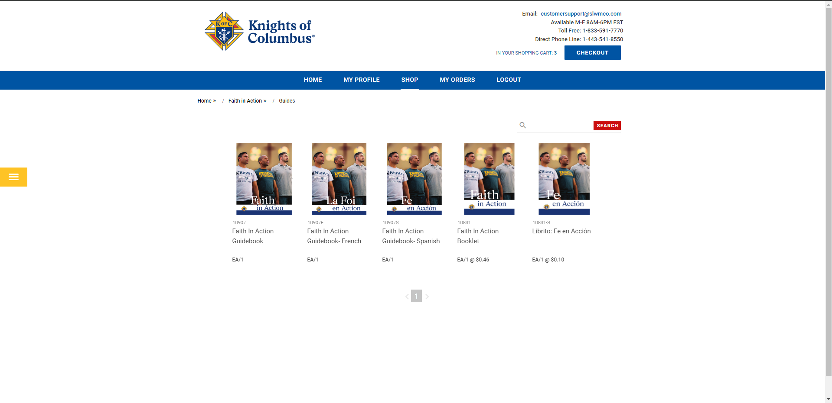
How to Order the Faith in Action Guidebook
Click on “Guidebook”
For the shorter and less detailed version, click “Booklet”
Once you click the box you want, specify the quantity you would like and order.

Slide 18
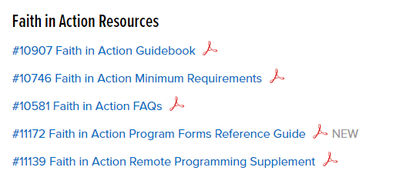
Other Faith in Action Resources
Also available on kofc.org website:

Slide 19
Other Resources
- Diocesan Program Directors
- State Faith In Action Directors

Slide 20


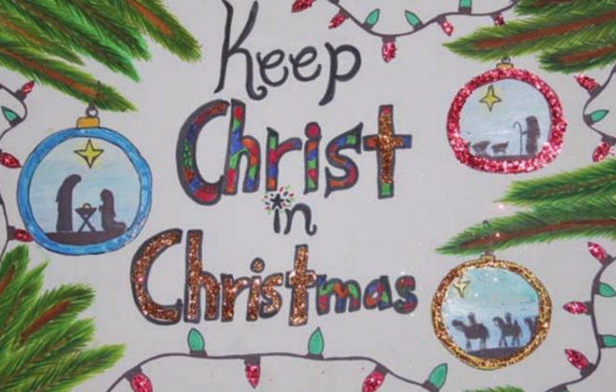
Council, District & Diocesan Level Programs
1st Half of the fraternal year

Slide 21



Council, District & Diocesan Level Programs
2nd Half of the fraternal year

Slide 22
How to order awards for district programs
Through supplies online on supreme’s website, you can order kits for:
  Soccer Challenge ($5/ea, max of 3)
    Guide Sheet and Play book
    Posters
    Scoresheets & Certificates
  Essay Contest ($5/ea, max of 3)
    Guide
    Posters
    Judging Sheet & Certificates
  Free Throw Championship ($0/ea, max of 3)
    Guide
    Scoresheets
    Certificates

Slide 23
How to order awards for district programs
You can order district metals for winners of district events also through supplies online on supreme’s website, you can order kits for:
  Soccer Challenge
  Hockey Challenge
  Free Throw Championship

Slide 24
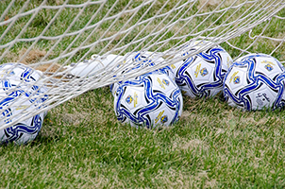
Upcoming State-Level Programs
State Soccer Challenge Finals, Saturday, October 4, 2025
Registration: 12PM, Competition: 1PM
St John Vianney Church, 4101 Clyde Park Ave SW, Wyoming, MI 49509

Slide 25

Upcoming State-Level Programs
State Spelling Bee, Saturday, March 7, 2026
Registration: 12PM, Competition: 1PM
Fr. Van Rooy #2740, 1021 Woodside Ave Essexville, MI 48732

Slide 26
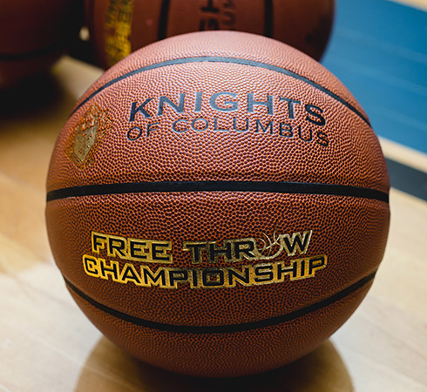
Upcoming State-Level Programs
State Free Throw Championship,
Sunday, March 15, 2026
Registration: 12PM, Competition: 1PM
Sacred Heart Parish, 302 South Kinney,
Mt. Pleasant, MI 48858

Slide 27
What Goes With Programs?
FRATERNAL PROGRAMS REPORT FORM (#10784)!
Question: Who can submit the 10784?
Answer: Anyone from your Council Roster with an active email on file.
Question: Where do I complete the form?
Answer: Form is done online at kofc.org website
Question: Is there training available on how to complete this form?
Answer: YES!! Your Monthly DD Summary Report will have a link on to access training but can also be found on the supreme website. Search for “Fraternal Programs Report Form Training Video” in the search bar.

Slide 28

Youth Protection

Slide 29
Youth Protection
Position | Meet Sam | Duty to Report Mandated Reporter | KofC Safe Environment Policies | Background Investigation
Grand Knight | Required | Required | Required
Program Director | Required | Required | Required
Community Director | Required | Required | Required | Required
Family Director | Required | Required | Required | Required
Who needs Training?

Slide 30
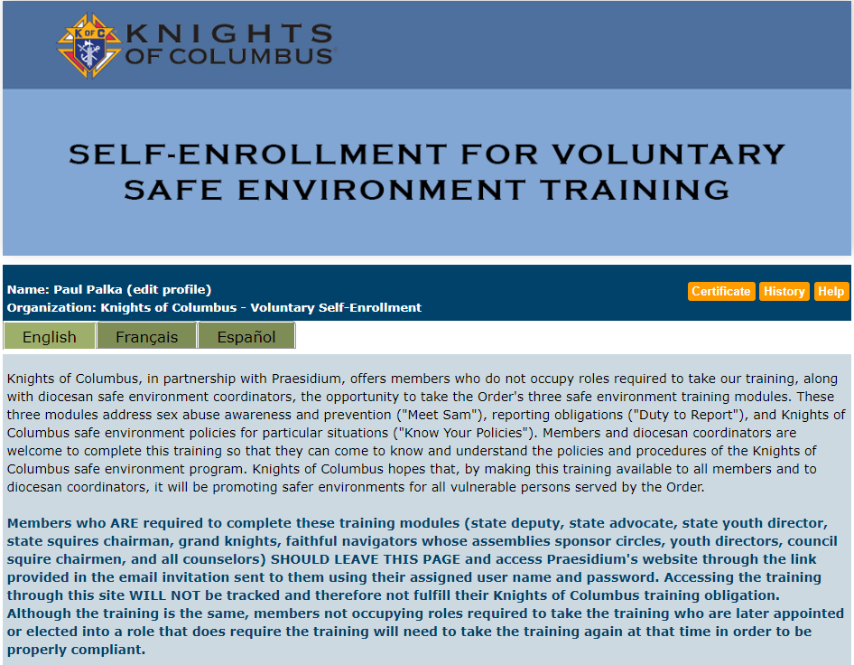
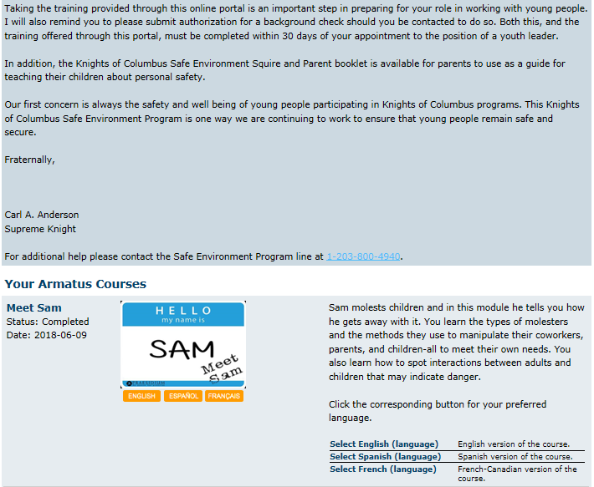
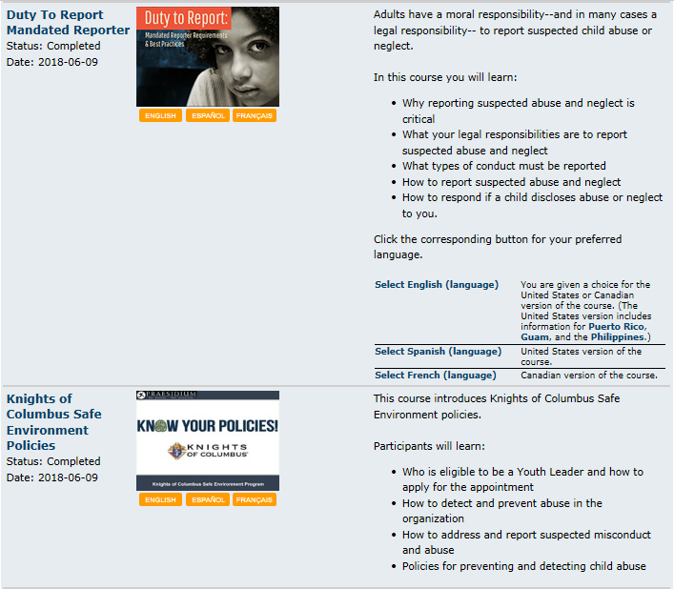
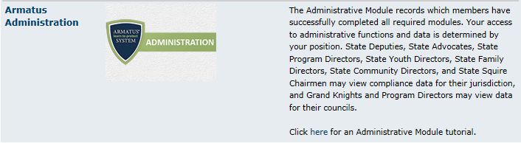
Armatus Site
Please read as this explains why this is so important.
Meet Sam – This is the first (of 3) classes. Click on Meet Sam to take this class.
Duty To Report – This is the second (of 3) classes. Click on Duty To Report to take this class.
KofC Save Environment Policy – This is the third (of 3) classes. Click on KofC Save Environment Policy to take this class.
Background Check (not shown here) must also be selected by all Community Directors & Family Directors.
Armatus Administration is a very useful tool for Grand Knights to use to monitor the training progress of council members.

Slide 31
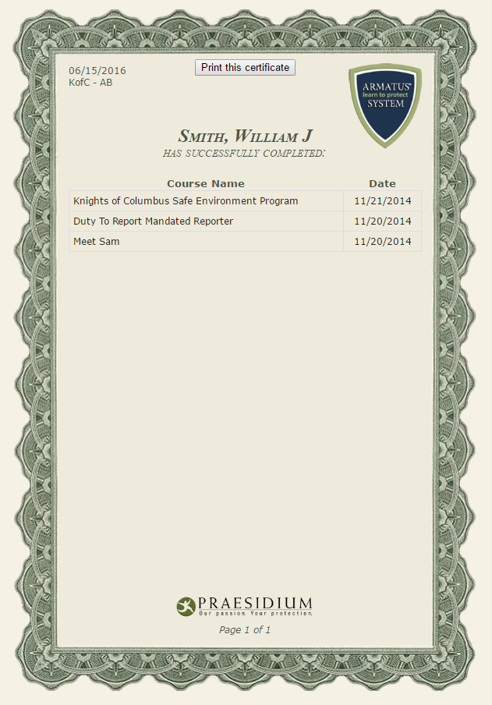
Training Certificate
Print or save your course completion certificate
Your Name Here

Slide 32
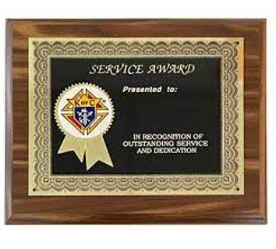
State Council Service Program
Each year every jurisdiction recognizes the best program in each of the Service Program categories of: Faith, Family, Community, and Life. Michigan ackowledges its winners at the State Convention on Mackinac Island in May.

Slide 33
What is Needed to Enter?
A noteworthy program
State Service Program Award Form (#STSP) needs to be completed.
To have a better chance to win, complete a Booklet
The 2024-2025 directories will include information on what is required for the booklet. Look for it in the back. It will also be available in the “Council Forms” section on mikofc.org

Slide 34

Family of the Year
Each year our State Deputy chooses and recognizes a family who stands above the rest in promotion of the principals of our Church and our Order. A family that can best called the “model” family.

Slide 35
What is Needed to Enter?
Family of the Year Form (#10680) needs to be completed.
To have a better chance to win, complete a Booklet
The 2024-2025 directories will include information on what is required for the booklet. Look for it in the back. It will also be available in the “Council Forms” section on mikofc.org

Slide 36
To improve chances to win:
At the Winter Leadership Meeting each District Deputy will provide at registration their councils rough draft to the State Program Director with a bio of the family and picture. The SPD and SFD will review and return with feedback to the District Deputy at the end of the Winter Diocesan Meeting.

Slide 37

Columbian Award
To successfully be eligible for the Columbian Award, a council must:
Successfully submit the form 185, 365, 1728, and SP-7 and be accepted
Be 100% Youth Compliant with all 4 required positions
Council be in good standing AND by submitting council audits in September (1295a) and February (1295b).
Satisfy the Faith in Action credits
  Must earn at least four (4) program credits in each of the Faith in Action categories.

Slide 38
Expectations
Motivate Your Councils. Aspire to make your councils better then you found it!
(Use Dan Remeika’s Talking Points)
Keep that smile on your face.
Stay positive all the time. Do not be negative!
Grow the order by working in tandem with your membership director on integrating membership recruitment in programs.
Identify problems/resolve them
  Ask for help if needed

Slide 39
Expectations
Report your FIA programs for your councils/district on CATs (Council Activity Tracker)
Promote FIA Programs, encourage new FIA programs if not already being done.

Slide 40
Goals
Submit the Form 185, Form 365, 1295a, 944, 1728, 1295b, SP-7, etc. on time
100% Compliance with Youth Protection
Council Audits submitted and in good standing
Leave your councils better than you found them

Slide 41

Resources
You don’t have to “know” everything.
You just need to “know” where to find the answers
Faith In Action Manual (#10590)
Supreme Fraternal Leadership Guide (kofc.org)
Supreme Fraternal Leader Advisory (kofc.org)
Supreme website (kofc.org)
State website (mikofc.org)
Diocesan Directors
State Deputy Regional Representative’s (SDRR)
State Faith in Action Directors
Dan Ramika’s Talking Points

Slide 42
Any Questions???

