Slide 1
Filling Out A Fillable PDF
Easy As 1 - 2 - 3
1. Open & Down Load
2. Fill out & Save to Your Computer
3. Attach & Send
Notes:
All slides except 4 & 5 use fly in Best to fill forms on a desk or Lap top – Both Apple iphone & androids have little quircks that can cause problems
Slide 1 4x
Slide 2 2x
Slide 3 2x

Slide 2
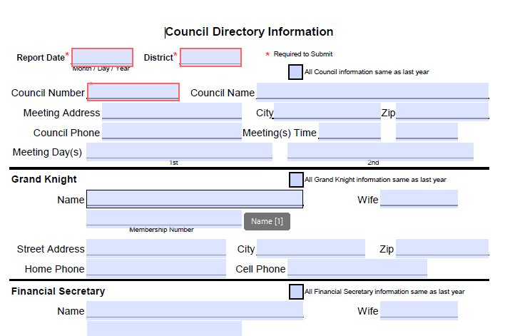
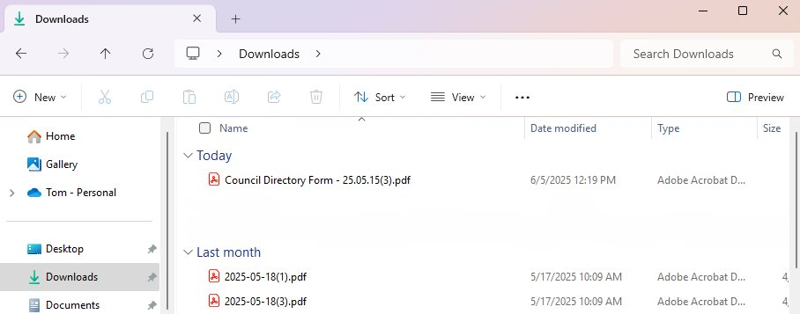
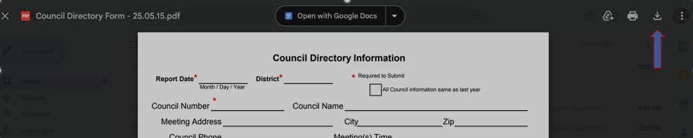
1. Open & Down Load
Notes:
If Received in an Email all you may have to do is open
If You use the State Website, you may need to Download
Either it will be in your Download Folder (Windows 11)
Or You may need to manually down load

Slide 3
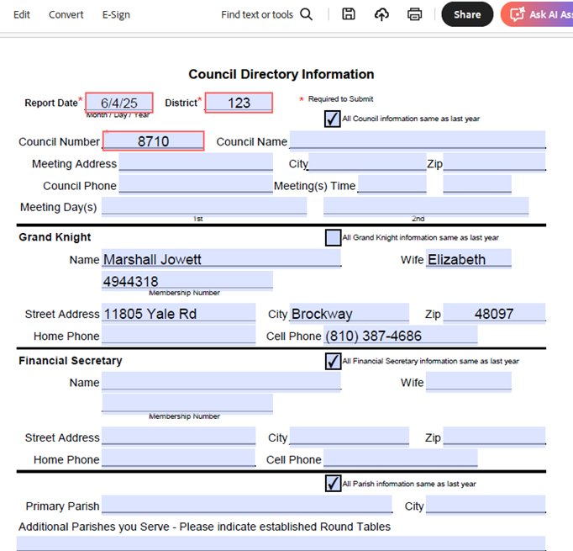


2. Fill out & Save to Your Computer
Notes:
Make sure Required information is correct
Use check boxes when available
When Saving to your computer
Use Save as and make the name unique
Make Sure you make note where you saved it

Slide 4
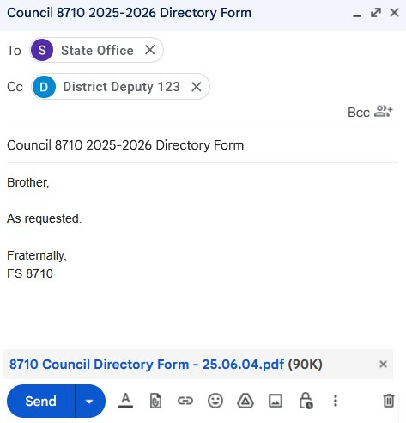
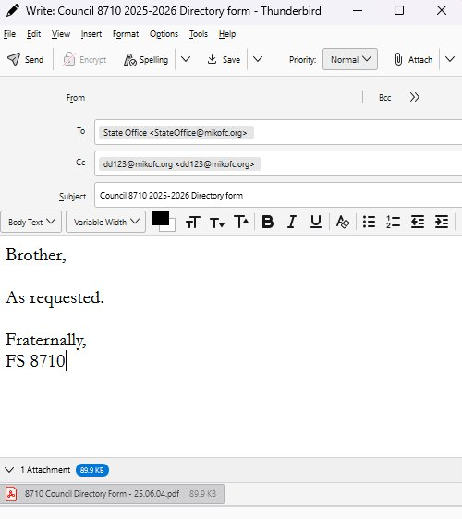
3. Attach & Send
Notes:
What ever app you use to Email Make sure You:
Send it to everyone that should receive a copy
That the PDF is attached
Now as a bonus, you have a copy on your computer that you can Print and if you need to update contact information you can just edit & resend

Slide 5

Questions?

