Slide 1
Council and Agency Partnership

Slide 2
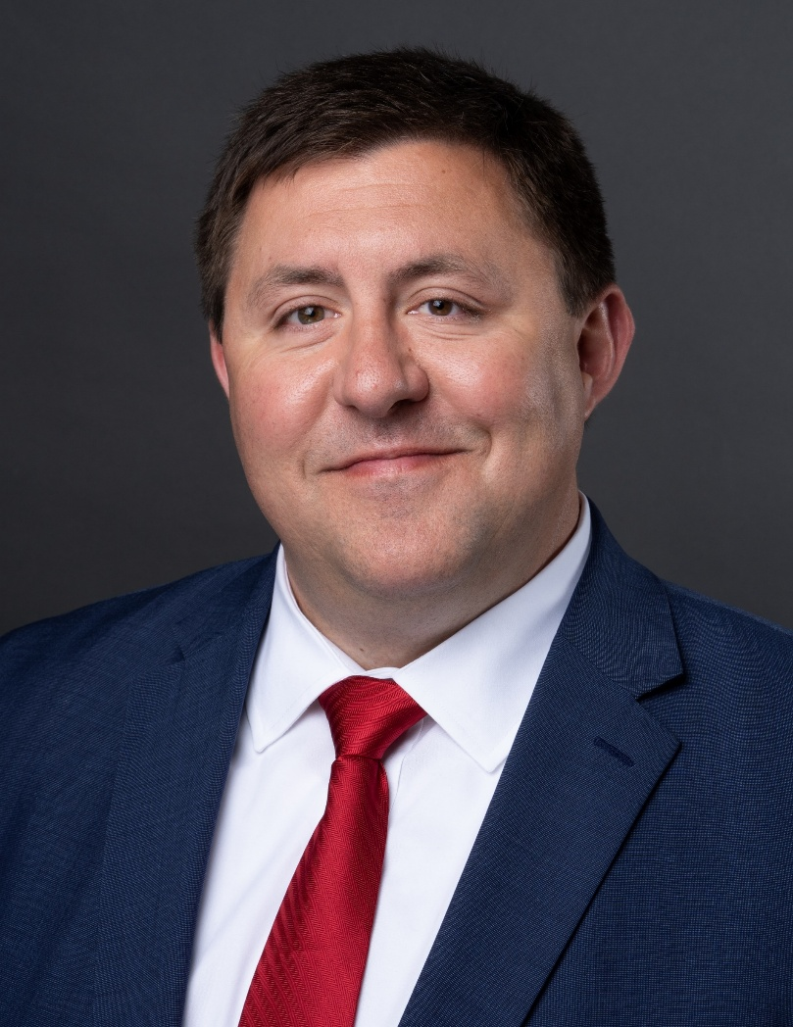
General Agent Presenting
Benji Borrelli, General Agent and Supervising Financial Advisor serving Southeast Michigan
(877) 857-6237 or go to www.borrellikofc.com
Notes:
Brief introduction

Slide 3
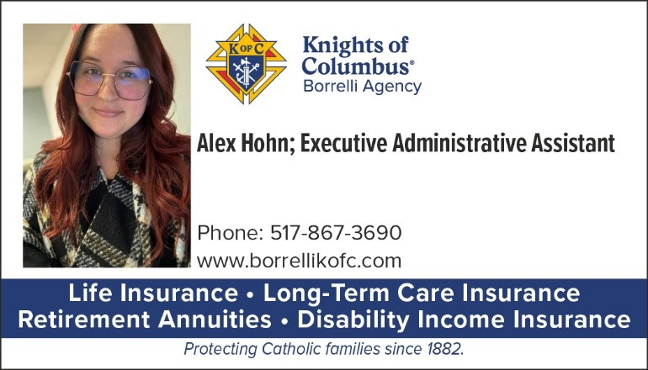
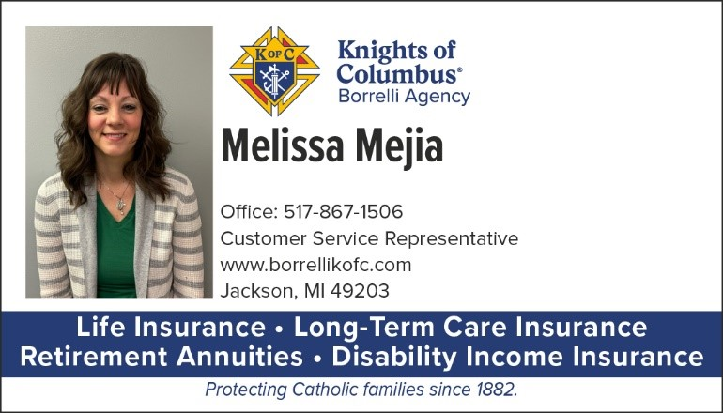
Support Staff serving Southeast Michigan

Slide 4
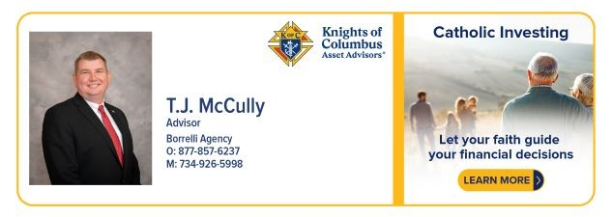
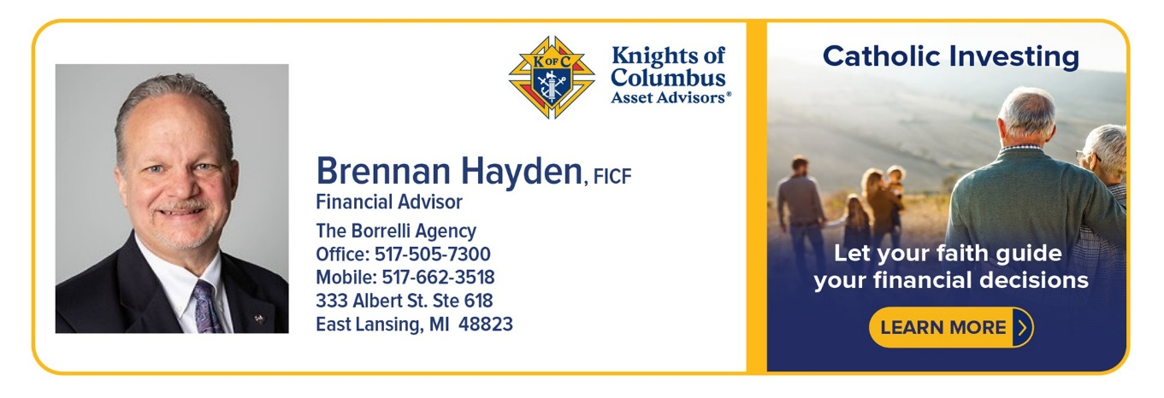
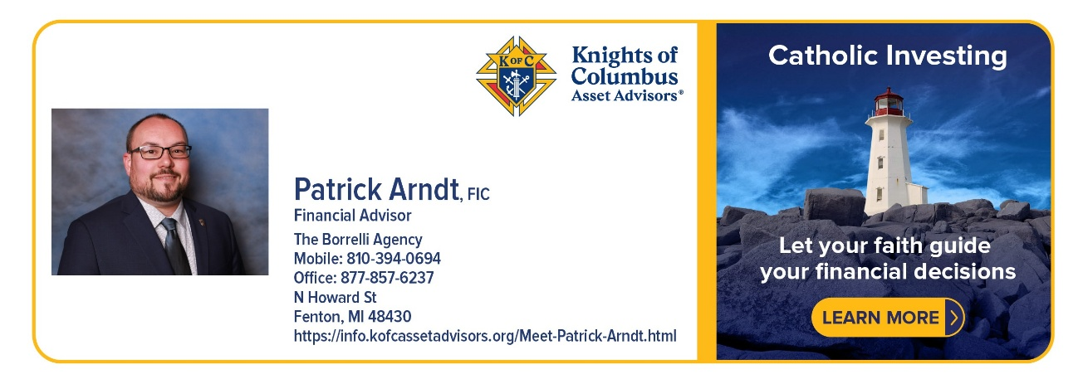
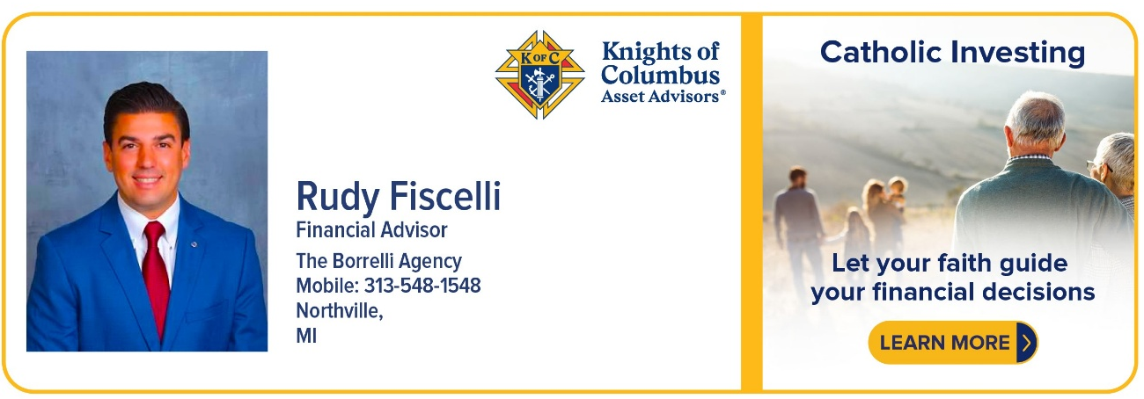
Financial Advisors serving Southeast Michigan

Slide 5
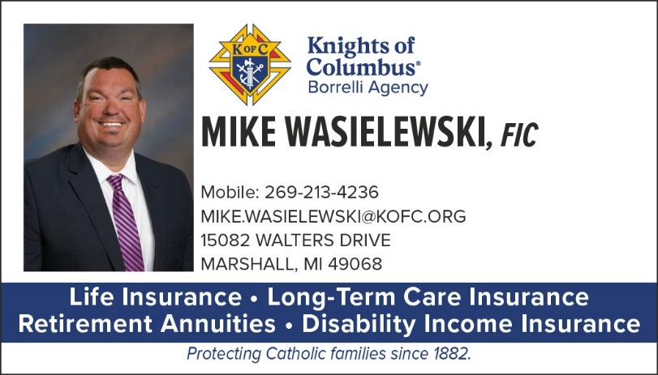
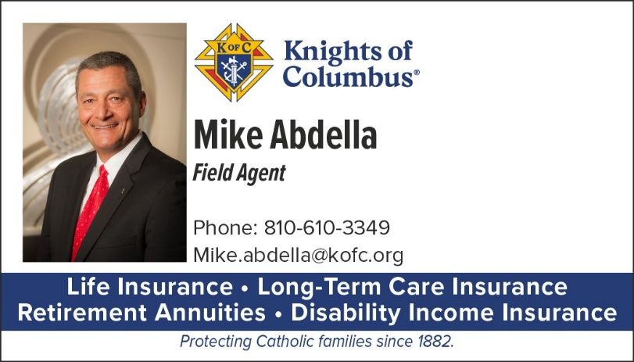
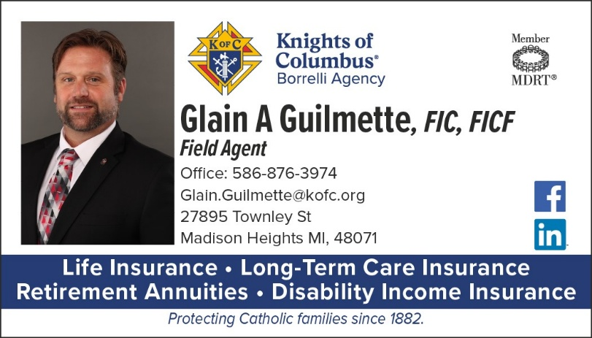
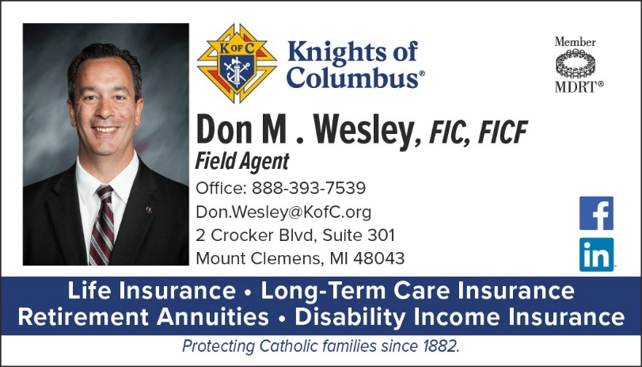
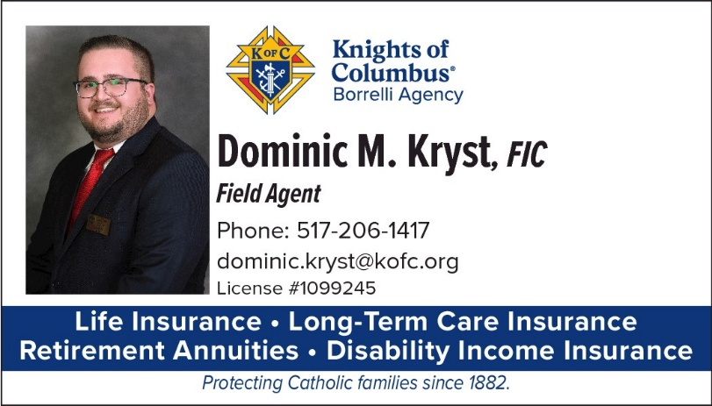
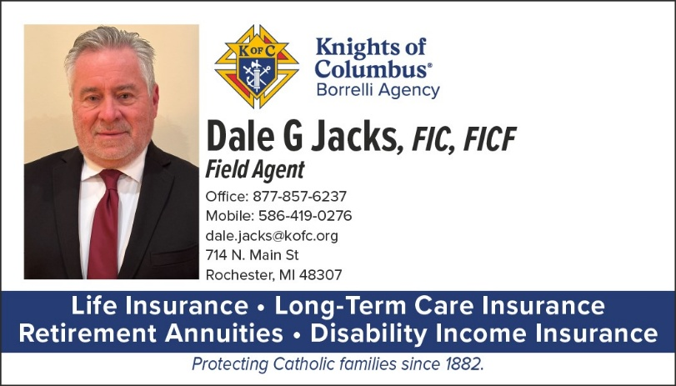
Field Agents serving Southeast Michigan

Slide 6
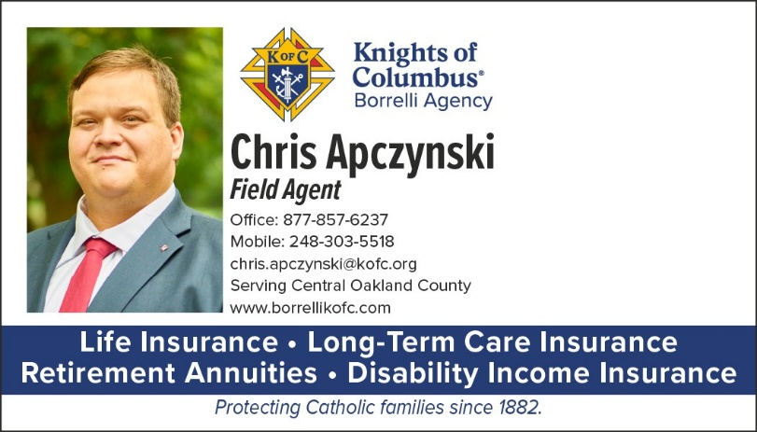
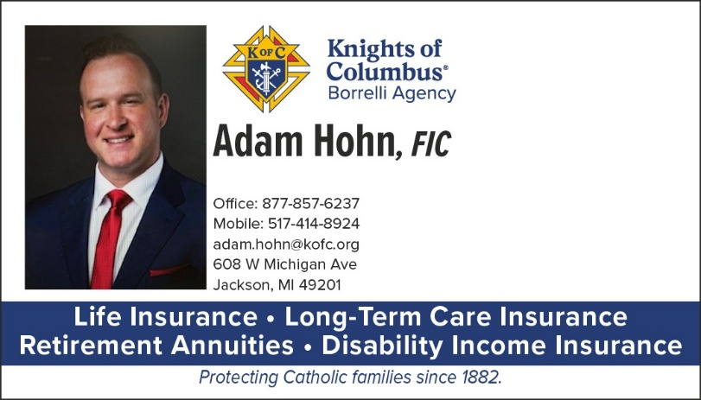
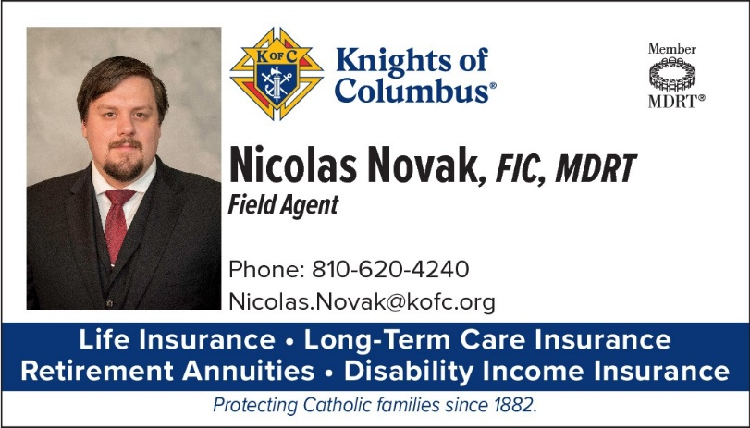
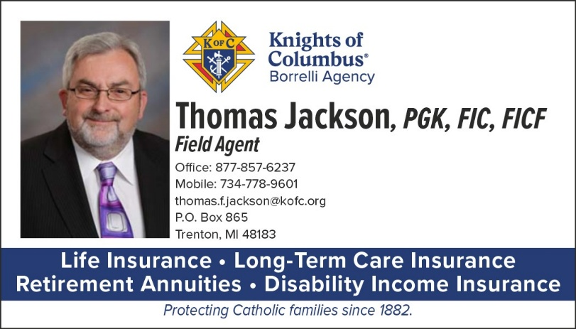
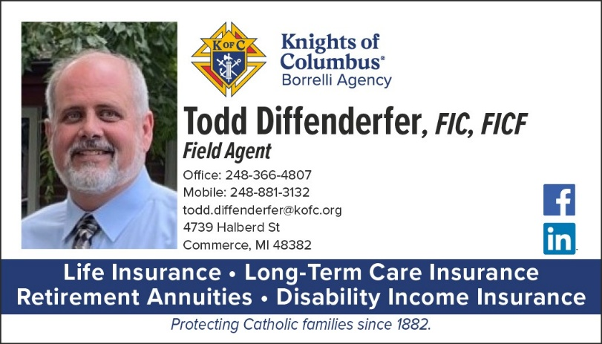
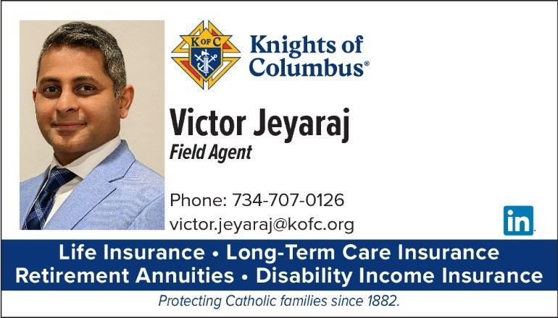
More Field Agents serving Southeast Michigan

Slide 7
1 General Agent
2 Support Staff
4 Financial Advisors
12 Field Agents
Serving over 30,000 members!
Notes:
OPTIONAL CLOSING
Only authorized Knights of Columbus Field Agents may offer financial services in our councils.
Outside financial advisors are prohibited from prospecting, presenting, or advising at any Knights function—it’s a violation of our by-laws.
We must protect our councils, our agents, and our members, ensuring we stay true to our mission.
Thank you for your time – close out with questions.

Slide 8
We need 14 more men to join us!
Notes:
OPTIONAL CLOSING
Only authorized Knights of Columbus Field Agents may offer financial services in our councils.
Outside financial advisors are prohibited from prospecting, presenting, or advising at any Knights function—it’s a violation of our by-laws.
We must protect our councils, our agents, and our members, ensuring we stay true to our mission.
Thank you for your time – close out with questions.

Slide 9
What do Field Agents do?
The are the sales force of the Knights of Columbus!
They are membership recruiters!
They are council activity promoters!
They are licensed financial professionals!
They are active Knights in your parish and community!
They support their family by you choosing the financial products they offer for your family.
Notes:
OPTIONAL CLOSING
Only authorized Knights of Columbus Field Agents may offer financial services in our councils.
Outside financial advisors are prohibited from prospecting, presenting, or advising at any Knights function—it’s a violation of our by-laws.
We must protect our councils, our agents, and our members, ensuring we stay true to our mission.
Thank you for your time – close out with questions.

Slide 10
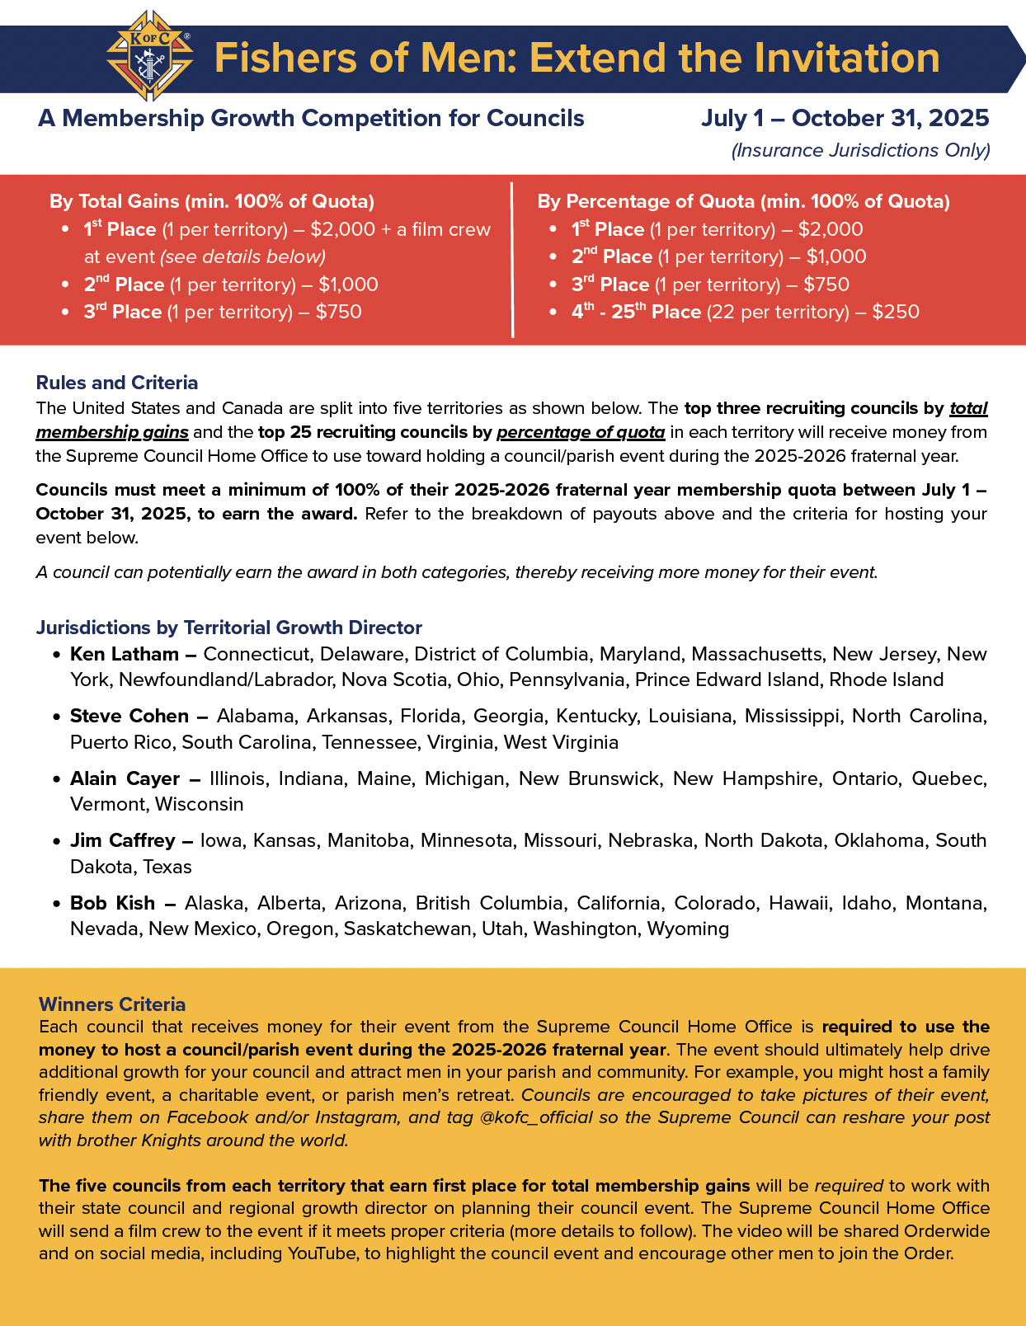

Membership Recruitment – Partnering with your field agent
Field agents are professional recruiters.
They should be part of your recruiting team and council recruiting strategy.
Partner with your agent to help your council reach 100% of membership quota by Oct. 31 and win the "Fishers of Men: Extend the Invitation" competition.
Notes:
All new members should be introduced and encouraged to meet with the Field Agent early. This builds stronger member retention and ensures every man hears the full Knights of Columbus history, the mission of Blessed Michael McGivney, and understands all the benefits available to them and their family. They can receive a full financial needs analysis and begin aligning their financial decisions to their faith. We are only reaching about 25 to 35 percent of new members right now. That needs to change if we want to grow in alignment with our founding mission.
Your field agents are the perfect partner for council growth and can help you achieve your goals. They know how to recruit well because they tell the story of our Order and our mission well. Partner with them as your council works to win the Fishers of Men: Extend the Invitation competition from between July 1 and October 31.
The Supreme Council Home Office is challenging all councils to reach 100% of their council membership quota by October 31st. The United States and Canada are split into five territories. The top three recruiting councils by total membership gains and the top 25 recruiting councils by percentage of quota in each territory will receive money from the Supreme Council Home Office to use toward holding a council/parish event during the 2025-2026 fraternal year.
Information about this incentive was mailed to every council with the Fraternal Planner and is included in every Fraternal Leader Advisory email.

Slide 11
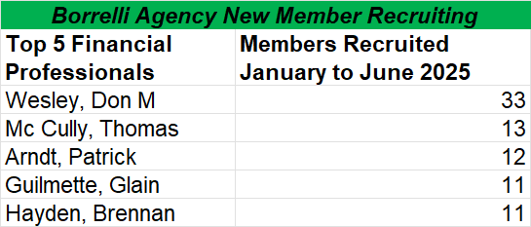

Slide 12

Founders Award for Star Council
2 Fraternal Benefit Events Needed
Councils must host / promote at least two* Fraternal Benefit Events during the fraternal year. The required sum total attendance of members, or member eligible men, at these events must equal or exceed:
  10 for councils with 99 or fewer members
  14 for councils with 100 or more members
*If the GK and DGK meet individually with their agent for a personal financial review, these two meetings will count for one of the two required FBEs, College & Military Councils exempted
College and Military Councils only need to host/promote one FBE.

Slide 13

Our Insurance Solutions
Our suite of top rated insurance products covers a wide spectrum of needs.
Term Life Insurance
Term life insurance can provide affordable protection to your loved ones for temporary needs. It’s simple and straightforward.
Permanent Life Insurance
Permanent life insurance is a great way to provide security for your family. It’s guaranteed. It’s dynamic.
Annuities
An annuity is a retirement savings product. You make contributions, and, after a specified amount of time, the annuity pays you a regular income stream.
Long-term care insurance
Long-term care insurance can help your family prepare for an extended care event, should you need valuable care management services in the future. It’s preventative protection.
Disability Income Insurance
Disability income insurance provides you the opportunity to protect your greatest asset – your ability to earn an income. It’s protection for your paycheck.
Notes:
Read through our product portfolio. No insurance solution may look the same, and no insurance plan stays stagnant year over year. Highlight our ability to work with you and customize your protection plan to ensure you can meet your financial goals and encourage the need to update your financial strategy as your family changes.

Slide 14
Knights of Columbus Asset Advisors
An old friend, a new opportunity. Our Catholic and capable products respect the investment guidelines of the United States Conference of Catholic Bishops (USCCB)
Profits that help to support our charitable work, evangelization and the Church at the local and global levels
Access to our donor-advised fund (Knights of Columbus Charitable Fund), through which you can maximize your giving and create a legacy of generosity
Mutual Funds
Exchange-Traded Funds
Private Wealth Management
Separate Account Strategies
Retirement Products and Solutions
Donor-Advised Funds
Notes:
Knights of Columbus Asset Advisors can help ensure your investments reflect your Catholic values. That’s why they have combined professional asset management with Catholic moral principles, helping you plan for tomorrow without compromising your faith.

Slide 15
Who serves your council?
Please email your name and council number(s) to alexandra.hohn@kofc.org and we will reply to connect you with your financial professional.
Notes:
OPTIONAL CLOSING
Only authorized Knights of Columbus Field Agents may offer financial services in our councils.
Outside financial advisors are prohibited from prospecting, presenting, or advising at any Knights function—it’s a violation of our by-laws.
We must protect our councils, our agents, and our members, ensuring we stay true to our mission.
Thank you for your time – close out with questions.

Slide 16
Thank you!
Notes:
OPTIONAL CLOSING
Only authorized Knights of Columbus Field Agents may offer financial services in our councils.
Outside financial advisors are prohibited from prospecting, presenting, or advising at any Knights function—it’s a violation of our by-laws.
We must protect our councils, our agents, and our members, ensuring we stay true to our mission.
Thank you for your time – close out with questions.

