Slide 1
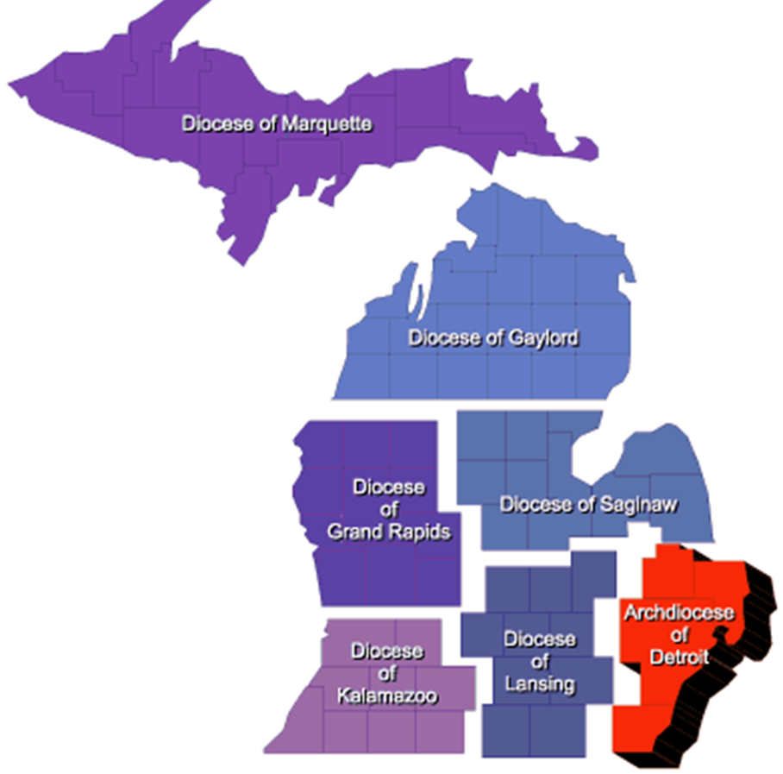
“Rise up and Answer the Call” Membership Growth Goals, Planning & Actions for 2021 - 2022
State Membership Director
Dan Fuller
Will your Council Answer the call?

Slide 2
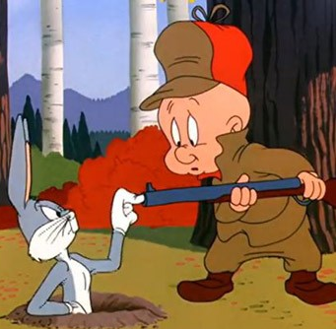
Membership is a Program
Momentum, let’s get off to a fast start
Understand and set Membership Goals
Understand the Fraternal Benefits Goals
Every Council Actively Growing
Recognition & Incentives
Every Month is Membership Season

Slide 3
Keys to a Fast Start!
Keep the Momentum Going
Our responsibility is to INSPIRE, MOTIVATE and EMPOWER
Get every council engaged and growing
Schedule “Membership Growth” events
Fill your District & Council calendars ASAP
Hold your Brother Accountable to that schedule
Address the E-member backlog…..Exemplify them ASAP
Don’t take the Summer off
Prioritize our friends & family
Invite them to be Knights
One on One recruiting is always best
We EMPOWER catholic men to be better…

Slide 4
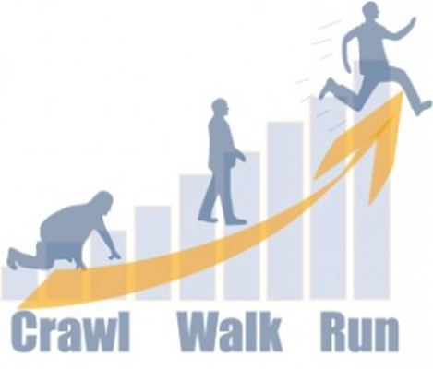
Getting Off to a Fast Start!
Every council engaged and growing
Is your council engaging in growth goals? Yes or No
Are you a “Can Do” or a “Not Now” council
If “yes” lead them through filling their calendars with events that will drive growth and visibility….Corp Communions, Delta Church Drives, “Consecration to the Holy Family”, etc.
If “no” ask WHY?
Lead the “Not Now” councils to “Can Do” councils through addressing their needs ASAP
Who can help you? Chaplains, Diocesan Directors, SDRRs, State Directors…
FYI – use the “Crawl, Walk, Run” training module to move “no” councils to “yes” councils
Leave No Council Behind…

Slide 5
Council Membership & Benefits Goals
Council growth goals are set at 5% of membership
Large council growth is capped at 20 new members
Small council growth is capped at 3 new members
Fraternal Benefits Goals (work with your F.A.)
2 Benefit Events are required per F.Y.
Minimum of 10 catholic men need to be at each event
6 to 8 weeks are needed to plan, advertise/promote, and host each event
Fill out form 11077 for credit
Set your plan and shoot for STAR

Slide 6
Michigan State Council’s Growth Goals
Membership Intake 2,075
100 through Hispanic Outreach
272 through a youth movement in the ages of 18 to 50
800 through e-membership
90% of our 424 active councils engaged in membership growth
New Council Dev 4 new councils
2 re-instated councils
10 Hispanic Round Tables
80% of all underserved catholic communities Round Tabled
Star Councils 64 councils
Exemplifications 400 exemplifications
DDs document exemps using form 450, send to forms@mikofc.org
DMD will track all exemplifications in their area
Exceeding these goals makes Michigan “Circle of Honor”

Slide 7
Council, District & State Performance
Michigan has 424 active Councils
122 Founders Day Award Winners 29%
77 McGivney Award Winners 18%
163 Columbian Award Winners 38%
50 Star Councils 12%
3 Star Districts 3%
1 Double Star District 1%
Michigan’s Intake was 1589 of 1845 for 86.12% of goal
8th of all Division 1 States
38th out of 75 Jurisdictions in our Order

Slide 8
Achieving our goals through team work
Ambassador Teams Delta Church Drive Teams
(Clergy, DMD, DD, GK, CMD, FA) Hispanic Outreach Teams
Ethnic teams to engage specific catholic communities Eastern Rite & Vietnamese Catholics
Exemplifications In-Person after a Mass and Corporate Communion
(Clergy, DMD, DD, GK, CMD, FA) English, Spanish and Vietnamese languages
In-Person before a council meeting
On-Demand via kofc.org
Monthly District & Council Exemplification Schedules
Quarterly Recruiting August Blessed Fr. McGivney’s Birthday
& Exemplifications October Columbus Day & Fr. McGivney Beatification Anniversary
(Clergy, DMD, DD, GK, CMD, FA) January New Year a New Knight
April Lenten/Easter Renewal
Take Action & Be Accountable to our Team Members

Slide 9
Key take away actions
Lead your councils in setting membership growth goals
Address there specific needs so they can grow
Seek out resources to support your council’s needs
Build Ambassador Teams & Exemplification Teams
Be ACCOUNTABLE to your team members
Celebrate successes through recognition
Empower your councils to grow and serve
We EMPOWER catholic men to be better…

