Slide 1
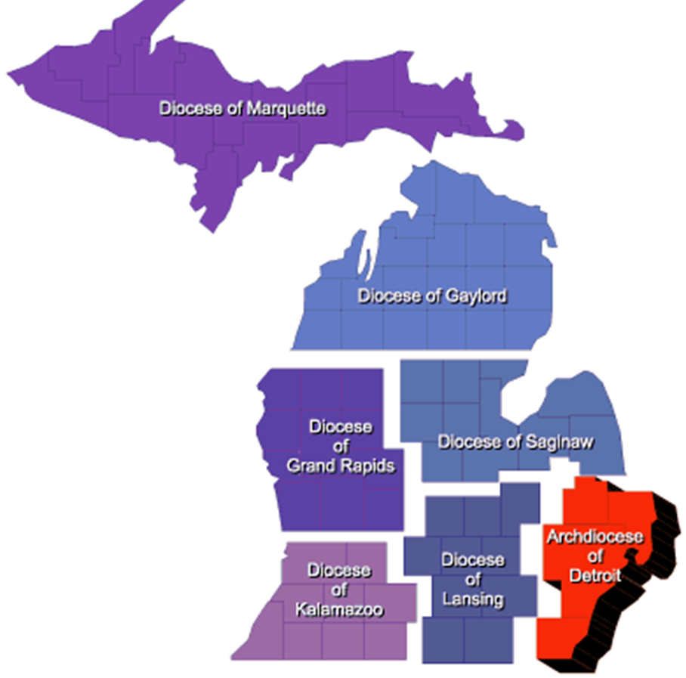
“Rise up and Answer the Call” Implementing a Delta Drive 2020 - 2021
State Membership Director
Dan Fuller
Growth through Team Work and Planning

Slide 2
Delta Drives, a best practice tool
What is a Delta Church Drive?
Planned / Communicated / Well staffed / Follow-up / Recognition
Where do I get a Delta Drive kit?
Kofc.org at supplies online section of the website
(see details in the last few slides)
Creative use of a Delta Drive
Any gathering of Catholic men and their families
Dinners, Festivals, Community Events
Questions contact jon.olson@kofc.org or d.fuller@mikofc.org

Slide 3
Delta Drive check list –cont.
GK schedules meeting with Parish Priest and Parish Staff
Explain your membership goals and “Faith In Action” programs that need helping hands
Explain how the D.C.D works
Ask for your Priest permission and support

Slide 4
Delta Drive check list –cont.
With Father’s Permission
Set a date in parish calendar for ALL weekend masses
Select a person to deliver the Pulpit Announcement (get Father’s approval)
Select you Ambassador Team and set a date for a practice session
Set your goals and expectations
Discuss a follow-up plan for new candidates and prospects
List support items needed including obtaining a D.C.D Kit (Supreme Supplies)

Slide 5
Delta Drive check list
GK & MD assemble the Ambassador team
Get help from your District or Region is you need more experienced Ambassadors
GK & MD complete Contact Landing Page Request Form at: info.kofc.org/pagerequest

Slide 6
Delta Drive check list
GK will lead D.C.D Roll-out Meeting for the Council. All Director and Ambassadors should attend
Confirm the date of the Church Drive and all Masses to be covered
Assign Duties – Contact Card placement, Ambassador Dues, Pulpit Announcement, Follow-up with Candidates, Onboarding & Mentoring of New Members
Briefing on Contact Landing Page
Introduce Ambassador Team and plan training sessions (complete before D.C.D, invite DMD)
Set goals and expectations with your team
Instill excitement in your team and get their buy-in to also be excited

Slide 7
Delta Drive check list
Ambassador Training Session One
Article in Church bulleting 1-2 weeks prior to the “Drive” weekend.
A Pulpit announcement prior to the “Drive” would be great too

Slide 8
Delta Drive check list
Ambassador Training Session Two
D.C.D is hosted at all Saturday and Sunday Masses
GK and MD will input prospect information into Council Landing Page
After the last Mass of Sunday, GK should try and brief the team before going home
Plan for an Exemplification after the last Mass on Sunday

Slide 9
Delta Drive check list
Ambassador follow-up campaign (contacting prospects)
Online membership email campaign (emails from prospect page info)
Thank you to Father article with a sorry we missed you message in the Church Bulletin
Every established Round Table needs to implement a Delta Church Drive
Extra credit – offer a participation raffle item in exchange for prospect information
Bible, Crucifix, Unique Rosary
Gift card for local restaurant
Plan… Communicate… Focus on what we can do… Be proud…

Slide 10
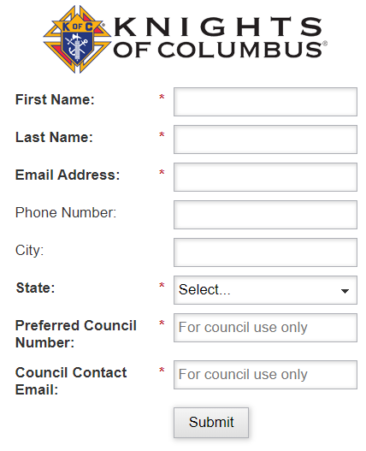
Supreme KofC.org Landing Page
Here is the link https://info.kofc.org/us.html to the page
Your team can enter the information as soon as possible
Put in your council number and email address that you want then click Submit
Prospect will get emails from Supreme
Whoever email is entered in Council Contact Email will get email with the details

Slide 11
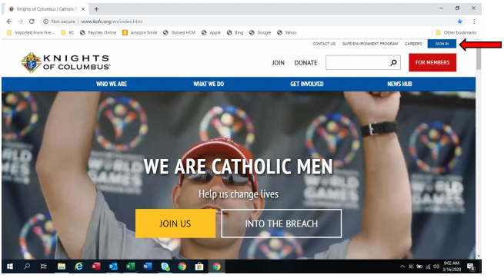
Ordering Your Delta Drive Kits kofc.org site
How to order Delta kit off Supreme website
Select the “sign in” icon to get to the “officers online” portal. You will need access to officers online and your username and password to complete this.
If you forgot you username or password, please use the “password reset” or account assistant to help with this

Slide 12
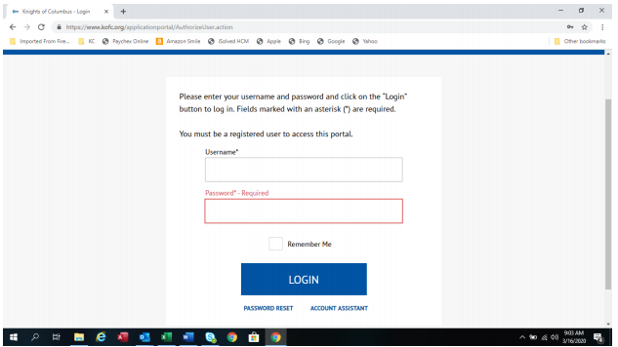
Ordering, next step
If you forgot you username or password, please use the “password reset” or account assistant to help with this

Slide 13
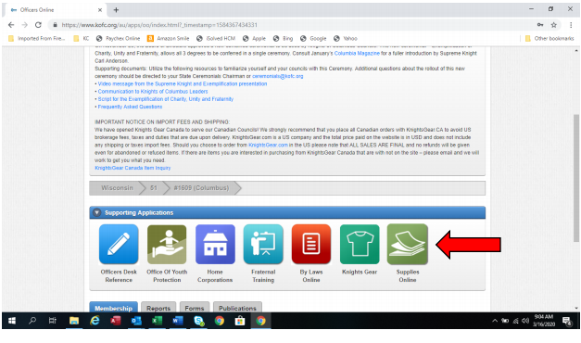
Ordering, next step
When you are in the “officers online” page, select the “supplies online” icon

Slide 14
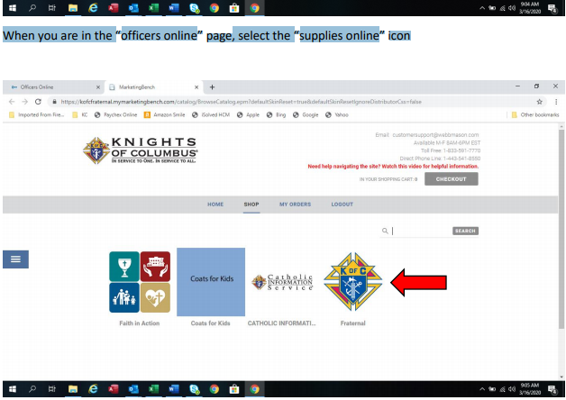
Ordering, next step
When in the “supplies online” page, select the “Fraternal” icon. (The Knights of Columbus Emblem)

Slide 15
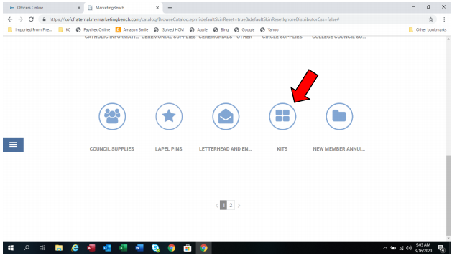
Ordering, next step
Scroll down on the “Fraternal” page and select the “kits” icon.

Slide 16
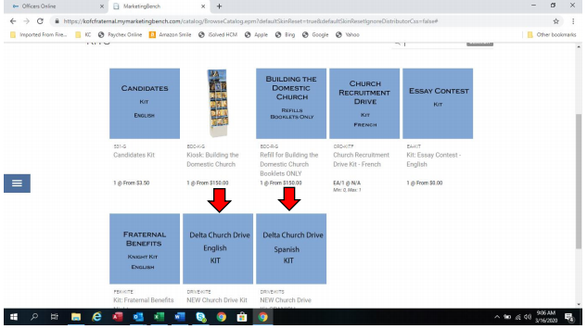
Ordering, next step
You will see the English and Spanish kits.
Please select the one that you would like.

Slide 17
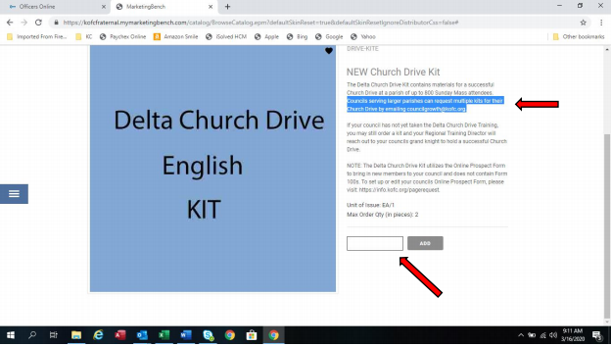
Ordering, next step
Enter either 1 or 2 kits.
If you need more than that please email your request to councilgrowth@kofc.org

Slide 18
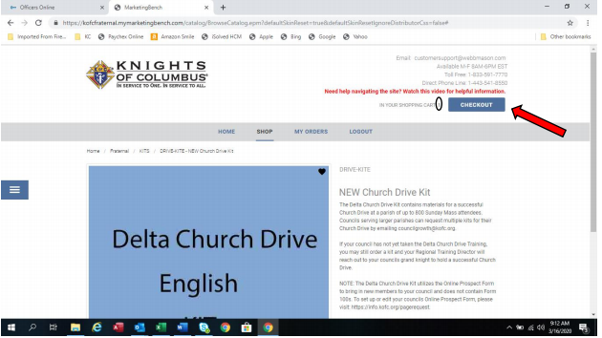
Ordering, next step
Make sure the amount of kits you requested is correct and select the “checkout icon”

Slide 19
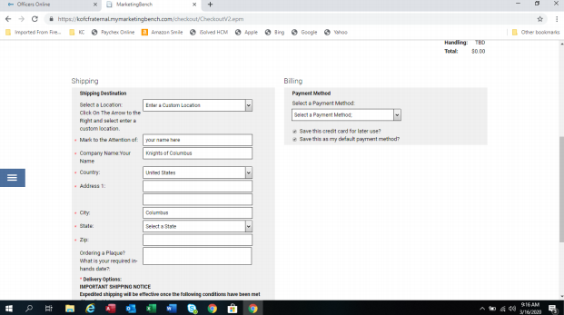
Ordering, next step
If you have not already had something shipped through this portal, you may have to select the “enter a custom location” from the select a location pull down menu.
Please fill out as precisely as possible.
The page will need you to enter a credit card and the billing information, you will not be charged for the shipping of the delta kits.

Slide 20
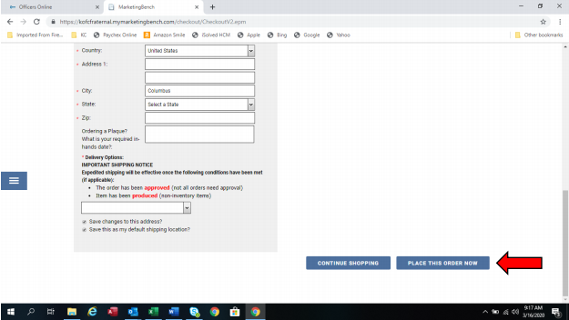
Ordering, next step
Select the “place this order now” icon to see if you have any errors on this page and then continue

Slide 21
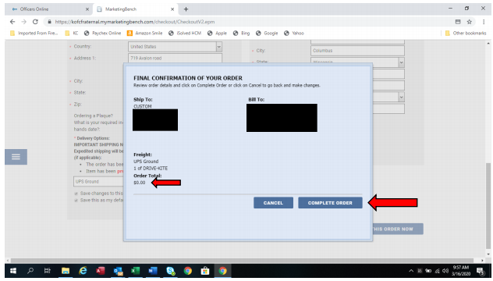
Ordering, next step
When no errors are detected, the “pop up” window will appear for your final check. Notice you were not charged. Select the “complete order” icon.

Slide 22
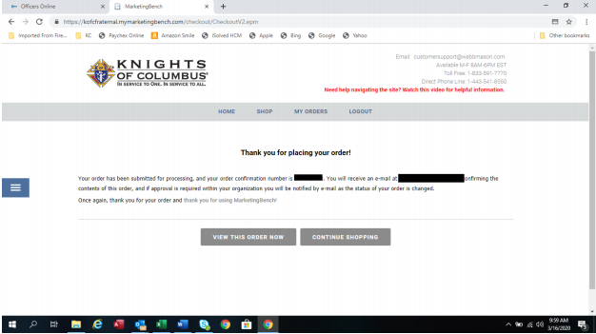
Ordering Delta Drive Kit, Last Steps
After a few moments of processing you will see the “thank you for your order” page with your confirmation # and the email address it sent it to.
Please write this number down BEFORE you exit this page.

