Slide 1
Diocesan Director Breakout
2021-2022 Fraternal Year
Paul Palka
SPD

Slide 2
Diocesan Program Directors
Region #1
SDRR – Larry Herman
M E – Michael Prokopowicz
M W – Vern Miron
G – Patrick Oliver
Region #2
Dean Hayward
S E – William Learman
S W – Ray Gehlmann
L N – Ed Warren
L S – Matt Wierzgac

Slide 3
Diocesan Program Directors (cont)
Region #3
SDRR – Martin Brown
K – Louis Scohy
R N – William “Jim” Dingman
R S – Tom Farley
R H – Luis Rebolledo
Region #4
SDRR – R. Terry Carl
D N – Joseph Brenner
D S – Kenneth Warzybok

Slide 4
Diocesan Program Directors (concluded)
Region #5
SDRR – Paul Thorn
D N – John Reeser
D S – Lou Brotchner

Slide 5
Making Programs Happen
The Pandemic is waning What are we going to do?
Attend meetings of your Councils in your region
Attend programs held in your region
Meet regularly with your SDRR & DD’s
Offer guidance when asked to do so

Slide 6
How Do I Make These Things Happen
At the Tri-District meetings schedule your visit with the Councils
Ask for Council Newsletters to be sent to you about up coming events, and try to attend when possible
Your SDRR should be scheduling regular monthly meetings, please attend
When the Councils and DD’s reach out to you respond quickly

Slide 7
Expectations
Checking Supreme Reports for missing forms monthly
Responding to emails within 24 hours
Attending all District Meetings
Attending all SDRR and SPD meetings
Visiting all Councils assigned to you
Offering advise monthly on programs to pursue

Slide 8
What You Are Not Expected to Be
You are NOT to sit by the phone, but be proactive
You are NOT to just pass on questions, but be a source of truth when asked
You are NOT to wait to be asked to set up Youth events, but be proactive
You are NOT in a sideline position but a Leader of Men

Slide 9
Year Two or More
Very few are new to this position
If you are new work with a seasoned DPD for guidance
Ask questions, there are no dumb questions
Start scheduling all your Diocesan Level events now, do not wait to be asked

Slide 10
Events to Schedule
Diocesan Soccer Challenge, needs to be done 2nd or 3rd week of September
Diocesan Spelling Bee, needs to be completed by late February
Diocesan Free Throw, needs to be completed by late February

Slide 11
Forms Due Dates
185 Officers chosen for term due 6/30/21
365 Service Program Personnel due 8/1/21
1295 (Summer) Audit due 8/15/21
1728 Fraternal Survey due 1/31/22
10784 Special Olympics Report Due 1/31/22
1295 (Winter) Audit Due 2/15/22
11077 FBN twice a year
SP7 June 30th
Here is the link to the guide: 11172 FIA Program Reference Guide (kofc.org)

Slide 12
10784 Forms
The 10784 form has been changing monthly. We need to review the document at least quarterly to keep up.
This form now covers so much more than just the basic programs!

Slide 13
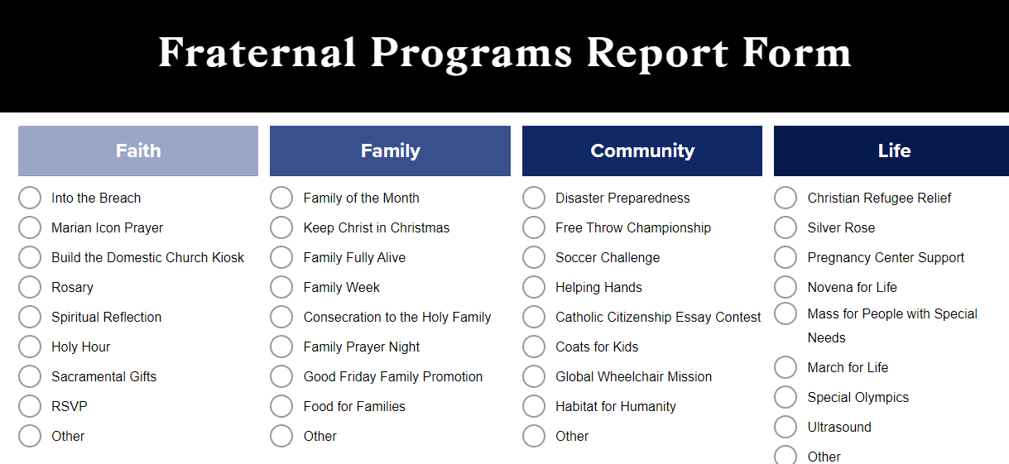

Slide 14
If more than 10784 is needed?
Most items listed on the 10784 stand alone. When they do not they indicate in Red if other another form is needed, like the RSVP form.
Your Grand Knight must complete Form # 2863 for council refund.

Slide 15
Meeting with SPD
We will be having a monthly meeting via Zoom during the year starting in July at 7pm
Check the State Website first as a resource
If the question is specific to a category reach out to that Director first
Contact me when you need my help

Slide 16
Questions?
(There should be a lot of them)

