Slide 1
2025 Winter Diocesan Meeting
Come SOAR with Us

Slide 2
Seminarian Support
Seminarian Tuition Assistance Assessment
Michigan K of C Endowment Fund
for
Sacred Heart Major Seminary

Slide 3
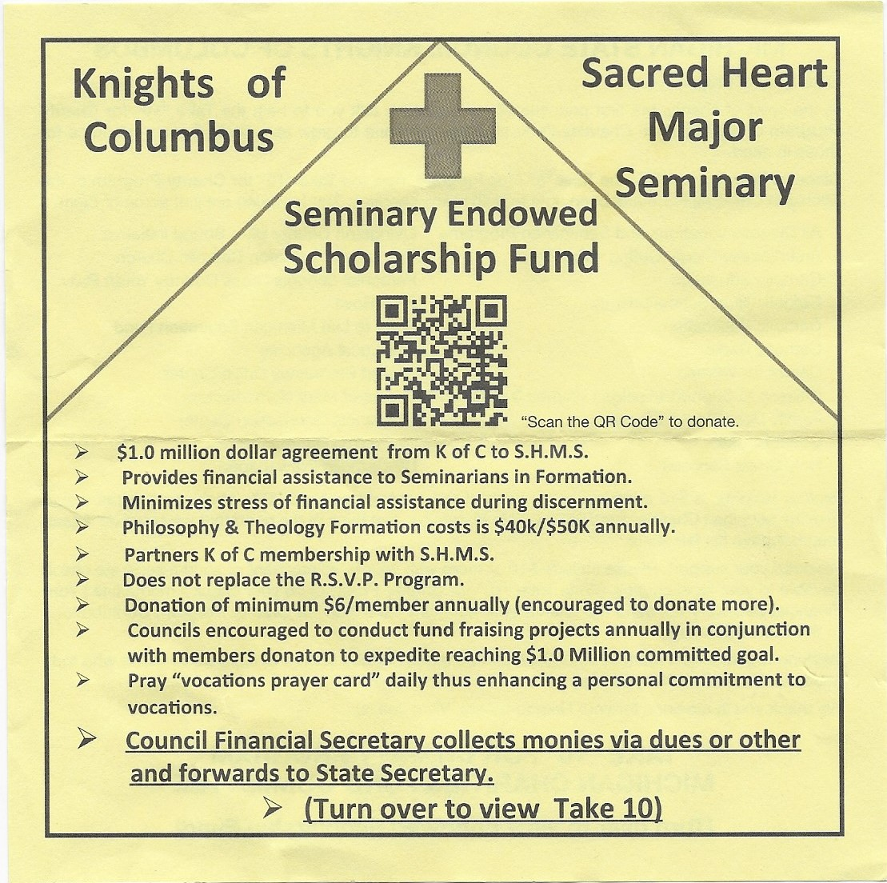

Slide 4
Mi Drive
Spring drive should be held around Palm Sunday, March
Councils are encouraged to hold two drives each year, around Columbus Day and Palm Sunday, get permission from your Pastor if the drive will be held on Church grounds
Council decides how the funds are distributed but it MUST be an organization whose purpose is support those with special needs. It can be multiple organizations, you can also include Special Olympics as well
Form Mi-13 needs to be filled out after the drive
Send the Mi-13 and check to Mark Brezenski, address is in the directory
Do not send checks to George Walrath or George Stump
If you have any questions, contact Mark Brezenski

Slide 5
2025 State Chaplain Tribute Banquet
Saturday, February 22, 2025
Zuccaro’s Banquet & Catering
46601 Gratiot Ave
Chesterfield Twp, Michigan 48051
Councils receiving the “Quick Start” awards are encouraged to attend to receive the award and be recognized.
Please send form back to State Office if attending. Admittance by reservation Only. No tickets will be sold at the door.

Slide 6
2025 State Convention
In February, you will need to nominate and submit your council’s delegates for the 2025 State Convention at Mackinaw Island.
Remind delegates to choose 2 hotels on the form they receive and send it back to the address mentioned on the form.

Slide 7
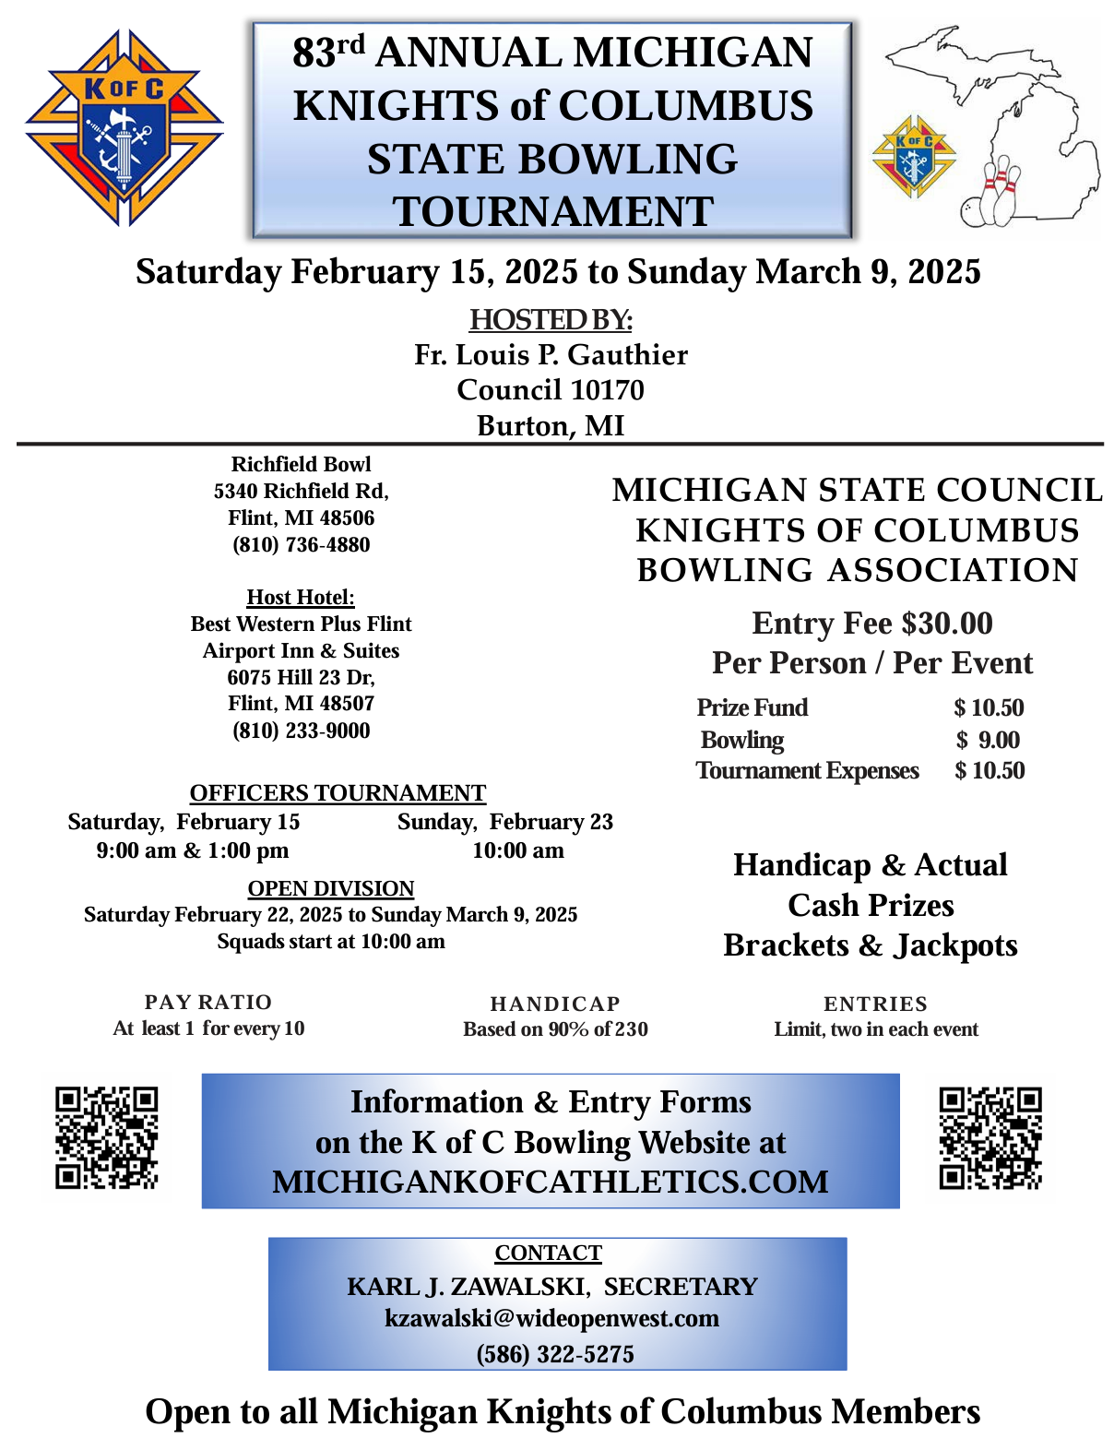

Slide 8
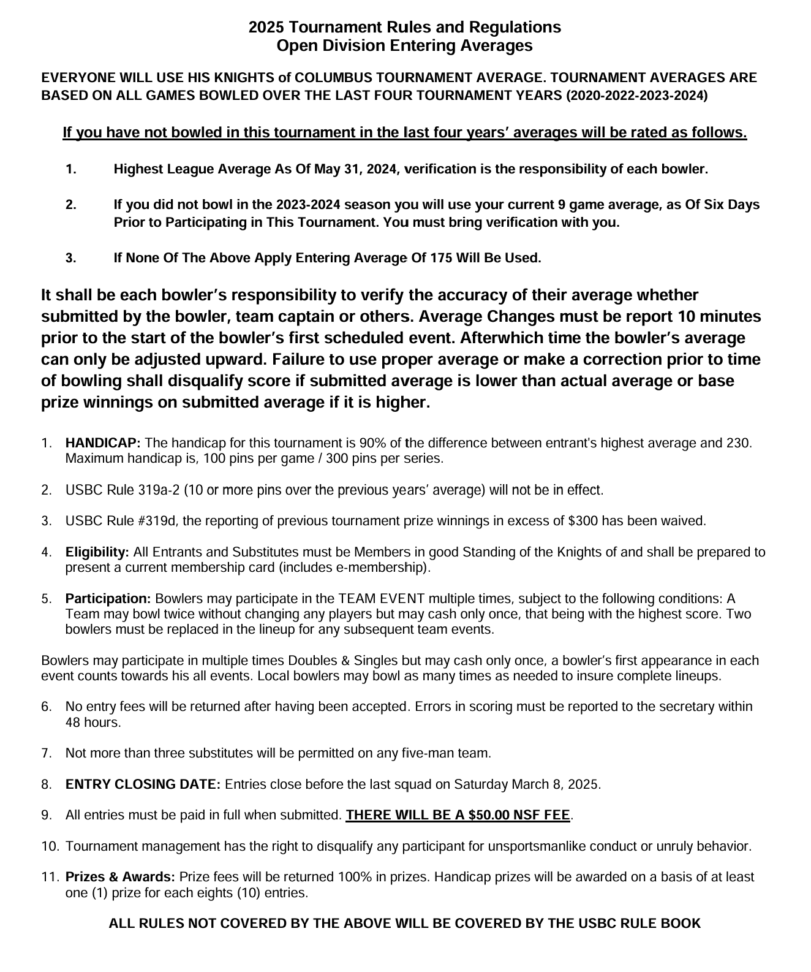
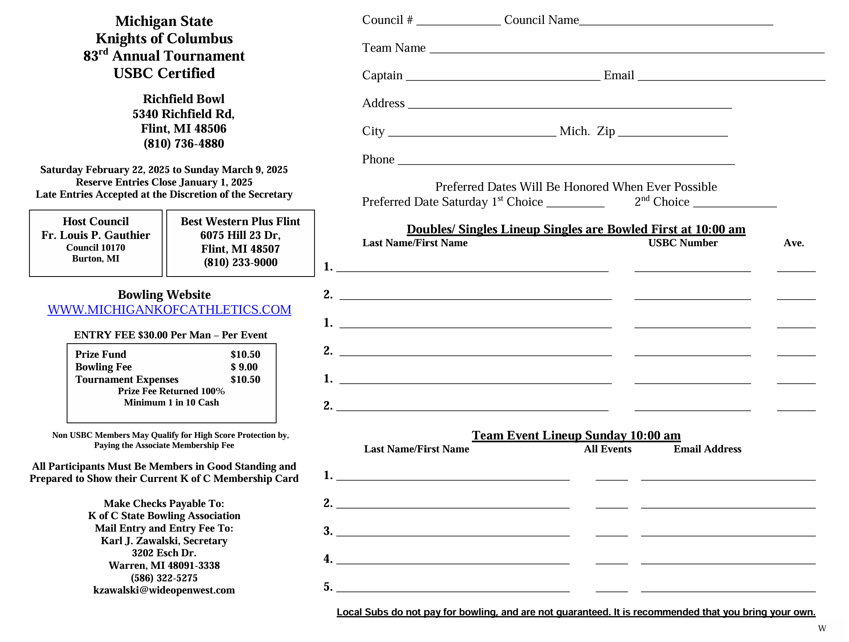

Slide 9
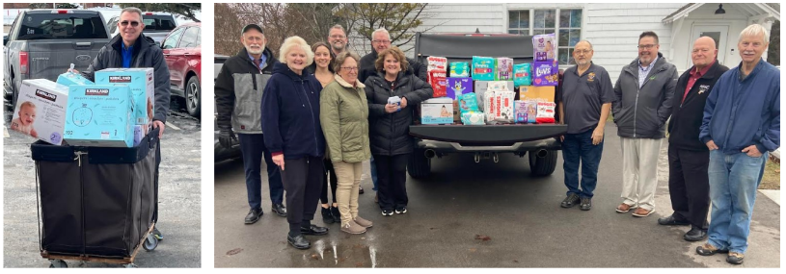
Diaper Donation Drive Update
At the Winter Leadership Meeting held earlier this month resulted in a successful Diaper, Wipe & Gift Card drive for pregnancy centers across the state. In total over 11,000 diapers, 20,000 wipes and gift cards & checks totaling $4,425 was donated at the Winter Leadership Meeting. A sincere thank you to all participating council, district deputies and all others who supported this drive for newborns across the state.

Slide 10
Diaper Donation Drive Update
Distribution of the donations were made to the following pregnancy centers:
Archdiocese of Detroit - Planned Choices, Allen Park
Lansing Diocese - Pregnancy Center of Eaton County, Charlotte
Saginaw Diocese – LifeClinic Community Resources, Midland
Grand Rapids Diocese – HELP Pregnancy Aid, Grand Rapids
Kalamazoo Diocese - Alternatives of Kalamazoo, Kalamazoo
Gaylord Diocese - Options Pregnancy Center, Alpena
Marquette Diocese - Pregnancy Services of Delta County, Escanaba
Thank you to those that too the time to deliver donations to our pregnancy center partners! On behalf of each diocese an ASAP application will be sent to the Supreme Council.

Slide 11
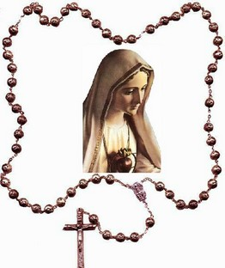
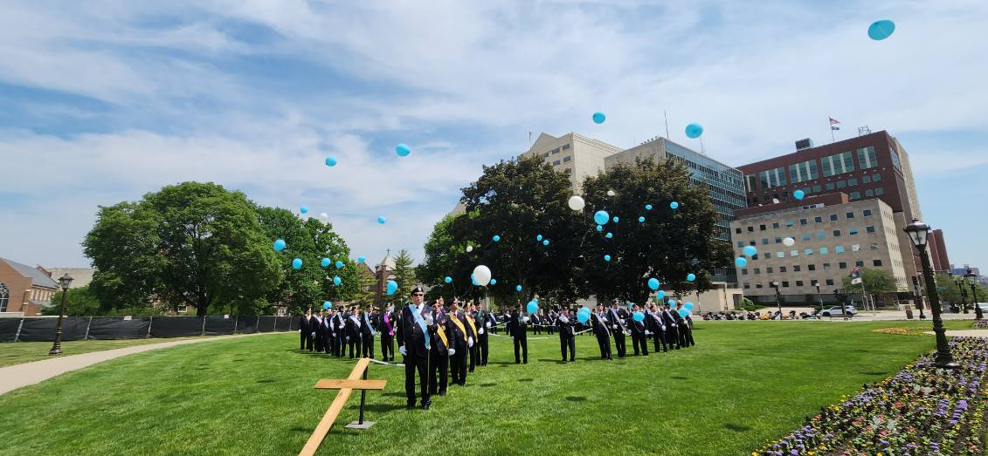
Faith
Living Rosary
The Living Rosary will be held on the Lansing Capital Lawn on September 13, 2025.
The importance of this date is that our Holy Mother had her apparition on the 13th of the month.

Slide 12
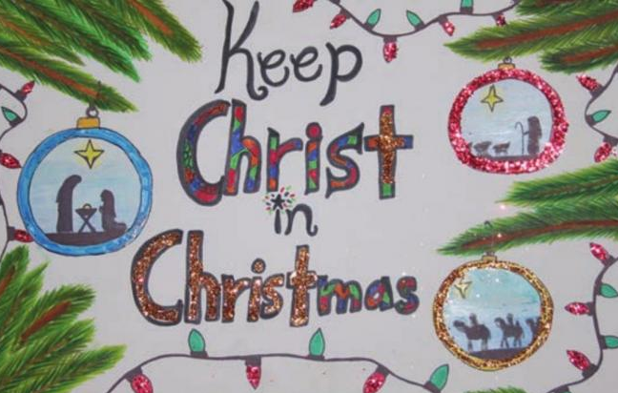
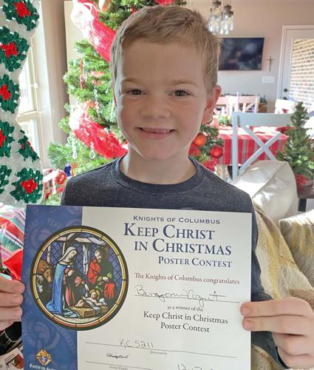
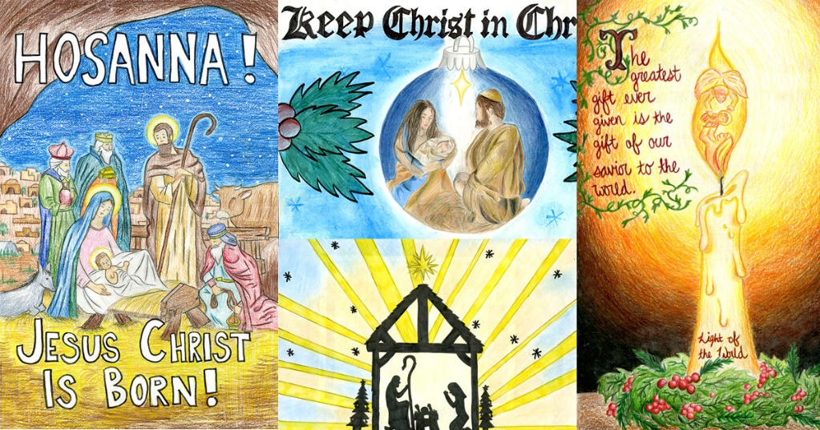
Family Programs – State-Sponsored Events
Keep Christ in Christmas Poster Contest January 31

Slide 13
State Spelling Bee
Saturday, March 1, 2025 Registration: 12PM, Competition: 1PM Fr. Van Rooy #2740, 1021 Woodside Ave, Essexville, MI 48732

Slide 14
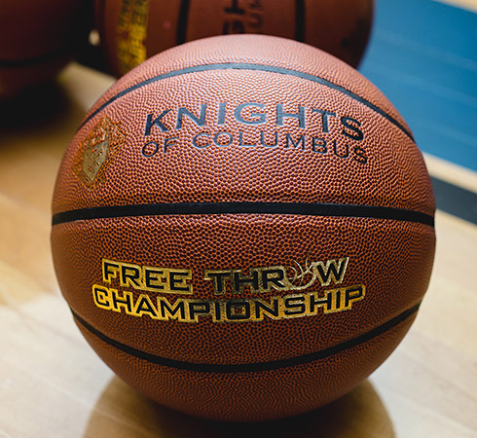
State Free Throw Championship
Sunday, March 16, 2025 Registration: 12PM, Competition: 1PM Sacred Heart Parish, 302 South Kinney, Mt. Pleasant, MI 48858

Slide 15
Holy Cross Services Update
Happy to report the following summary of items donated and collected from the Knights of Columbus for Holy Cross Services on Saturday, Dec 14, 2024, across the state of Michigan:
$5,565 in gift cards
$275 in cash and checks
1,230 sweatshirts
32 toiletries baskets
Assortment of socks, hats, gloves, blankets, pajamas, underwear

Slide 16
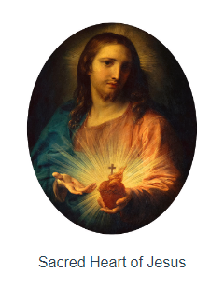
Faith
Pilgrim Icon
Sacred Heart of Jesus
To be delivered to each SDRR in each Diocese/Archdiocese January 2025
Runs through Fraternal Year 2026 – 2027
Each District Deputy will be responsible to work with the SDRR and other District Deputies to schedule and handoff Icon to each parish.

Slide 17
2025 Winter Diocesan Meeting
Come SOAR with Us

Slide 18
Call to Order Joel Kendzorski State Warden

Slide 19
Pledge of Allegiance

Slide 20
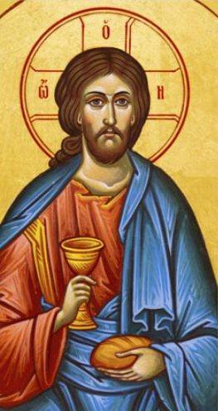
Opening Prayer

Slide 21
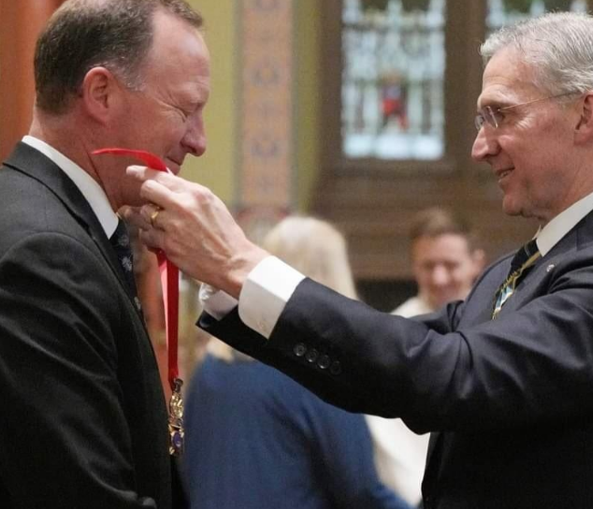
State Deputy Comments Barry Borsenik

Slide 22
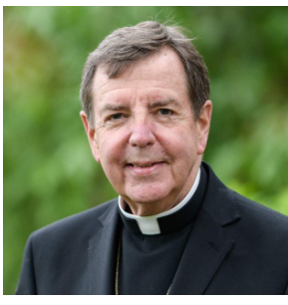
Welcome Archbishop of Detroit Most Rev. Allen H. Vigneron, D.D.

Slide 23
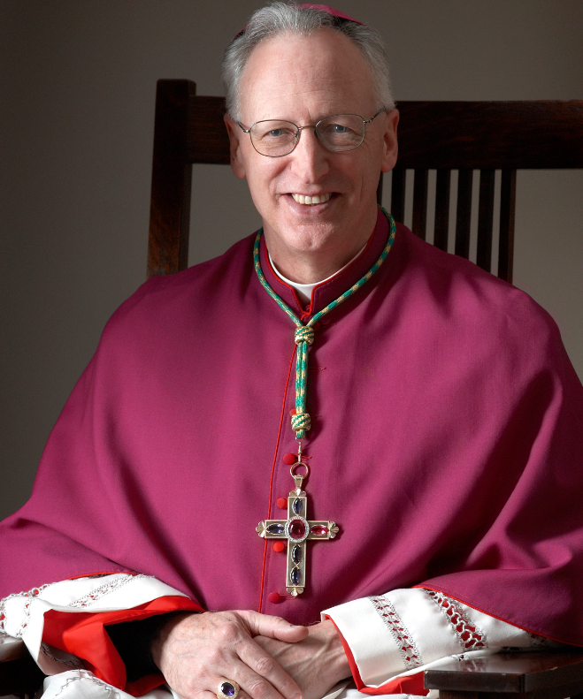
Welcome Bishop of Lansing Most Rev. Earl Boyea, D.D.

Slide 24
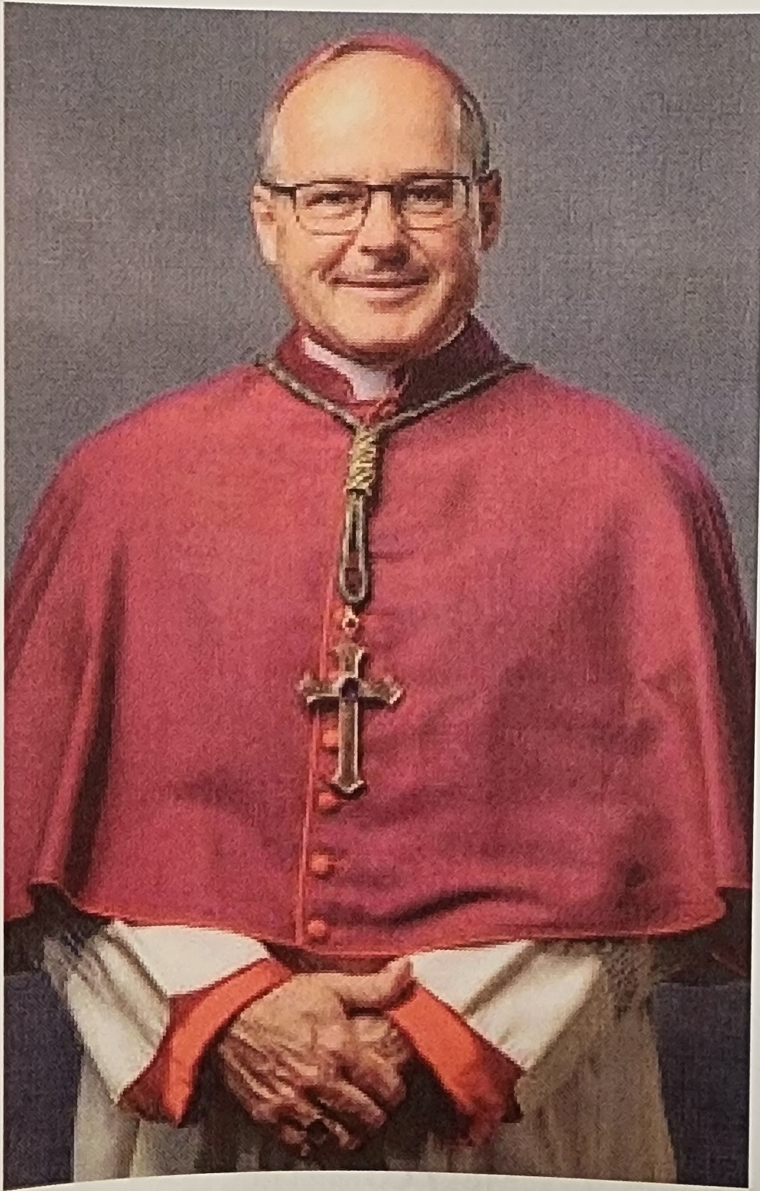
Welcome Bishop of Kalamazoo Most Rev. Edward M Lohse, JCD

Slide 25
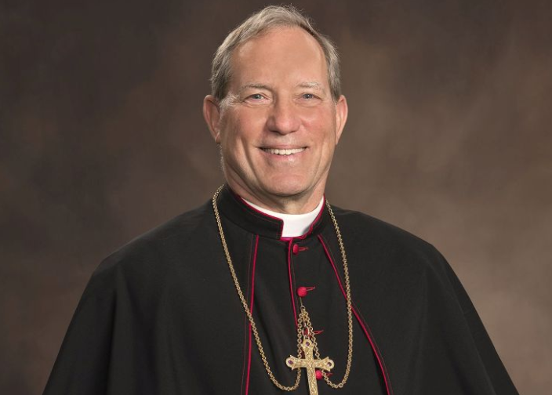
Welcome Bishop of Saginaw Most Rev. Robert D. Gruss, D.D.

Slide 26
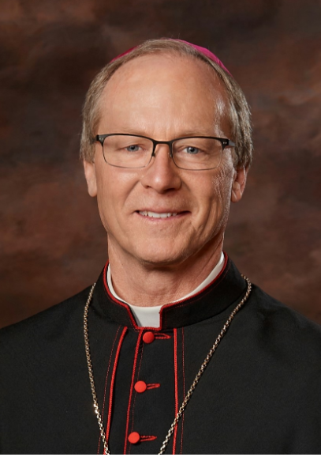
Welcome Bishop of Gaylord Most Rev. Jeffrey J Walsh, D.D.

Slide 27
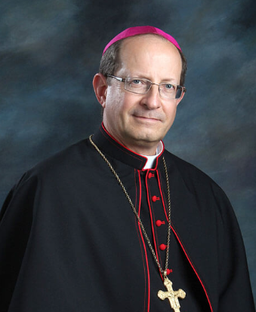
Welcome Bishop Grand Rapids Most Rev. David J. Walkowiak, D.D.

Slide 28
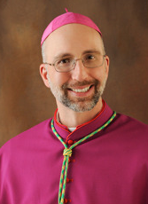
Welcome Bishop of Marquette Most Rev. John F. Doerfler, D.D.

Slide 29
Supreme Insurance Presentation

Slide 30
Membership/Programs
An Invitation to Come SOAR with Us

Slide 31
Membership & Programs
Doug Kokot
State Membership Director
Matt Wierzgac
State Program Director

Slide 32
SOAR
An Invitation to Come SOAR with Us
Service – What Life is About
Optimism – The Faith that Leads to Achievement
Aspire – to Accomplish Great Deeds
Responsibility – to do Your Duty
Let’s SOAR to New Heights

Slide 33
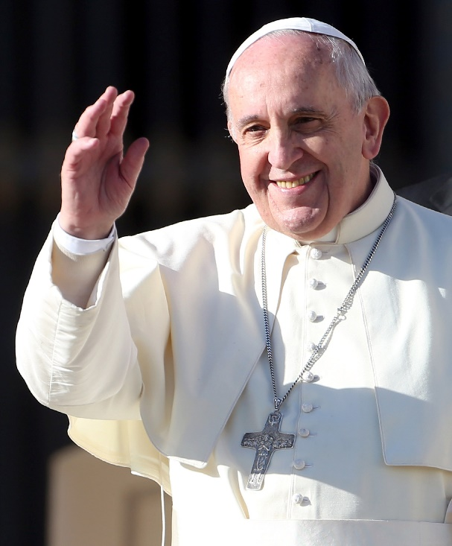
Pope Francis – Holy Year of Hope
Pope Francis announces the 2025 Jubilee Year theme: ‘Holy Year of Hope’. Pope Francis went on to declare this year’s moto “Pilgrims of Hope”. A synonym for hope is Optimism.
What a better visualization; the Knights of Columbus as Pilgrims of Hope. We bring hope to the less fortunate through our many programs.

Slide 34
Pope Francis – Holy Year of Hope
Knights of Columbus bring Hope and Optimism to men who are looking to grow their faith as each of our councils (with their parishes) rollout Cor.
The more men see our optimism for our faith and future, the more they will be encouraged to join with us.

Slide 35
Why We Recruit
If we focus on numbers, we have already lost
Provide an avenue for men to grow closer to God
Grow in faith through action
More members equal more fuel doing the good works of our order through programs

Slide 37
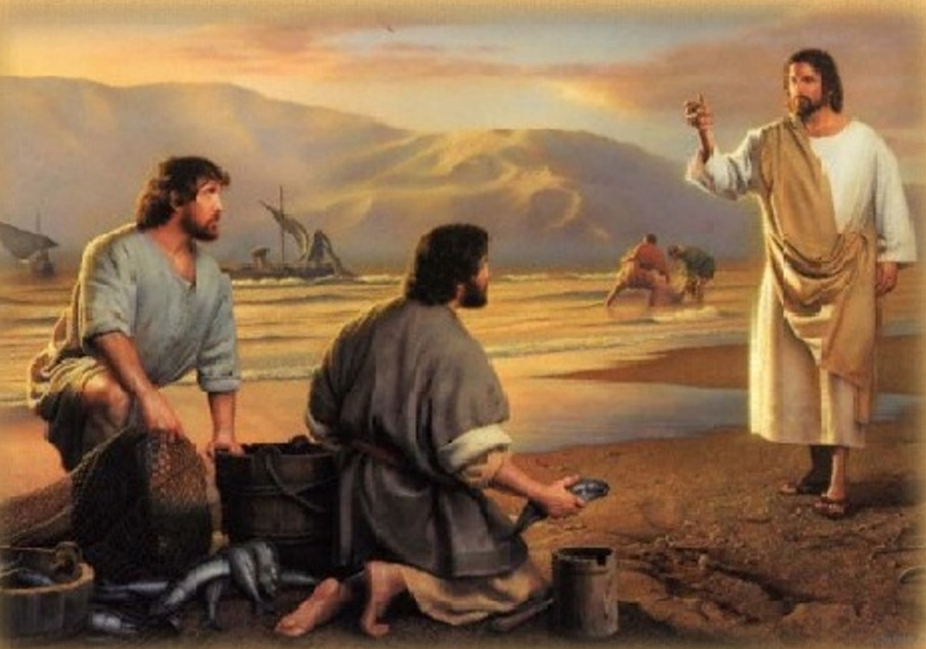
Fishers of Men
HOW TO INVITE SOMEONE
CONVERSATION STARTERS
OVERCOMING OBJECTIONS
TIPS TO REMEMBER
FRATERNAL BENEFITS: WHY JOIN
RESOURCES

Slide 38
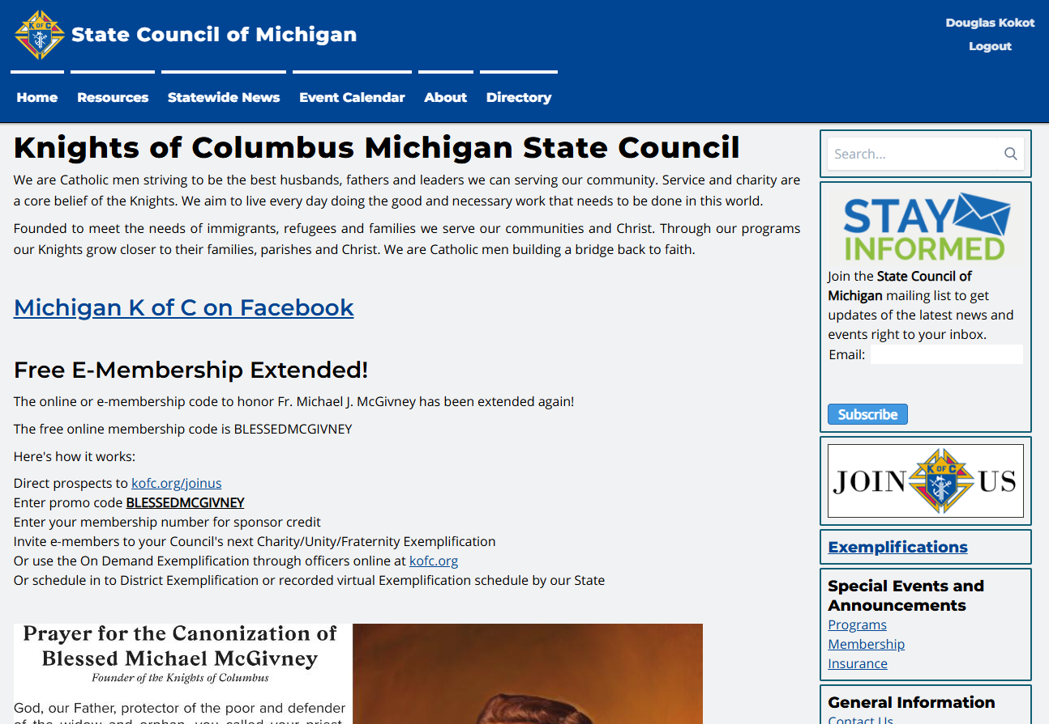
Where to Find Fishers of Men Publication

Slide 39
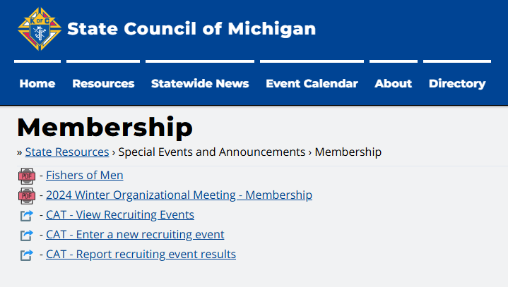
Where to Find Fishers of Men Publication

Slide 40
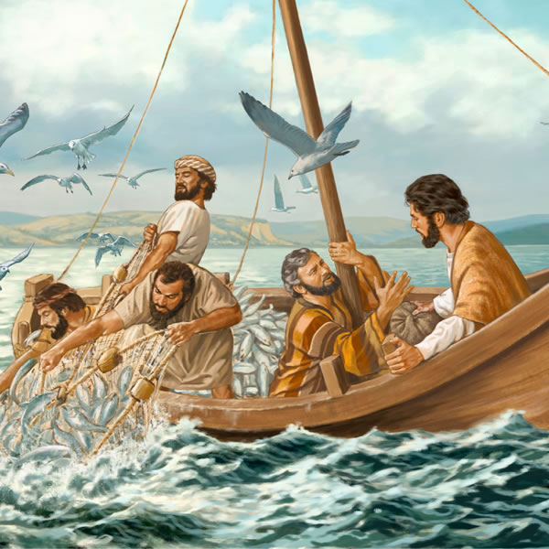
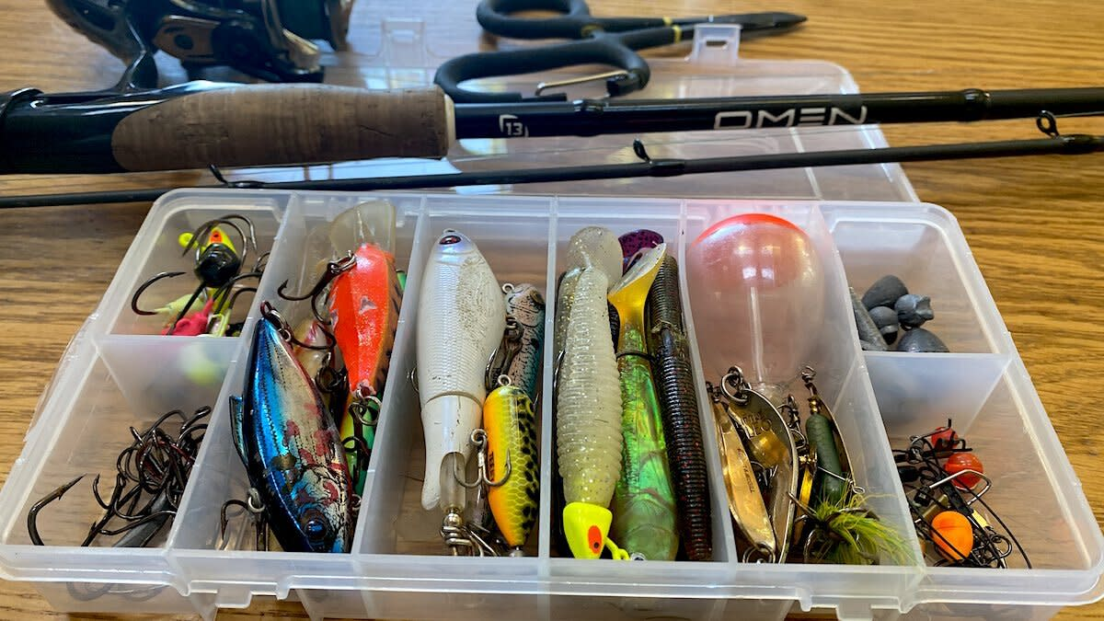
Let’s be Fishers of Men
What is in your tackle box?
Pick the right lure

Slide 41
Let’s be Fishers of Men
Every Knight is called to bring others to Christ and help realize Blessed Michael McGivney’s mission.
“Come after me, and I will make you ﬁshers of men.”
MT 4:19

Slide 42
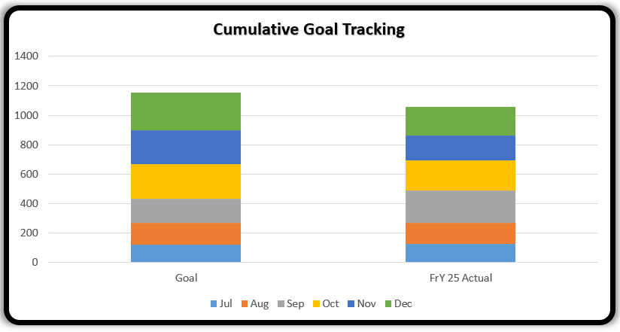
How are We Doing
Year end 1055
January 230

Slide 43
How do we get there?

Slide 44
Wednesday March 5th

Slide 46
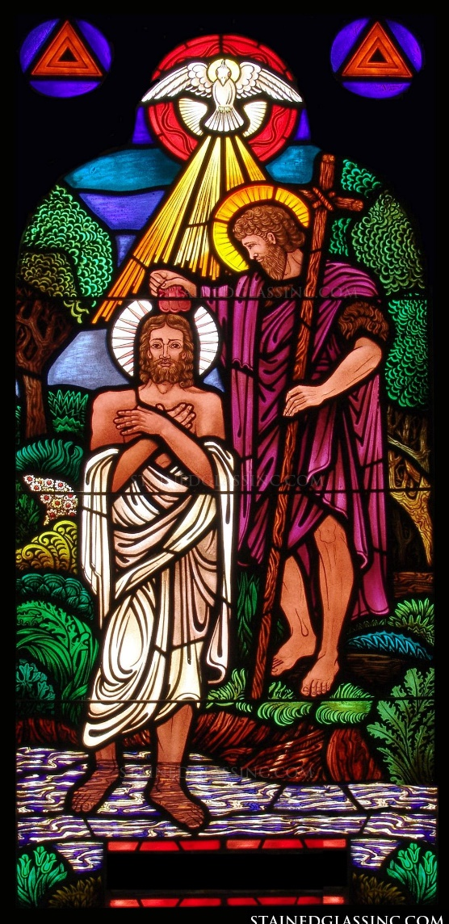
& The Knights of Columbus

Slide 47
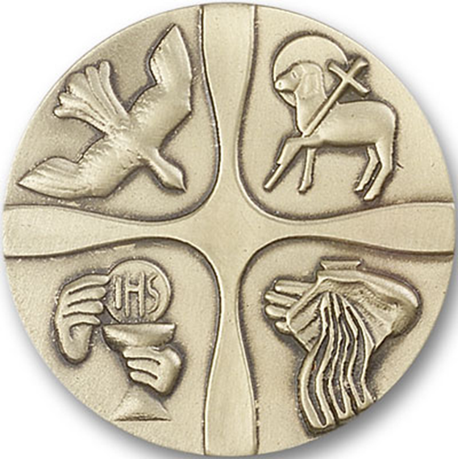
How
Knights as Sponsors 1#
Request to speak at a class
Provide gifts to OCIA candidates – rosaries, etc.
Request a list of OCIA candidates
Notes:
Grand knights should ask the pastors of all the parishes the council serves if they can regularly give them a list of RCIA graduates. (The grand knight should assure the pastor that RCIA members will not be coerced into joining.) The grand knight should give the list to the membership director who can contact the men personally. Along with other recruitment materials, give these prospects copies of the Faith-Based Recruitment flyer (#4497) that details how K of C membership can help men and their families grow the Faith. Men recently admitted to the Church are promising prospects. Approach them and you are sure to increase your membership!

Slide 48
Zero Growth Councils
State – 161
Detroit – 43
Gaylord – 15
Grand Rapids – 22
Kalamazoo – 15
Lansing – 27
Marquette – 21
Saginaw – 18

Slide 49
Help Make Every Knight a more Effective Recruiter
Have your councils use:
“Ask Yourself First”

Slide 50
Notes:
What we do pretty well:
Supreme Literature, Training DDs, Training GKs
What about the guy on the ground?
We usually give him some handouts as say good luck.
Do you remember the first time you were asked to help out a Membership drive?
This is a tool for the guy on the ground.
It also gets at the prospective members question “What’s in it for me”.

Slide 51
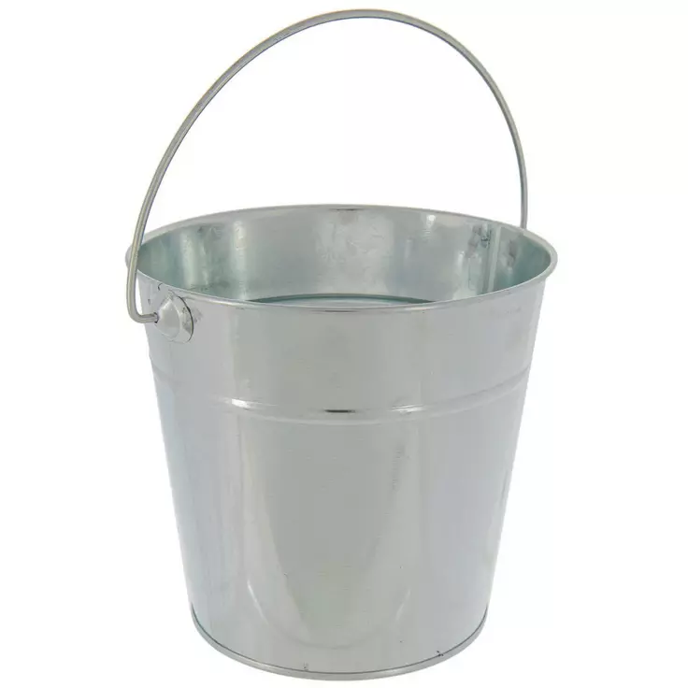
How many men joined the first time Ask them?
Ask
Ask
Ask

Slide 52
One thing about joining the Knights...
Your rewards are not only earthly…
They are Eternal

Slide 54
Why We Do Programs
Our goal is to help men; their families and their parishes grow closer to Christ. Through our programs and resources, we provide opportunities to live and spread the Catholic faith.
Together, we’re empowering Catholic men to live our faith at home, in our parish, at work and in our community

Slide 55
What Goes With Programs?
FRATERNAL PROGRAMS REPORT FORM (#10784)!
Question: Who can submit the 10784?
Answer: Anyone from your Council Roster with an active email on file.
Question: Where do I complete the form?
Answer: Form is done online at kofc.org website
Question: Is there training available on how to complete this form?
Answer: YES!! Training can be found on the supreme website. Search for “Fraternal Programs Report Form Training Video” in the search bar.

Slide 56
Let's take a look at the 10784 Submissions
Council Submissions Across the State:
0 Submissions | 206
1-5 Submissions | 103
6-10 Submissions | 47
11+ Submissions | 69

Slide 57
On the horizon..
The 1728 (Annual Survey of Fraternal Activity) form is due by 1/31/2025
This form can also be done online on kofc.org. Any member of the council can complete the form online. They just need their membership number.

Slide 58
On the horizon (Continued)..
Semi-Annual Audit (2nd Half) 1295b | 2/15/2025
State Program Award (STSP) Final Submissions | 3/15/2025
Family of the Year Final Submissions | 3/15/2025
Columbian Award | 6/15/2025*
* Can be submitted early if all requirements are completed
Special Olympics is completed on the 10784 & SP-7 Form. No longer its own form

Slide 59
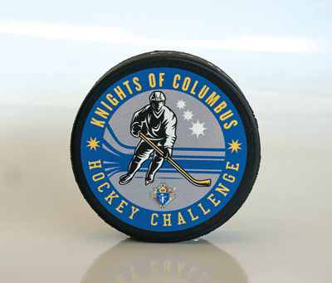
Hockey Challenge
Council – March / April
District / Diocese – May
State – June (there is no Supreme competition)
Each level should be played in a gym, local park, ice rink, or another location approved by the Council
More information to come

Slide 60
Knight of the Month / Year
Increase participation to at least 70% of active councils.
mikofc.org/resources/community-support-materials
This recognition is important to the individual Knight.
Use Recognition as a recruiting tool.
SEND FORMS TO: l.herman@mikofc.org and g.kolbicz@mikofc.org

Slide 61
State Council Service Program
Each year every jurisdiction recognizes the best program in each of the Service Program categories of: Faith, Family, Community, and Life. Michigan ackowledges its winners at the State Convention on Mackinac Island in May.
What is needed to enter?

Slide 62
Family of the Year
Each year our State Deputy chooses and recognizes a family who stands above the rest in promotion of the principals of our Church and our Order. A family that can best called the “model” family.
All Family of the Year submissions should be submitted to the State Family Director and State Program Director both electronically and in paper format. The submission must include the form #10680
What is needed to enter?

Slide 63
Expectations
Motivate Your Councils. Continue to optimistic and encourage attendance and participation!
Invite new members to participate in your council programs. Help them feel welcomed and wanted!
Keep that smile on your face.
Stay positive all the time. Do not be negative!
Identify problems/resolve them
Ask for help if needed

Slide 64
Resources
You don’t have to “know” everything. You just need to “know” where to find the answers
Faith In Action Manual (#10590)
State Directory & Leadership Guide (Found at MIKOFC.org)
Supreme website (www.kofc.org)
State website (www.mikofc.org)
Diocesan Directors
State Deputy Regional Representative’s (SDRR)
State Directors
Fraternal Leader Advisory on Supreme’s Website
Dan Remeika’s Talking Points

Slide 66
Cor Paul Kelsey/John Hundiak

Slide 67
The Power of Prayer
Session objective: To reintroduce prayer in Cor, to give practical suggestion on what kind of prayer fits in Cor, to give you time to pair fraternal time with prayer suggestions

Slide 68
The Purpose of Prayer in Cor
Shared time in prayer will help men focus their minds and hearts on God and give depth and life to formation and fraternal brotherhood.
Prayer builds up fraternity because it is an encounter and reminder that we have a greater purpose.
Prayer animates our fraternity and formation, transforming to a lived reality

Slide 69
Prayer for Cor is NOT …
Cor consists of three key elements which must be present for every gathering: Prayer, Formation, and Fraternity
Prayer in Cor is NOT just an:
Opening prayer
Closing prayer
Spiritual Reading
Inspirational Talk

Slide 70
Prayer for Cor is …
Cor Consists of three key elements which must be present for every gathering: Prayer, Formation, and Fraternity
Prayer in Cor is intended to be a point of encounter:
Rosary, can be done with intercessory prayer
Chaplets (Divine Mercy, 7 Sorrows of Our Lady)
Novenas
Holy Hour, silent prayer in the Church
Mass
Liturgy of the Hours
Lectio Divina

Slide 71
Incorporating Prayer
Discerning the group needs of the brotherhood and the flow of Cor
Consider what your group is familiar with and how to best introduce new forms of prayer
Consider what kind of prayer best builds up the fraternity and formation of that day.
Make praying easy
Provide what is needed for all men to participate
Rosaries, prayer books, prayer cards
Talk all members through what to expect during time in prayer

Slide 72
Power of prayer
A Fraternity that is new needs to build trust and prayer that:
instructs and informs.

Slide 73
Power of prayer
A Fraternity that is new needs to build trust and prayer that:
instructs and informs.
A Fraternity that is established needs to build depth and prayer that:
drives intimacy with Christ.

Slide 74
Power of prayer
A Fraternity that is new needs to build trust and prayer that:
instructs and informs.
A Fraternity that is established needs to build depth and prayer that:
drives intimacy with Christ.
A Fraternity that is strong needs growth/mission and prayer that:
fosters discernment.

Slide 75
Power of prayer
A Fraternity that is new needs to build trust and prayer that:
instructs and informs.
A Fraternity that is established needs to build depth and prayer that:
drives intimacy with Christ.
A Fraternity that is strong needs growth/mission and prayer that:
fosters discernment.
A Fraternity that is broken needs healing and restart and prayer that:
brings them back to Christ.

Slide 76
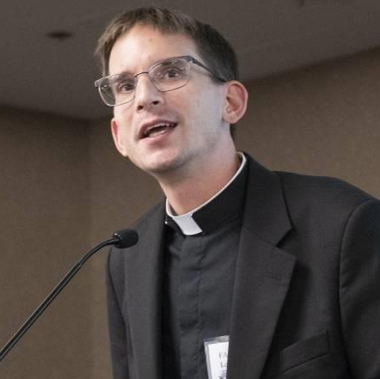
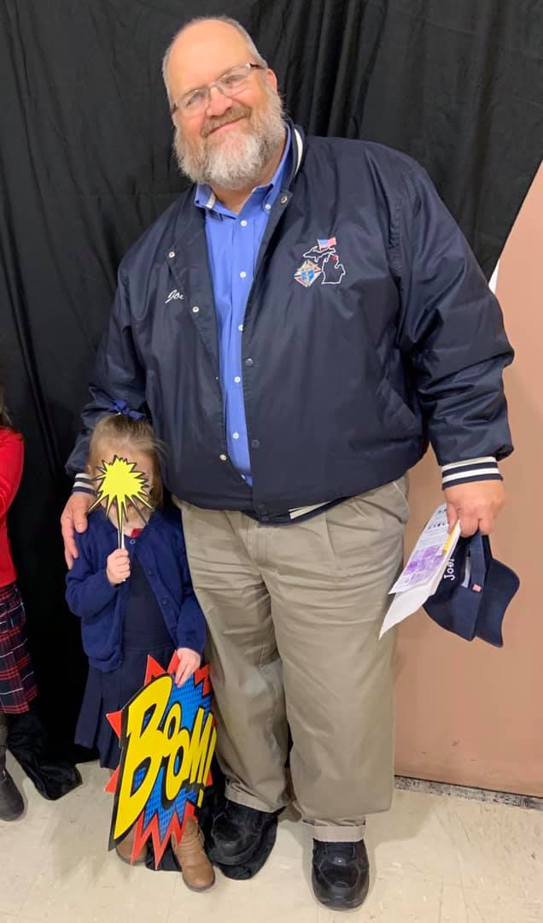
Religious Message from our State Chaplain
Fr. Andrew S. LaFramboise

Slide 77
State Warden
Joel Kendzorski

Slide 78
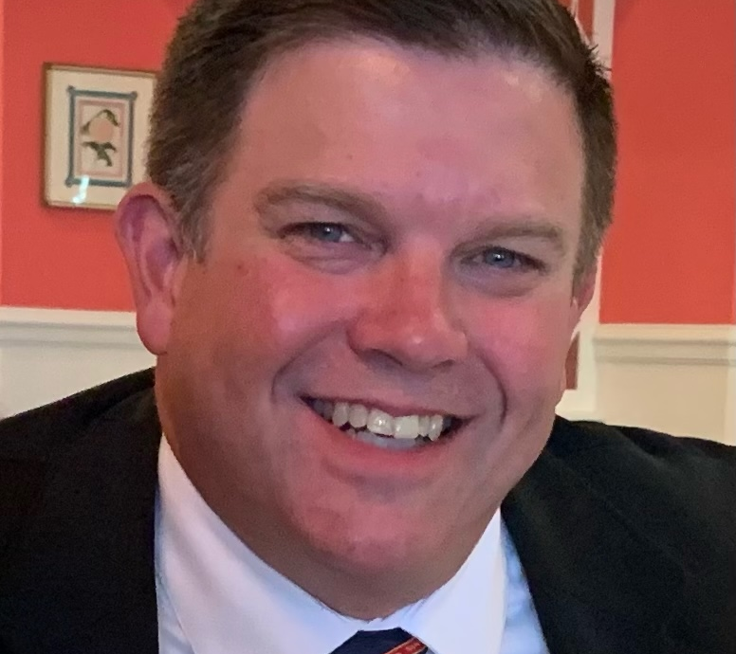
State Advocate
Daniel C. Fuller, Jr.

Slide 79
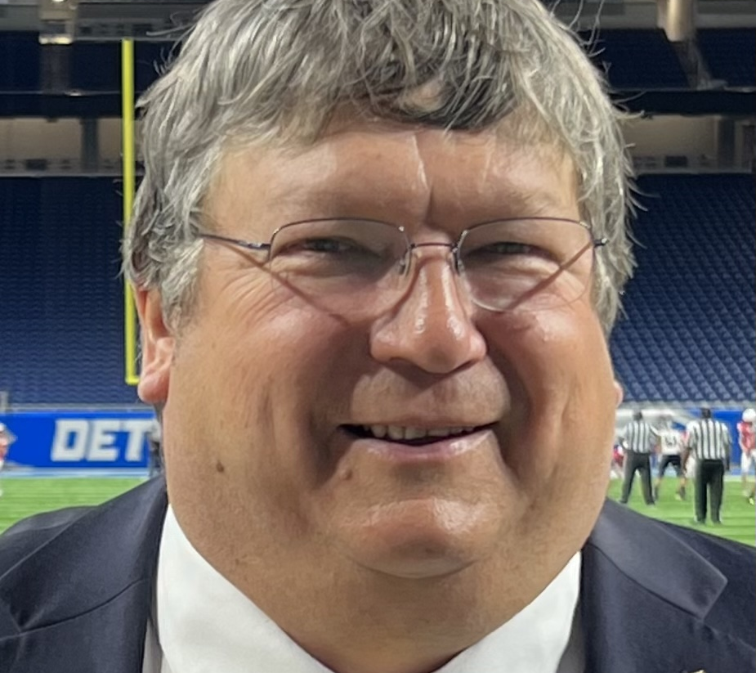
State Treasurer
Vern A. Miron

Slide 80
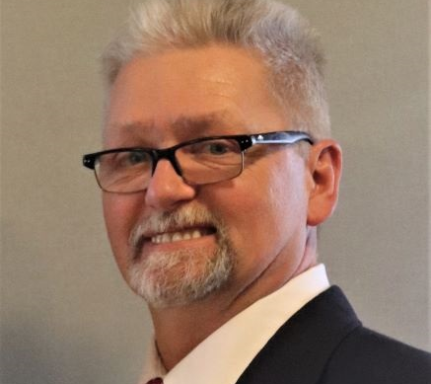
State Secretary
Charles E. McCuen, III

Slide 81
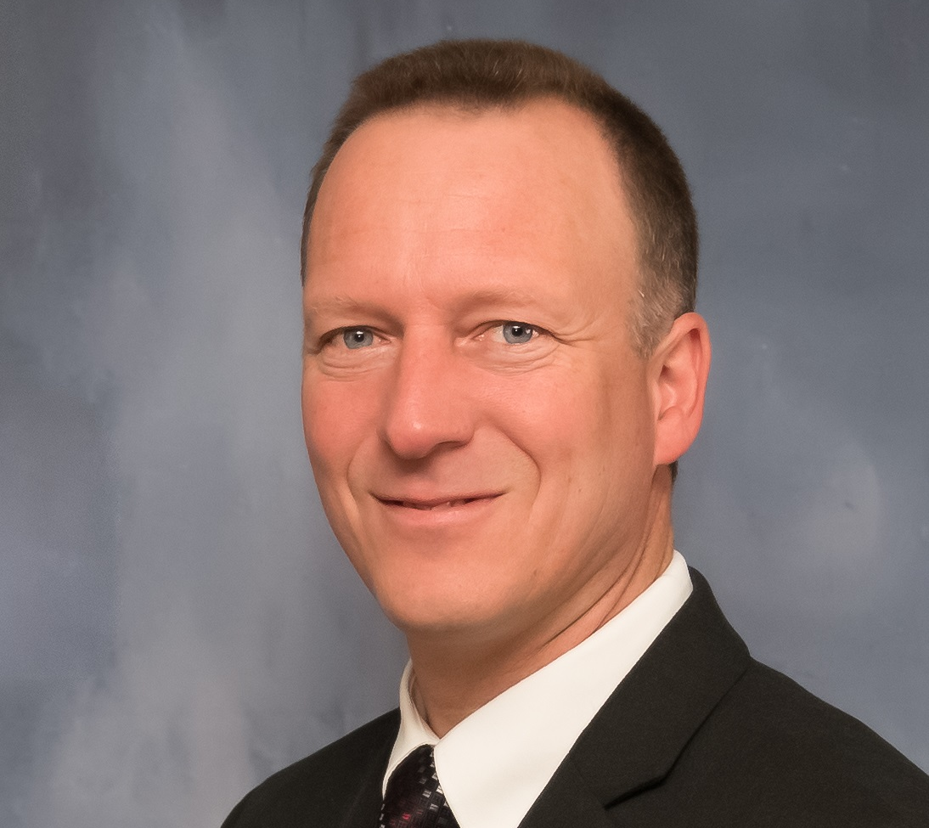
State Deputy
Barry M. Borsenik

Slide 83
Closing Prayer

Slide 84
Safe Travels Home

