Slide 1

Membership Director Training 2023-2024
Overview – Membership in the Knights of Columbus
Planning – Essential for council growth
Advertising – Attracting new members
Recruiting – Inviting new members
Admissions – Initiating new members
Retention – Keeping members active
Best Practices Checklist

Slide 2
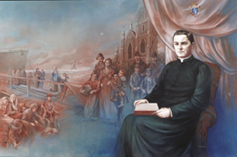

1. Overview – The Basics
Roles & Responsibilities
Why is membership important?
Life cycle of a KofC member
Notes:
Audio Overview
These 9 things should be your main focus as you begin
Have these done by end of September (Q1)
These are the most important things to get you started
If you handle these first, the rest is much easier
If you miss 1 or more of these, your job gets a lot harder

Slide 3
1.1 Roles & Responsibilities
Planning: Collaborate with your Grand Knight and Program Director
  Establish committees for recruiting, admissions, exemplifications and retention
  Establish a list of recruiting events using the Council Activity Tracker (CAT) system
  Establish a list of Exemplifications using Sheets (via your MDxxxxx@mikofc.org email)
Recruiting:
  Hold recruiting events at least 6 times / year
  Incorporate recruiting into your Faith in Action Programs (where non-members attend)
  Advertise your councils within your parishes and communities
Admissions:
  Hold regular exemplifications after recruiting activities
  Work with your F.S. to ensure all new members are added to the council roster
  Assign each new member a Mentor to get him active and feeling welcome
Retention: Keeping members active and paying their dues
  Work with the Retention Director to execute the Retention process

Slide 4
1.2 Why do we recruit?
Remember why we recruit
Order - To sustain and grow the Order
Church – To strengthen our Parishes
Community – To practice charity where needed
Members – To be better Catholics, husbands & men
Family – To strengthen Catholic Families
Vivat Jesus – To “Live Jesus” through our actions

Slide 5
1.3 Life cycle of a member
Yes
Recruiting
Admission
Active Years
Recommit
???
Inactive Years
End
No
Membership Team
Retention Team
Recruiting = Attracting new members
Admissions = Getting prospects to join AND be active
Active years = Knights “Living Jesus” active and fulfilled
Recommitment = ???
Inactive years = Illness, age or loss of interest
End = Death, suspension or withdrawal

Slide 6
2. Planning
Establish Committees
Plan Recruiting events – 3 months out
Plan Exemplifications – 3 months out
Notes:
Audio Overview
These 9 things should be your main focus as you begin
Have these done by end of September (Q1)
These are the most important things to get you started
If you handle these first, the rest is much easier
If you miss 1 or more of these, your job gets a lot harder

Slide 7


2.1 Planning – Establish Committees
Recruitment: Have a list of 10-15 people willing to assist as needed
  Personable council members – Friendly, outgoing, young (if possible), and active
  Council Leaders – Council Officers & Directors and Past Grand Knights
  Power Recruiters – Field/General Agent, Pastor, District Deputy & Diocesan Mem. Dir.
  Order Supplies – Always start the year with a Delta Church Drive kit
Admissions:
  Answer candidate questions and determine where their interests lie
  Ensure candidates are 17 ½ , male and Catholic
  Get them to and through an exemplification
  Assign a Mentor – Someone to watch over them until they are active and feel welcome
Exemplification: These can be a lot of fun. Don’t miss out.
  Develop a Council Exemplification Team, be part of a District Team or ask one of the Traveling Exemplification Teams to conduct the Exemplifications for you
  Have men for each roll and, if possible, a back-up for each role
Retention: Appoint a Retention Director and 3-4 others
  Work pro-actively to keep members active
  Work with the Financial Secretary to follow the retention process

Slide 8


2.2 Establish a list of recruiting activities
Faith In Action Programs: Program Director does most of the work
  Get a list of planned programs from your council Program Director
  Identify (at least) 4-6 throughout the year where non-Knights will be attending
  Meet with your recruiters and plan to recruit at these programs
Fraternal Benefit Events: General Agent does most of the work
  Get an event on the council calendar
  Advertise & invite non-members (maybe set up a meeting place with a meal)
  The General Agent / Field Agent will run the event and follow up with all candidates
Delta Church Drive: One / Parish / Year
  Follow the Delta Drive Process (Your DD or DMD can help if you’ve never done one)
  Do one at your home parish plus every Parish associated with your council (Round Table)
  Your Area Regional Growth Training Director offers training.
Council Activity Tracker:
  Document your planned activities each June & December for the next 6 months.
  As time goes by, update your plan (monthly) so it remains accurate and up-to-date

Slide 9
CAT Process
Go to the State Website (www.mikofc.org)
Scroll down & click on Membership
Click on “CAT - Enter a new Recruiting Event”
Fill in the blanks
Hit submit
Note: Enter “at least one” and “No more than 3” events per quarter.

Slide 10
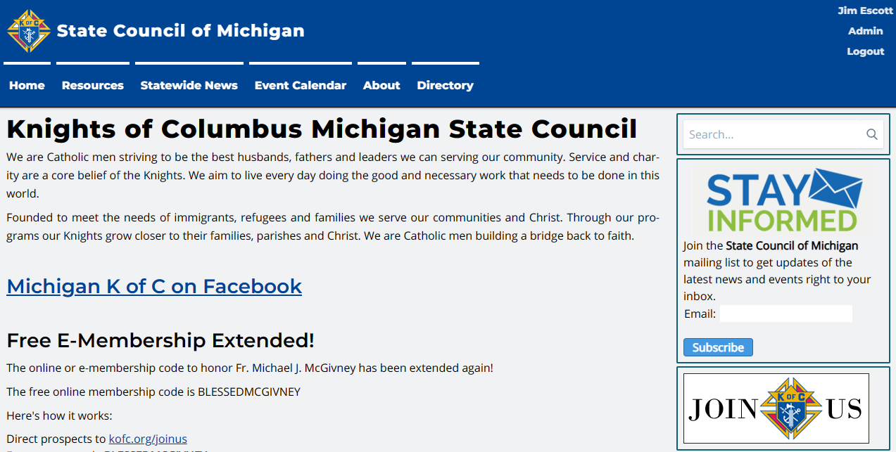
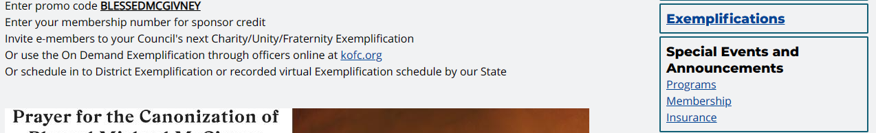
CAT – Step 1 = Go to the State Website

Slide 11
CAT – Step 2 = Click on Membership

Slide 12
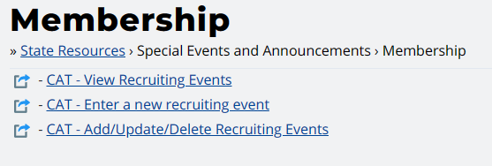
Step 3 = Click on CAT - Enter a new Recruiting Event

Slide 13
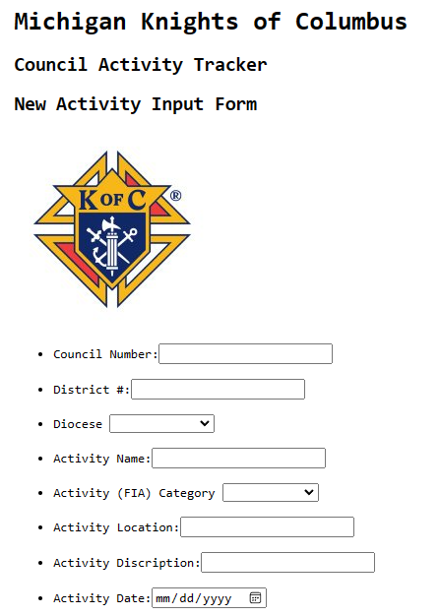
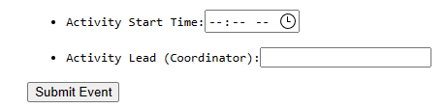
Step 4 = Fill in the blanks
Fill in the blanks
  Council #, District #
  Activity Name, Activity FIA Category
  Activity Location, Description, Date & Time
  Activity Lead
Hit submit

Slide 14

2.3 Establish a list of Exemplifications
Council (or District) Exemplifications:
  Each quarter, update the Exemplification Sheet with your exemplifications
  https://script.google.com/a/mikofc.org/macros/s/AKfycbzcx98cRrAZKTUsZVq31oMSKW5r6wAP7lJ04ezJcc2f0xc716TOGOHBMbTipKzjLDQ/exec?v=form
  Ensure your team has the necessary supplies (Pins, rosaries, baldrics, etc…)
  Hold them “in church” after a mass on Saturday or Sunday – Invite the Parish to observe
Attend (or Host) a Traveling Team Exemplification:
  Michigan will be holding special “Major” exemplifications throughout the state.
  A specially trained team will do the degree (memorized and very professional)
  The Exemplification should be done after a Mass followed by a meal for all.
  See the Exemplification Sheets application to see scheduled events or schedule your own.
Online Exemplifications: These should be a last resort
  Exemplifications are so much more meaningful and memorable if they’re done in person
  But online exemplifications are still available for those unable to a attend live event.
  Here is the link if/when needed: Instructions for Online Exemplification

Slide 15

3. Advertise & Communication
Social Media (Council Website, Parish Website, Facebook, etc…)
Recruiting Handouts
  Delta Church Drive Kits
  Faith In Action books (#10831)
  Council Specific (Prayer Cards & Tri-folds)
Other Council Advertising
  Church Bulletins (in each Parish your council supports)
  Shirts/Hats – Wear at most council activities
  Building the Domestic Church Kiosk
  Council Banner
  KC the Teddy Bear
  The list goes on and on
Notes:
Audio Overview
These 9 things should be your main focus as you begin
Have these done by end of September (Q1)
These are the most important things to get you started
If you handle these first, the rest is much easier
If you miss 1 or more of these, your job gets a lot harder

Slide 16
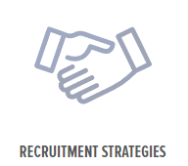
4. Recruiting – Top 7 Recruiting Strategies
Church (Delta) Drives
Nearby Parishes and Schools
Council Program Activities
RCIA/OCIA Candidates
Friends and Family
Fraternal benefit Events
Former Members

Slide 17
4.1 Delta Church Drives Delta Drive
People – Bring your recruiting team and have Knights families visible
Process
Follow -up
  Online Member – Get candidates to become online members right there, on the spot. Then, get them to a council event and a meeting. Once they’re comfortable, ask them to join your council.
  Council Member – Invite them to a council event and an exemplification to join your council.
  All Others – Some men may not join right away. Keep their information on file. Invite them to events. Many people join after being asked 10-20 times.
  Ask you District Deputy or Diocesan Membership Director for help if you need it.
Plan
Prepare
Practice
Implement
Welcome

Slide 18


4.2 Nearby Parishes and Schools
Run a Delta Drive at a Church or Parish near you
Hold a DCD at all round tabled churches
Seek out new Parishes to round table
Colleges – Always looking for volunteer opportunities
High Schools – Get seniors before they head off to college

Slide 19
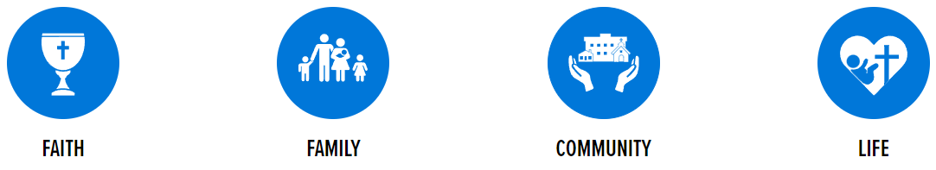

4.3 Council Program Activities
Councils plan and run Faith in Action programs all the time.
Let the Program Directors plan the event
Your team should plan to recruit at the event.
  Have sign-up sheets include spots for recruiters
  Make sure you have supplies on hand
  Work the crowd and, when appropriate, invite them to join

Slide 20

4.4 RCIA/OCIA Candidates
New Catholics love to live their faith
Participate in Parish RCIA/OCIA teams to help out
Sponsor an RCIA/OCIA candidate
Be a Guest speaker
Be yourself
  Make friends
  Develop relationships
  During RCIA/OCIA – Invite them to a council event (or 2)
  Give them each a gift (a bible, a crucifix, something religious)
  After RCIA/OCIA – Invite them to join

Slide 21

4.5 Family and Friends
Pick a Friends and Family Month
  Pass out “Ask Yourself First Flyer 15.11” to all council members
  Pass out 2-3 candidate cards (prospect cards) to all members
  Pass out other recruiting material (council Tri-folds, KofC brochures and prayer cards)
Ask each member to invite a friend or family member
  Invite them to a council event (FIA Program or a Fraternal Benefit Event)
  Invite them to join

Slide 22

4.6 Fraternal Benefit Events
Schedule a Fraternal Benefit Seminar | KofC.org
11077-fraternal-benefit-seminar-form.pdf
Promote the event
  For members (Council email and/or social media)
  For Parishioners (Parish email, bulletin and/or Pulpit Announcement)
  For Candidates (Email, phone calls, flyers)
Consider hosting a live event
  At your Parish or Council hall
  Include a meal (at least snacks)
  Have recruiting material at all tables
  Field/General Agent will lead the presentation

Slide 23

4.7 Former Members
Get a list of former members
  Your F.S. can provide contact information for Council former members.
  Michigan sends out a state-wide list annually
Reach out to them twice a year
  Invite them to rejoin
  Invite them to a “good” council activity
  Send them a summary of council accomplishments
  Remove them from your list if…
    They ask you to stop contacting them
    They can’t be reached
    If they’ve moved away – Send their contact info to a local council

Slide 24



5. Admissions
Educate & vet – Make sure it’s a good fit
Admit – Get him to join
  E-member (Join the Knights NOW, join the council soon)
  Invite him to council events and a “good” council meeting
  When he’s ready, invite him to join
Welcome
  Assign each new member a mentor
  Meet the guys – Make him feel at home & welcome
Active – Engaged in programs and “involved”

Slide 25


5.1 Educate & Vet is a two-way exercise
He’s checking us out
  Educate him on “what we do”
  Invite him to activities so he can see “what we do”
We’re checking him out
  Male, Practical Catholic & 17 ½
  What are his interests?
  What programs would he be interested in?
Notes:
Audio Overview
These 9 things should be your main focus as you begin
Have these done by end of September (Q1)
These are the most important things to get you started
If you handle these first, the rest is much easier
If you miss 1 or more of these, your job gets a lot harder

Slide 26


5.2 Admit
E-member – A good first step
Council Member - Exemplification
  Have options (Council, District, State & Online)
  Have materials (Pin, Rosary, “These men they call Knights”)
    Get him to an exemplification (offer to drive)
    Invite him to a council meeting
    Offer to drive him to the meeting
    E-members can come BEFORE an exemplification
    Non-members can come AFTER an exemplification
    Make him feel special, welcome and comfortable

Slide 27

5.3 Welcome & Active
Proposer (Mentor) Roles & Responsibilities
  Drive him to Council meetings (for a while)
  Introductions – Individually & to the entire council
  Sit with him – Explain what’s going on
  Active – Sign him (and you) up for an activity
Council Roles & Responsibilities
  Program Director – Get him engaged in an activity
  Grand Knight – Welcome and explain Shining Armor Award
  Everyone – Make him feel special, welcome and comfortable

Slide 28
6. Retention - Member Retention
Have a Retention Committee
Follow the Retention Process
  Retention Director - How to Execute the Retention Process (PDF) 20.11
Retention Strategies
When/how to remove members from your Council

Slide 29
6.1 Retention Strategies
Once He’s Joined, Keep Him Involved
Go for the Fourth!
Half Showman, Half Teacher — The Lecturer
Take an Inventory
Keeping Members Interested
Every Council Active
Fraternal – First and Foremost
Shining Armor Award
Don't Let Your Council Go into a Summertime Slump
Honor Those Members Who are Always There
Well-Run Meetings will Boost Attendance

Slide 30
6.2 Removing Council Members
Do remove these members | Do NOT remove these members
Suspension - Convicted of a felony | Religious (Priests, Deacons, Brothers)
 | Members close to Honorary status
 | Disabled members – Disability Relief form 1831
Withdrawal – Men who ask to be removed | Members down on their luck – Affiliate Program
Valid Withdrawal = Not a Practical Catholic (See note) | Non-payment of Dues (3+ years) – Affiliate Program
Invalid withdrawal = too old, disabled, hardship, moved, lost interest, doesn’t have time | Moved away – transfer them to a new council or Affiliate Program
Note:
The only people who can determine if a person is NOT a practical Catholic are (1) the member and/or (2) his Pastor
There is a new option this year. The Affiliate program. This may (or may not) be offered again going forward.

Slide 31
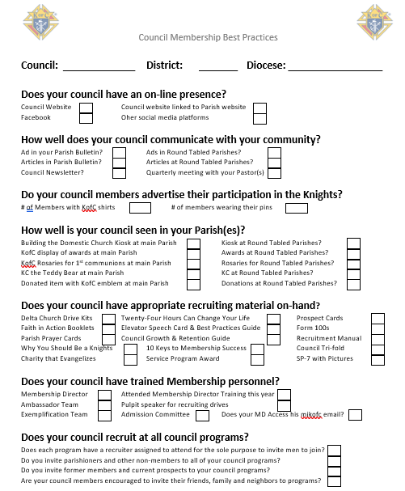
7. Best Practices Checklist
Check off what you do
Check off “at least” one new thing to do this year
Then, do it

