Slide 1
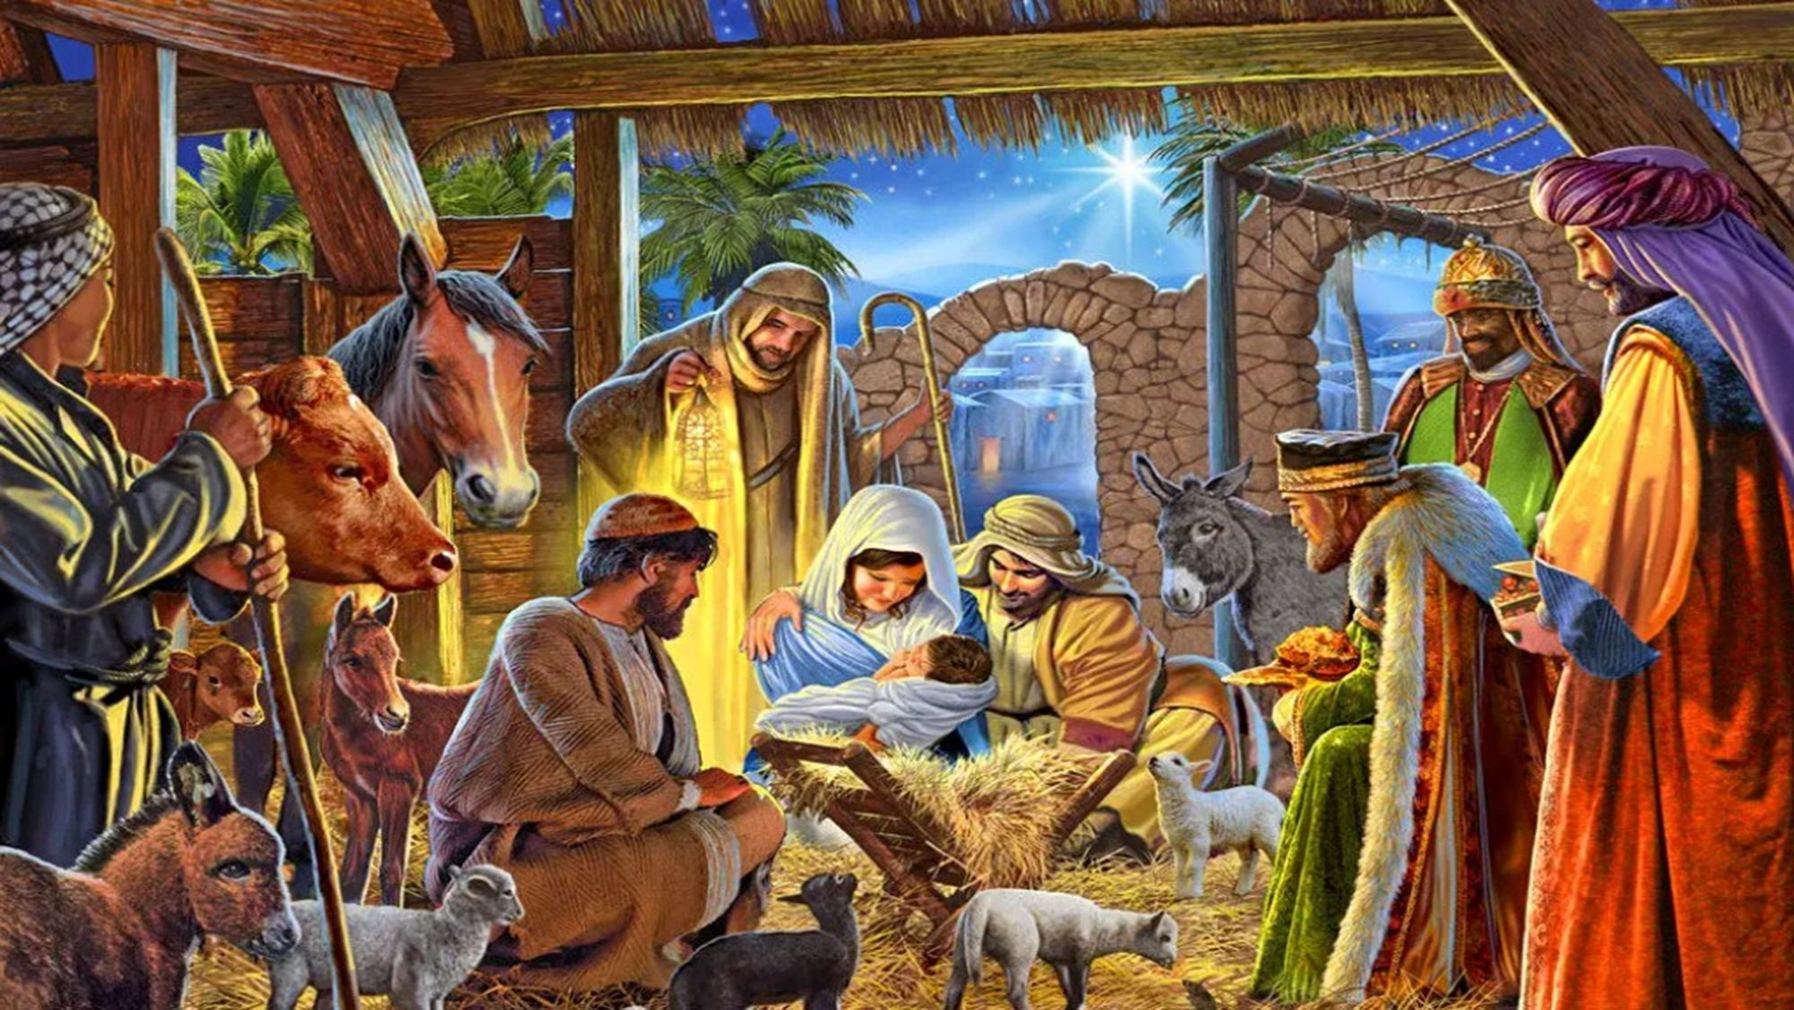

2025 Winter Leadership Meeting
Programs Breakout Session
Service
Optimism
Aspire
Responsibility
SOAR WITH US!

Slide 2


Slide 3
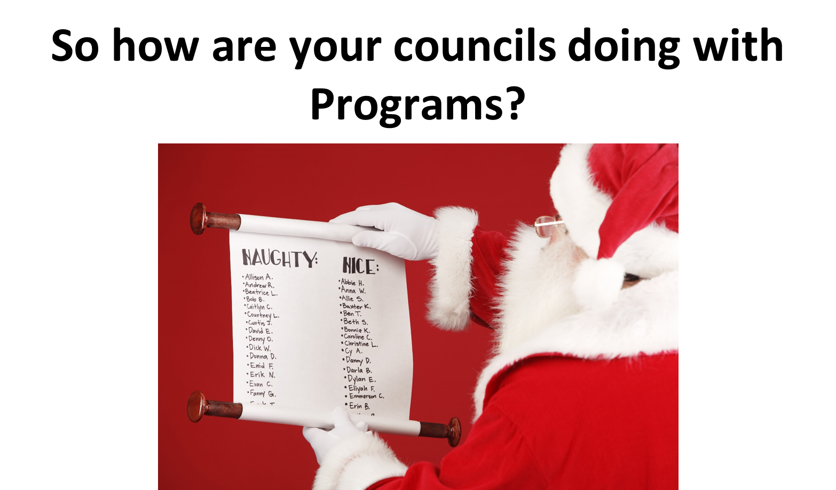

Slide 4
Let's take a look at the 10784 Submissions
Across the State:
Faith | 695
Family | 620
Community | 281
Life | 836
Total Submissions Statewide (2025): 2432
Total Submissions Statewide (2024): 1786
36.17% Increase

Slide 5
Let's take a look at the 10784 Submissions
Council Submissions Across the State:
 | 2025 | 2024
0 Submissions | 229 | 222
1-5 Submissions | 100 | 113
6-10 Submissions | 49 | 41
11+ Submissions | 74 | 49
*Although more submissions submitted, more councils have not submitted a single 10784 so far.

Slide 6
10784 Program Submissions
Question to ask (for those who have not submitted a 10784)
Are the councils doing programs? If so, what is the underlying reason they are not spending the 10-15 minutes to submit a 10784 form after?
Do they understand where to complete the 10784? Do they have the skills to navigate and complete this form? If not, please provide guidance as needed.
https://tinyurl.com/kofc-10784 <-- TRAINING VIDEO
Why is the 10784 so important? Why do I need to do this form?

Slide 7
10784 Program Submissions
Why is so darn important?
It Documents Your Council’s Work
*If it isn’t on a 10784, Supreme has no record that it happened.
2. It will become required for awards:
*Even if your council does the work, you can’t earn awards without the documentation.
3. It Helps Supreme Track the Order’s Impact
*This data is used to help with annual reports and to maintain nonprofit compliance. (FORM 1728)

Slide 8
10784 Program Submissions
Why is so darn important?
4. It Supports Accountability and Transparency. The Knights rely on these forms
5. It Keeps Councils Organized
* Regularly completing the form encourages councils to plan and evaluate programs, helps Program Directors and Grand Knights stay on track, and prevents missed deadlines and lost credit for activities

Slide 9
10784 Program Submissions
Do’s and Don'ts
Does time serving as an officer count as a 10784 Submission?
No. Neither is hall admin time. That should get reported on 1728 form.
Can a council meeting count as a 10784?
No. The meeting itself should not be reported, but if you do a rosary, COR, or other program before or after the meeting, that can be reported.
Does a COR event also count as a 10784?
Yes! Just don’t forget to also complete the COR Survey. ☺
Does a membership drive or exemplification count as a 10784?
No. Not unless its being run in tandem with a program. (Example: Pancake Breakfast)

Slide 10
On the horizon..
- The 1728 (Annual Survey of Fraternal Activity) form is due by 1/31/2026
The Semi-Annual Audit is now only due once a year and in August.
  Next due date is next fraternal year 8/15/2026
Special Olympics is done via 10784
  No separate form anymore for this program
State Program Award Submissions are due 3/15/2026
State Family of the Year Submission is due 3/15/2026
State Blessed Michael McGivney Award Submission is due 3/15/2026
The SP-7 Form is due by 6/30/2026, however can be submitted early if council completes all the necessary requirements early.

Slide 11
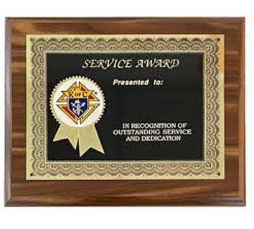
State Program Awards
Thank you to those who submitted a Rough Draft. We will return with feedback by Diocesan Meetings.
Final Submissions due 3/15/2026

Slide 12
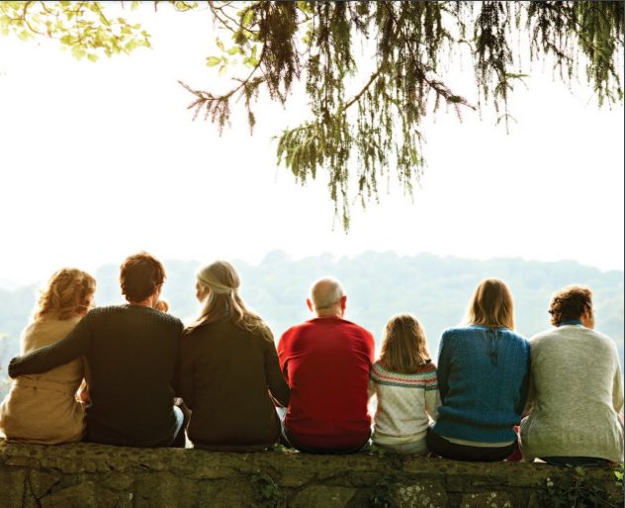
Family of the Year
Thank you to those who submitted a Rough Draft. We will return with feedback by Diocesan Meetings.
Final Submissions due 3/15/2026

Slide 13
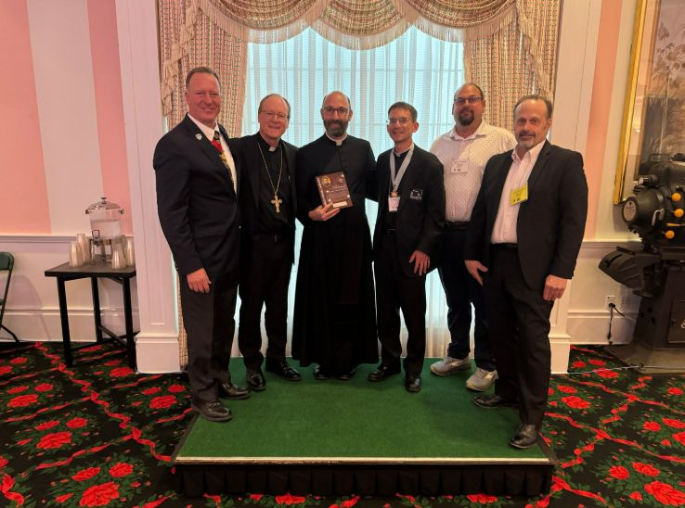
State Blessed Michael McGivney Award
SBMMA Form Available on kof.org
Final Submissions due 3/15/2026

Slide 14
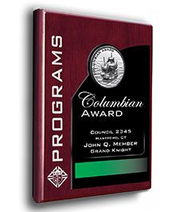
Columbian Award
To successfully be eligible for the Columbian Award, a council must:
Successfully submit the form 365, 1728 (a & b), and SP-7 and be accepted
Satisfy the Faith in Action credits
  Must earn at least four (4) program credits in each of the Faith in Action categories.

Slide 15




A Review of the Faith in Action Programs
Supreme-Recommended Program Category Matrix
4
4
16
4
4
Featured Programs (Highlighted in Red) count for 2 points each.

Slide 16

NEW! Faith in Action Programs
Bright Futures
Celebrating our Catholic Heritage
Viva Christo Rey
Imitating Juan Diego
Remembering our Faithful Departed
Quinceanera Support
Holy Hour for Life with Our Lady of Guadalupe
The Gospel of Life
* More Information on these newly added FIA Featured Programs are NOW on kofc.org.

Slide 17
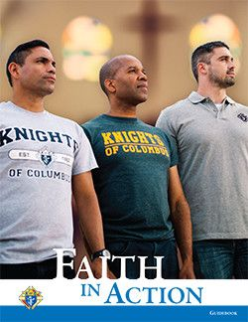

And now from our Faith in Action Team
FAITH
FAMILY
COMMUNITY
LIFE

Slide 18
Faith in Action: Family Programs

Slide 19
Faith in Action: Family Programs
Who am I? Jim Kelly, PGK (09-11), FDD (14-18, 22-24)
Married to Stephanie
Kids: Jimmy, Maria, Clare, Michael, and John Paul

Slide 20
SOARing into Family Programs: Goals
Service: Councils participate in the Order-wide recognized family programs and create their own family programs.
Optimism: Councils attract and recruit men with families.
Aspire: Families are engaged in the Council and related-Parish Activities.
Responsibility: District Deputies promote family programs to councils.

Slide 21
SOARing into Family Programs: Results
We have strong councils that secure the legacies of our parishes and councils throughout the State.
SUCCESS!

Slide 22
Do Family Programs Even Matter?
Yes! Mission Critical!
All Councils should be offering something for our families.
Work follows a man home; at home he is under-appreciated.
Family programs give men the ability to spend time with their families while still building up bonds of fraternity and living their faith.
No better example for a man’s sons, grandsons, and nephews.

Slide 23
Family: The District Deputy’s Role
Get credit for what’s already happening.
  Encourage councils to fill out the 10784 on a more timely basis.
Be the voice that encourages Council to plan out family programs.
  Consecration to Holy Family
  Family of the Month/Family of the Year
  Keep Christ in Christmas Poster Contest
  Food for Families
  Other Family Programs
Don’t let Family Programs be the ones playing catch up in June.

Slide 24
Consecration to the Holy Family
Feast of the Holy Family is Sunday, December 29, 2024
  Can be celebrated any time
  Other examples would be a feast of Mary or St. Joseph or Mother’s Day or Father’s Day
Ask Father to make an announcement and lead the prayer of Consecration to the Holy Family.
Supreme Chaplain suggests families spend a week discerning and prayerfully preparing for the Consecration.
Possible celebration or hospitality after the Consecration.

Slide 25
Family of the Month/Family of the Year
Email submissions to j.kelly@mikofc.org
Family of the Year submissions
  Add detail, photos, tell a story.
  Explain why this family stands out.
  Examples of past winners available on State website
  District deputies should be actively encouraging submissions

Slide 26
Keep Christ in Christmas Poster Contest
Children design posters reflecting the theme “Keep Christ in Christmas”
Council judging should occur just around Christmas
District level target end date January 15
Diocesan level judging January 31
State level judging February 15
Supreme submissions due February 28

Slide 27
Keep Christ in Christmas Poster Contest
Age Groups:
Kindergarten
Grades 1-2
Grades 3-4
Grades 5-6
Grades 7-8

Slide 28
Food for Families
Supreme-sponsored program
Get 2 points on SP-7 for donating $500.00 or 1,000 pounds to local food pantries, food banks and soup kitchens.
If you do that and report it, Supreme will refund $100.00 back to the Council.
If you don’t quite make those goals, Council can still get 1 point on its SP-7.
Last year’s State Family Service Program of the Year winner

Slide 29
New! Remembering Our Faithful Departed
Supreme suggests 3 possible activities that could be used to remember deceased members of their council, families, and parishes.
Organize a visit to a cemetery to pray for the faithful departed.
Organize or help a school or parish's All Saints Day parade, in which children dress up as their favorite saints.
Set up ofrendas and altars in remembrance of the departed.
Notes:
Supreme has several prayers cards that can be used for this purpose, or the council could lead a rosary or Chaplet of Divine Mercy as a group and allowing time for individuals to visit graves. This might be a good way to reach out to a growing Hispanic community if you have one in your parish.

Slide 30
New! Quinceañera Support
A quinceañera celebrates a 15-year-old young woman’s passage from childhood to adulthood, as she thanks God for the blessing of her life and she asks for His blessing going forward.
Councils can offer Mary as the ultimate role model for all women.
Supreme suggests working with pastor to identify a good time of year. Jim suggests the months of May or October, or a feast dedicated to Mary like Assumption (8-15) or Coronation (8-22).
Supreme-sponsored program earns 2-points on SP-7.

Slide 31
Other Family Programs
Into the Breach: Mission of the Family – incorporate into Cor meetings or offer as a stand-alone program.
  It was designed for discussion among men (Cor) but Supreme recognizes that it can be a useful program for husbands and wives to view together.
  5 episodes, so not a huge commitment.
Family Prayer Nights.
  Great way to connect the Council and Parish with families.
  Could be an Adoration geared toward bringing your kids.
  Could be a Rosary.
  Council could host reception afterward.
  Doing it 4 times per year gets the council two points on its SP7
Ice Cream Socials.
Family Movie Nights.

Slide 32
Family Service Program of the Year
Examples of past winners can be found on State website.
Would like to get at least one from each district.
District Deputies may need to give them a nudge to submit.

Slide 33
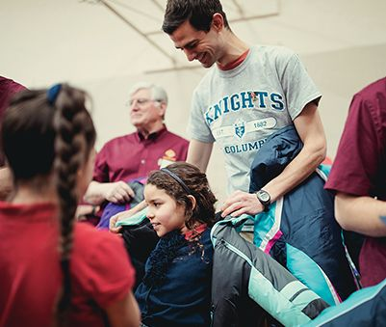
State Community Director
Larry Herman

Slide 34
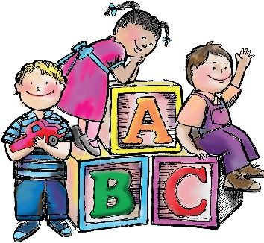

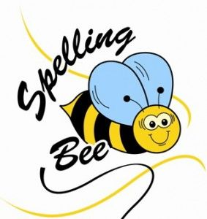
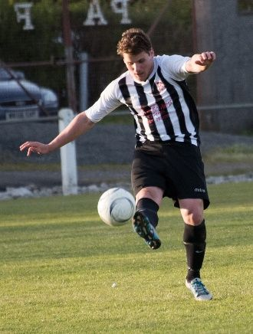


Key Community Activities
Youth Activities
Council Recognition
Knight of the Month / Year

Slide 35
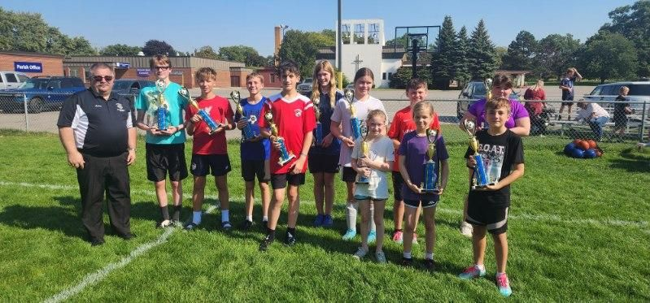
Youth Activities Soccer Championship
Competition held on 10/4/2025 in Wyoming, MI
The winners:
  Gaylord Diocese – 2
  Saginaw Diocese – 2
  Grand Rapids Diocese – 3
  Archdiocese of Detroit – 2
  Lansing Diocese - 2

Slide 36

Youth Activities Key Dates
State Competitions
Essay Contest – Saturday, January 3, 2026
Spelling Bee – Saturday, March 7, 2026
Free Throw Contest – Sunday, March 15, 2026
State Hockey Challenge (Ice) – TBD
State Hockey Challenge (Floor) – May 30, 2026
ALL COMPETITORS MUST COMPETE IN AT LEAST 2 LEVELS OF LOCAL COMPETION (COUNCIL AND DISTRICT or REGIONAL) FOR SPELLING BEE AND FREE THROW COMPETITION TO QUALIFY FOR INTERNATIONAL COMPETITION

Slide 37
2026 Free Throw Contest
Diocese of Marquette Free Throw Competition Policy
Several years ago, the State Deputy at the time and the Supreme Program Director reached an understanding, allowing the Diocese of Marquette to conduct a separate competition for the State Free Throw Championship. This decision was made primarily due to the significant travel distance involved and the potential hazards of crossing the Mackinac Bridge in March.
It was agreed that the Diocese of Marquette would hold a second competition for its Diocesan winners, following the same rules and procedures as the State-level event. Scoresheets from this competition will be forwarded to the State Community Director for inclusion in the State competition results. The event will be administered by the current State Deputy’s representative.
Each participant will take the required number of shots, with an additional five shots used to determine a winner in the event of a tie. If the State competition proceeds beyond five tie-breaker shots, the participant present at the State event will advance.
This arrangement was reviewed and verified by the State Community Director at the beginning of the 2025–2026 fraternal year

Slide 38
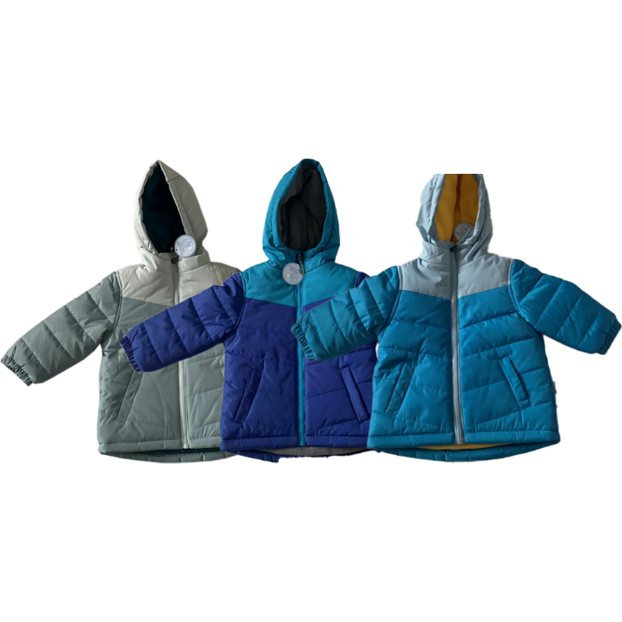
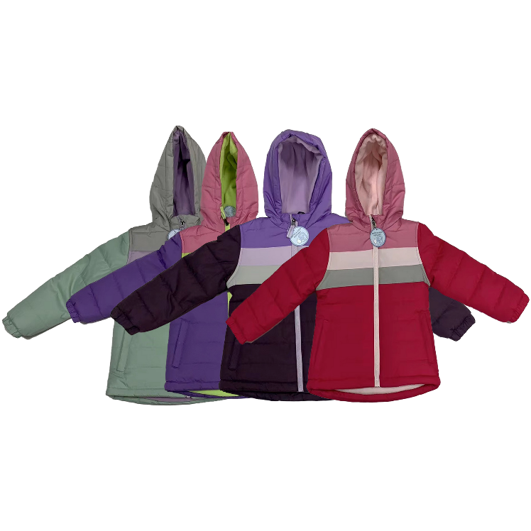
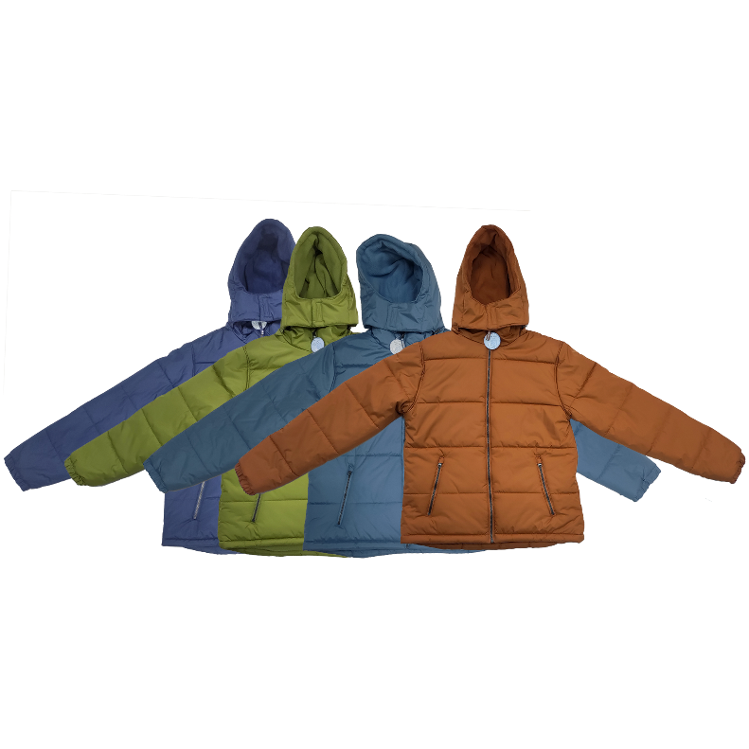
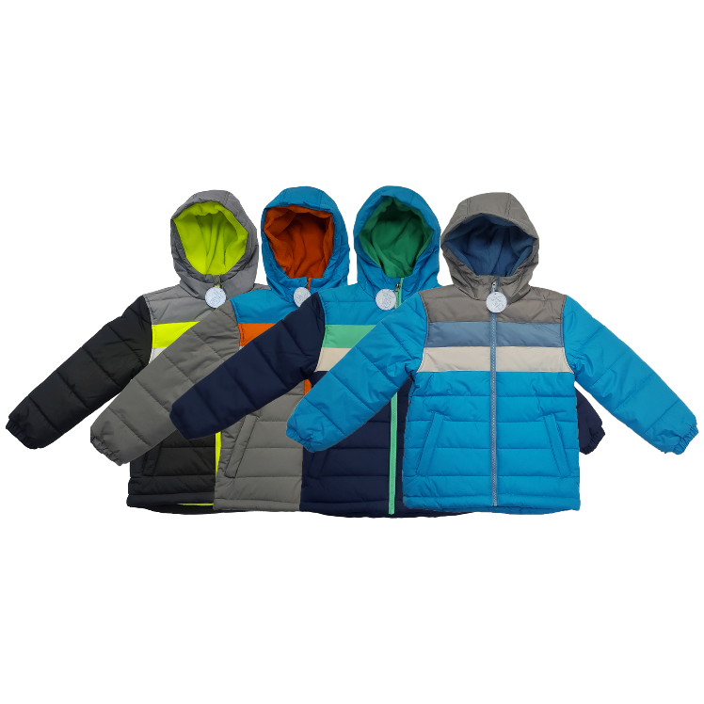
Coats for Kids

Slide 39
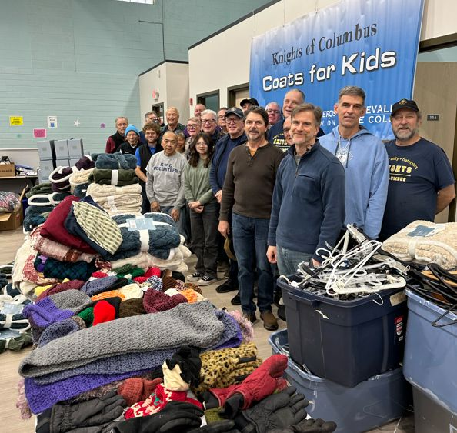
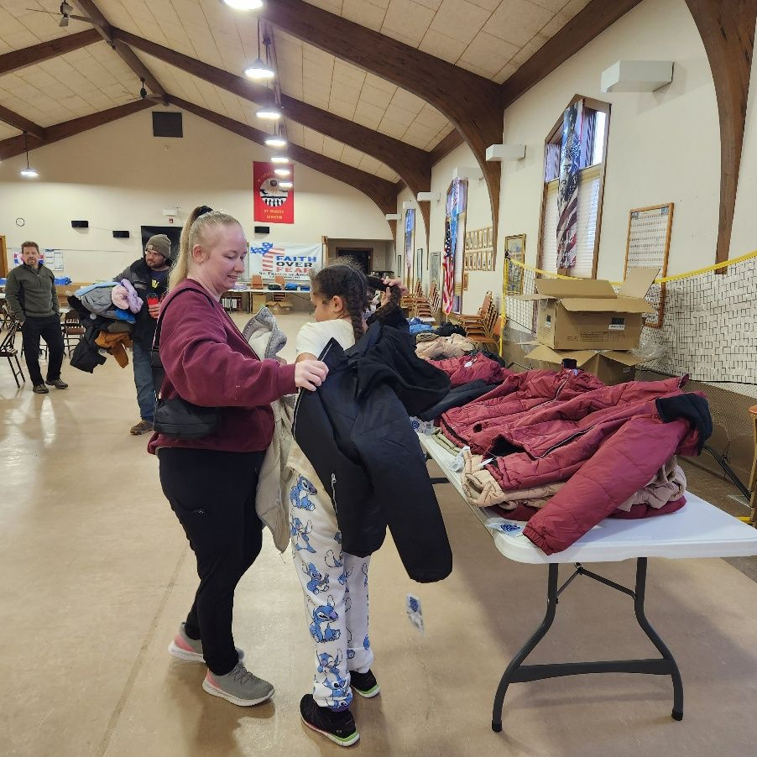
Coats for Kids
Very Successful Year!!
Distributions are complete

Slide 40

Coats for Kids
In 2022 - $54,000 was collected through the BOGO (Buy One Get One Free) program
In 2023 over $139,000 was raised!
In 2024 over $185,000 was raised!

Slide 41

Coats for Kids
2025 over $260,000 was raised
1,429 cases ordered or 17,148 coats for Michigan Kids
Councils purchased over 880 cases of coats in 2025, this was a 140-case increase over last year
As of October 28, Michigan was in 1st place

Slide 42

Coats for Kids By The Numbers
Amount Collected
2024 2025
  Detroit $93,079 $142,985.54
  Gaylord $4,299 $6,009.34
  Grand Rapids $39,841 $54,165.12
  Kalamazoo $6,583 $2,914.66
  Lansing $25,484 $34,051.98
  Marquette $10,140 $11,054.58
  Saginaw $8,678 $15,828.57

Slide 43
Coats for Kids By The Numbers
Detroit Council 4401 St Francis of Assisi $17,972.18
Grand Rapids Council 706 Dan M Kennedy $7,143.20
Lansing Council 788 Richard $3,061.24
Marquette Council 2300 Iron River $3,288.68
Kalamazoo Council 3798 Paw Paw $1,149.52
Saginaw Council 8043 Fr. Vernon J. Sierminski $3,344.62
Saginaw Coucil 414 Bay City $3,230.90
Gaylord Council 15937 St Francis of Assisi $3,458.00

Slide 44
Preparing for BOGO in 2026
New guidelines for BOGO 2026-2027
Supreme will reach out to start planning Spring 2026
  Once I receive the new guidelines, I will meet with the State Deputy, State Secretary and the State Program Director to streamline the program for 2026.

Slide 45
Global Wheelchair Mission
State Wheelchair Chairman Role Created
Resource
  Wheelchair Sunday Booklet
  Free on Supplies online
Containers of Wheelchairs
  $42K
  280 wheelchairs, $150 per wheelchair
  District or Diocese project
  More information to come

Slide 46
Celebrating Our Catholic Heritage
Promote the rich culture of local parish communities and celebrate the unique aspects of their heritage and faith
Councils can organize devotions or parish festivals featuring acts of piety that are relevant to the cultural groups in their parish
Suggested dates for this program are around the feast day of relevant saints to cultural groups of the parish
  Examples
    Our Lady of Guadalupe – December 12
    St Joseph – March 19
    St Patrick – March 17

Slide 47
Bright Futures
Catholic Schools need support
Organize fundraisers, create parish libraries featuring Hispanic authors and saints, and collaborate on school beautification and other projects
Suggested Dates
  Black Friday
  Catholic Schools Week
  Back To School Week

Slide 48
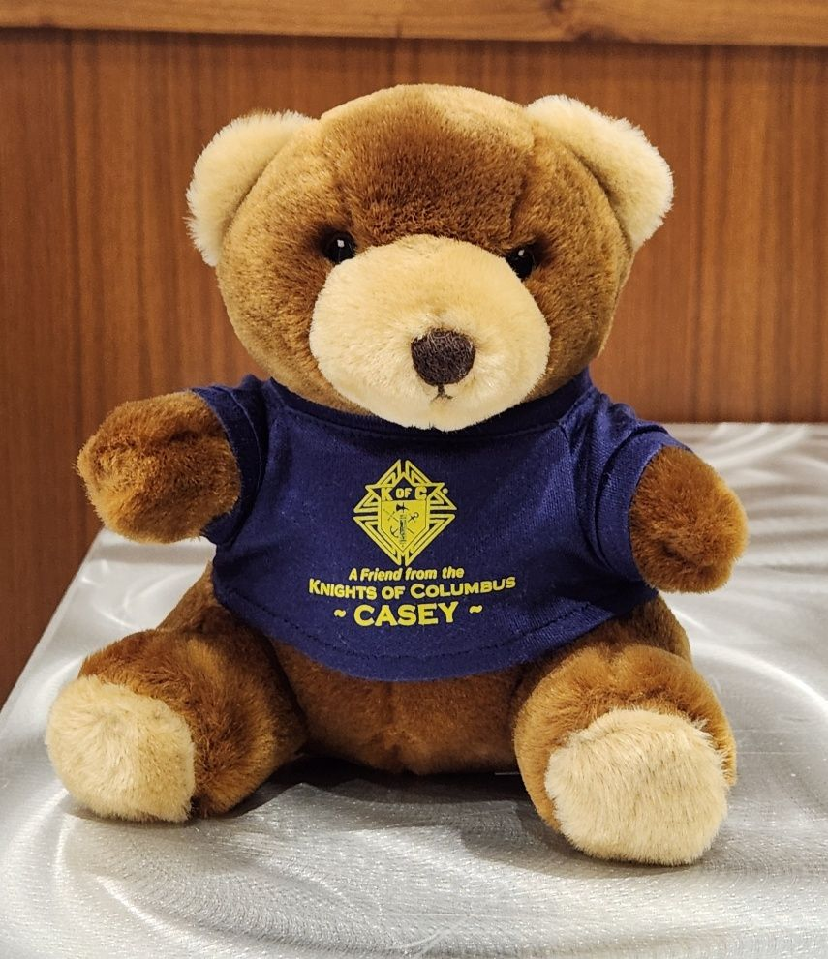
Casey Bears
Orders have not dropped
26 cases shipped in the last 6 months
Please support this program
We are currently extremely low on
inventory, please contact me before
ordering. I am working on a new
supplier and hope to have inventory
soon

Slide 49
Knight of the Month / Year
Increase participation to at least 57% of active councils.
mikofc.org/resources/community-support-materials
This recognition is important to the individual Knight.
Use Recognition as a recruiting tool.
SEND FORMS TO: l.herman@mikofc.org and g.kolbicz@mikofc.org

Slide 50
Hockey Challenge
Council – March / April
District / Diocese – May
State – May 30, 2026
Each level should be played in a gym, local park, ice rink, or another location approved by the Council

Slide 51
New for 2026 – 2027
Starting next Fraternal Year, the Hockey Challenge will offer an International Challenge
Use the second half of this fraternal year to promote the Hockey Challenge and send participants to the State Competition in May

Slide 52
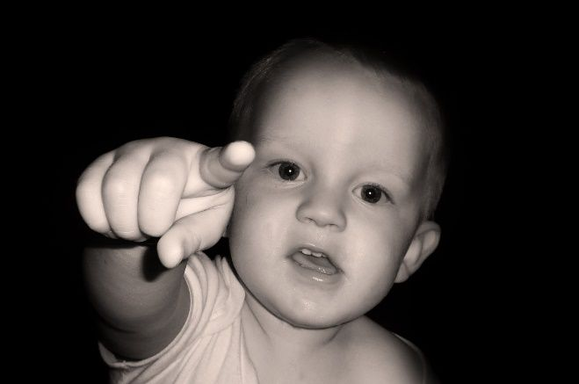
Who Plans these Events?
State Community Director plans State events
Diocesan Program Directors plan Diocesan events
District Deputies plan District events
E-mail to l.herman@mikofc.org

Slide 53
Thank You!
Thank your Districts and Councils frequently
Thank the participants in the events
Thank your Parish priests
PS Don’t forget to do the 10784 for the project…..

Slide 54
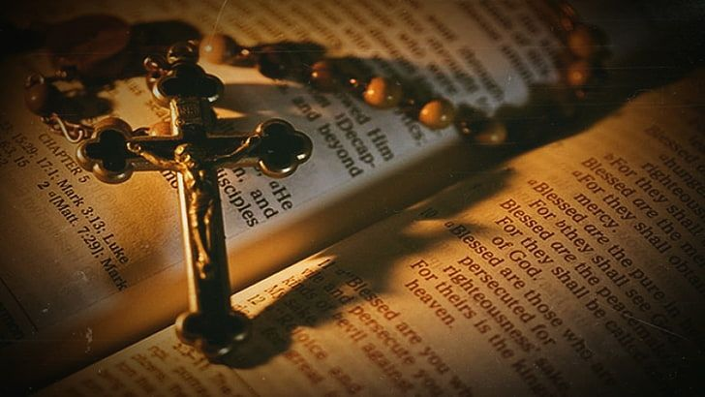
Faith
Robert Bagley
State Faith Director
r.bagley@mikofc.org
269.806.3883

Slide 55
Featured Programs Minimum Requirements

Slide 56
FAITH REFUND SUPPORT VOCATIONS PROGRAM (RSVP) Councils are required to donate at least $500 to an individual seminarian or religious aspirant. For every $500 donated, Supreme will refund the council or assembly $100, with a maximum refund of $400 per individual supported. Report activity using the RSVP Refund Application (#2863)
HOLY HOUR Councils are required to hold at least four Holy Hours (quarterly) or organize and support two Holy Hours and at least one Eucharistic Procession. Report activity using the Program Report Form (#10784)

Slide 57
INTO THE BREACH Councils are required to hold eight sessions to discuss the content of the original Into the Breach video series or apostolic exhortation (#340) or five sessions of Into the Breach: The Mission of the Family video series. Report activity using the Program Report Form (#10784).
SPIRITUAL REFLECTION Councils are required to host or attend a Spiritual Reflection for the men of the council and the parish that is at least a day long and is attended by 10 men or 10% of your council, whichever is fewer. Report activity using the Program Report Form (#10784)

Slide 58
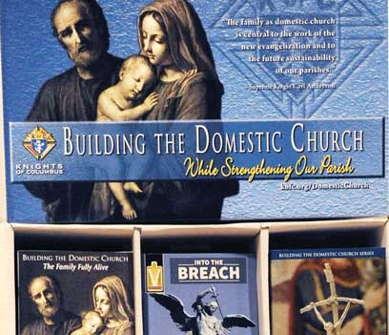

Slide 59
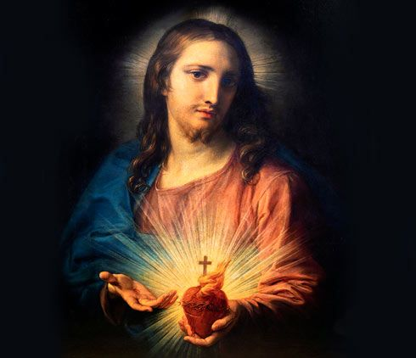

Slide 60
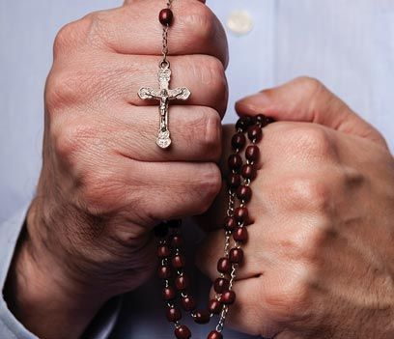

Slide 61
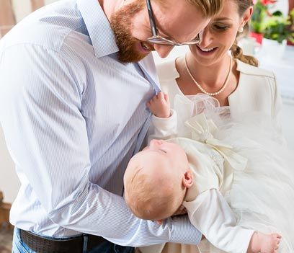

Slide 62
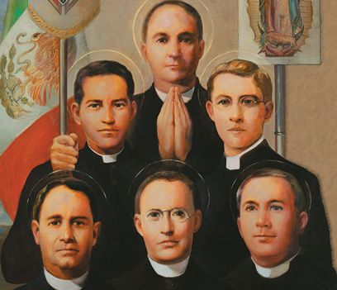
¡Viva Cristo Rey!

Slide 63
A HIGHER PURPOSE
The ¡Viva Cristo Rey! program celebrates the sanctity of the
Mexican Martyrs, including members of the Knights of
Columbus, who were killed for their faith during the religious persecution of Catholics by the Mexican government in the early 20th century. During the persecution, which led to “La Cristiada,” or the “Cristero War,” priests, missionaries and members of religious orders were expelled from the country, more than a million Mexicans migrated to the United States seeking refuge and others spontaneously organized to defend themselves against government oppression, some peacefully and others taking up arms under the banner of “Cristo Rey y Santa María de Guadalupe” or “Christ the King and Holy Mary of Guadalupe.”

Slide 64
OVERVIEW
Councils are encouraged to ask for the intercession of the Mexican Martyrs by going to Mass, praying the novena leading up to their feast days, and spreading devotion to these saints and blesseds throughout their community.
SUGGESTED PROGRAM DATES
The May 21 feast of the Mexican Martyrs (Optional Memorial of Saint Christopher Magallanes, Priest, and Companions, Martyrs), the Solemnity of Christ the King, and the Nov. 20 (in some dioceses) feast commemorating the following Knights of Columbus: Bl. José Trinidad Rangel Montaño, Bl. Andrés Solá y Molist, Bl. Leonardo Pérez Larios.

Slide 65
Imitating Saint Juan Diego

Slide 66
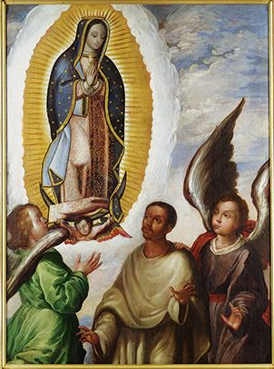

Slide 67
A HIGHER PURPOSE
The Imitating Saint Juan Diego program encourages councils to promote devotion to St. Juan Diego and Our Lady of Guadalupe. As Knights of Columbus, whose patroness is Our Lady of Guadalupe, we are called to be her messengers, just as St. Juan Diego was throughout his life.

Slide 68
OVERVIEW
The appearance of Our Lady of Guadalupe to St. Juan Diego led to the mass conversion of millions of indigenous people to the Catholic Faith and continues to serve as a means of evangelization today. Councils can teach others about the lives of Our Lady of Guadalupe and St. Juan Diego and emphasize their status as powerful intercessors by organizing a traveling image of Our Lady of Guadalupe which can be shared between families, by encouraging acts of popular piety, and by sharing other devotional materials with members and their parish community.

Slide 69
SUGGESTED DATES TO HOST YOUR EVENT
The suggested timeframe for this program is early December, coinciding with St. Juan Diego’s feast day on December 9 and Our Lady of Guadalupe’s feast day on December 12. Alternatively, your council can end the program on these dates and host a celebration on his feast day.

Slide 70
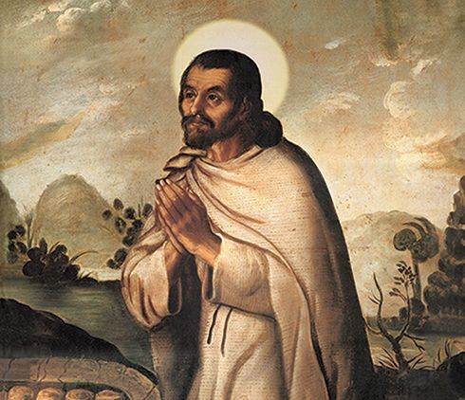

Slide 71

Special Olympics

Slide 72
The Knights of Columbus has a unique partnership with Special Olympics, making it a “Featured Program”!
Contribute a minimum of:
$2,000 or 200 volunteer hours = II (2) TWO
Program credits toward the Columbian Award!!!

Slide 73
Basic Steps for Councils:
Identify a program Chair to oversee all action steps and delegate tasks.
Contact the local Area Director for Special Olympics Michigan – ask how you can help.
Set goals for man hours / funds to be donated.

Slide 74
All councils are to report their participation in Special Olympics programs through the online Fraternal Programs Report Form (#10784) under the LIFE category.
You’d be surprised how many councils get this wrong!
All participation taking place in calendar year 2025 must be reported through the online #10784 by January 31, 2026 to be considered in the rankings. (submit multiple forms for multiple donations / events)
Along with every Special Olympics event comes the prospect of recruiting new members. Be sure to include a recruitment strategy as part of your plans.

Slide 75
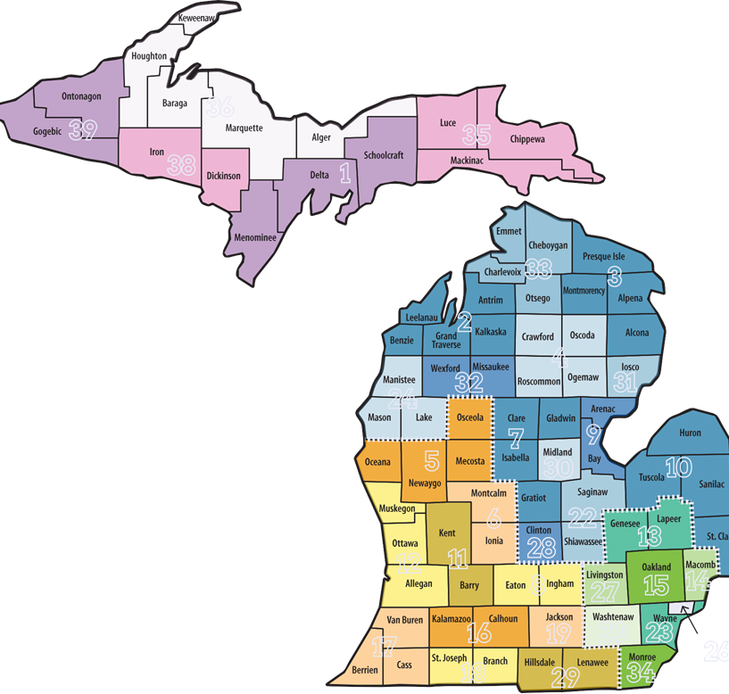
Special Olympics Michigan
Service Areas are by county.
Most are Multiple counties, but not all.
Several Councils can support the same Special Olympics Area.

Slide 76
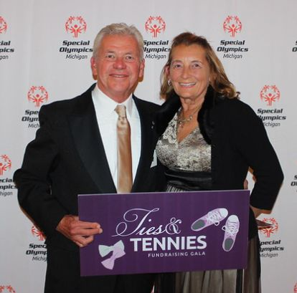

Courage In All You Do!
Ed and Lynn Strach Pro-Life Chair Couple
SOARing For Life!

Slide 77


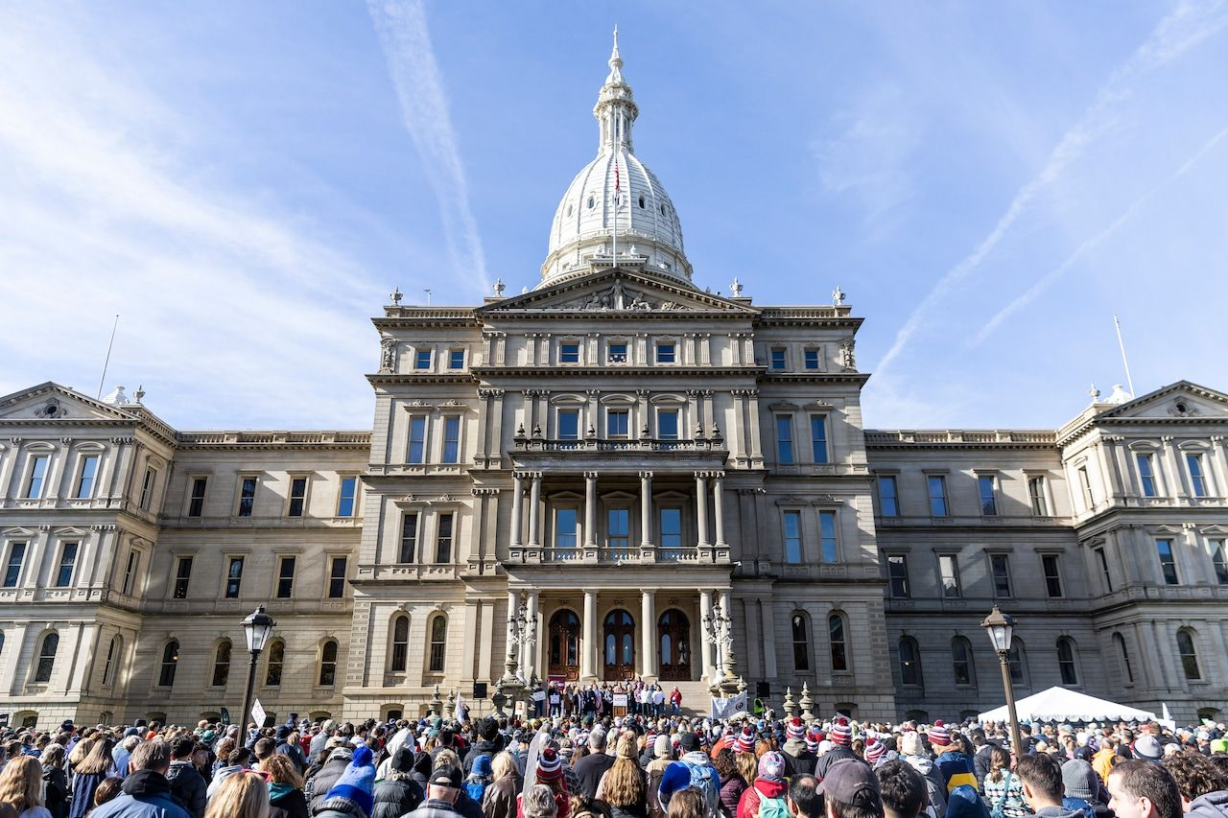
Take Courage to the Streets
Thursday, November 6, 2025, at the State Capitol

Slide 78
Take Courage to the Streets
A Bishop’s Prayer for Life

Slide 79
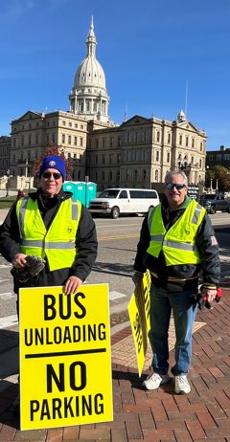
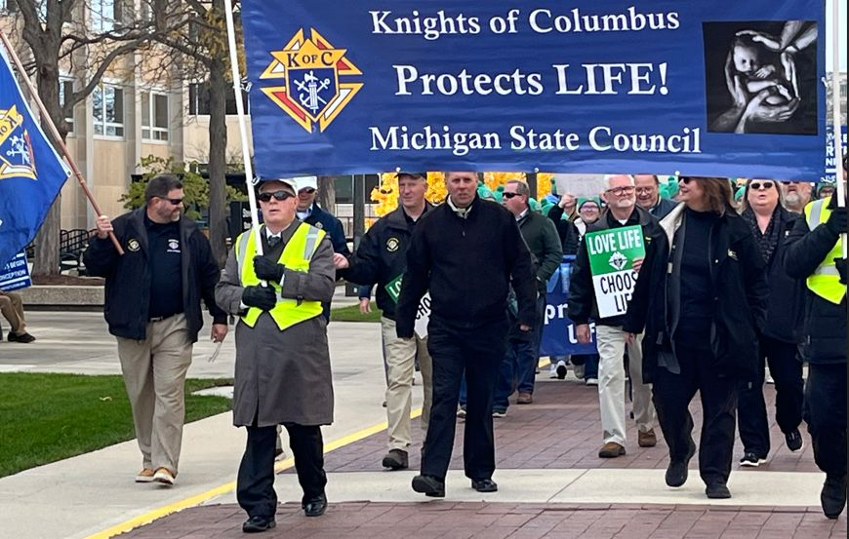
Take Courage to the Streets
Thursday, November 6, 2025, at the State Capitol

Slide 80
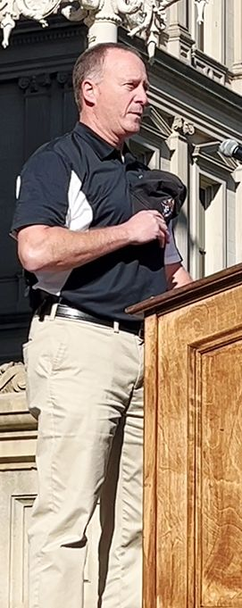
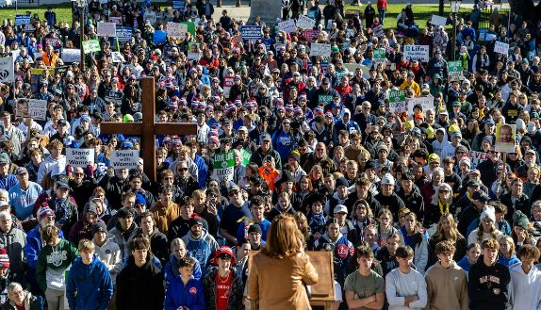
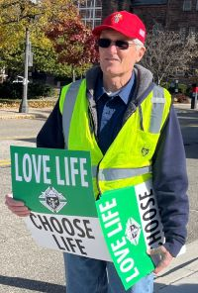
Take Courage to the Streets

Slide 81
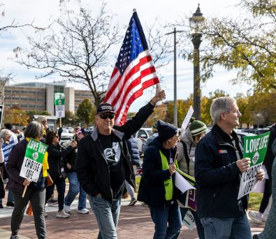
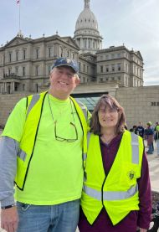
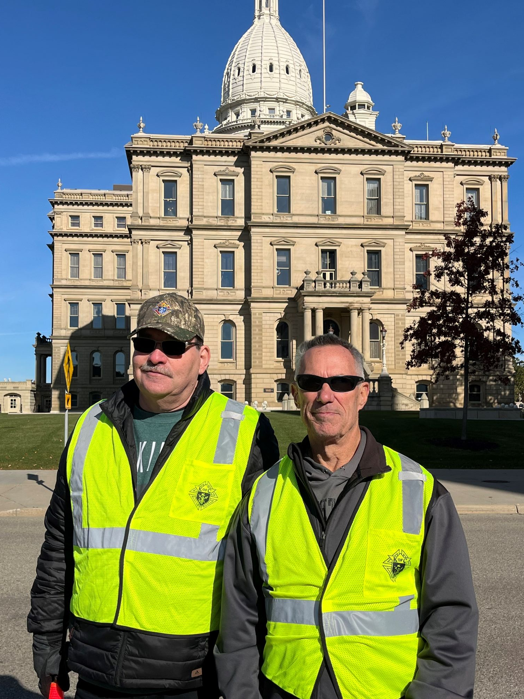
Take Courage to the Streets

Slide 82
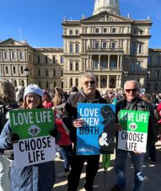
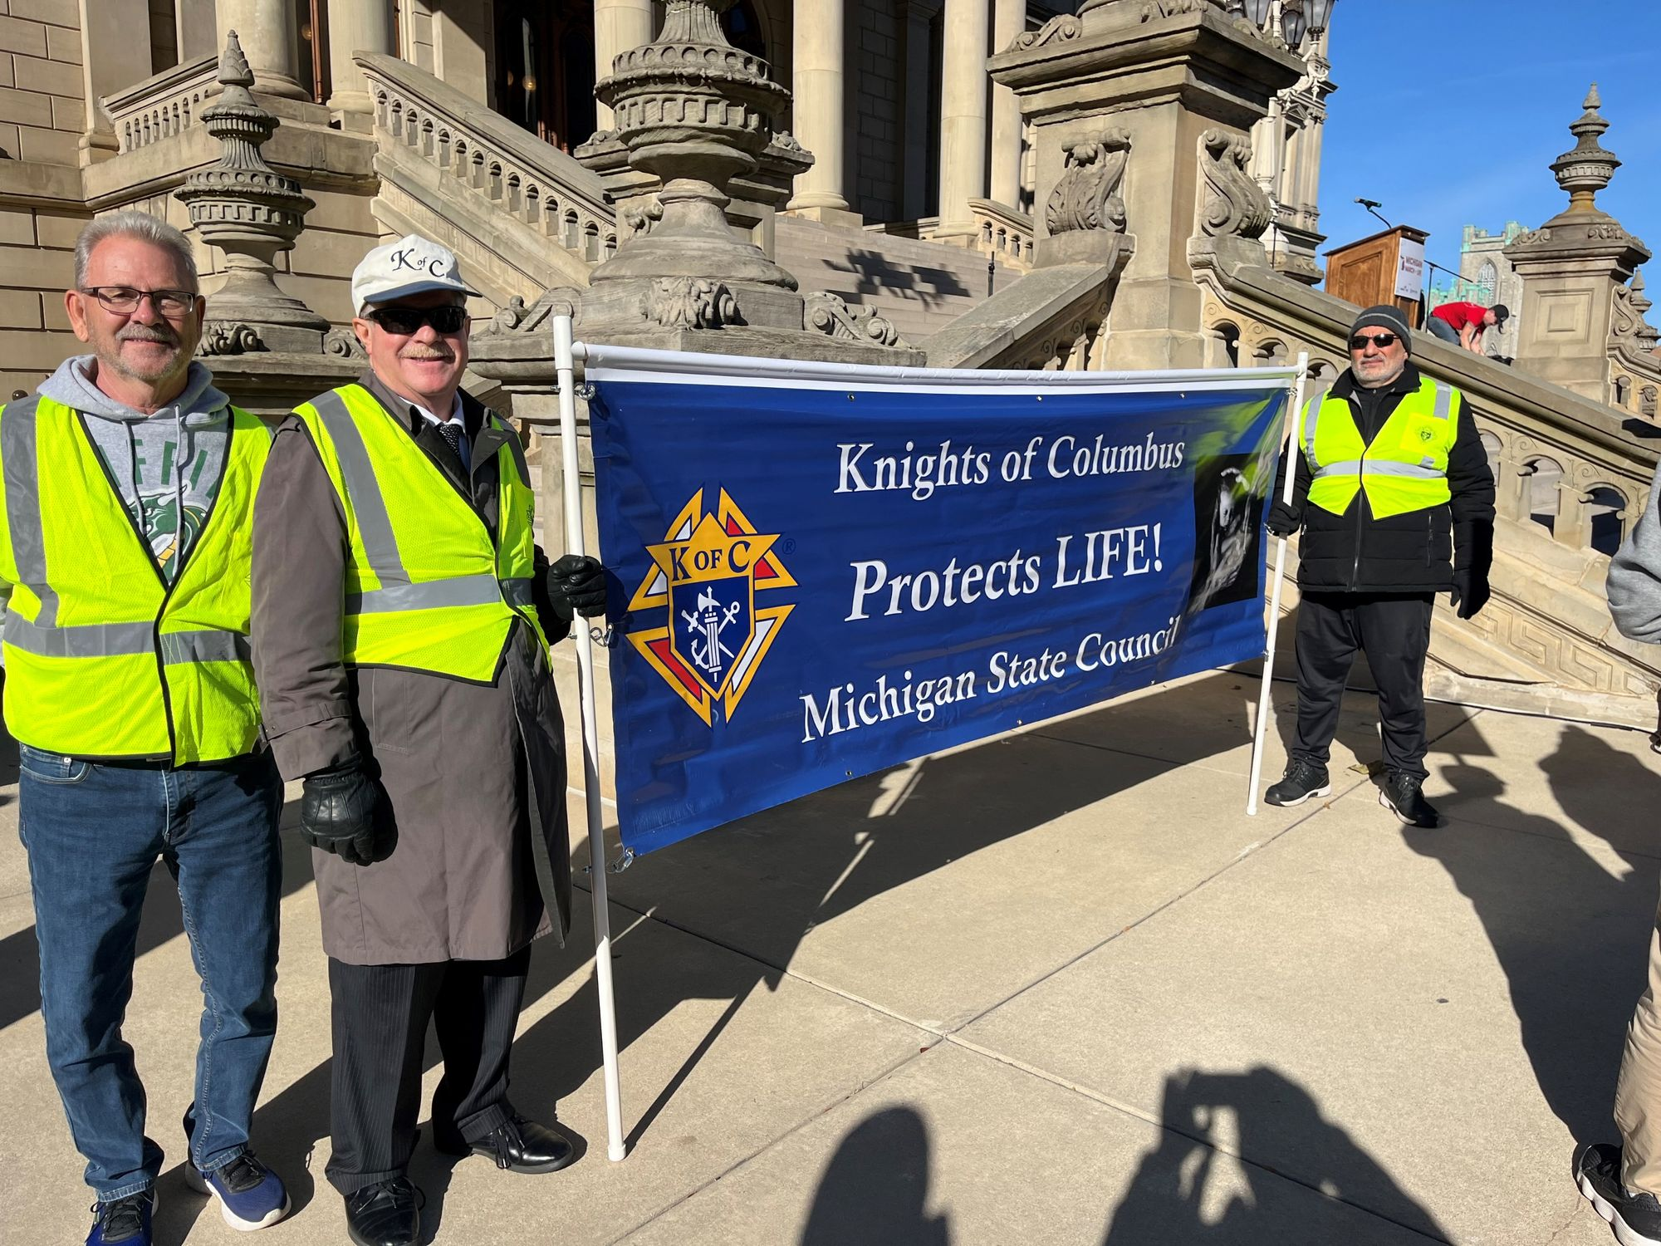
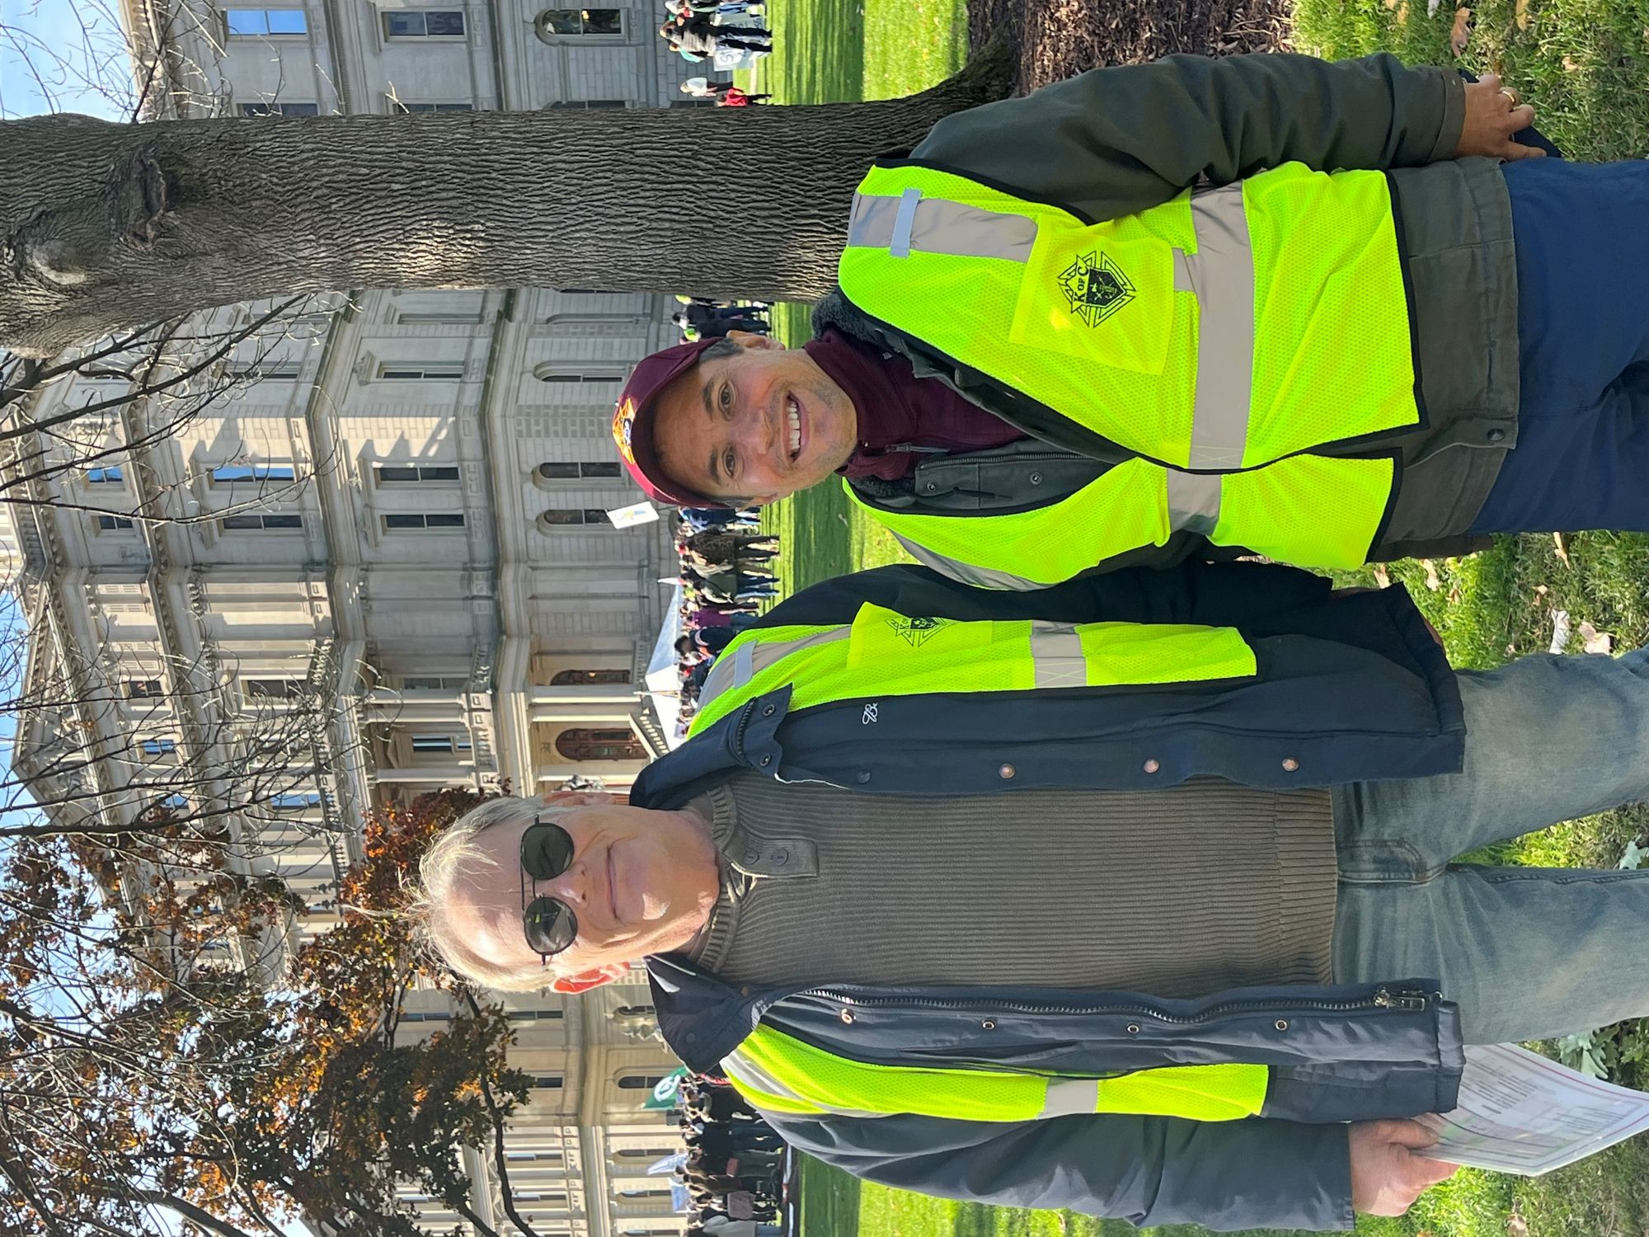
Take Courage to the Streets

Slide 83
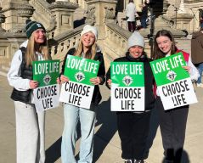
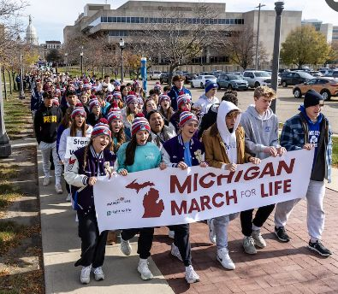
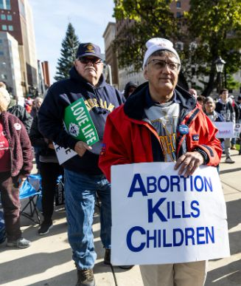
Take Courage to the Streets

Slide 84
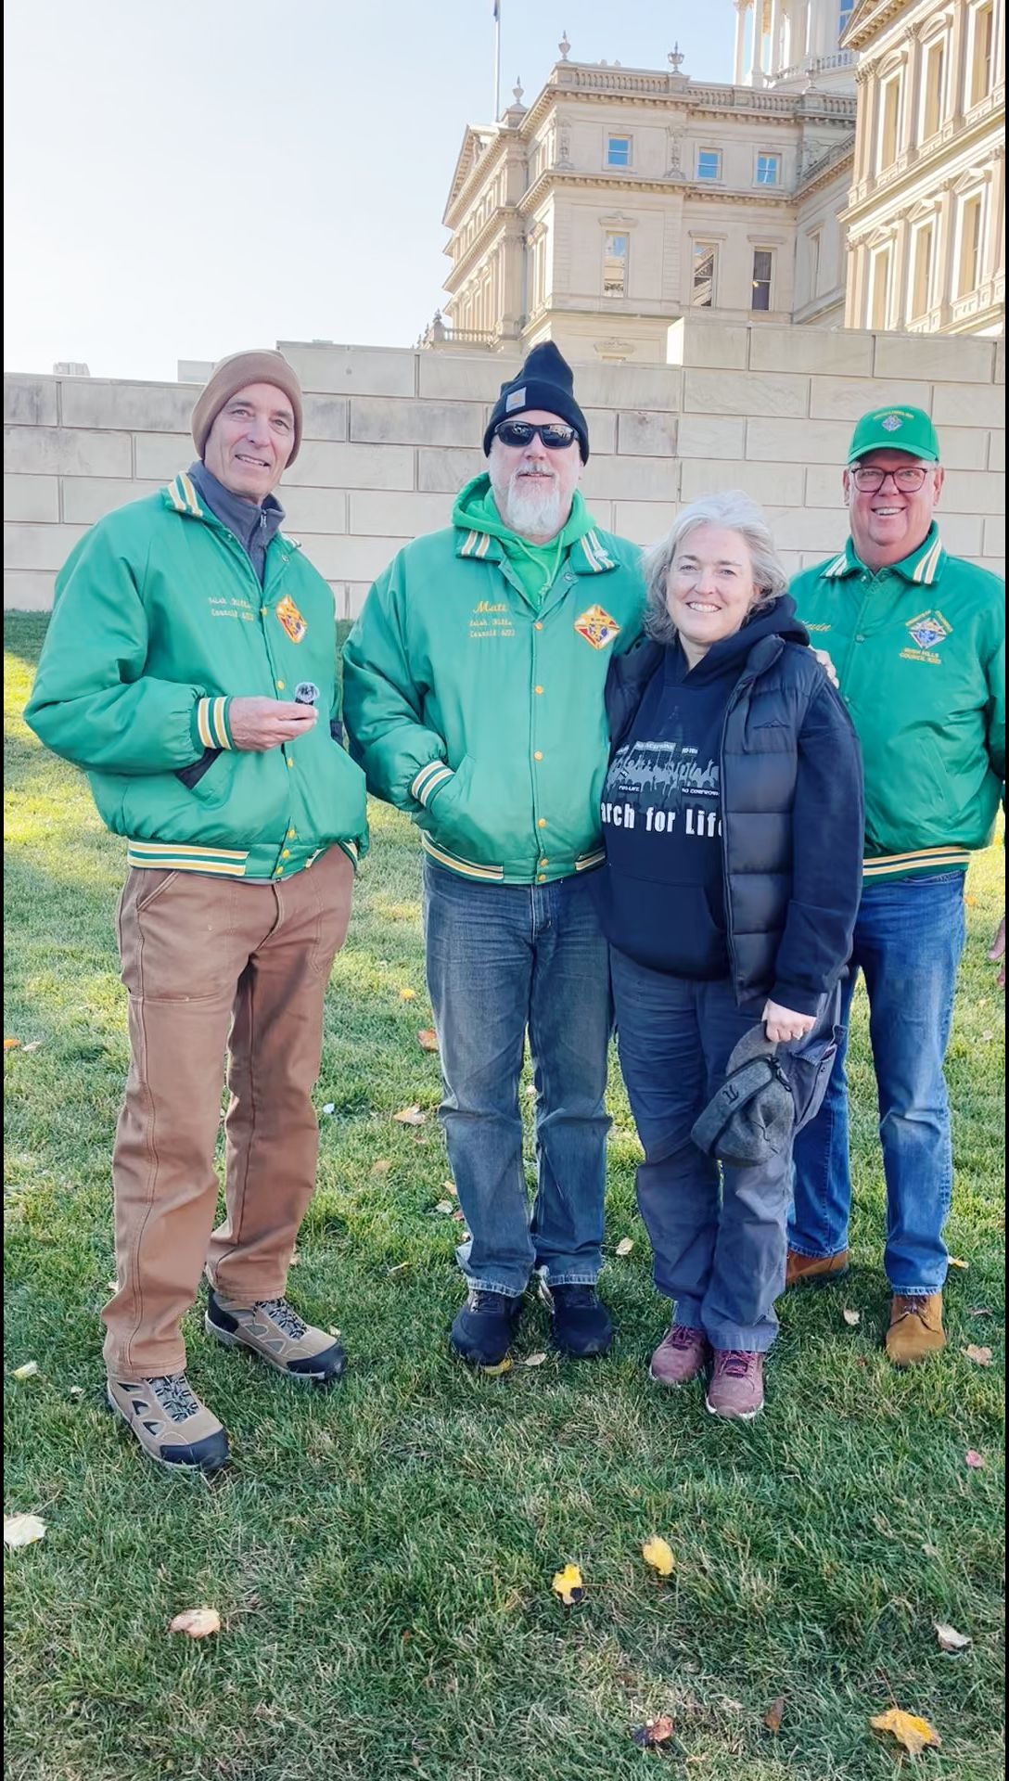
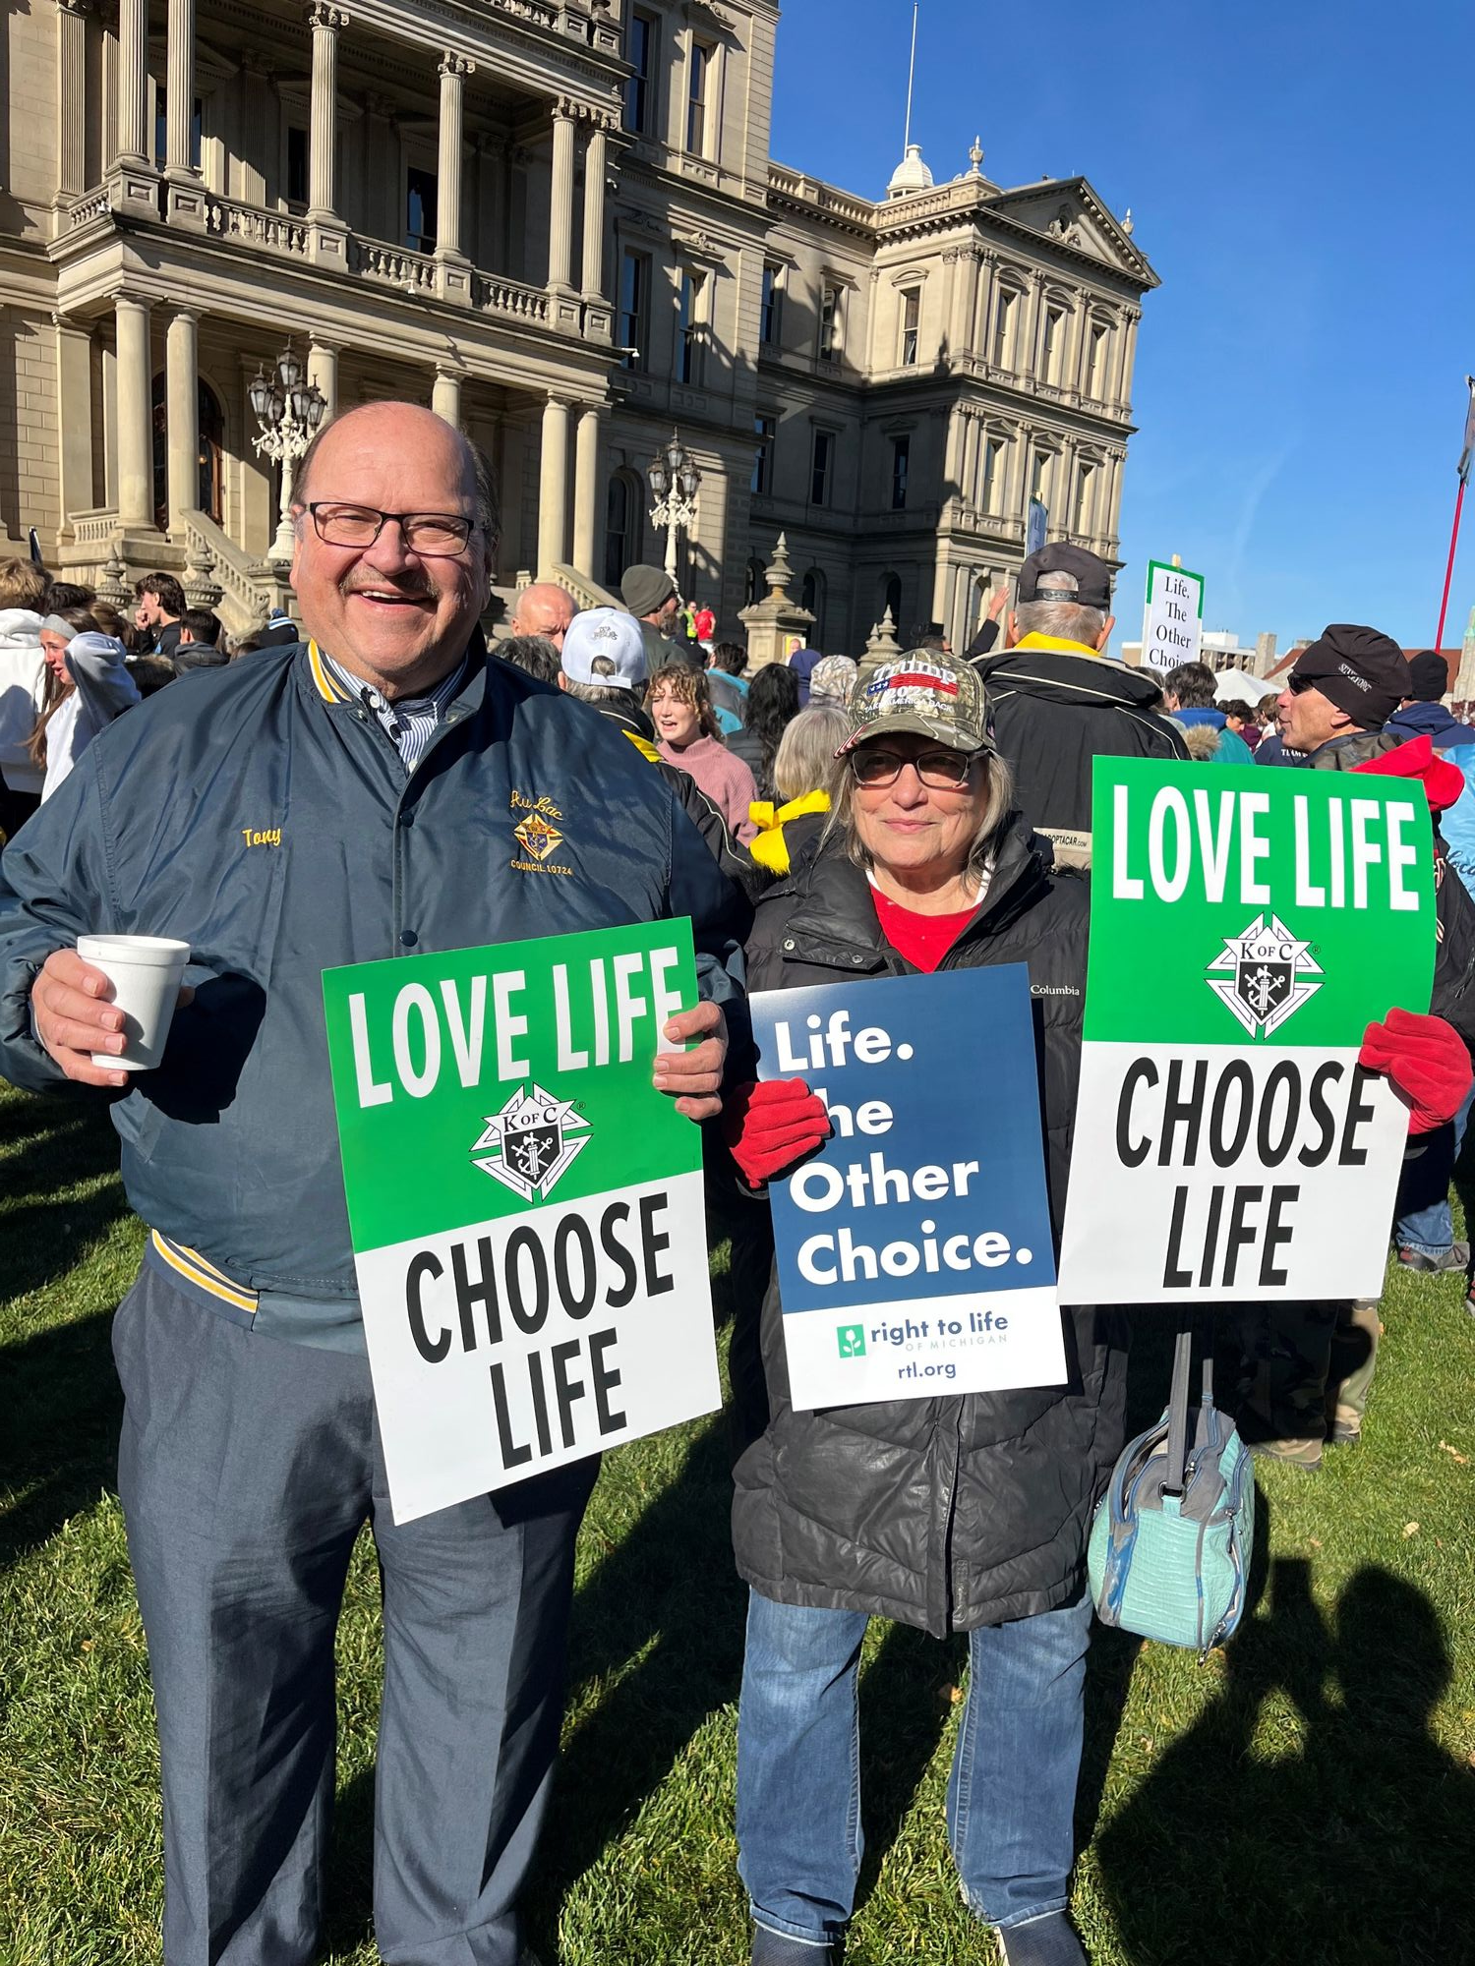
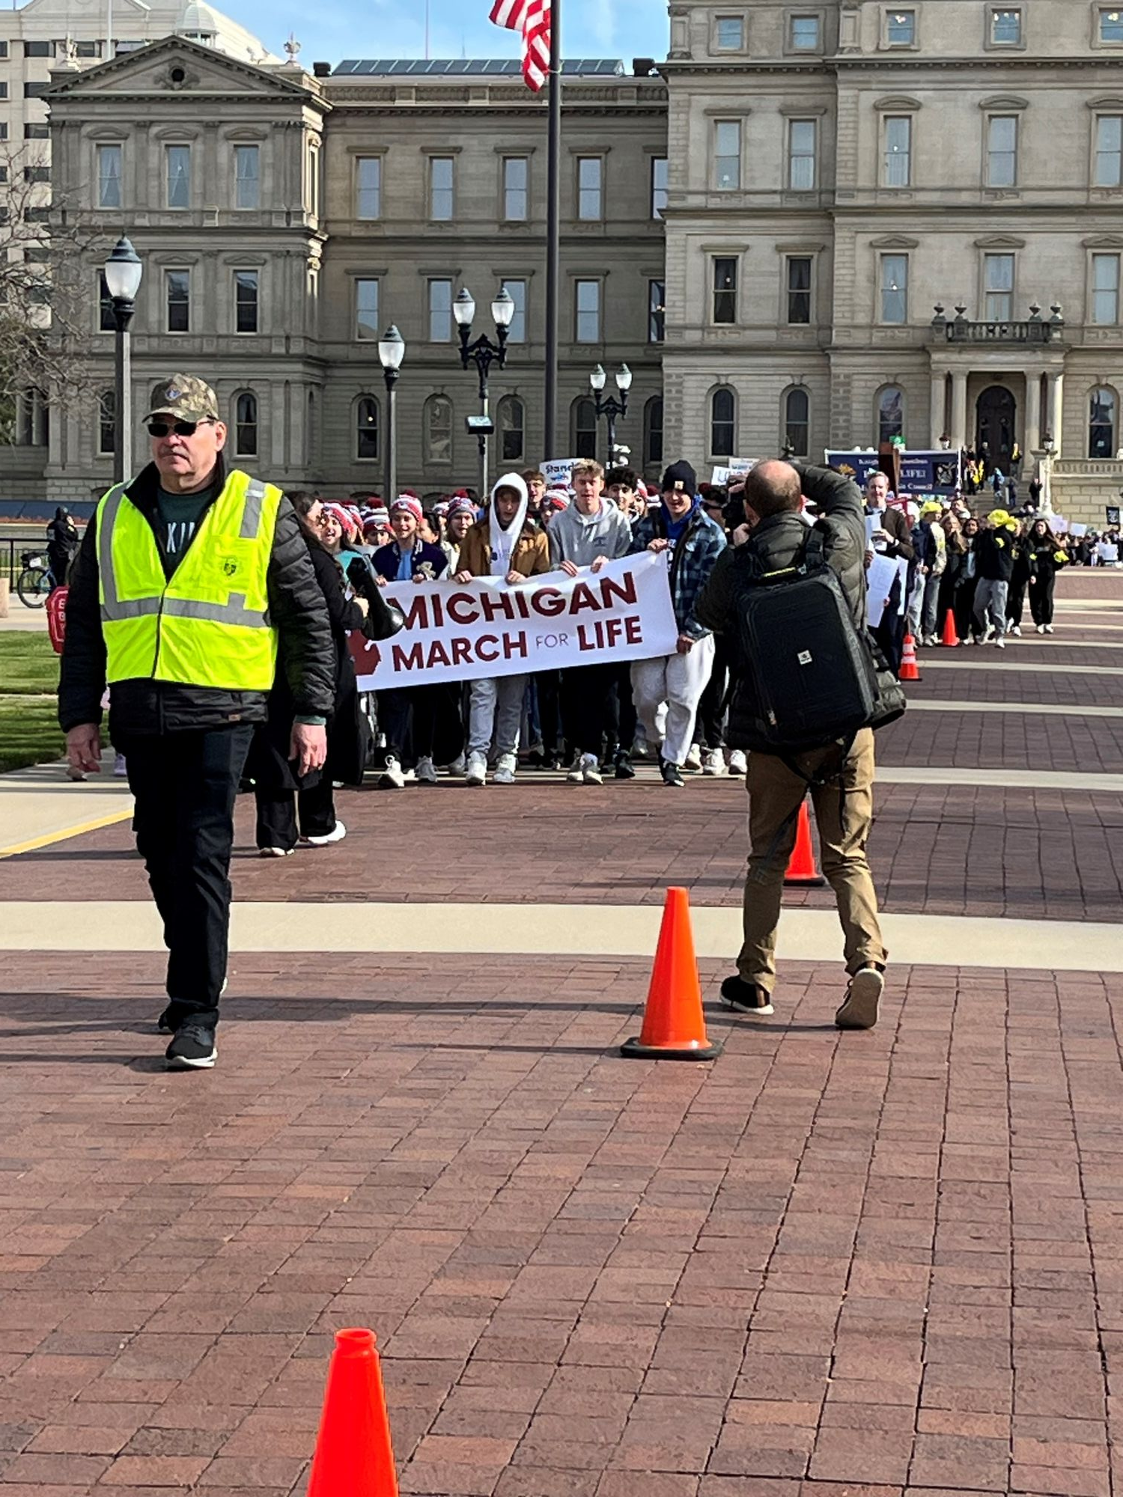
Take Courage to the Streets

Slide 85
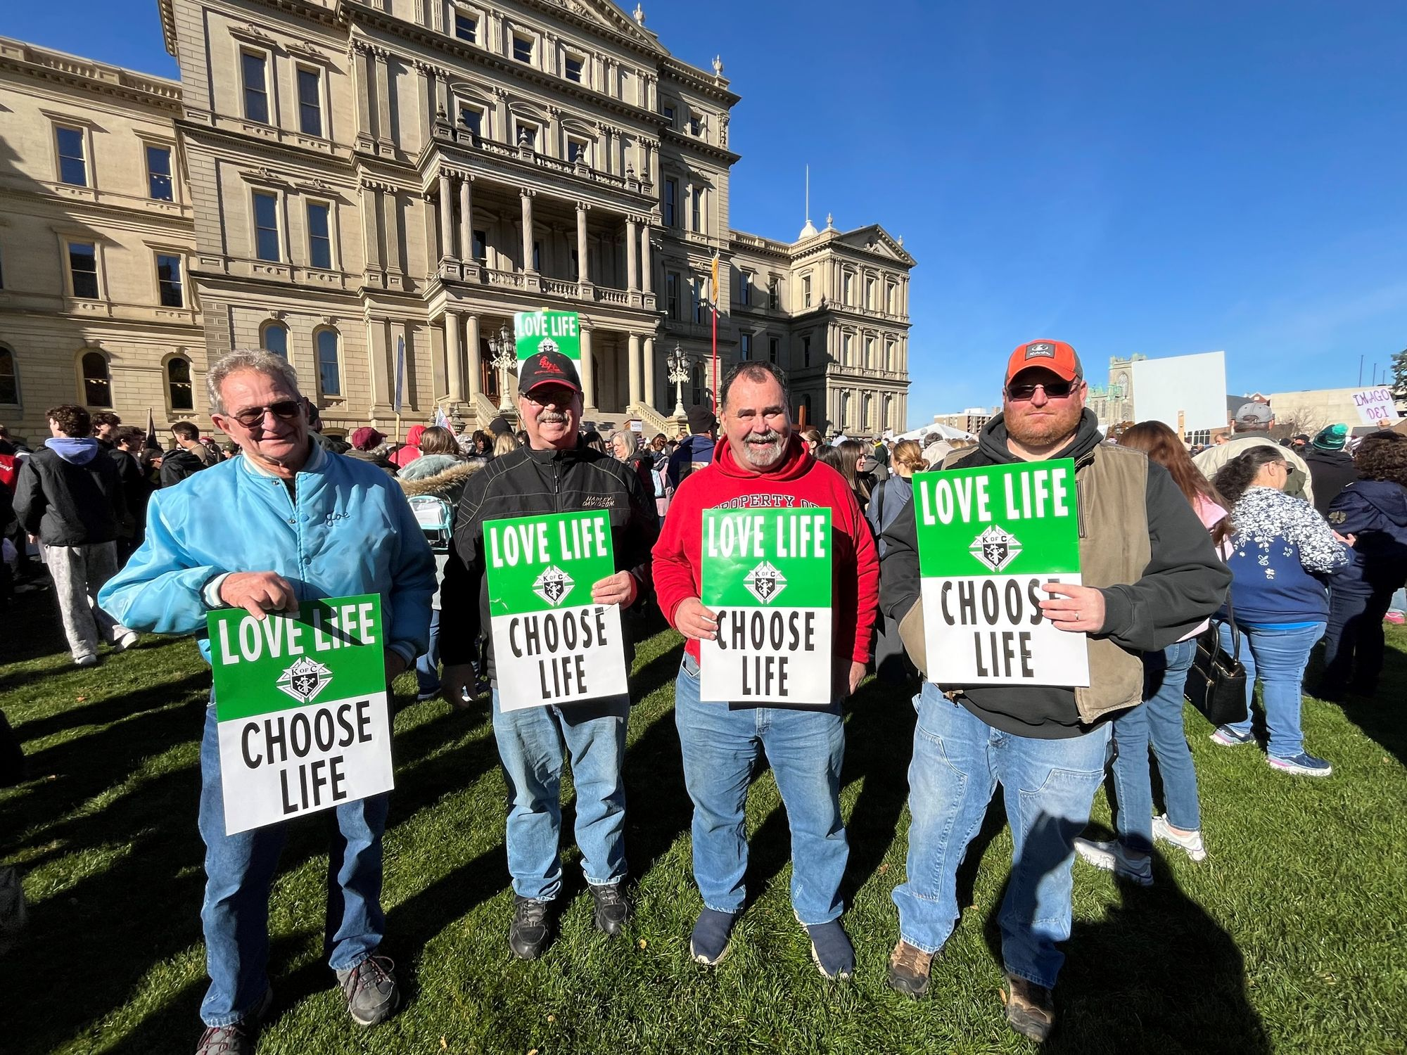
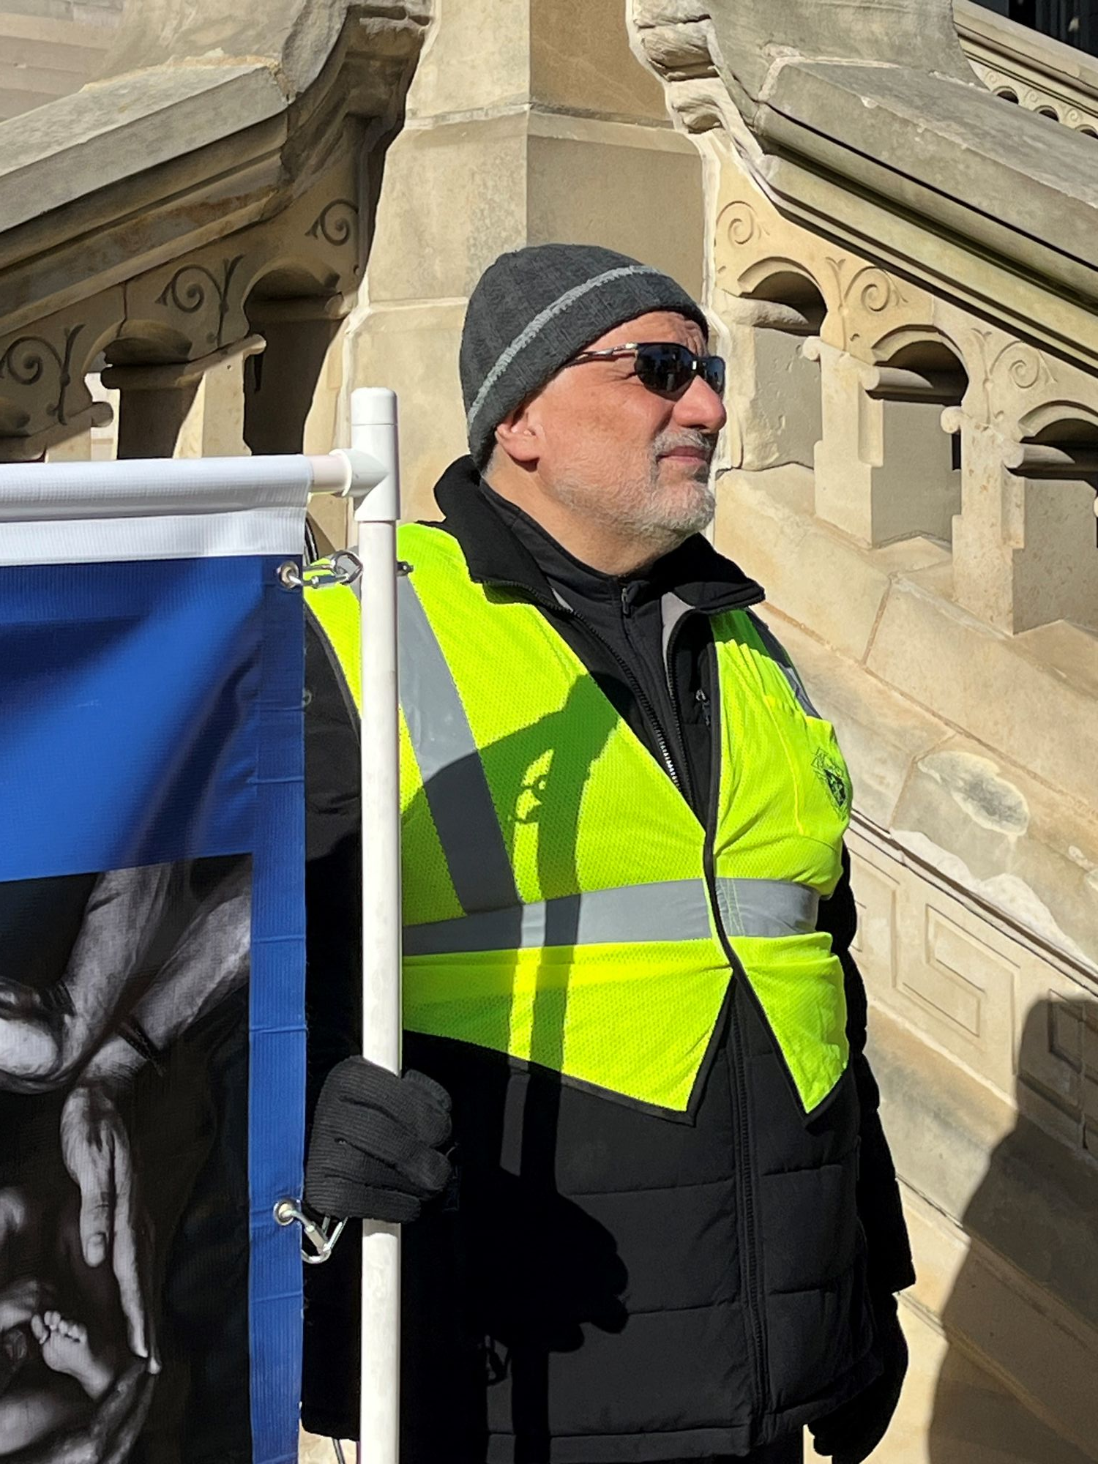


Take Courage to the Streets

Slide 86

Take Courage to the Streets
Thank you to all at the RTL MI March for Life and especially our volunteer Brother Knights and Ladies!

Slide 87
ASAP100
Council Participation Status
Webform Process
Pregnancy Resource Center Supreme Council Map
Application Process (per request)

Slide 88

ASAP100
As of the end of October, Michigan councils have contributed $61,120 to the ASAP Program.
We currently have 25 councils participating out of 402 active statewide, which represents a 6% council participation rate.
At the district level, 21 of 102 districts have at least one council participating, giving us a 21% district participation rate.
We remain committed to 100% participation, and with more than half the fraternal year still ahead of us, now is the time for every council to get involved.

Slide 89

PLEASE RECORD COUNCIL ASAP PARTICIPATION
https://tinyurl.com/2025-ASAP

Slide 90


Building Relationships for Generations to Come
Achieved the 103rd Dedicated Ultrasound!
Four other Ultrasounds in the works
Bringing a total of 107 Ultrasounds in Michigan

Slide 91


Take Courage In All you Do!
Ed and Lynn Strach
Contact us at e.strach@mikofc.org or 734-476-6296

